Slide 3
ai,a_e,ay
ai, a_e and ay all sound the same :
It’s the long a sound
ai as in rain, pain, chain
a_e as in cake, make, rake
ay as in say, pray, gray

Slide 4
ai
Recap: What sound does an a and an i next to each other (ai) make when they are put together? Click here to listen to the sound.
That’s right, ‘ai’
Repeat the sound after me: ai, ai, ai Click here to listen
It’s as if you’re speaking in
capital letters A A A

Slide 5
a_e
Recap: Remember the fairy ‘e’?
When the ‘a’ is split from the ‘e’, it becomes a long a sound, Click here to listen to the sound.
If there was no fairy ‘e’, what would the following words sound like? rak, nam and cran
Add the fairy ‘e’ and repeat the words: rake, name, crane.
Can you hear the difference?
It makes the ‘a’ sound like a ‘capital a’

Slide 6
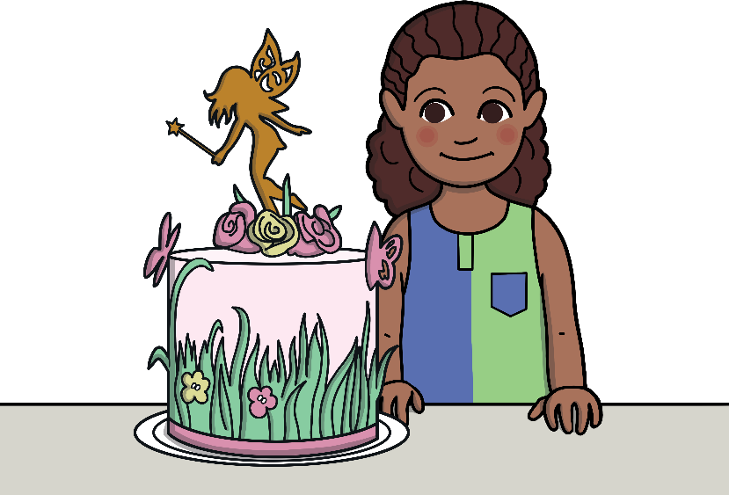
ay
Recap: What sound does an ‘a’ and a ‘y’ make?
Remember the ‘ay’ makes it a long a sound
Words such as say, pay and birthday

Slide 7
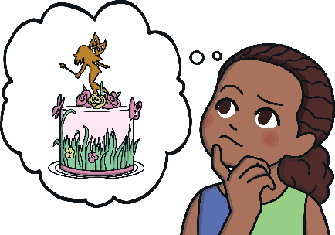
Nandi was having a bad day! It’s her 7th birthday on Monday and she wants a fairy cake, but mom is saying no.
I said no, Nandi. You had one last year and Gogo wants to bake you a snail cake.
But I want a fairy cake!
But I have a right to have a birthday cake!
Well, it's not a right; it’s a luxury. You have a right to healthy food, but with that right comes a big responsibility.
I don’t understand, please explain it me, mom.

Slide 8
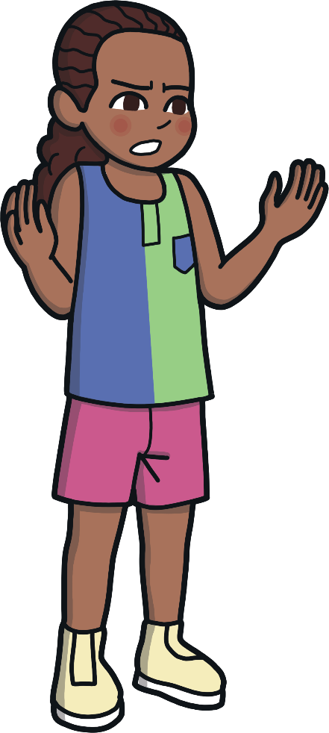
Nandi was having a bad day! It’s her 7th birthday on Monday and she wants a fairy cake, but mom is saying no.
We all have basic human rights, such as the right to healthy food, clean water, shelter, basic health care and to an education.
We are lucky because we have all those things?
Yes, but with each right comes a responsibility, which means you must look after your rights.

Slide 9
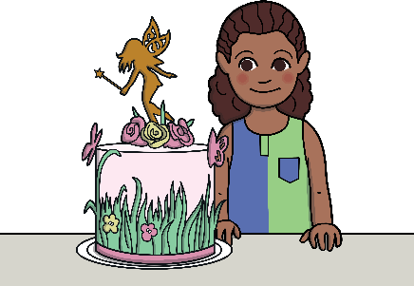
Nandi was having a bad day! It’s her 7th birthday on Monday and she wants a fairy cake, but mom is saying no.
My teacher says that we have to work hard on being responsible. We need shelter from the rain, healthy food on a plate, and to play in a safe place, like at school.
I’m sure you’ll be the only one with a cake like that! And you’ll make Gogo so happy.
Okay, that’s all fine, but I still want my birthday cake. I’ll let Gogo bake me a snail cake.

Slide 10
See if you can help Nandi blow out her birthday candles by clicking each candle and saying the word that appears.
train
sail
spray
shade
gate
chain
holiday
Notes:
Teacher: To blow out each candle, click the word once the students have pronounced the word correctly

Slide 11
Read all the words as they appear on the screen.
rain
email
cake
gate
play
Monday
grain
chain
rake
safe
clay
okay
paint
train
bake
flame
spray
plate
sail
explain
name
date
bay
pay
tail
again
shade
say
holiday
way

