Slide 1
Disclaimer/s
We hope you find the information on our website and resources useful.
Animations
This resource has been designed with animations to make it as fun and engaging as possible. To view the content in the correct formatting, please view the PowerPoint in ‘slide show mode’. This takes you from desktop to presentation mode. If you view the slides out of ‘slide show mode’, you may find that some of the text and images overlap each other and/or are difficult to read.
To enter slide show mode, go to the slide show menu tab and select either from beginning or from current slide.
You may wish to delete this slide before beginning the presentation.

Slide 3
Click on the picture that matches the sentence.
There is a spoon on the moon.

Slide 4
Try Again!

Slide 5
Well Done!

Slide 6
Click on the picture that matches the sentence.
There are dogs on logs.

Slide 7
Try Again!

Slide 8
Well Done!

Slide 9
Click on the picture that matches the sentence.
There is a bow in the snow.

Slide 10
Try Again!

Slide 11
Well Done!

Slide 12
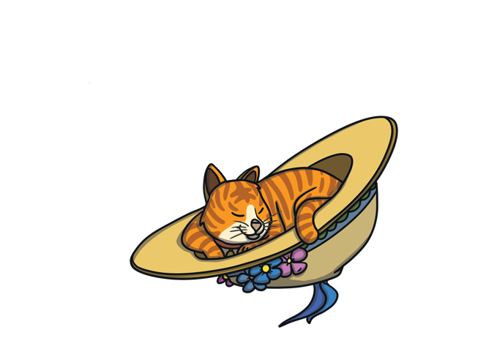
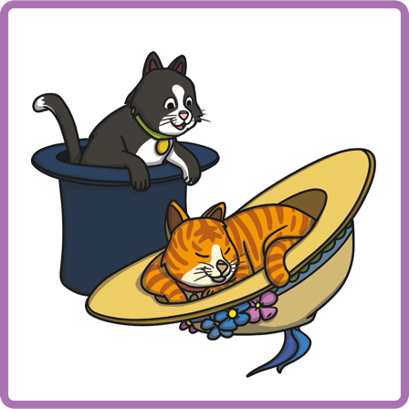
Click on the picture that matches the sentence.
There are cats in hats.

Slide 13
Try Again!

Slide 14
Well Done!

Slide 15
Click on the picture that matches the sentence.
There are stars on cars.

Slide 16
Try Again!

Slide 17
Well Done!

Slide 18
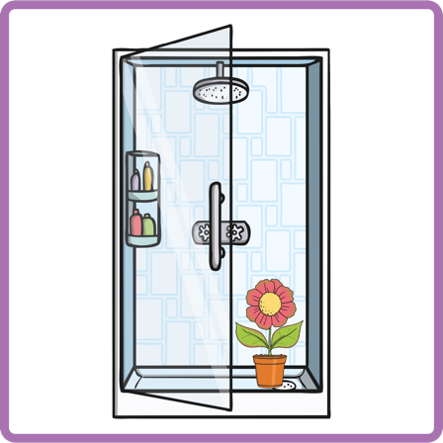
Click on the picture that matches the sentence.
There is a flower in the shower.

Slide 19
Try Again!

Slide 20
Well Done!

Slide 21
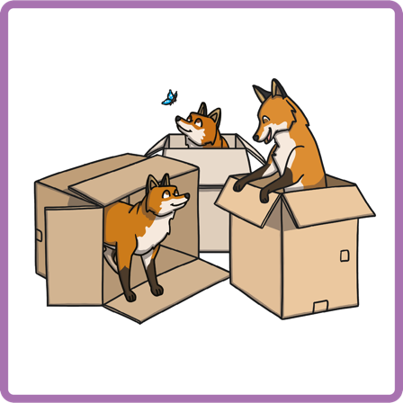
Click on the picture that matches the sentence.
There are foxes in boxes.

Slide 22
Try Again!

Slide 23
Well Done!

Slide 24
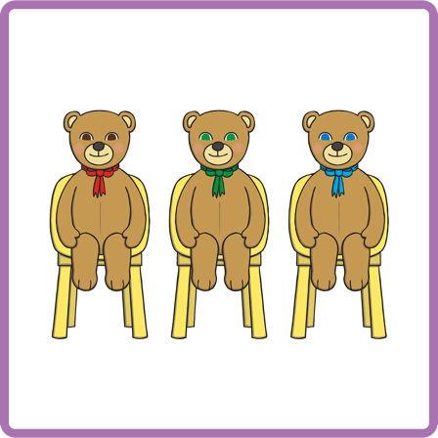
Click on the picture that matches the sentence.
There are bears on chairs.

Slide 25
Try Again!

Slide 26
Well Done!

Slide 27
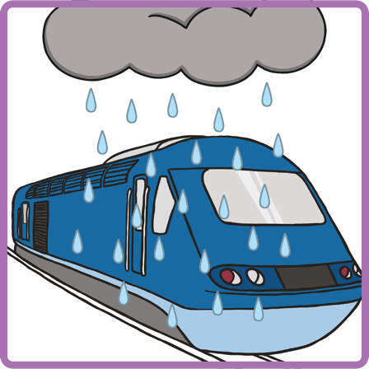
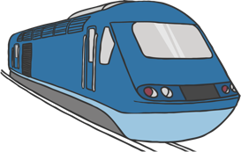
Click on the picture that matches the sentence.
There is a train in the rain.

Slide 28
Try Again!

Slide 29
Well Done!

Slide 30
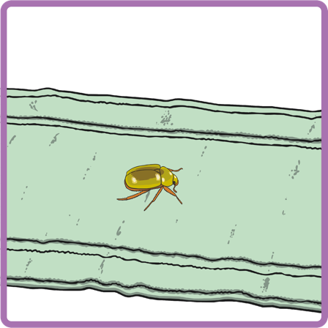
Click on the picture that matches the sentence.
There is a bug on the rug.

Slide 31
Try Again!

Slide 32
Well Done!

Slide 33
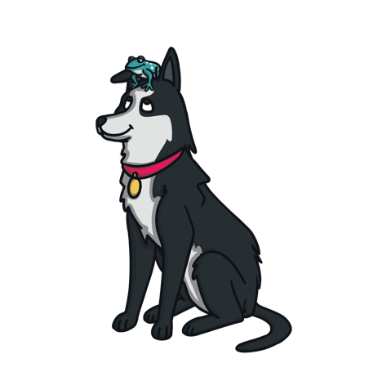
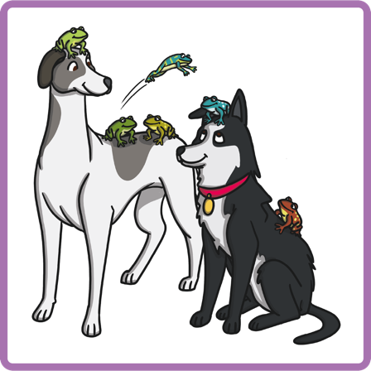
Click on the picture that matches the sentence.
There are frogs on dogs.

Slide 34
Try Again!

Slide 35
Well Done!

Slide 36
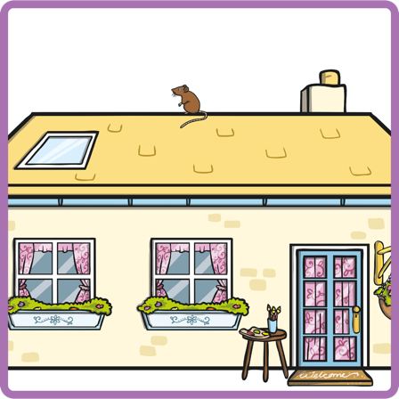
Click on the picture that matches the sentence.
There is a mouse on the house.

Slide 37
Try Again!

Slide 38
Well Done!

