Slide 1
Disclaimer/s
We hope you find the information on our website and resources useful.
Animations
This resource has been designed with animations to make it as fun and engaging as possible. To view the content in the correct formatting, please view the PowerPoint in ‘slide show mode’. This takes you from desktop to presentation mode. If you view the slides out of ‘slide show mode’, you may find that some of the text and images overlap each other and/or are difficult to read.
To enter slide show mode, go to the slide show menu tab and select either from beginning or from current slide.
You may wish to delete this slide before beginning the presentation.

Slide 3
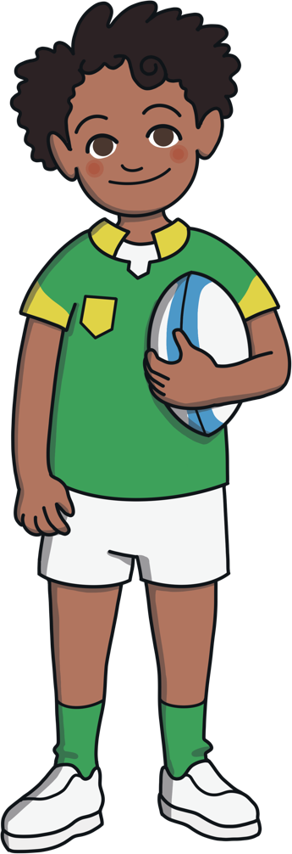
Prefixes
What is a prefix?
A prefix is a sound or group of letters that attach to the front of a root word, for example, ‘un’ or ‘re’

Slide 4
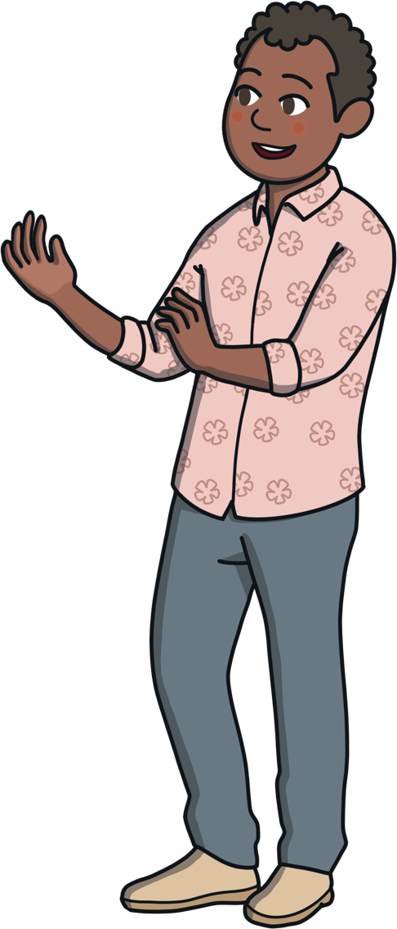
Prefixes
What is a root word?
A root word is a basic word, from which other words are made, by adding prefixes and suffixes.

Slide 5
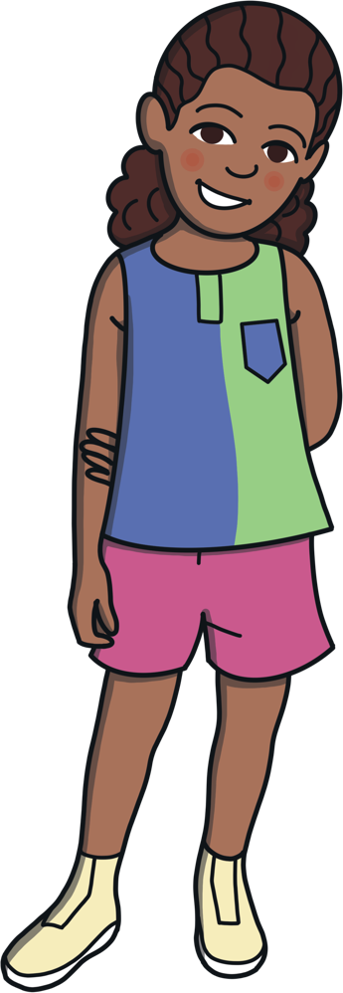
Prefixes
What does a prefix do?
A prefix changes the meaning of the root word.

Slide 6
Prefixes
Here are some questions to think about.
Think of words that start with un- or re-?
Are you able to identify the root word?
How does the un- or re- change the meaning of the word?

Slide 7
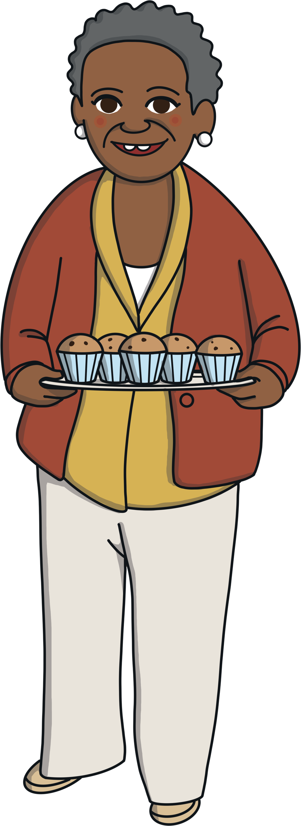
Examples
un | re
unable | remake
uncomfortable | remix
unsafe | repaint
undo | redo
untie | retie

