Slide 2
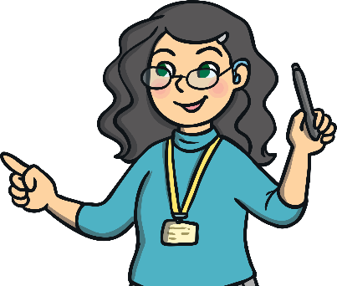
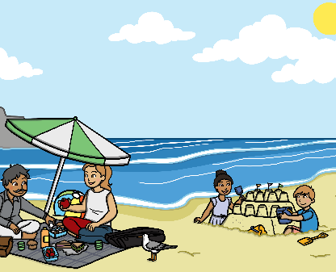
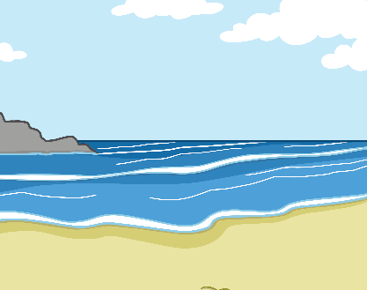
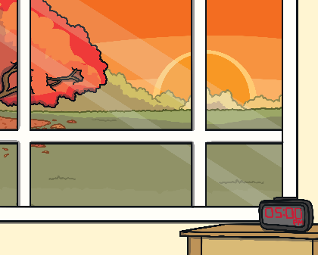
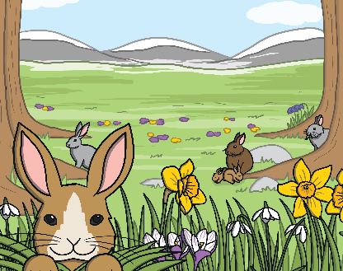
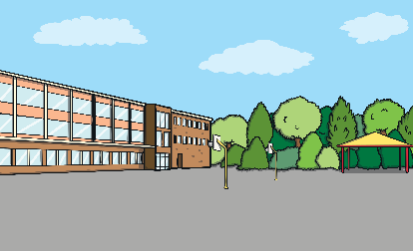
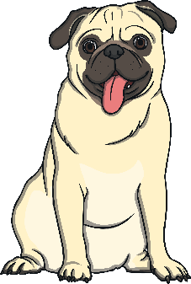
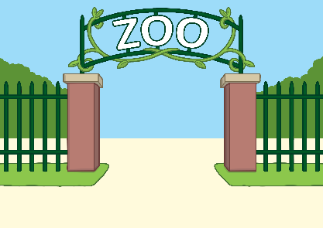
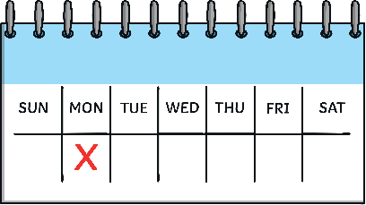
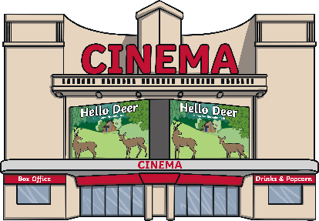
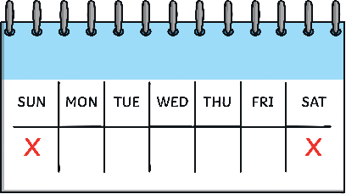
Click on the buttons for new words
Who?
Doing What?
Where?
When?
Clear sentence
in the afternoon.
in the classroom
on the weekend.
The tiger
The boy
in the zoo
The frog
The dog
The teacher
is playing
is running
is sitting
is jumping
is writing
in the movies
on the beach
in the park
on Monday.
on vacation.
in the evening.
on the weekend.
in the afternoon.
in the classroom
The teacher
is sitting
in the park
The frog
is jumping
The boy
is writing
on the beach
in the evening.
The tiger
is running
in the zoo
on holiday.
The dog
is playing
at the movies
on Monday.

