Slide 1
Animations Disclaimer
We hope you find the information on our website and resources useful.
PowerPoint
This resource has been designed with animations to make it as fun and engaging as possible. To view the content in the correct formatting, please view the PowerPoint in “slide show mode.” This takes you from desktop to presentation mode. If you view the slides out of “slide show mode,” you may find that some of the text and images overlap each other and/or are difficult to read.
To enter slide show mode, go to the slide show menu tab and select either from beginning or from current slide.
You may wish to delete this slide before beginning the presentation.

Slide 3
What Is a Shadow?
When light shines on an object, it creates a silhouette called a shadow.
Now see if you can guess what could be making each of the following shadows.

Slide 4
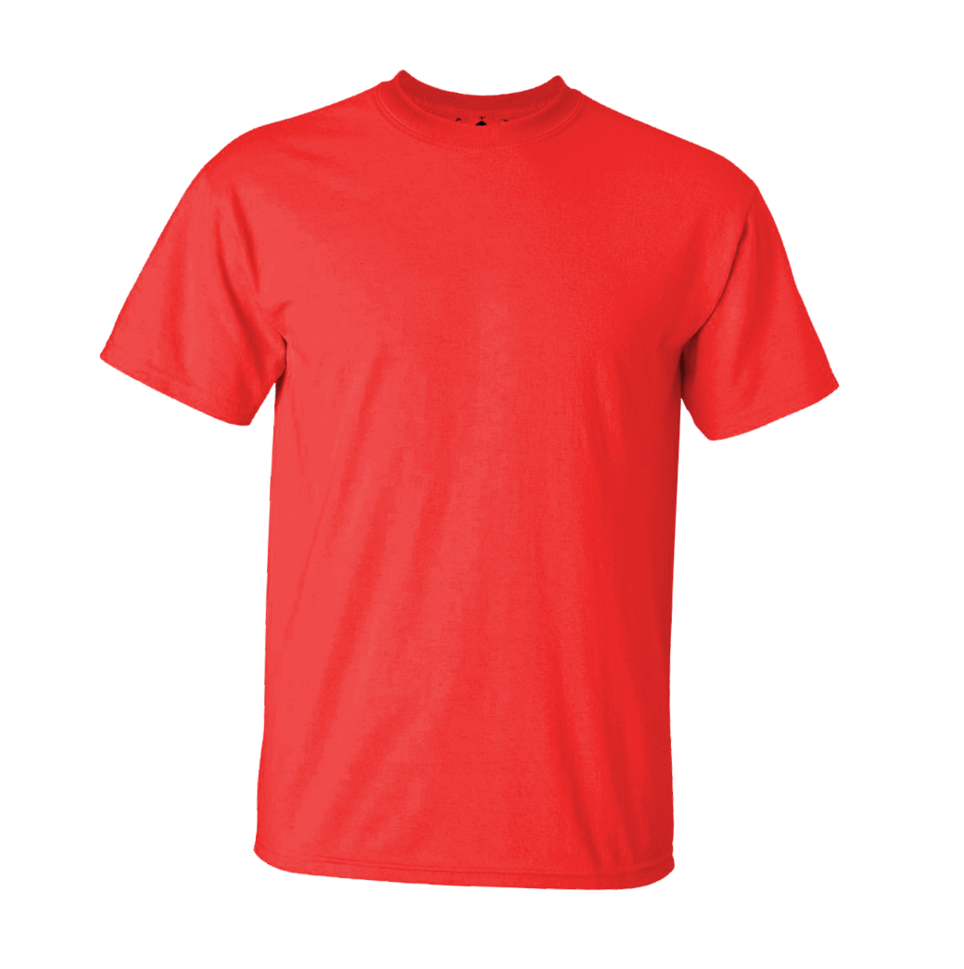
What Could It Be?
t-shirt

Slide 5
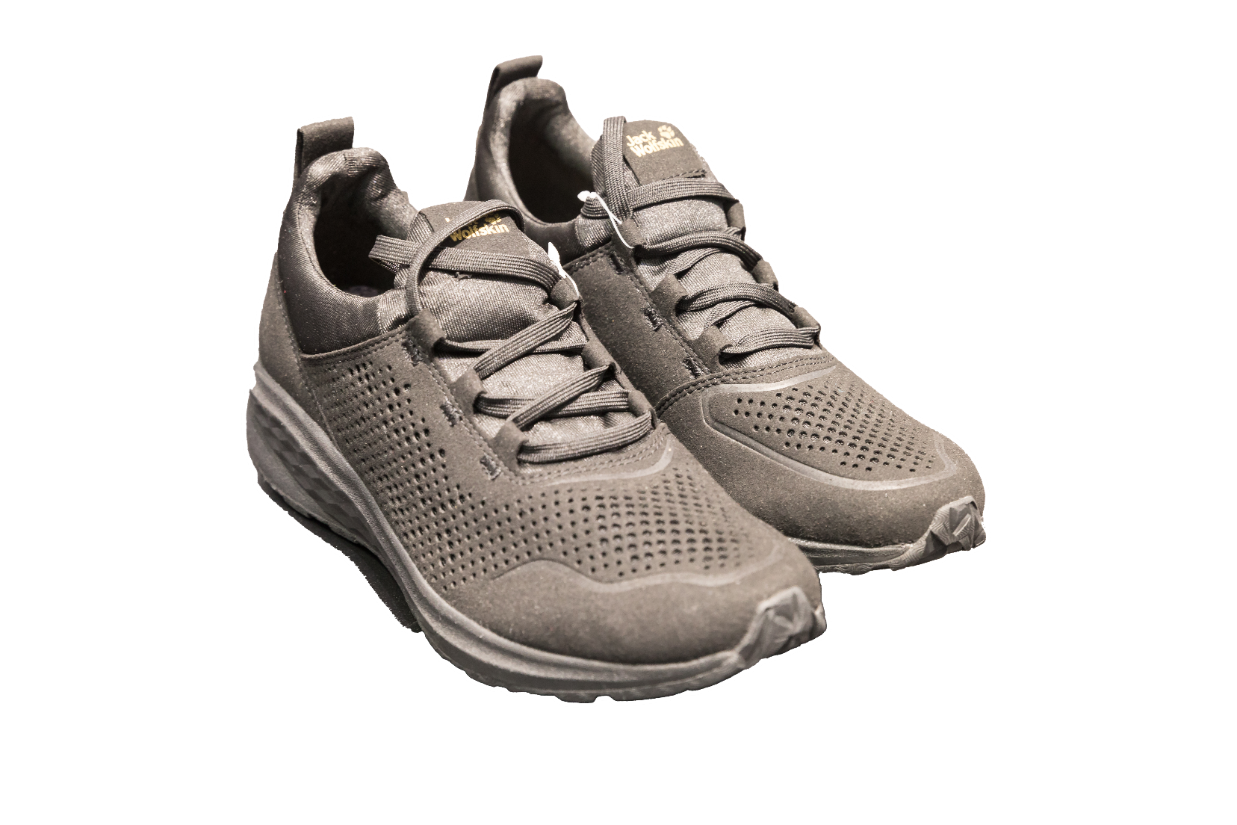
What Could It Be?
sneakers
Jack Wolfskin sneakers at OutDoor 2018 by Matti Blume is licensed under CC BY 2.0

Slide 6
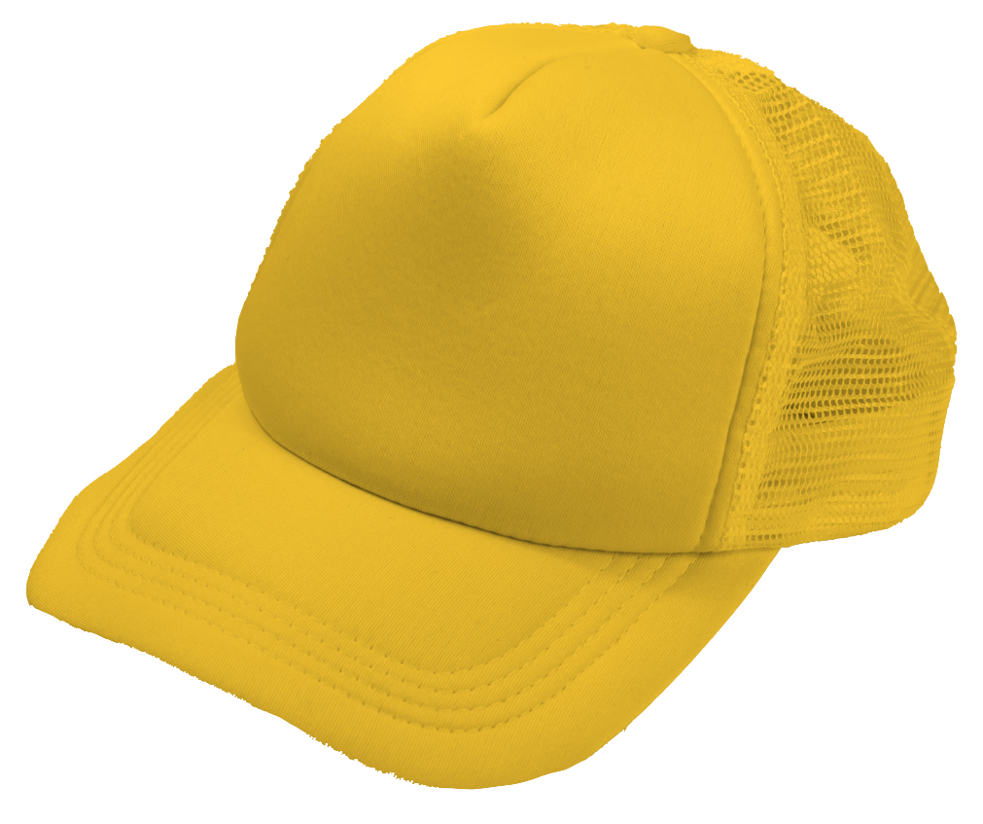
What Could It Be?
baseball cap

Slide 7
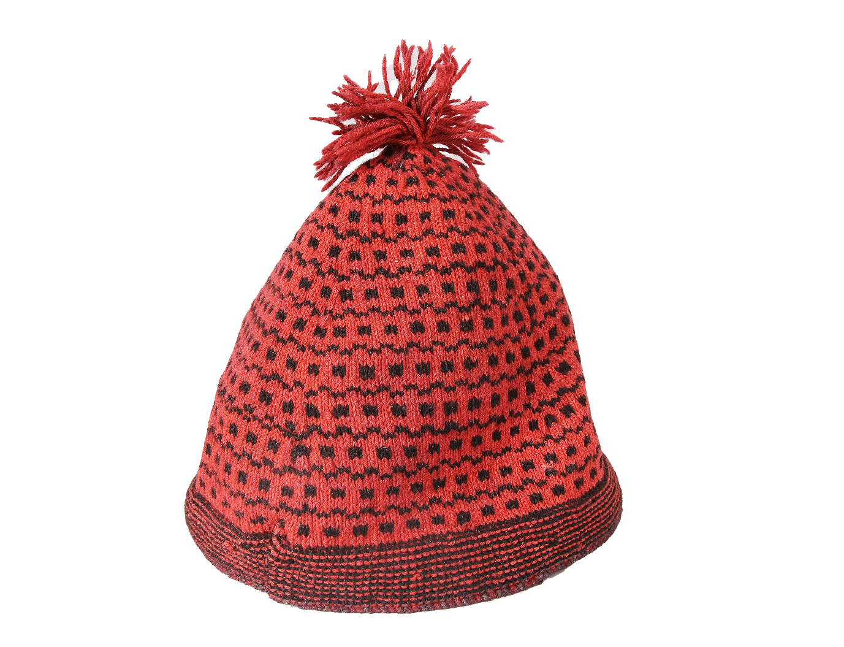
What Could It Be?
hat
Stickmössa by Elisabeth Eriksson is licensed under CC BY 2.0

Slide 8
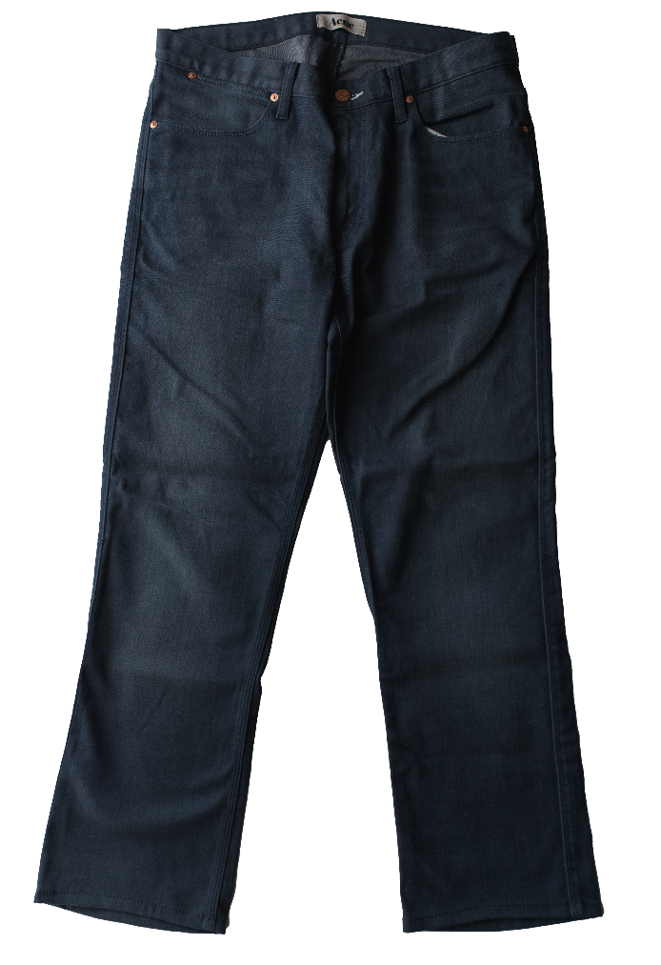
What Could It Be?
pants

Slide 9
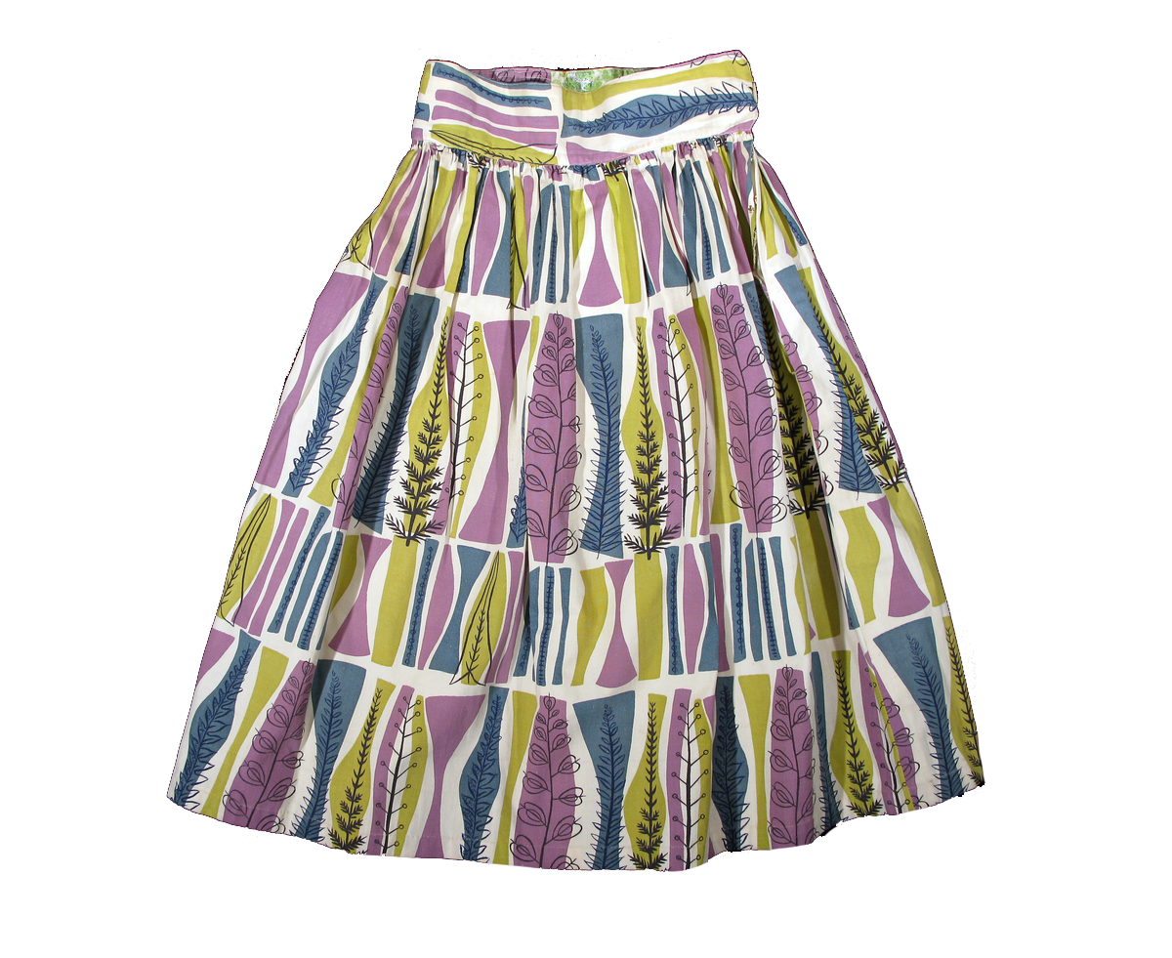
What Could It Be?
skirt
Svenska by Elisabeth Eriksson is licensed under CC BY 2.0

Slide 10
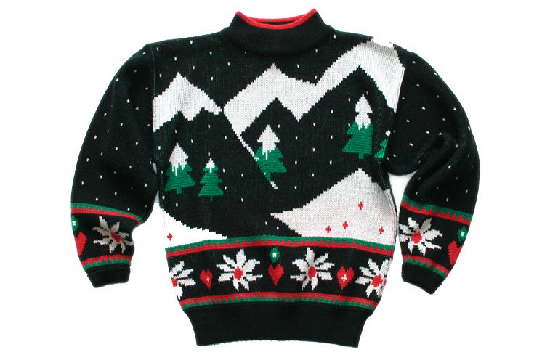
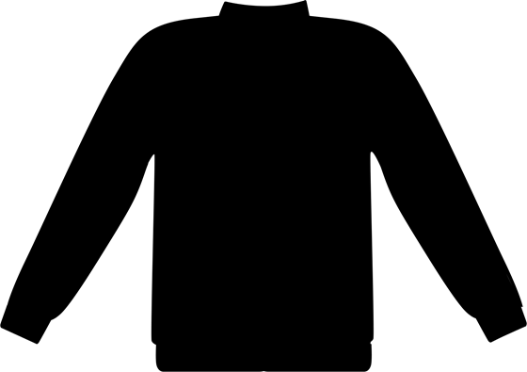
What Could It Be?
sweater
Christmas Sweater by TheUglySweaterShop.com is licensed under CC BY 2.0

Slide 11
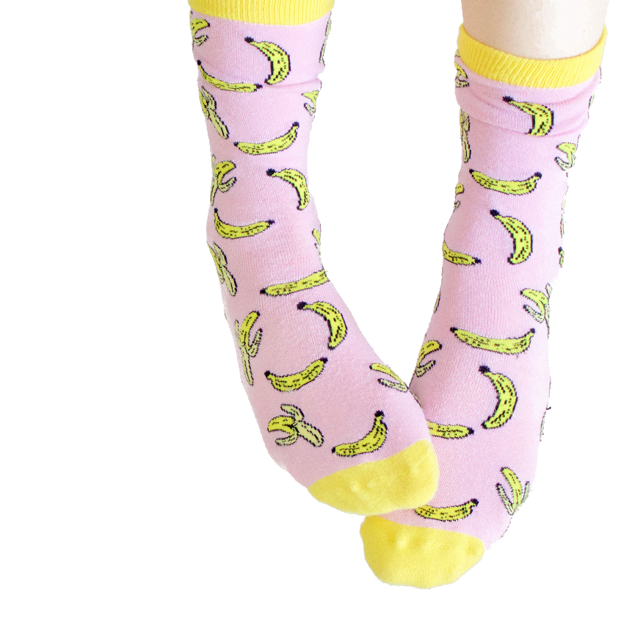
What Could It Be?
socks

