Slide 2
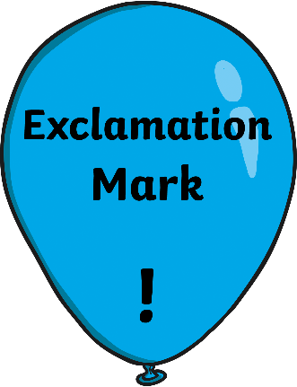
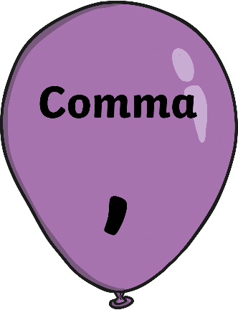
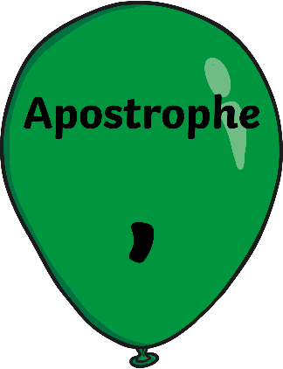
Popping Punctuation
How many different pieces of punctuation can you think of?

Slide 3
Why Use Popping Punctuation?
Why do we need to make sure that we use the correct punctuation in our writing?
If we do not use the correct punctuation, our writing may be unclear and it may not make sense to the reader.
Punctuation shows the reader where our sentences start and finish and makes what we are saying easy to understand.

Slide 4
Hidden Punctuation
There is a sneaky balloon covering up one piece of
punctuation in each of these sentences.
Decide what that piece of punctuation should be.
Click on the balloon to pop it and check if you are correct.

Slide 5
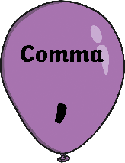
Hidden Punctuation
Which piece of punctuation is hidden?
How old are you?

Slide 6
Hidden Punctuation
Which piece of punctuation is hidden?
What a clever girl she is!

Slide 7
Hidden Punctuation
Which piece of punctuation is hidden?
Abdul and Tina sit together.

Slide 8
Hidden Punctuation
Which piece of punctuation is hidden?
I can’t believe what I have seen.

Slide 9
Hidden Punctuation
Which piece of punctuation is hidden?
I like to play with my friends.

Slide 10
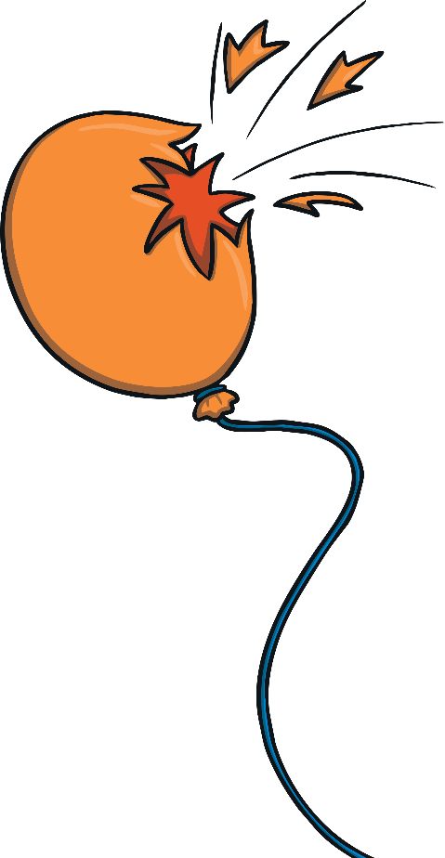
Missing Punctuation
Each of the following sentences are missing one piece of popping punctuation.
Click on the correct balloon to show which piece of punctuation is missing.

Slide 11
Missing Punctuation
Which piece of punctuation is missing?
I do not like chocolate
.

Slide 12
Missing Punctuation
Which piece of punctuation is missing?
What is your name
?

Slide 13
Missing Punctuation
Which piece of punctuation is missing?
Whattime is it?
What time is it?

Slide 14
Missing Punctuation
Which piece of punctuation is missing?
,
,
We wear our hats coat and scarves when it is cold.

Slide 15
Missing Punctuation
Which piece of punctuation is missing?
!
What a sunny day it is

Slide 16
Missing Punctuation
Which piece of punctuation is missing?
Is that Jens pencil case?
Is that Jen’s pencil case?

Slide 17
Missing Punctuation
Which piece of punctuation is missing?
I’m going to Harold’s birthday party.
I’m going to harold’s birthday party.

Slide 18
Missing Punctuation
Which piece of punctuation is missing?
!
How cruel the wind was that day

Slide 19
Missing Punctuation
Which piece of punctuation is missing?
We don’t want to be late.
We dont want to be late.

Slide 20
Missing Punctuation
Which piece of punctuation is missing?
?
Does the train stop at this station

