Slide 2
How to Play
Read the phrases that say “Just now, I am .” Then change the phrases to “Yesterday, I ” to make them past tense.
Example, “Just now, I am sinking.” “Yesterday, I sank.”
Say the “Yesterday, I…” phrase out loud, then click once to check your answer. If you get it correct, click it again to reveal a part of the picture!
The more past tense verbs you get correct, the more of the picture you will reveal!

Slide 3
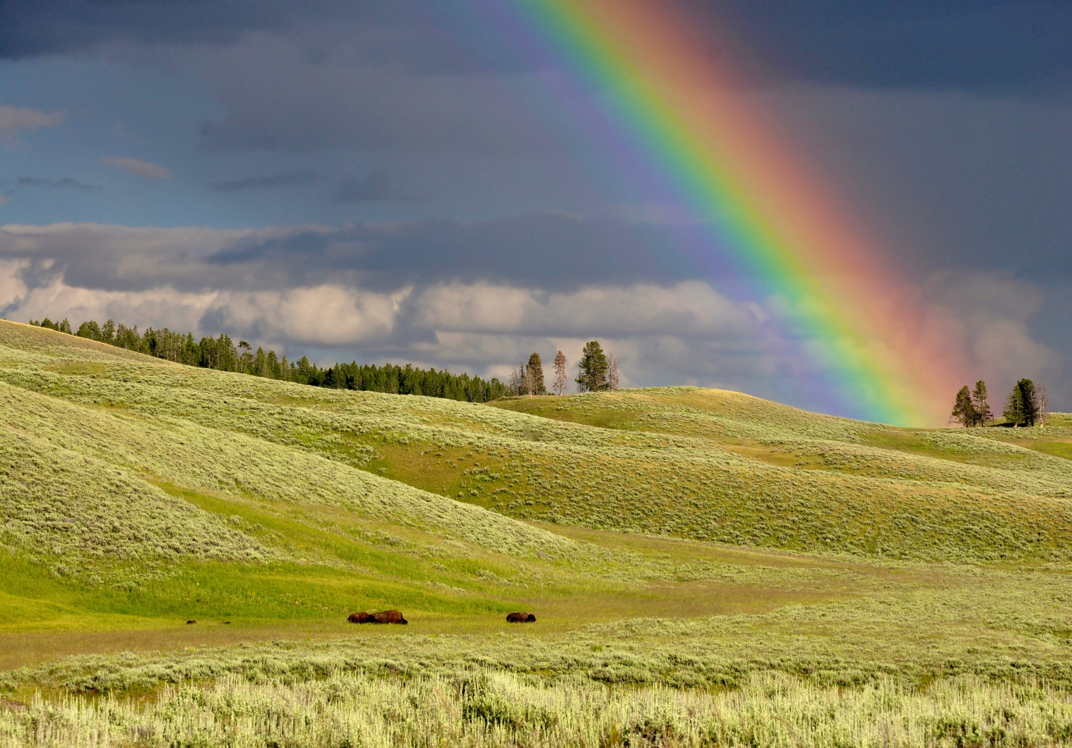
Just now, I am sleeping.
Yesterday, I slept.
Just now, I am teaching.
Yesterday, I taught.
Just now, I am driving.
Yesterday, I drove.
Just now, I am flying.
Yesterday, I flew.
Just now, I am swimming.
Yesterday, I swam.
Just now, I am drinking.
Yesterday, I drank.
Yesterday, I ate.
Just now, I am eating.
Just now, I am writing.
Yesterday, I wrote.
Just now, I am creeping.
Yesterday, I crept.
Just now, I am buying.
Yesterday, I bought.
Just now, I am digging.
Just now, I am catching.
Yesterday, I dug.
Yesterday, I caught.
Just now, I am growing.
Yesterday, I grew.
Yesterday, I heard.
Just now, I am hearing.
Just now, I am paying.
Yesterday, I paid.
Yesterday, I said.
Just now, I am saying.
Just now, I am sitting.
Yesterday, I sat.
Yesterday, I sang.
Just now, I am singing.
Just now, I am spending.
Yesterday, I spent.
Just now, I am winning.
Yesterday, I won.

