Slide 1
Animations Disclaimer
We hope you find the information on our website and resources useful.
PowerPoint
This resource has been designed with animations to make it as fun and engaging as possible. To view the content in the correct formatting, please view the PowerPoint in “slide show mode.” This takes you from desktop to presentation mode. If you view the slides out of “slide show mode,” you may find that some of the text and images overlap each other and/or are difficult to read.
To enter slide show mode, go to the slide show menu tab and select either from beginning or from current slide.
You may wish to delete this slide before beginning the presentation.

Slide 3
Riddle: Why did the student eat his homework?

Slide 4
How to Play
Read the questions. Answer the question, then click once to check your answer. If you get it correct, click it again to reveal a part of the riddle answer! The more questions you get correct, the more of the riddle answer you will reveal!

Slide 5
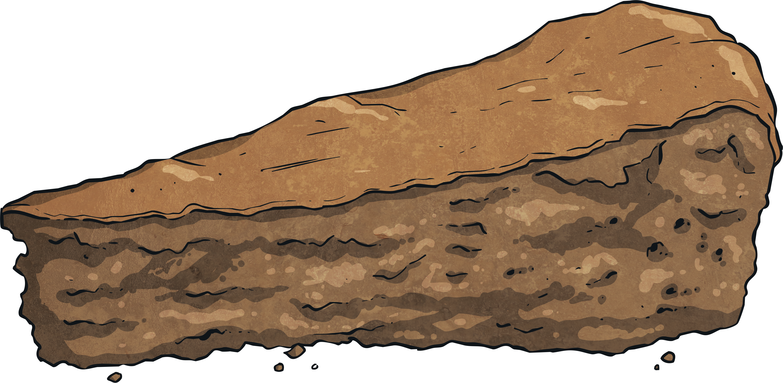
The student’s teacher said it was a piece of cake.
100 - 70
30
35 + 17
52
Compare with <, >, =. 43 37
43 > 37
Compare with <, >, =. 19 51
19 < 51
13 + 11 + 22 + 20
66
56 + 10
66
160 + 100
260
98 - 10
88
800 - 100
700
How many ones are in 16?
6
Continue the pattern: 5, 10, , 20, 25.
How many ones are in 18?
15
8
Write in words: 22
twenty-two
Write 124 in expanded form.
100 + 20 +4
Write 56 in expanded form.
50 + 6
Continue the pattern: 200, 300, 400, 500, , 700, 800.
600
Compare with <, >, =. 129 203
129 < 203
330 - 120
210
13 - 7
6
235 + 502
737
345 + 568
913
27 + 59
86
45 - 38
7
100 - 10
90
200 - 50
150

