Slide 2
Food
What is your favourite food?
Talk About It

Slide 3
Food Waste
We all love eating food yet each year there is a huge amount of edible food thrown away in the UK.
10 million wheelie bins
20 million wheelie bins
40 million wheelie bins
Every year, the equivalent of 40 million wheelie bins full of food that could still be eaten are thrown away. That’s the same as nearly 100 concert stadiums full!

Slide 4
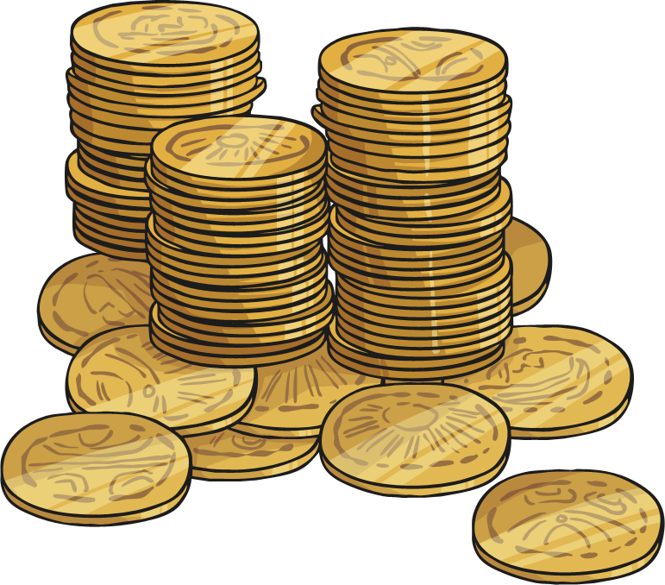
Why Is Food Waste a Problem?
There are many reasons why food waste is a problem:
The production of food uses a great deal of water. Food requires a lot of water to grow and produce it. By wasting food, we are wasting water supplies. It takes 100 buckets of water to grow the crops used to make one loaf of bread and 54 buckets of water to produce one chicken. When food is wasted, this means water has been used unnecessarily.
Wasting food wastes money. Wasted food costs an average family £70 per month.

Slide 5
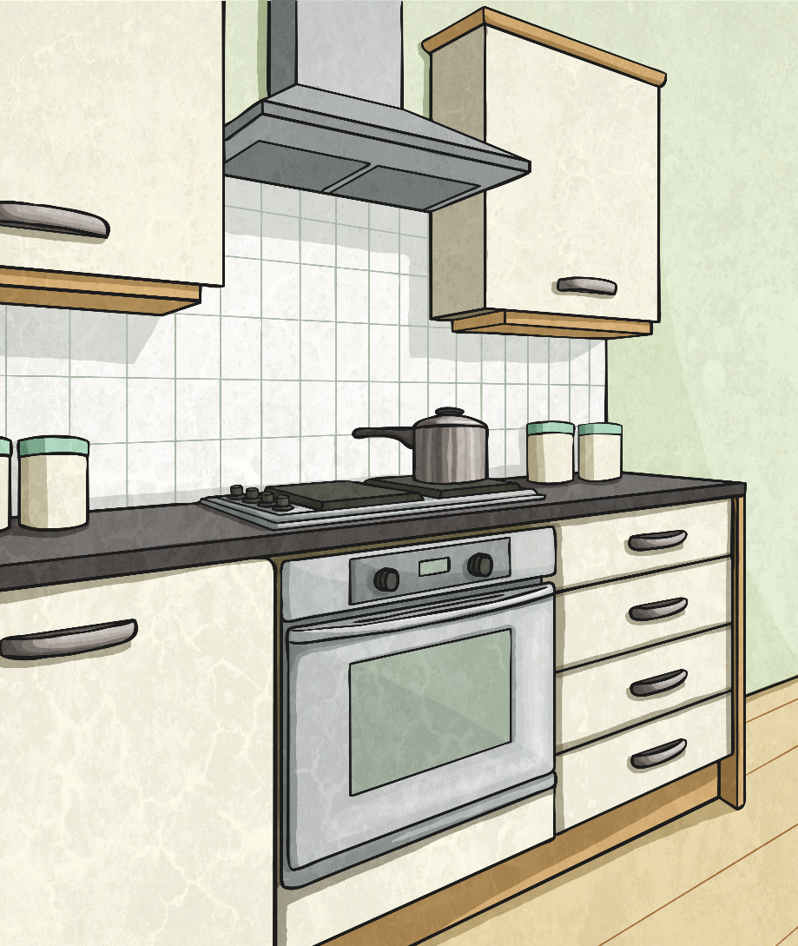
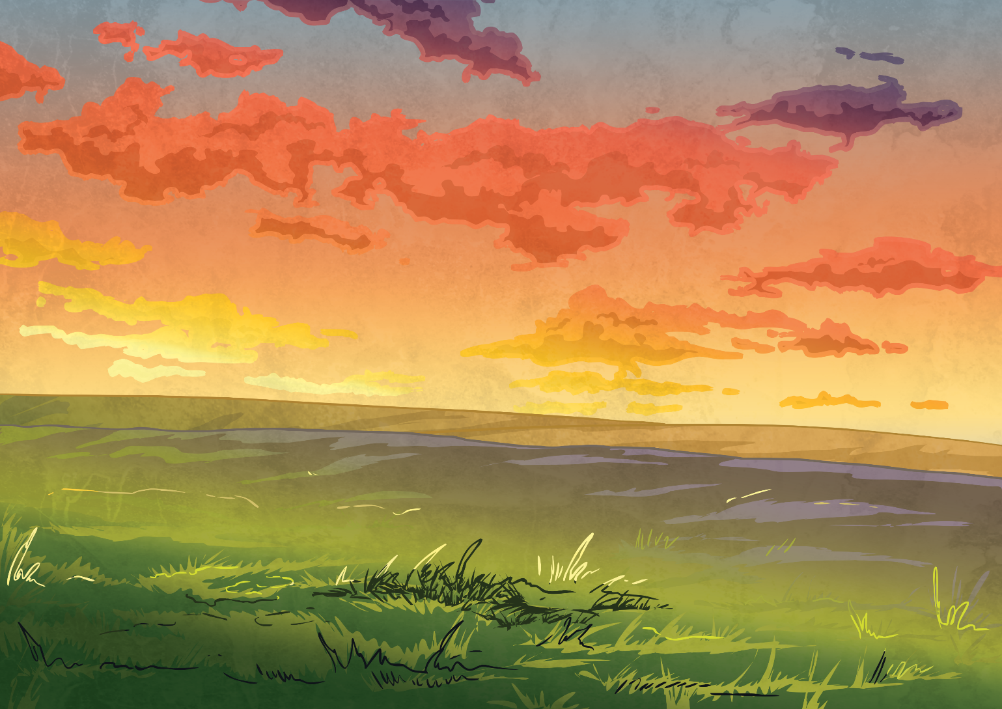
Food Waste and the Environment
Food waste is bad for the planet.
Producing, transporting and cooking food uses fuel. Burning fuel releases greenhouse gases, such as carbon dioxide, which contribute to climate change. When food is wasted, these greenhouse gases are unnecessarily released into the atmosphere.
Wasted food is often sent to landfill, where it rots and releases methane into the environment. Methane is a greenhouse gas.
Large amounts of land are needed to produce food. Wasted food means wasted land.
Did You Know…?
If the UK stopped wasting food, 17 million less tonnes of carbon dioxide would be released into the atmosphere. This is the equivalent of there being a fifth less cars in the UK.

Slide 6
Why Is Food Waste a Problem
The problem of food waste is worse when the issue of world hunger is considered.
Although enough food is produced for every single person, 815 million people in the world don’t have enough to eat.
66 million primary school-aged children go to school hungry each day.
3.1 million children under the age of five die each year because of a lack of food.
Around a quarter of all people in Sub-Saharan Africa are hungry every day.
Around 40% of children under the age of five in India are underweight due to lack of food.
We shouldn’t waste food if we have it.

Slide 7
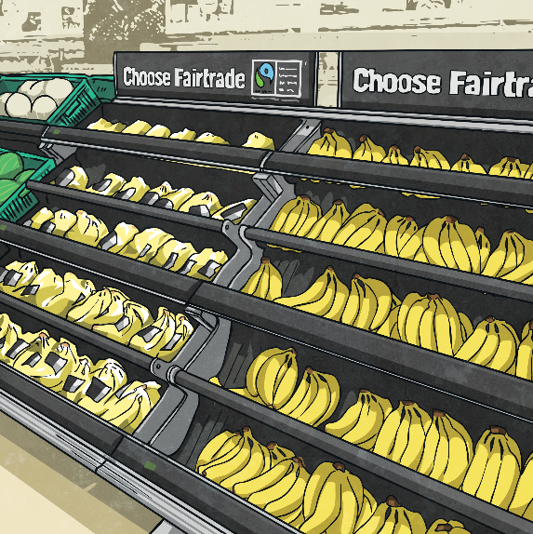
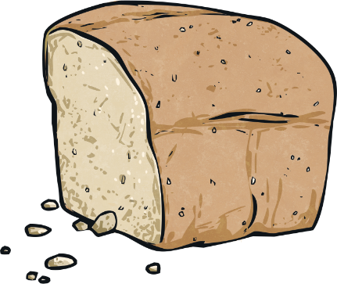
How Can We End Food Waste?
Having a good idea of how long food lasts is a good way to stop food waste. ‘Used By’ means food must be eaten by the date on the label. The ‘Best Before’ label means food is better before the date stated but is still safe to eat afterwards. Try not to throw food away just because it’s past its ‘Best Before’ date.
Best before vs Used By
Leftover food can be used in all kinds of ways. A loaf of bread that is going a bit stale can be used to make breadcrumbs. Vegetables that are a bit past their best can be ingredients in a tasty soup.
Left Overs

Slide 8
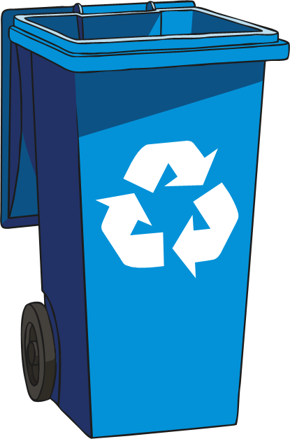
How Can We End Food Waste?
In lots of areas, homes are given little recycling bins called a caddy. Scraps of left over food, vegetable peel and egg shells are put in the caddy. On recycling collection days, the scraps are taken to the recycling centre.
Recycling Food
There are apps that help you use up leftover food. Some of these apps are for people who grown their own vegetables; they can let others know they have spare vegetables. Other apps let you order leftover food from restaurants. Charities that make food for the homeless can use apps to find out which supermarkets have extra food they can use. There’s also an app where you can enter in all your food that needs using up soon and it will make a recipe for you.

Slide 9
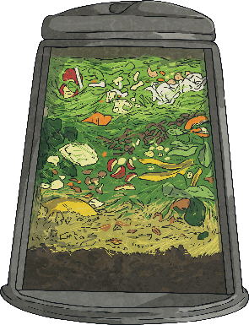
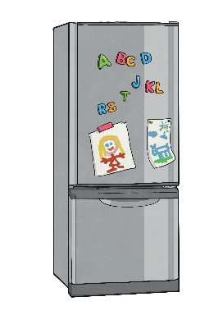
Food Waste and the Environment
Composting
Leftover food can be put in a composting bin. When mixed with bits of wood, cardboard, dead leaves and other things, the food eventually breaks down and turns into compost. Compost can be used to help plants grow well.
Only Buy What You Need
If people plan what they are going to eat each week and only buy the food that they need, less food is wasted.
Food Storage
Check how fresh food should be stored to help it last longer.

Slide 10
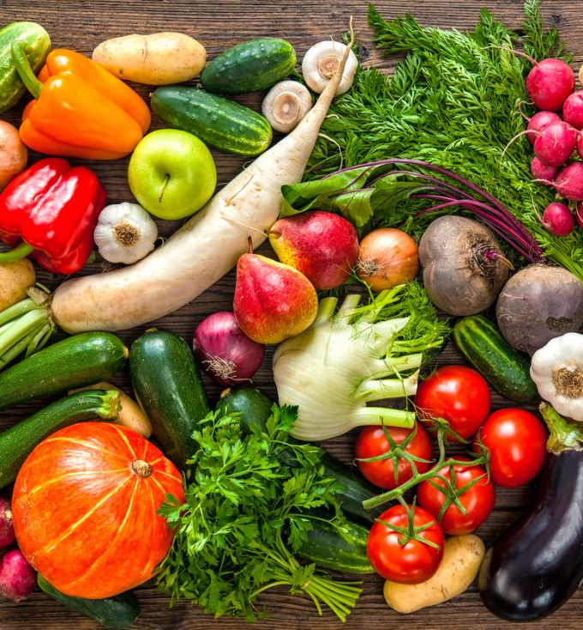
What Next?
Which of these ideas do you think would work best?
Could you use any of them in your own home or in your school?
Why not share these ideas with the people you live with or your headteacher?
If each person takes small steps, food waste can be stopped.
Talk About It

