Slide 2
What do you know about mountains?
Write down everything you know about mountains.
Have you climbed or seen a mountain?
What do you expect to see when you see a mountain?
Where are mountains found?

Slide 3
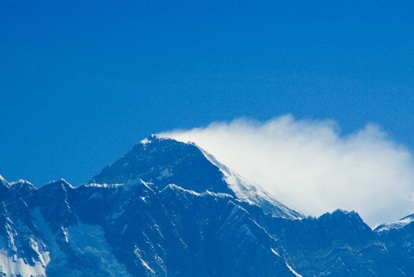
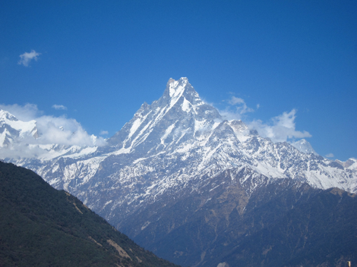
Mountains in Nepal
Mt. Everest
Annapurna
Mount Everest is the highest mountain in the world. It is in the Himalayas, China and is 8848metres high. 600 Climbers have reached the peak. 100 have died.
At 6962 metres the Annapurna is the highest peak in the western Hemisphere. The death toll is very high as climbers go up it too fast.

Slide 4
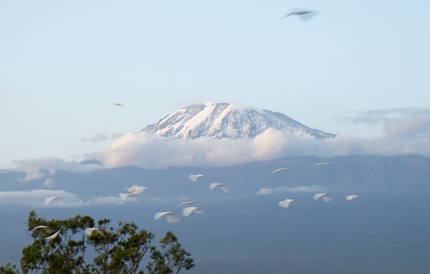
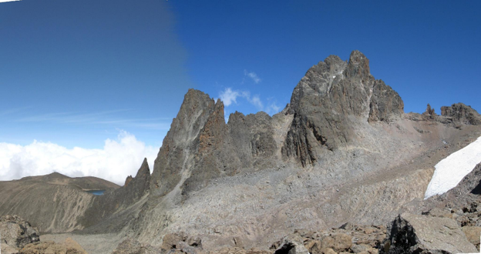
Mountains in Africa
Kilimanjaro
Mount Kenya
Kilimanjaro is the largest extinct volcano in the world and Africa's highest mountain, standing at 5963 metres.
Mount Kenya is also an extinct volcano. It is 5199 metres high.
Both mountains rise up from the flat plains. The bottom of the mountains are covered in scrubs which is rich with wildlife and vegetation.

Slide 5
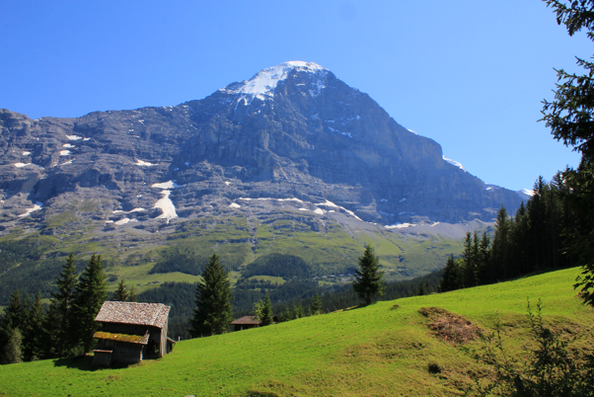
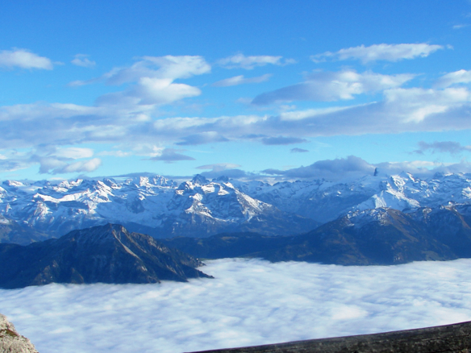
Mountains in Switzerland
Swiss Alps
The Eiger
The Swiss Alps are the portion of the Alps that lies within Switzerland.
It stands at 3970 metres and is one of Europe's most fearsome mountains. Its peaks are very difficult to climb. It has a severely towering north face. The Eiger has claimed the lives of many climbers.

Slide 6
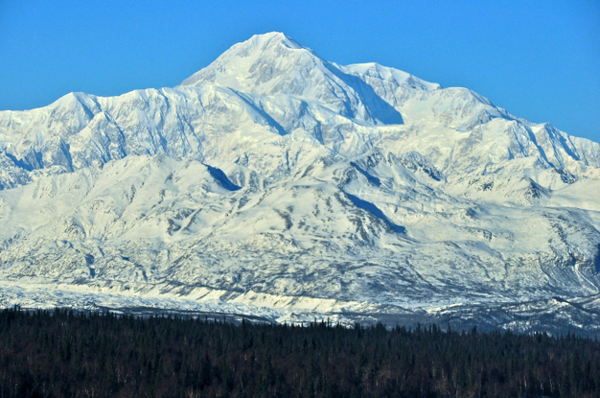
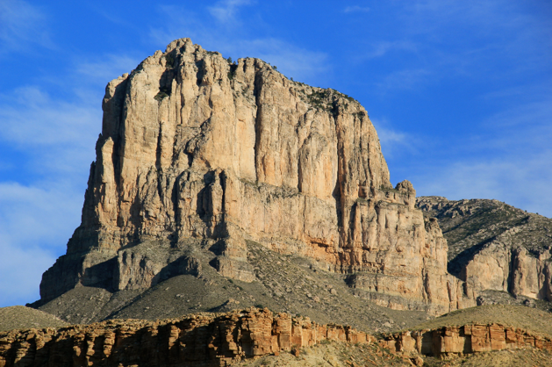
Mountains in USA
McKinley
El Capitan
McKinley is part of the Alaskan range, it is the highest mountain in the USA. It is natively known as ‘Denali’ meaning ‘The great one’. This giant snowy mass has 5 glaciers, and the south facing slope is 12 miles long.
El Capitan is 2307 metres high and dominates Yosemite National Park. It is a four day climb to the top.

Slide 7
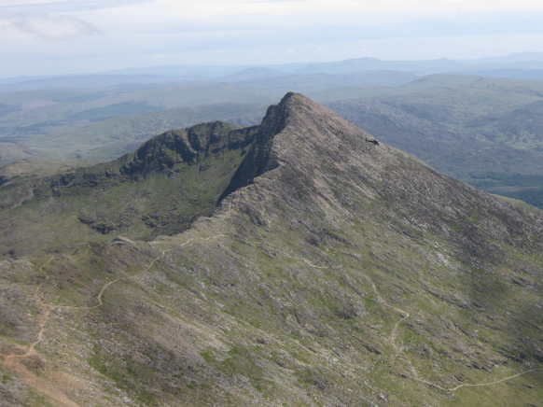
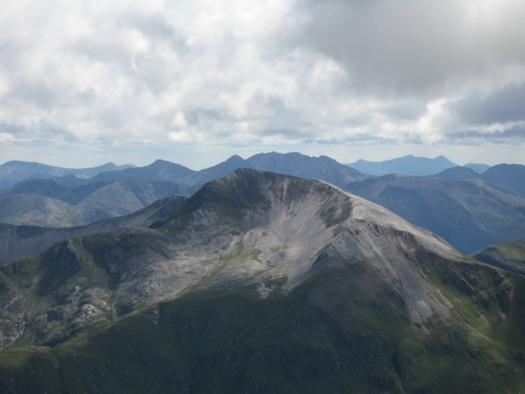
Mountains in Britain
These are not in the same league in term of height, but are just as impressive and challenging to climbers as the changeable weather in the mountain environment is a constant danger.
Snowdon
Ben Nevis
Snowden is the highest mountain in Wales, with a height of 1085 metres.
Ben Nevis is the highest mountain in the British Isles, standing at 1344 metres. It is in the Scottish Highlands.

