Slide 2
Discussion Points
These slides contain 30 child friendly, thought-provoking questions about life.
You could use them as:
Stimuli for class debates
Philosophy circles
Morning Tasks
Persuasive writing activities
The key to really thinking about each of these questions is “Why?” Encourage your children to justify their answers

Slide 3
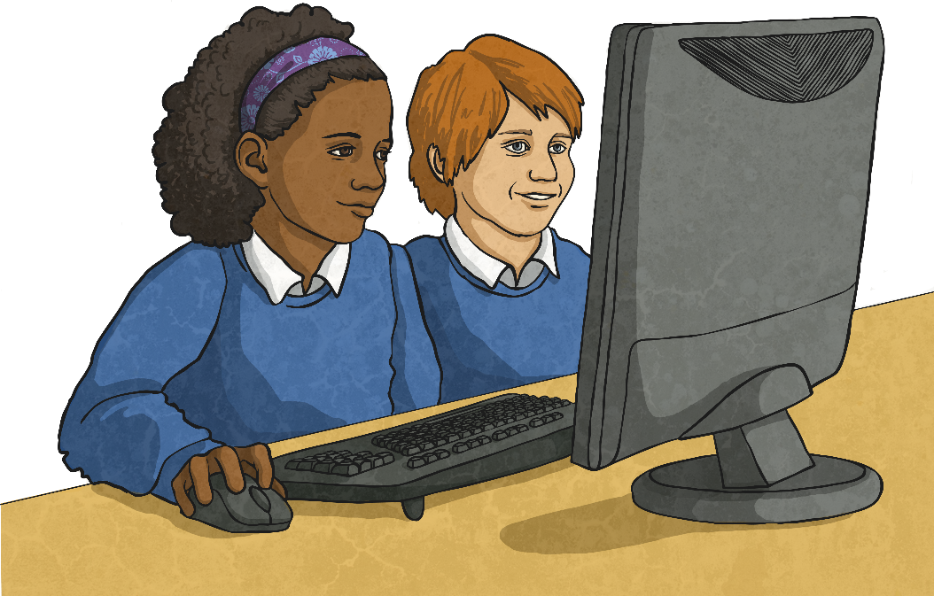
Are computer games good for you?

Slide 4
Are school uniforms a good idea?

Slide 5
Is it right for countries to spend money on sending people into space when so many people live in poverty on Earth?

Slide 6
Should school holidays be made shorter so that we can spend more time learning in school?

Slide 7
What is important about parents or carers?

Slide 8
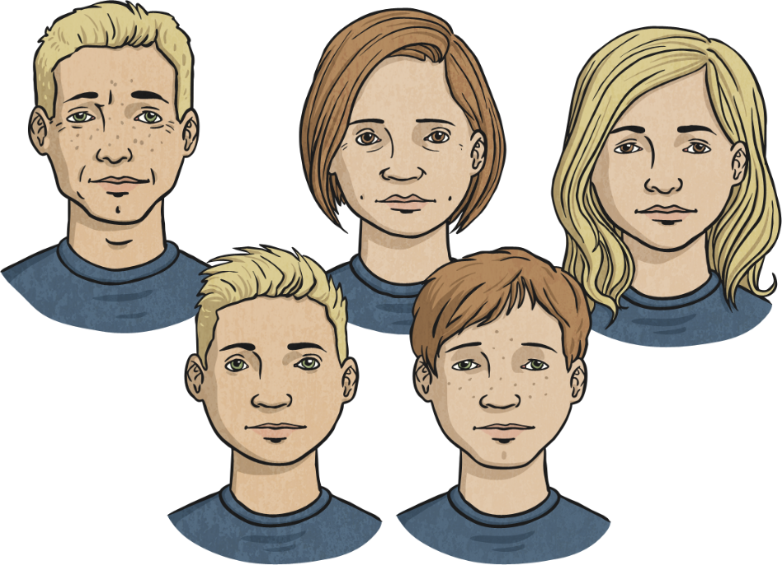
Do you think it is possible for two people to be exactly the same?

Slide 9
When is the best time to do homework?

Slide 10
Is it fun
being old?

Slide 11
What is
anger?

Slide 12
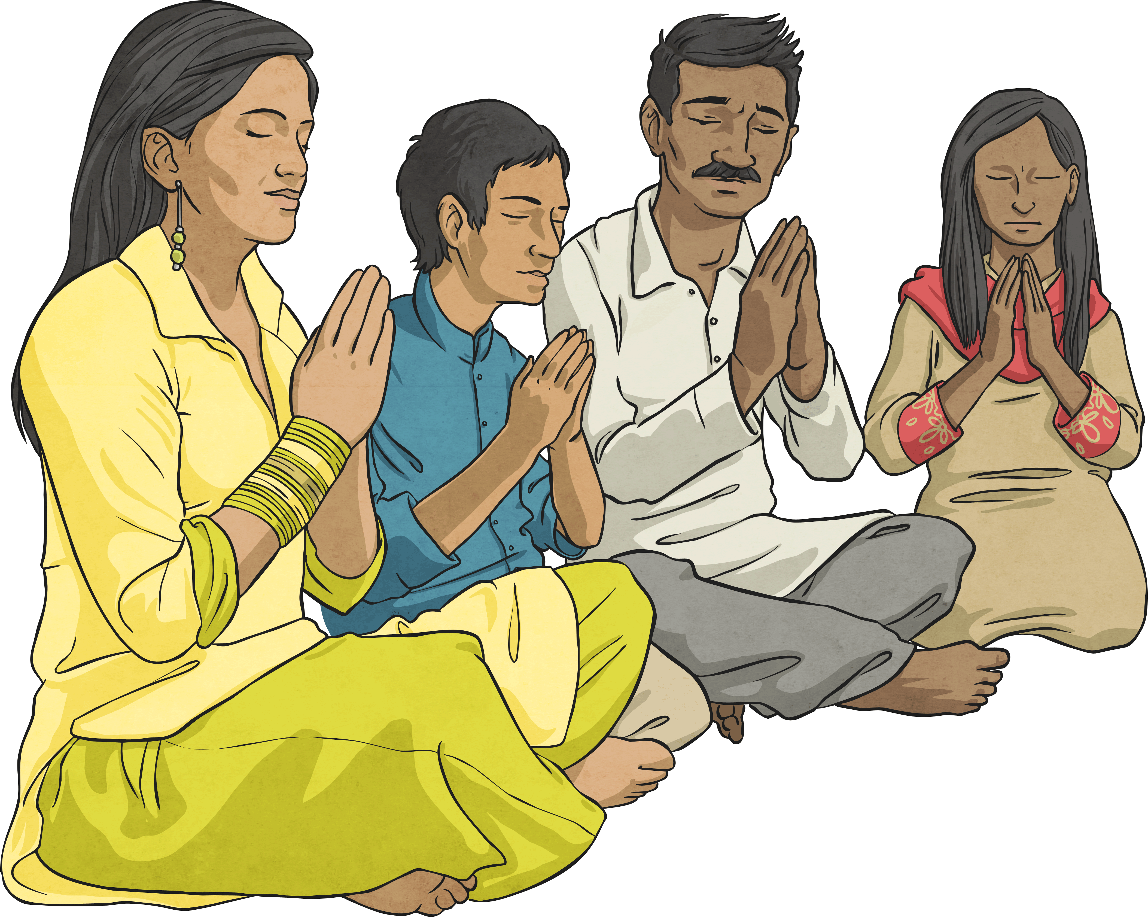
Is God still important
in today’s world?

Slide 13
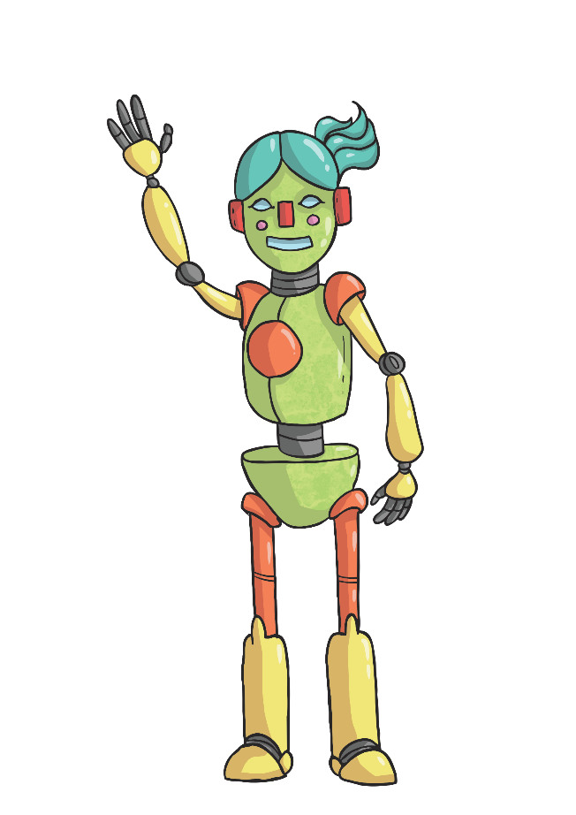
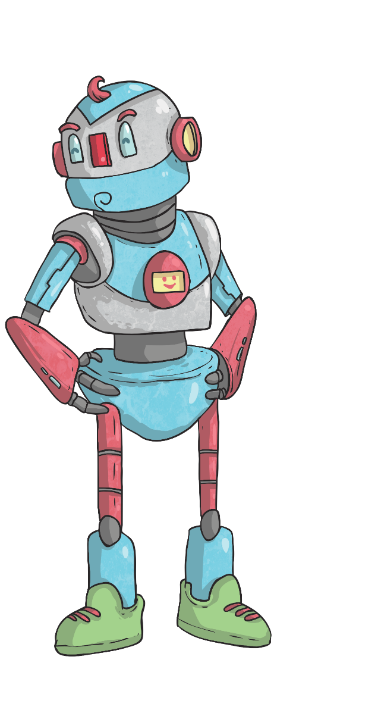
One day, will computers
replace teachers?

Slide 14
Is it easier to
help people if
you are rich?

Slide 15
Is it ok to keep animals in zoos?

Slide 16
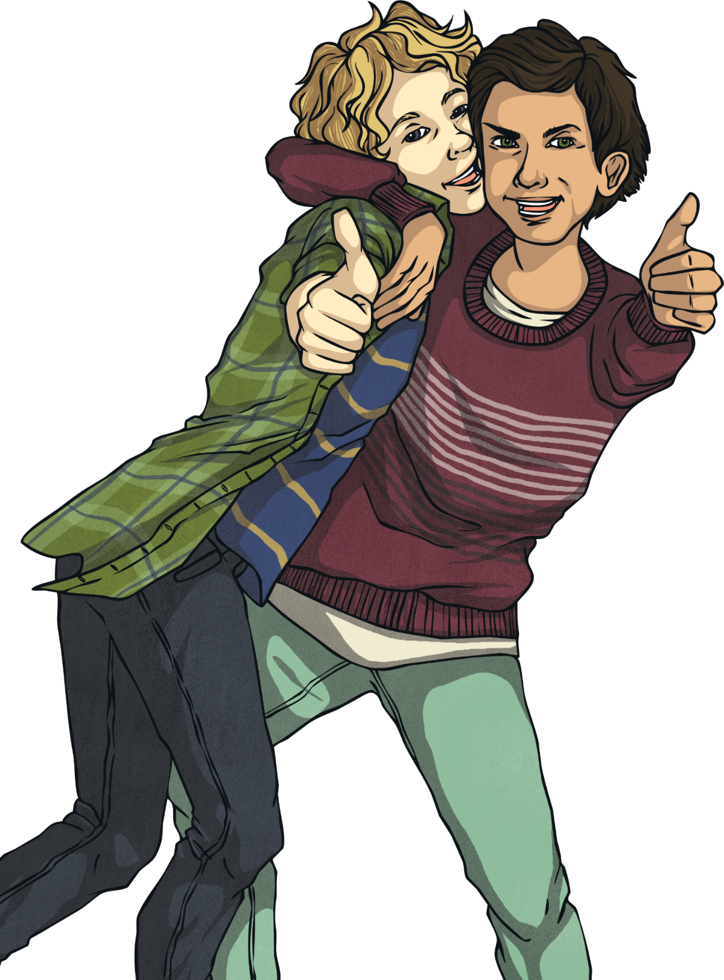
What makes
a good friend?

Slide 17
Is it our job to look
after the environment?

Slide 18
Is it more important to respect yourself or other people?

Slide 19
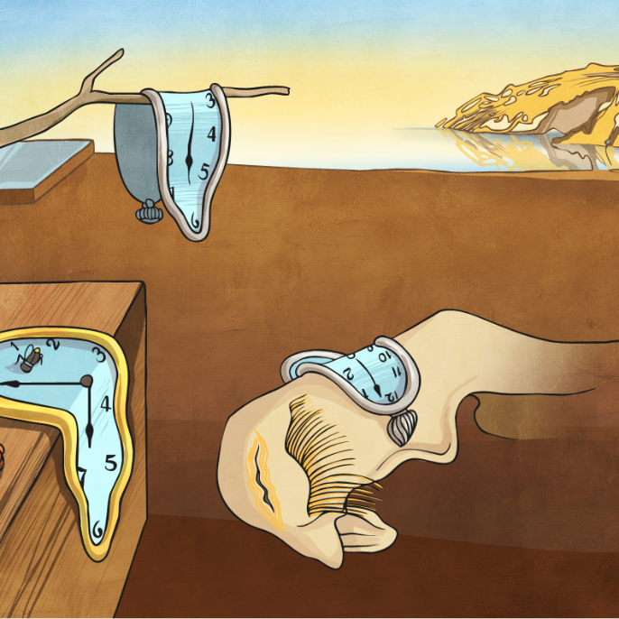
When did time begin?

Slide 20
Is night time more scary
than the day time?

Slide 21
If God exists, what do you think God’s plan for the world is?

Slide 22
What is
the greatest
special power?

Slide 23
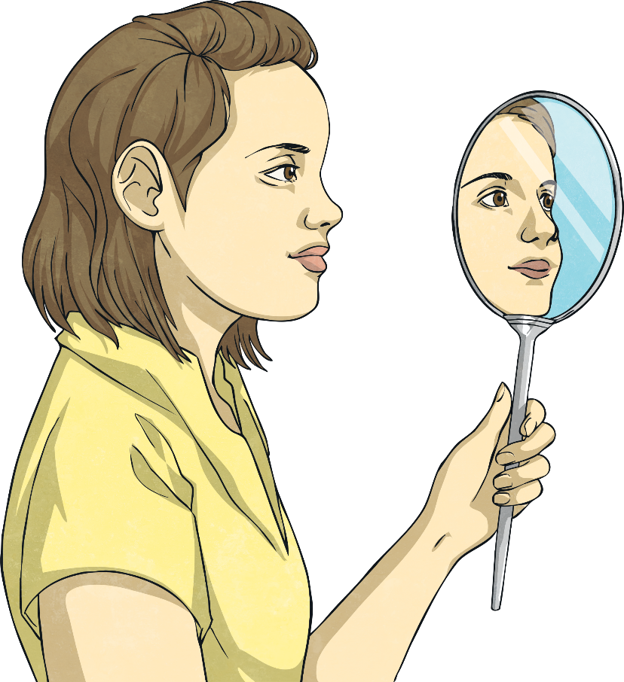
Why do
people wear make-up?

Slide 24
What makes us happy?

Slide 25
If animals could speak, what would they say about humans?

Slide 26
Why do people commit crimes?

Slide 27
How do we know the difference between right and wrong?

Slide 28
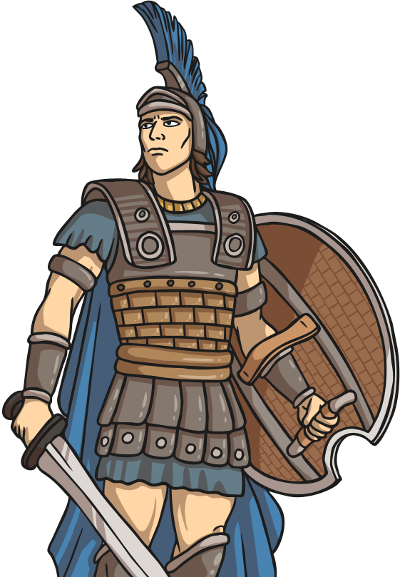
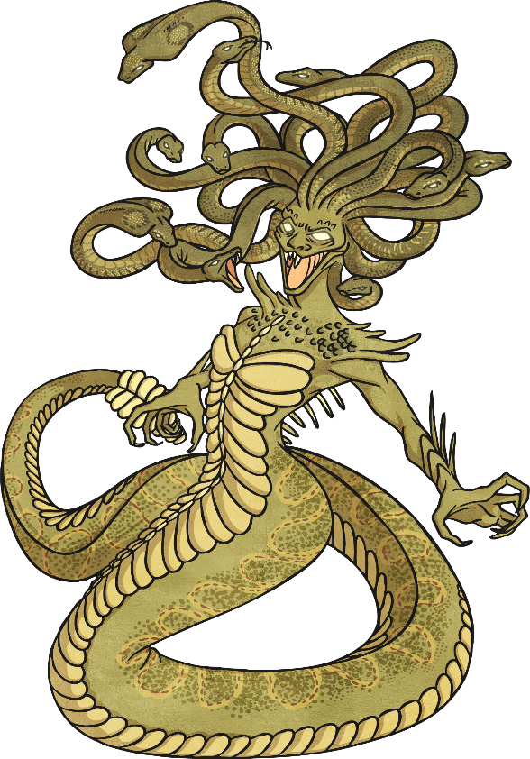
Is good more powerful than evil?

Slide 29
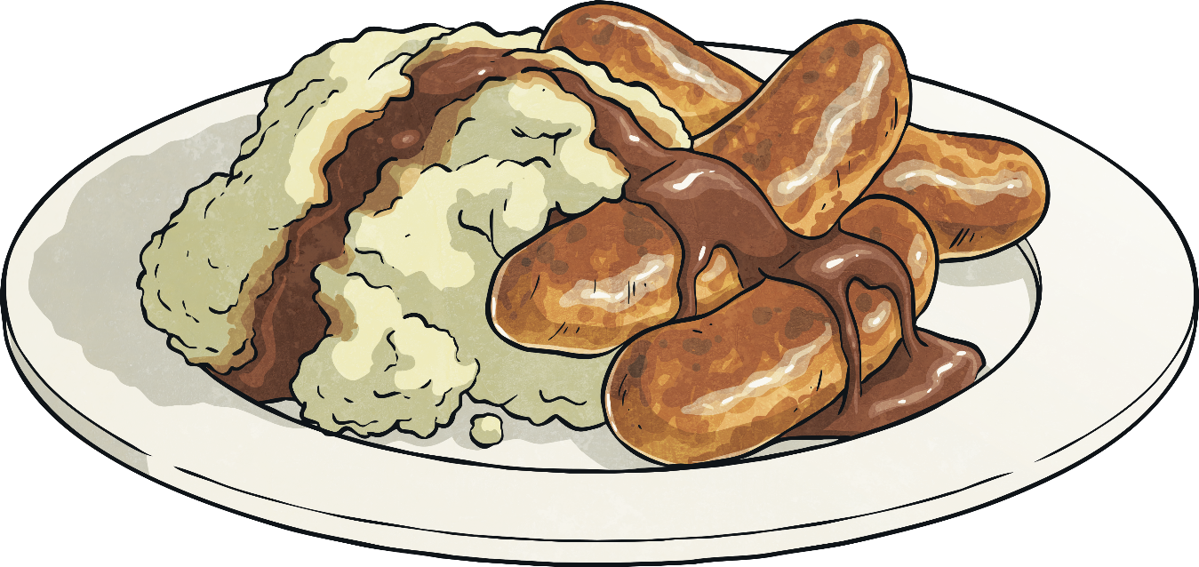
Is it ok to kill animals to eat them?

Slide 30
Does having more things make us happier?

Slide 31
Are exams and tests helpful?

