Slide 2
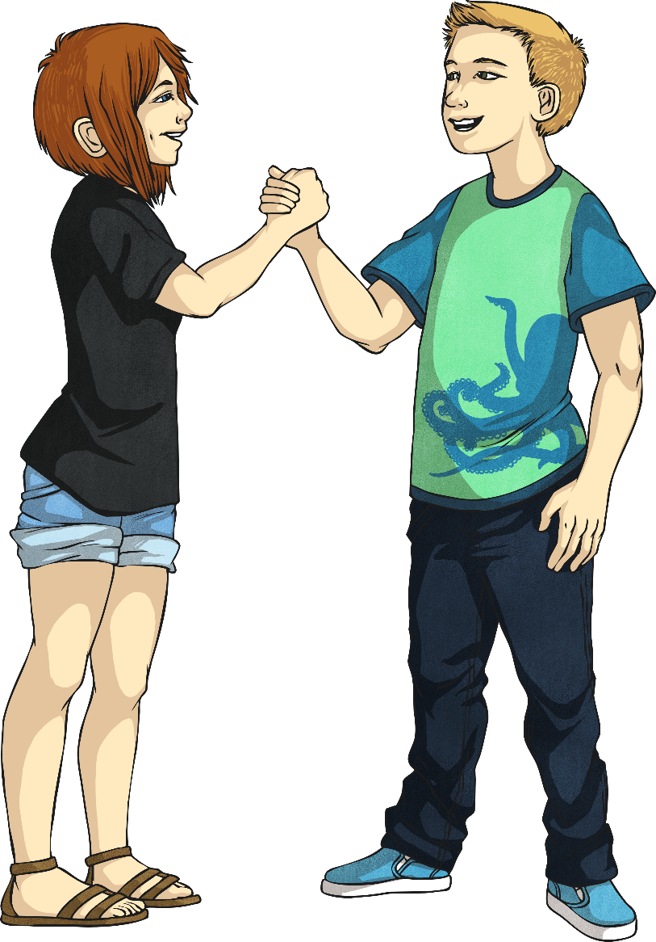
Have a conversation about…
the qualities you look for in a friend.

Slide 3
Have a conversation about…
your favourite sport to play.

Slide 4
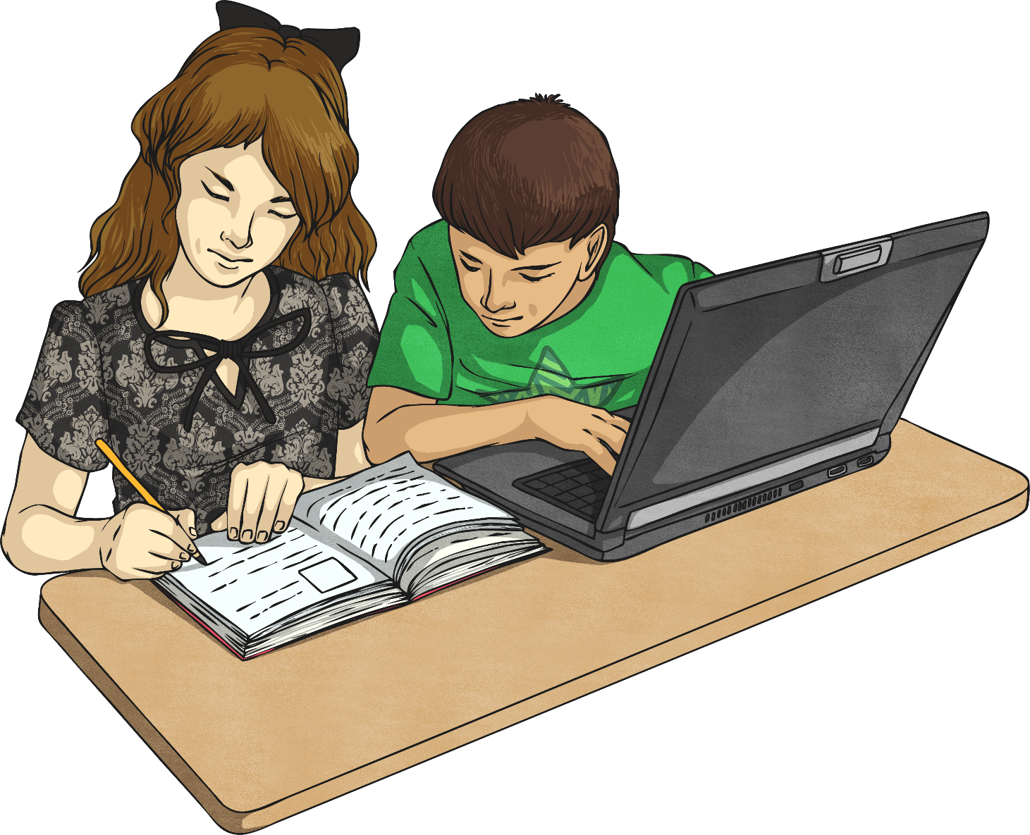
Have a conversation about…
some responsibilities you have at the moment.

Slide 5
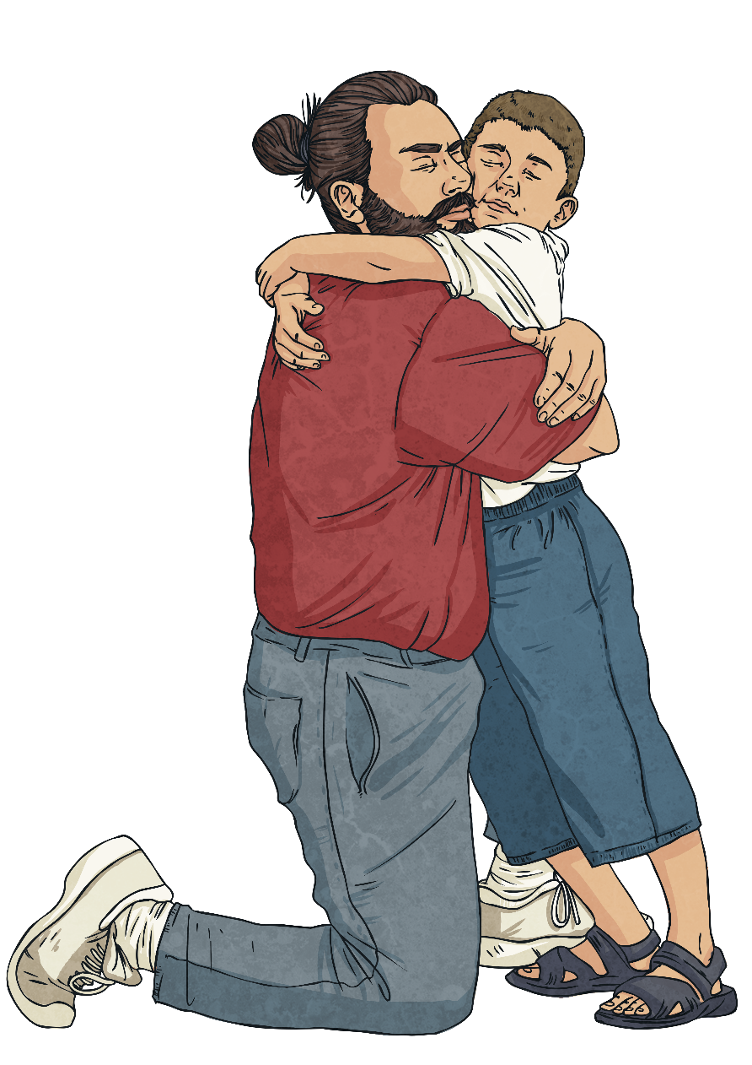
Have a conversation about…
what love means to you.

Slide 6
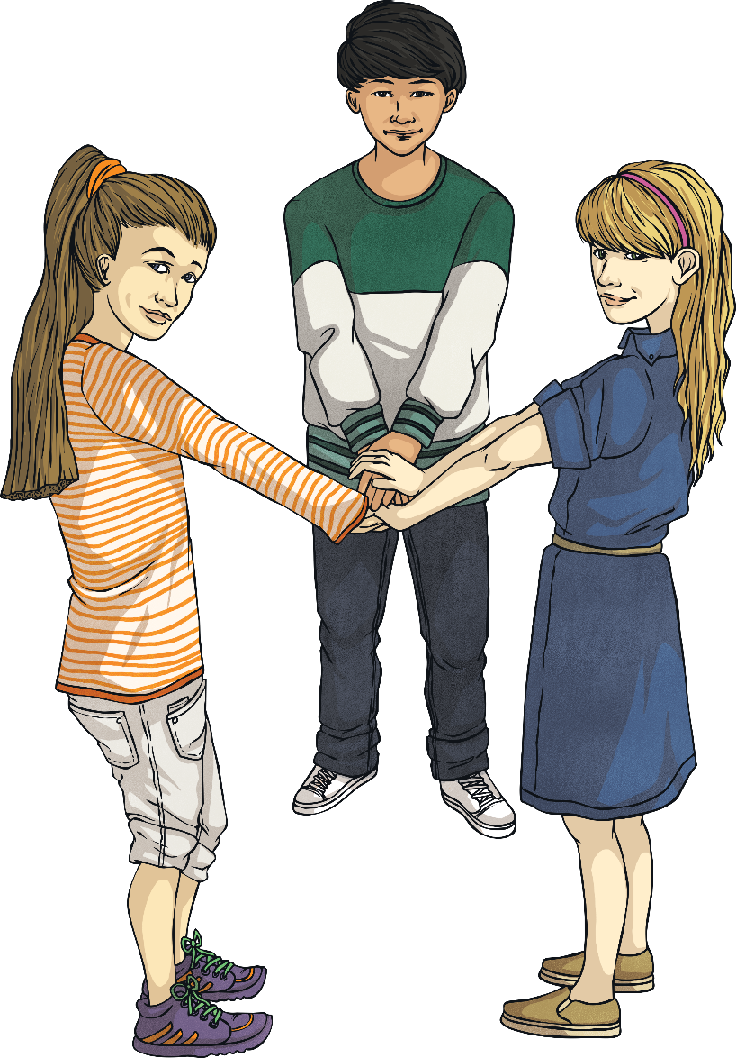
Have a conversation about…
how many friends you have.

Slide 7
Have a conversation about…
the people you live with.

Slide 8
Have a conversation about…
your happiest memory.

Slide 9
Have a conversation about…
your unhappiest memory.

Slide 10
Have a conversation about…
what would happen if you won the lottery.

Slide 11
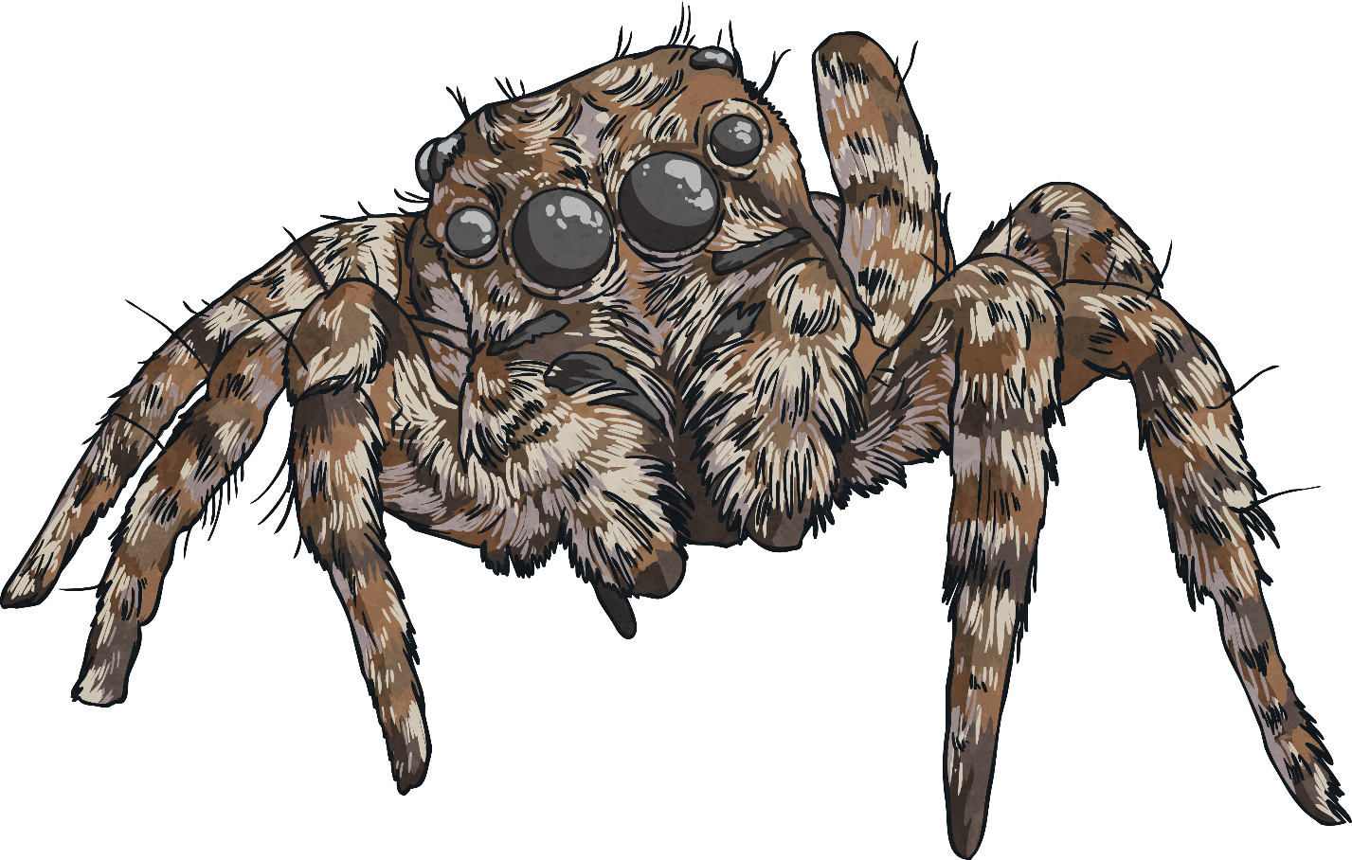
Have a conversation about…
something you are scared of.

Slide 12
Have a conversation about…
your favourite ice-cream flavour.

Slide 13
Have a conversation about…
which three wishes you would choose.

Slide 14
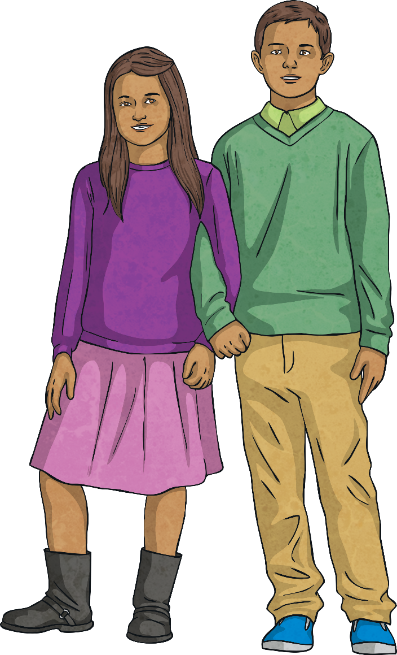
Have a conversation about…
someone special in your life.

Slide 15
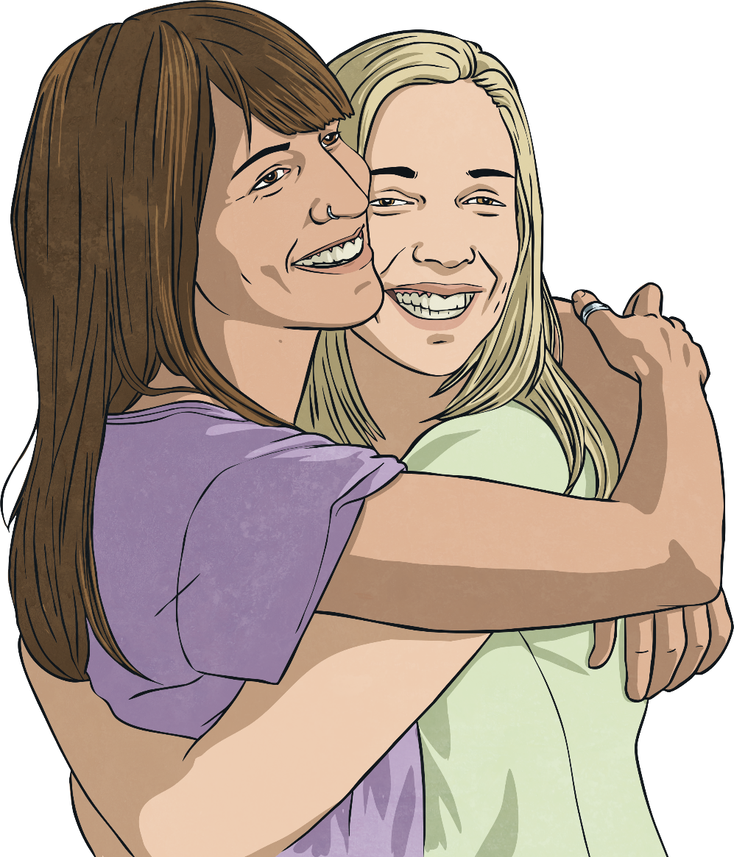
Have a conversation about…
who you would like to hug right now.

Slide 16
Have a conversation about…
one thing you love about yourself.

Slide 17
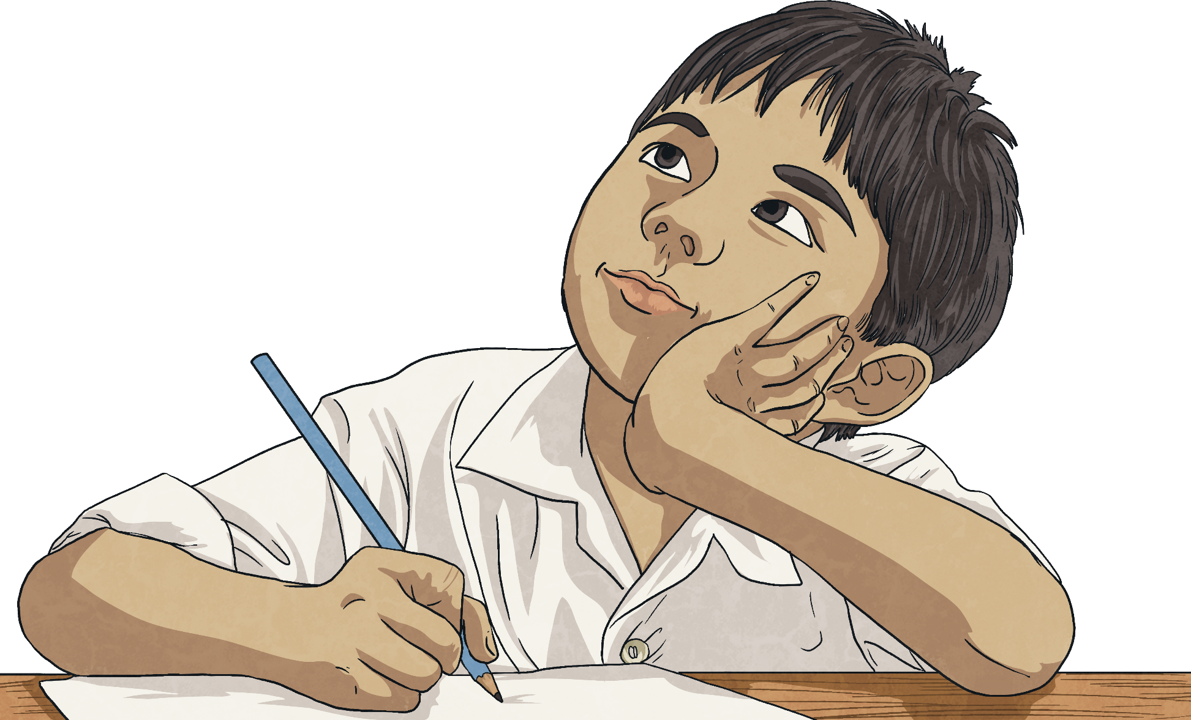
Have a conversation about…
one thing you would change about your life.

Slide 18
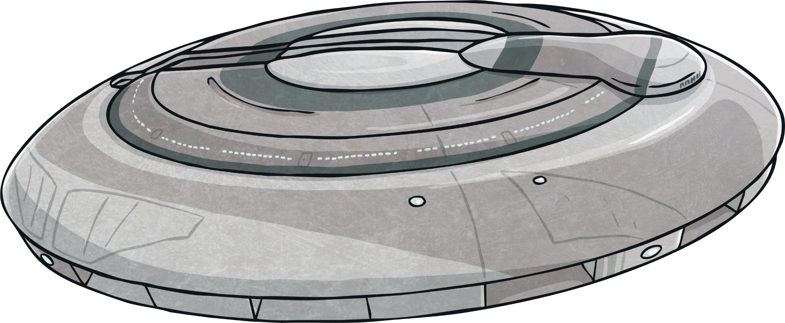
Have a conversation about…
who you would take with you on a spaceship to the moon.

Slide 19
Have a conversation about…
something that is worrying you.

Slide 20
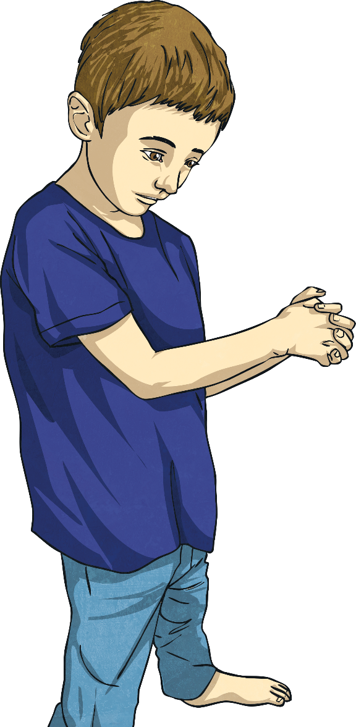
Have a conversation about…
something you wish you had not done.

Slide 21
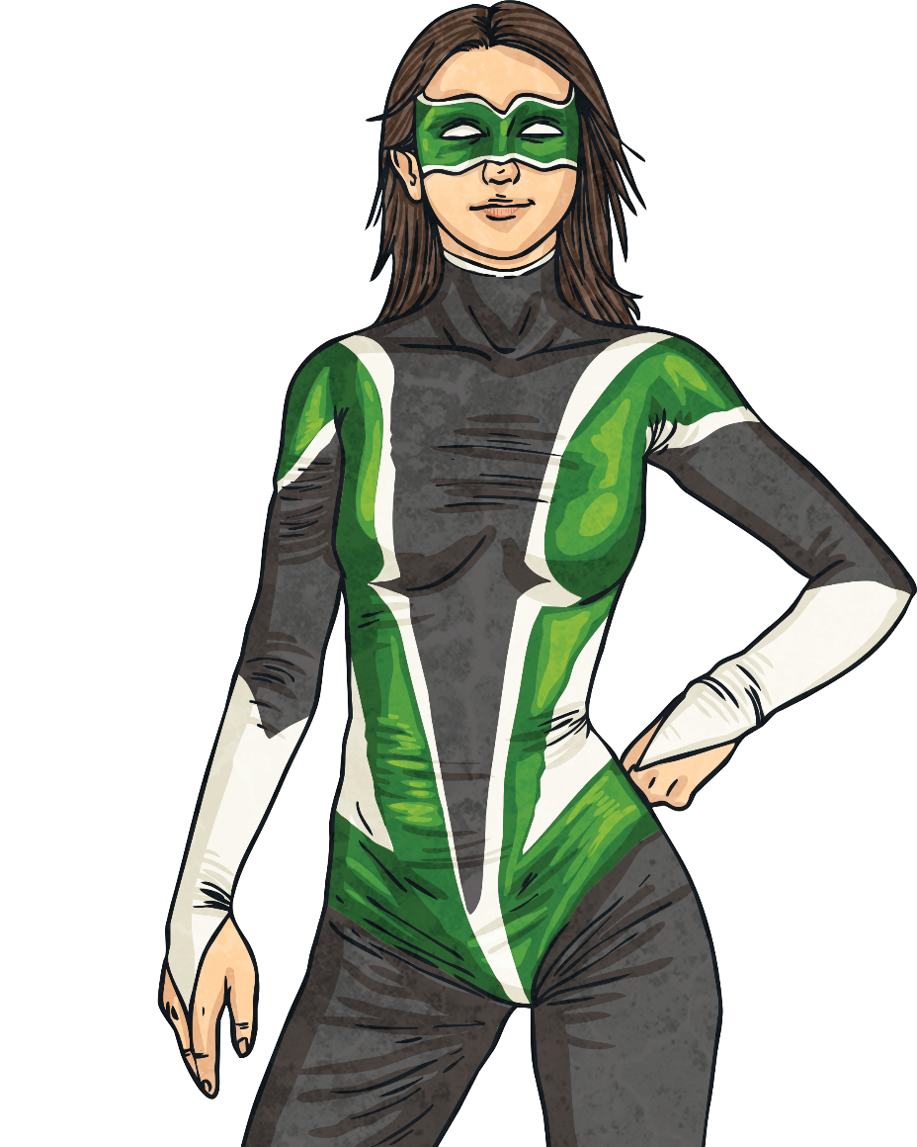
Have a conversation about…
which superpower you would choose.

Slide 22
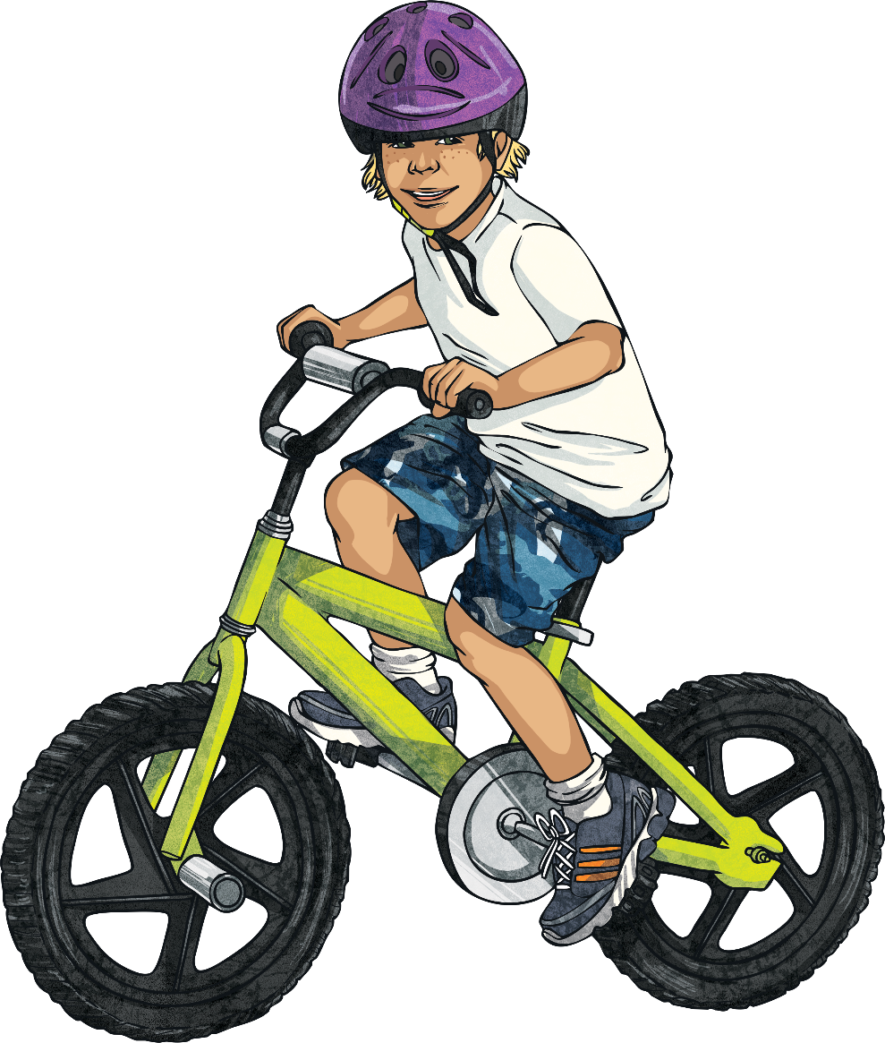
Have a conversation about…
what you are good at.

Slide 23
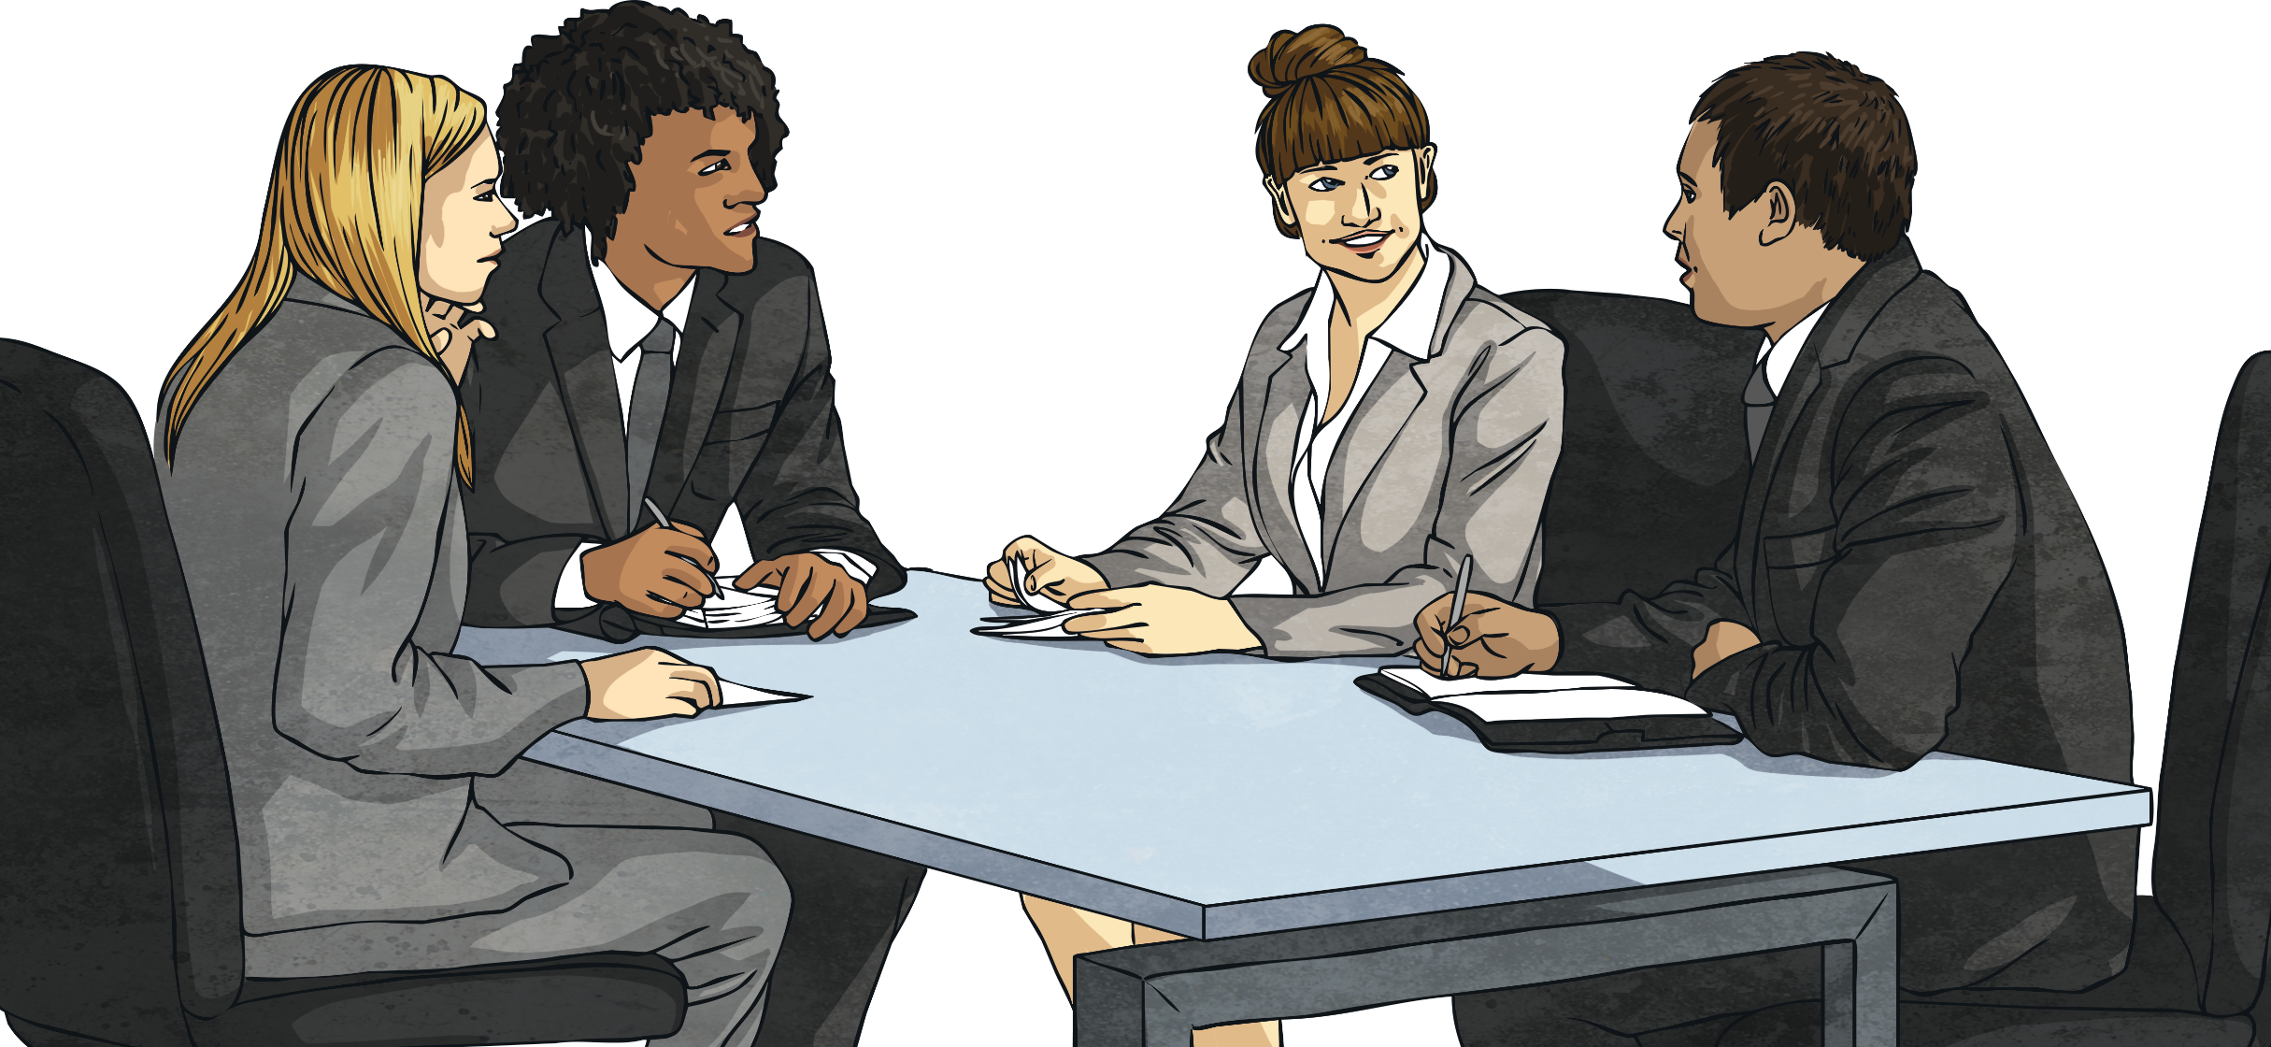
Have a conversation about…
what you want to be when you are older.

Slide 24
Have a conversation about…
your favourite holiday destination.

Slide 25
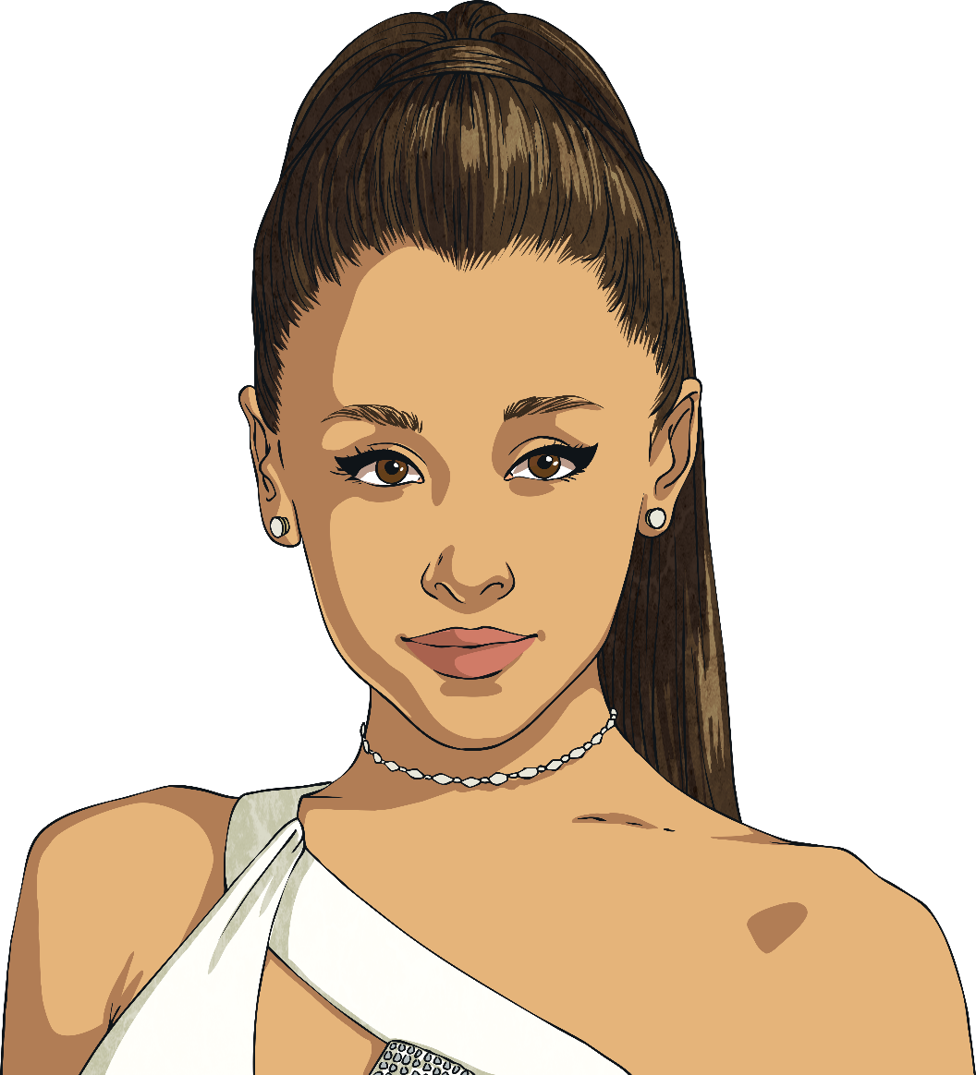
Have a conversation about…
your favourite famous person.

Slide 26
Have a conversation about…
where you would like to live, if you could live anywhere in the world.

Slide 27
Have a conversation about…
a time a friend let you down.

Slide 28
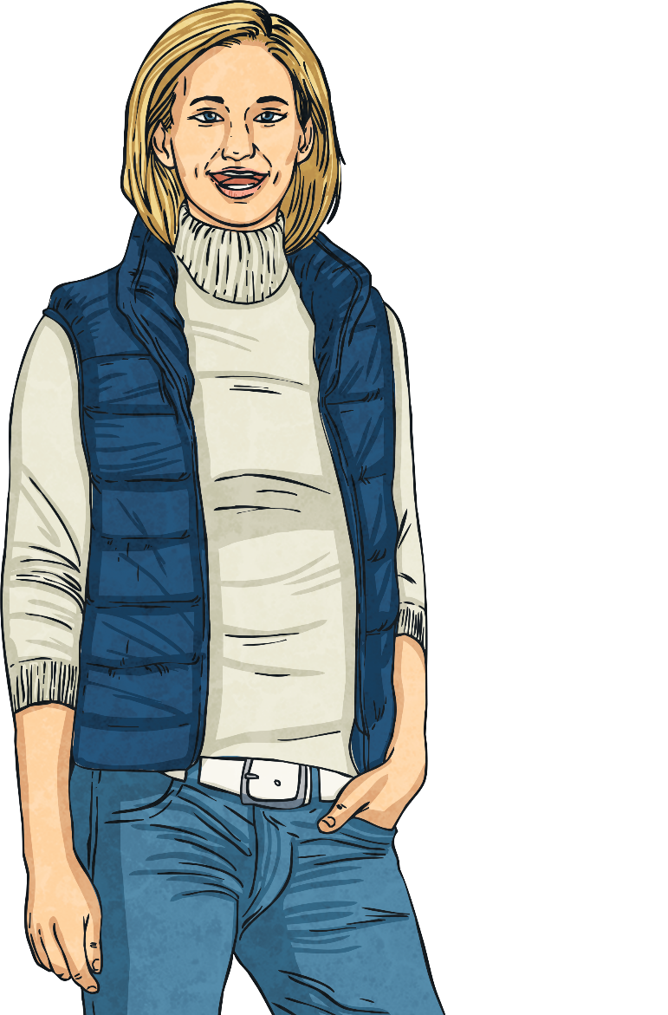
Have a conversation about…
who you see as your role model.

Slide 29
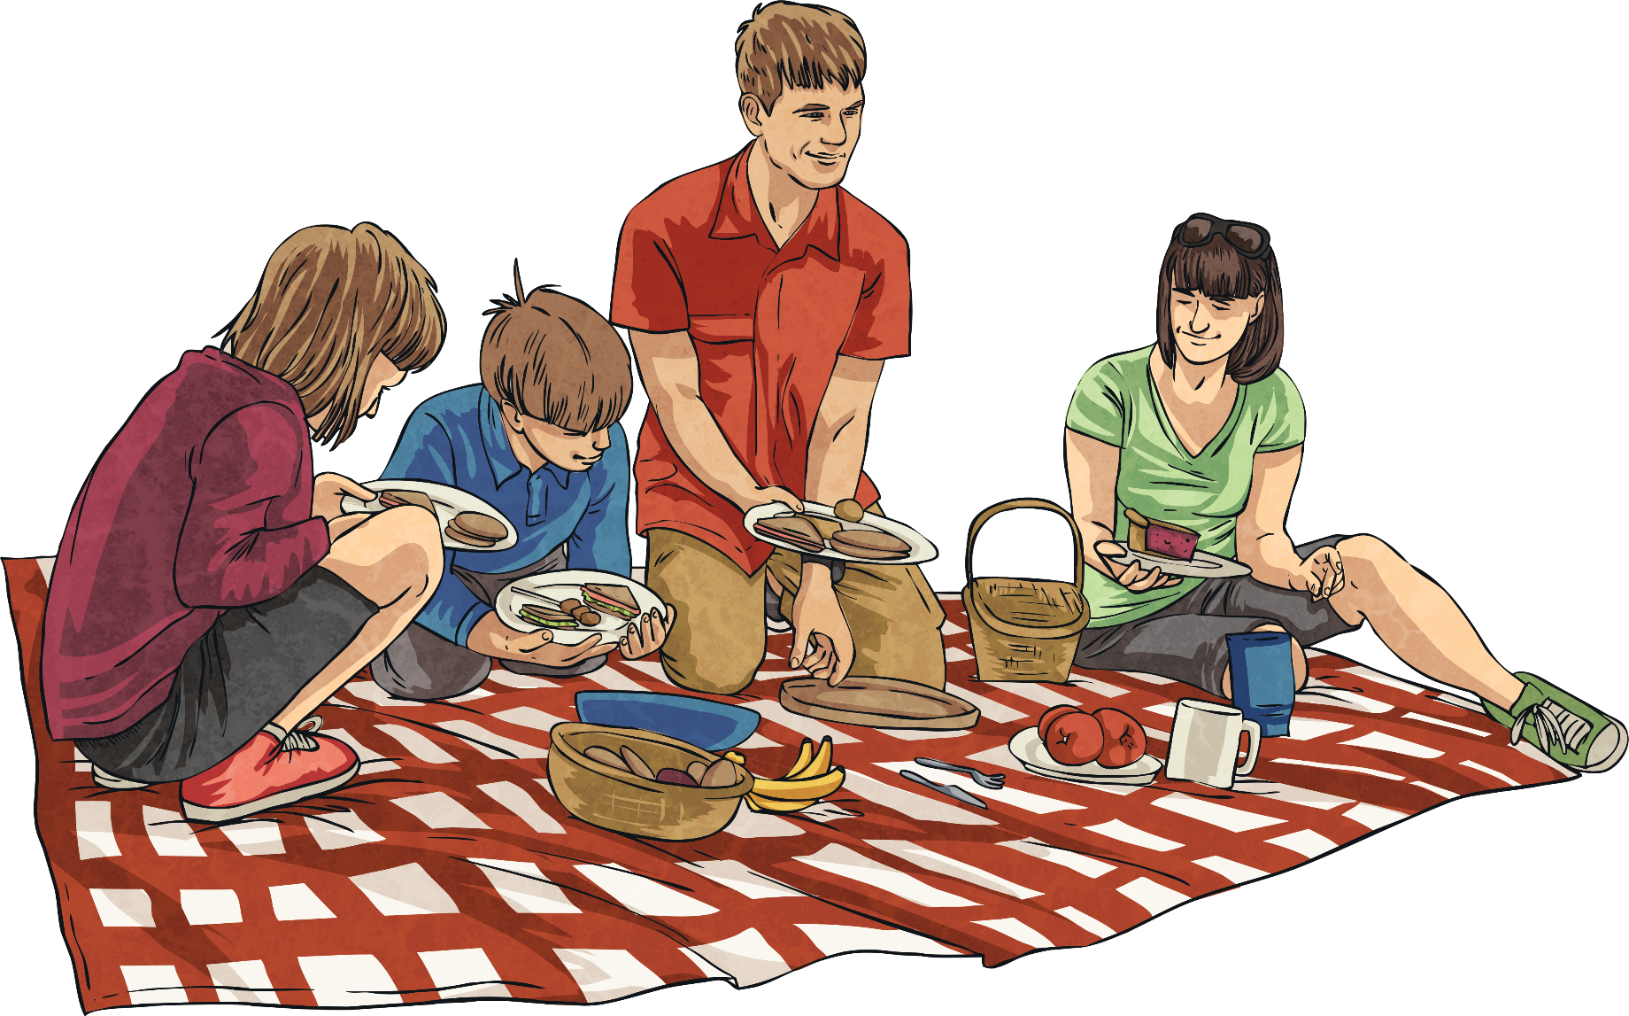
Have a conversation about…
the best things about your family.

Slide 30
Have a conversation about…
something you would like to learn to do.

Slide 31
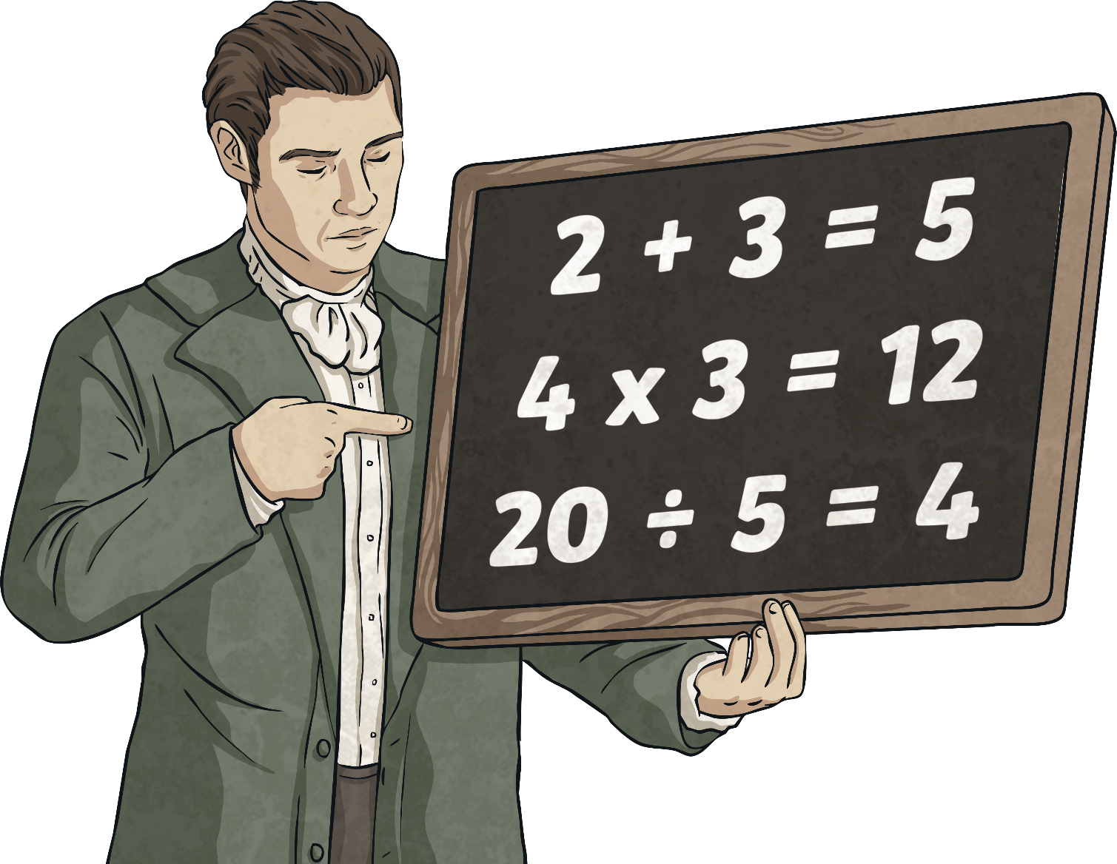
Have a conversation about…
something you have taught someone else to do.

Slide 32
Have a conversation about…
which animal you would like to be.

Slide 33
Have a conversation about…
your earliest memory.

Slide 34
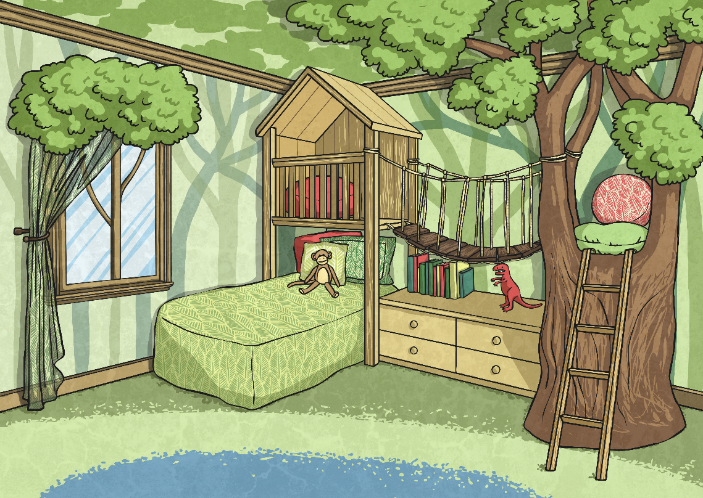
Have a conversation about…
what your bedroom looks like.

Slide 35
Have a conversation about…
the best present you have ever received.

Slide 36
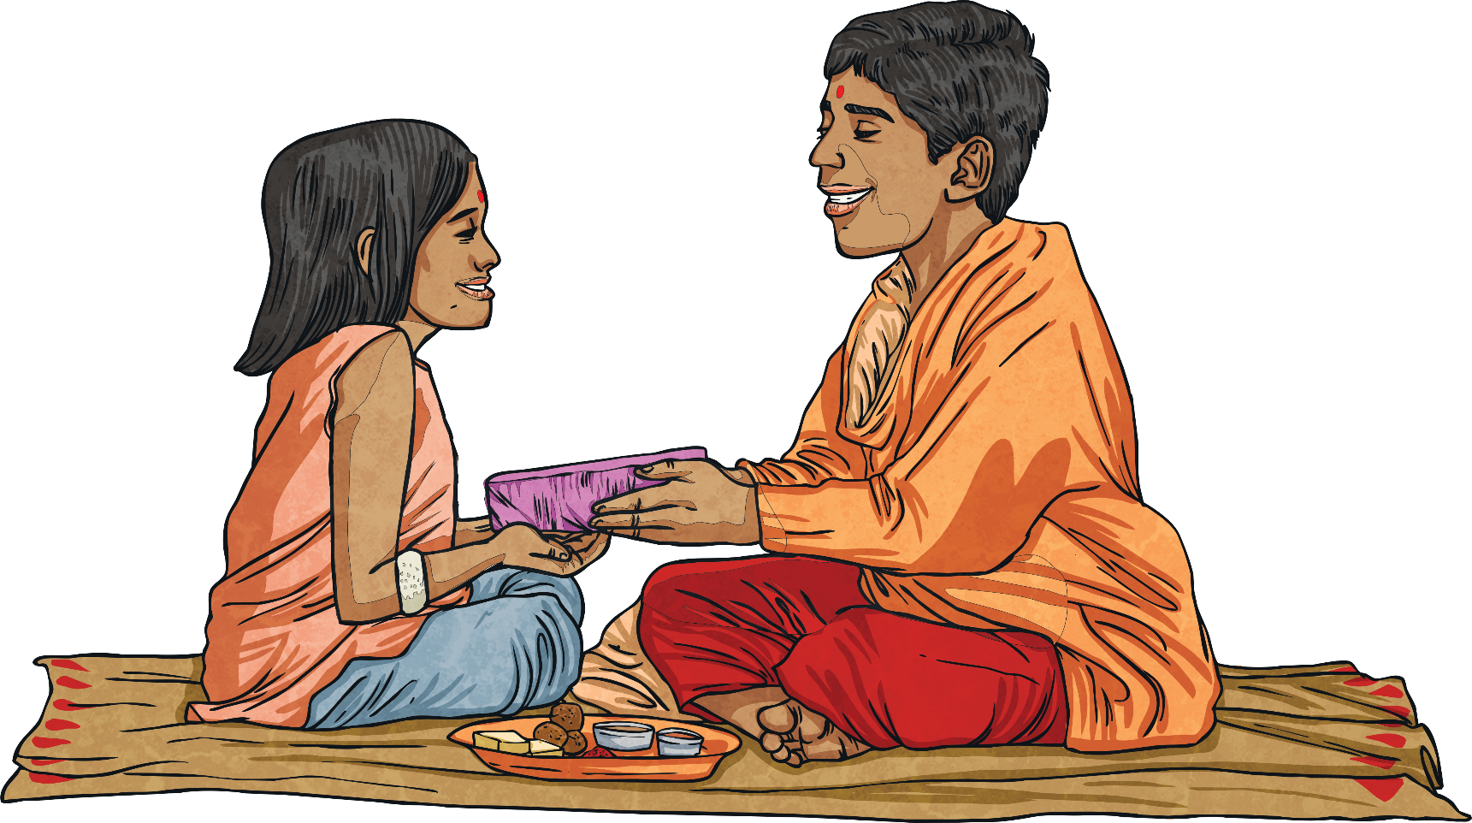
Have a conversation about…
the best present you ever gave to someone.

Slide 37
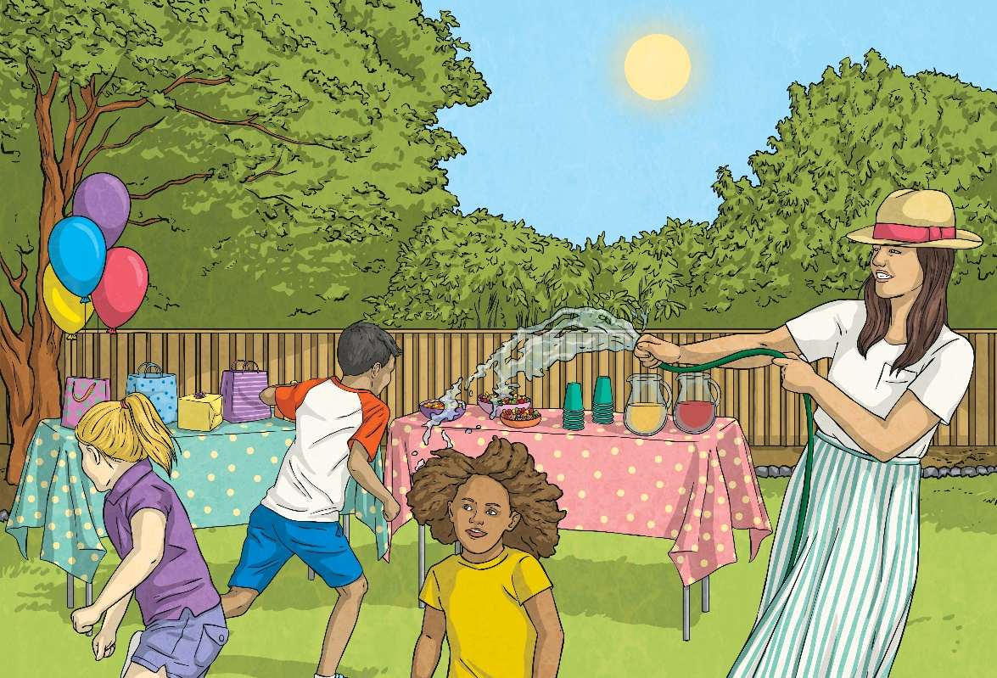
Have a conversation about…
your favourite season.

Slide 38
Have a conversation about…
your siblings, or being an only child.

Slide 39
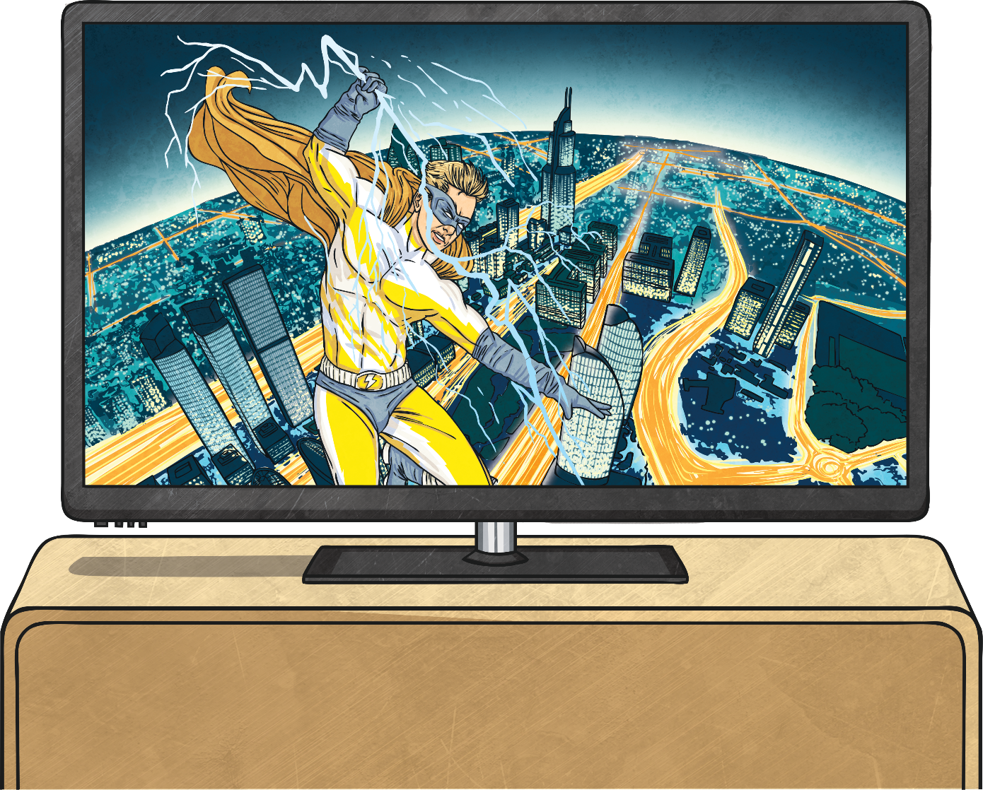
Have a conversation about…
your favourite TV show.

Slide 40
Have a conversation about…
what you do in the summer holidays.

Slide 41
Have a conversation about…
a time you felt sad.

