Slide 2
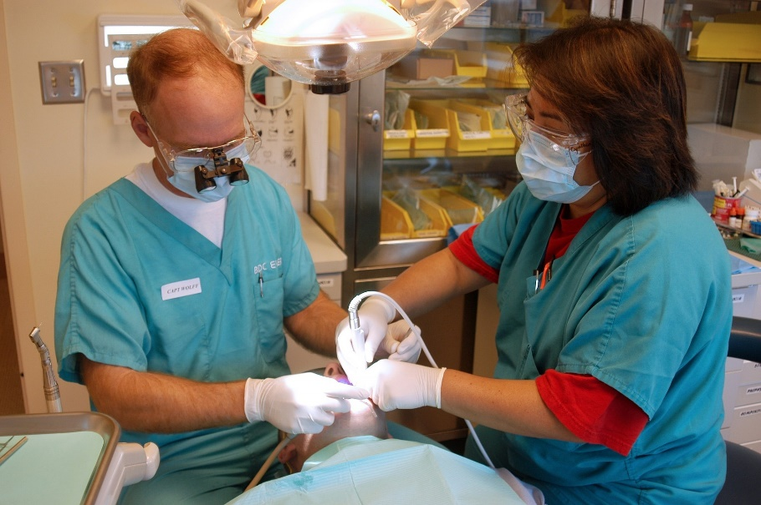
Reading a Picture
Activity 1
Look at this picture, then talk about these questions with a partner.
Why is the man wearing small binoculars clipped to his glasses?
Why are two people needed for this procedure?
Why is a bright light above the patient’s head?
Enlarge Picture
How can you tell that the people want to stay safe from infection?

Slide 3
Back

Slide 4
Example Answers
Activity 1
Why is the man wearing small binoculars clipped to his glasses?
The man is wearing small binoculars clipped to his glasses because he is working on something small inside the patient’s mouth and needs to be able to see it clearly.
Why are two people needed for this procedure?
Two people may be needed for this procedure because there are too many bits of equipment for one person to hold whilst treating the patient at the same time.
Why is a bright light above the patient’s head?
A bright light is above the patient’s head so that the dentists can see everything that they are doing clearly.
How can you tell that the people want to stay safe from infection?
I can tell that the people want to stay safe from infection because they are both wearing gloves, protective glasses and masks over their mouths

Slide 5
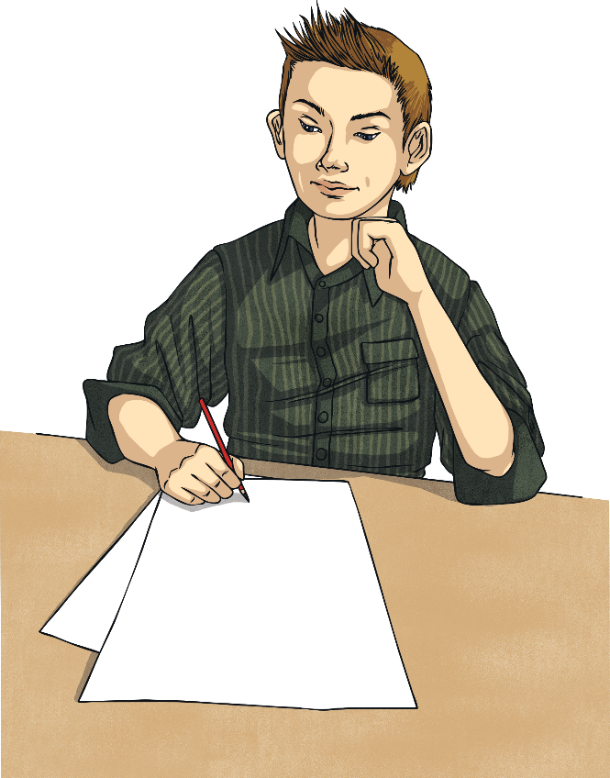
Drawing Inferences
Activity 2
Read these sentences and draw what is being described
The old train stood at the platform as three young brothers prepared for their journey. Each sat atop a brown suitcase with an identification tag around their neck made from paper and string. They all wore their best coats (which were far too big for them) and their smart, brown boots. Their concern and anxious thoughts were clear from their faces as they huddled together to comfort one another.

Slide 6
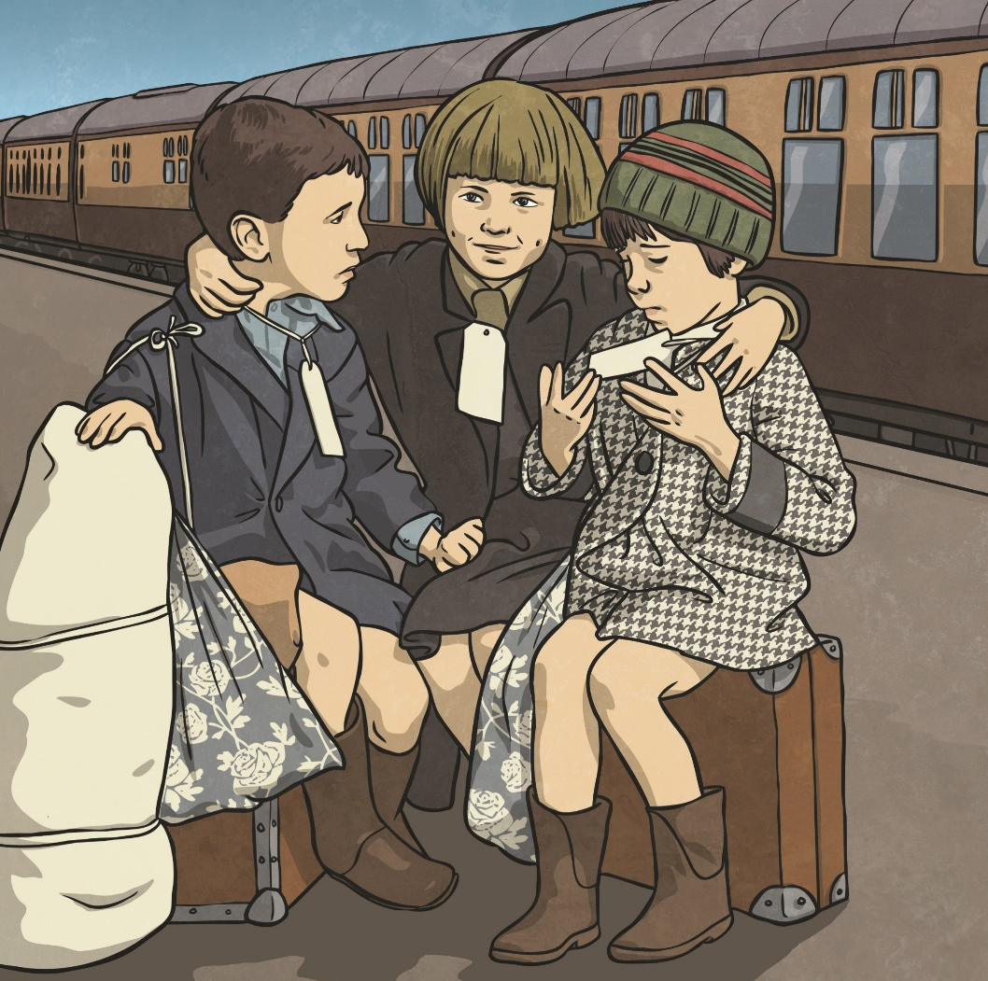
Drawing Inferences
Activity 2
Did you draw something like this?

Slide 7
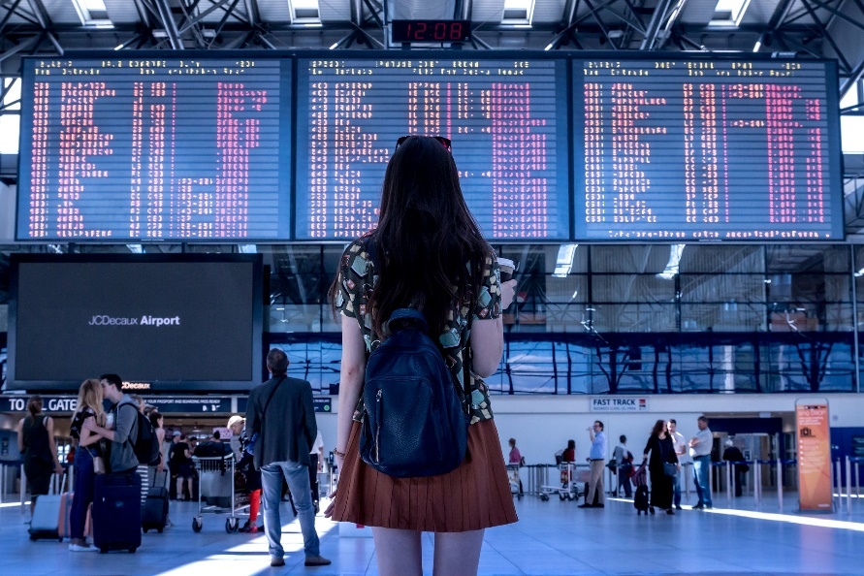
Reading a Picture
Activity 3
Look at this picture, then talk about these questions with a partner.
Where was this photograph taken?
Why do lots of people have suitcases with them?
Is the woman’s drink hot or cold? How do you know?
Enlarge Picture
What is the weather like outside of this building?

Slide 8
Back

Slide 9
Example Answers
Activity 3
Where was this picture taken?
I think that this photograph was taken at an airport. I think this because I saw big screens like that at the airport when I went on holiday.
Why do lots of people have suitcases with them?
Lots of people have suitcases with them because they are going on holiday and need to take clothes and toiletries with them.
Is the woman’s drink hot or cold? How do you know?
The woman’s drink is hot. I know this because only hot drinks are served in that type of cup. Cold drinks are usually in a bottle or plastic cup with a straw.
What is the weather like outside of this building?
The weather outside of this building is sunny and warm. I can tell this because I can see the sunlight on the floor. The woman is wearing sunglasses on her head and a short sleeved T-shirt so the weather must be warm.

Slide 10
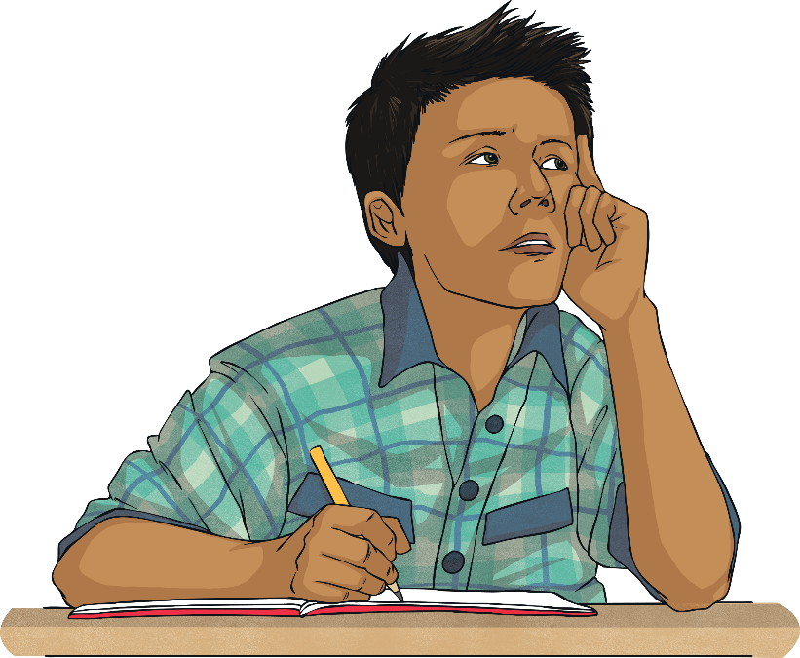
Drawing Inferences
Activity 4
Read these sentences and draw what is being described
The statue – once copper, now turquoise-green with age – stands towering in front of the city skyline at sunset. The statue of a woman wearing robes is revered around the world. In her left hand, she holds a book and in her right hand, she holds a flaming torch above her head. Her head, adorned with a spiky crown, looks out over the ocean as millions of people arrive at the shore each year.

Slide 11
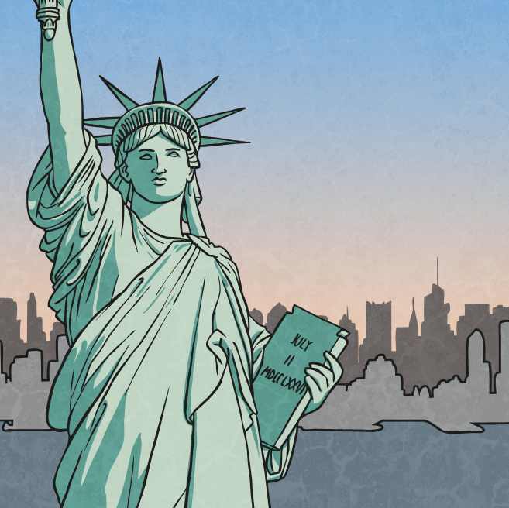
Reading a Picture
Activity 4
Look at this picture, then talk about these questions with a partner.

Slide 12
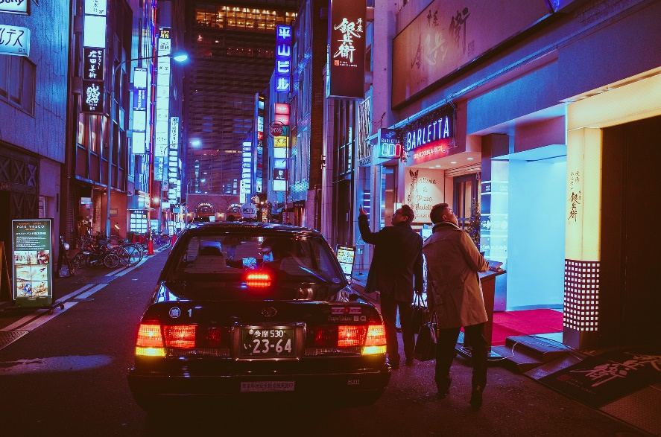
Reading a Picture
Activity 5
Look at this picture, then talk about these questions with a partner.
What time of day was this photograph taken?
Was this photograph taken in the UK? Explain your answer.
Explain how you can tell that this car is a taxi.
Enlarge Picture
Do you think that the men have been to this place before?

Slide 13
Back

Slide 14
Example Answers
Activity 5
What time of day was this photograph taken?
I can tell that this photograph was taken at night because the sky is dark and all of the signs are illuminated.
Was this photograph taken in the UK? Explain your answer.
I do not think that this photograph was taken in the UK because most of the signs are in Japanese and that is not common on UK streets.
Explain how you can tell that this car is a taxi.
I can tell that this car is a taxi because it has a sign on top of the car. I have seen taxis in my town which have these too.
Do you think that the men have been to this place before?
I do not think that the men have been to this place before because they are both looking around and pointing at things. That is not normally something you do if you have seen it before.

