Slide 2
Aim
To identify prepositional phrases and adverbial phrases
To distinguish between adverbial and noun phrases.

Slide 3
Prepositions
A preposition is a word that indicates place or direction.
Examples: across, into, between, above, beyond, towards, behind, over.
Prepositions describe the relationship between the subject of a sentence and another object.
Examples:
The apple was under the table.
The glider flew through the air.
The boy walked towards the school.
Which of the following words are prepositions?
in
to
house
location
travel
walk
inside
tomorrow
visit
mountain
beside
later
journey
upon
off
during

Slide 4
Prepositional Phrases
A prepositional phrase includes the object that the preposition in a sentence is referring to and any other words that link it to the preposition.
For example: He hid beneath the duvet.
A prepositional phrase usually includes a preposition, a noun or pronoun and may include an adjective. It does not include the verb!
Can you pick out the prepositional phrases from these sentences?
The general ordered the troops to retreat to the valley.
Jules was delighted to find a present inside the egg.
Mike didn’t think he could run up the hill.
Where could it be? It wasn’t in the box and it wasn’t round the back.
When the siren sounded they all set off into the ancient woods.

Slide 5
Prepositional Phrases
How many prepositional phrases can you make using these prepositions and objects. Can you make any interesting ones?
down
above
among
before
under
concerning between
inside
towards
along
during
beyond
amid
until
over
between
to
against
beside
crow
cow
chocolate
song
tiger
knife
hamster
carrots
tune
fridge
computer
hill
whale
dawn
trees
cave
mystery
stadium
beach

Slide 6
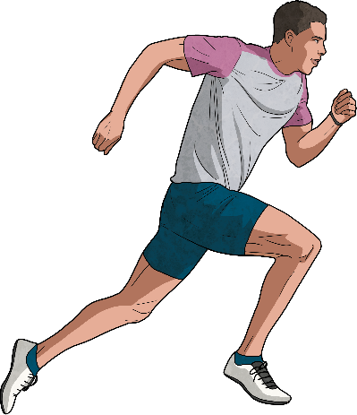
Adverbs
Adverbs are best known as being words which give us more information about verbs
For example:
He ran quickly to the gate.
However, they can also be used to moderate adjectives:
He was extremely brave.
- and other adverbs.
He picked it up incredibly carefully.
Which of the following words are adverbs?
quickly
hunted
wishing
entirely
ancient
everywhere
nervously
wispy
ferociously
tomorrow
safely
deceive

Slide 7
Adverbial Phrases
Adverbial phrases are two or more words that tell us more about a verb or an adjective.
They appear as a part of a sentence.
They tell us: how, where, where, when, how long or why.
They do not make sense alone.
Can you pick out the adverbial phrase from each of these sentences and decide what it tells us?
With a smiling face, he accepted the award. Adverbial phrase tells us HOW.
Milo liked to sleep on his master’s bed. Adverbial Phrase tells us WHERE.
For eight years, she waited for a rescue ship. Adverbial Phrase tells us HOW LONG.
He would not do a bungee jump because of the danger. Adverbial Phrase tells us WHY.

Slide 8
So What Is the Difference Between a Prepositional Phrase and an Adverbial Phrase?
A prepositional phrase is the overall term for any phrase that includes an object and a preposition (but not a verb).
One type of prepositional phrase is an adverbial phrase.
If a prepositional phrase answers any of these questions: ‘Where?’ ‘When?’ ‘Why’ or ‘How’, then it is also an adverbial phrase.
preposition
object
He lost it in the castle.
This is a prepositional phrase because it contains a preposition and an object, with no verb. It is also an adverbial phrase because it tells us where he lost it.

Slide 9
Which of These Prepositional Phrases Are Also Adverbial Phrases and Which Are Also Noun Phrases?
Adverbial
Where? When? In what manner? To what extent?
Noun
How many? Which one? What kind?
One fossil from Africa was 400 million years old. Noun phrase.
The markings on the animal were rare and unusual. Noun phrase.
Several people each year are killed by vending machines. Adverbial phrase.
The car sped towards the wall. Adverbial phrase.
He flicked the coins into the pot. Adverbial phase.

Slide 10
So are all Adverbial Phrases also Prepositional Phrases?
Not quite – look at the Venn diagram below, complete with examples. Can you think of any more examples for each section?
Noun
Phrases
Adverbial
Phrases
The rocks were grimy and very greasy.
Prepositional Phrases
He ran extremely carefully.
The moss on the stones was dangerous and slippery.
He ran across the
stepping stones.

Slide 11
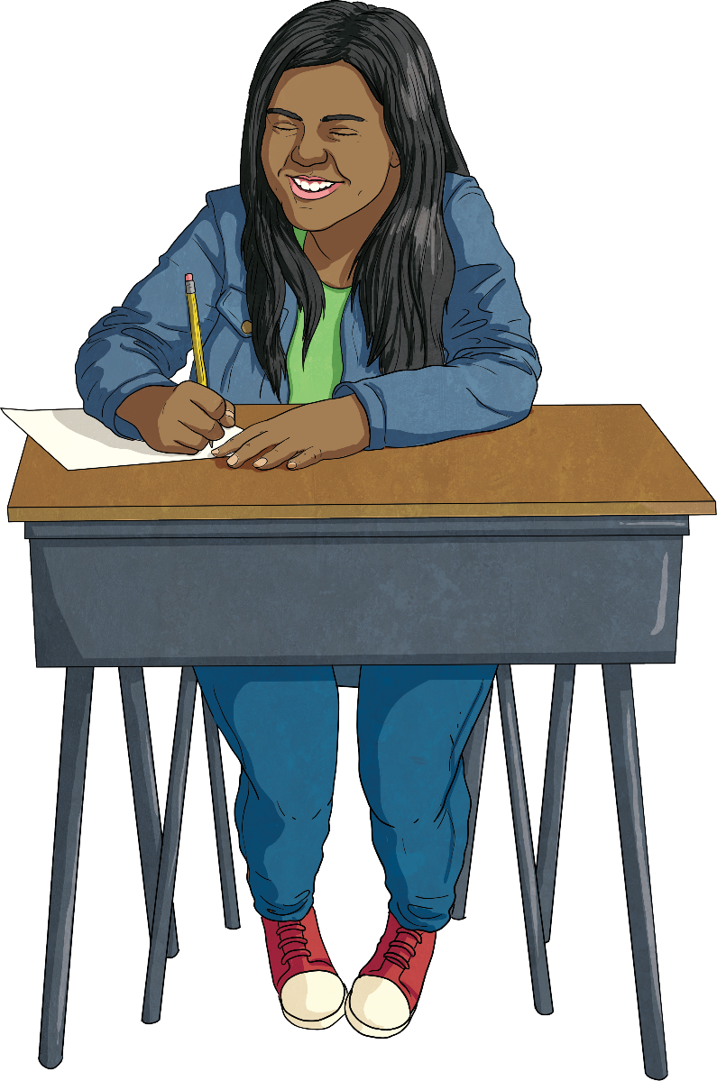
Would you like a challenge?
Plan how to explain this to someone who doesn’t understand it.
Find more examples of each type of phrase in a range of books.
Make a list of as many adverbial phrases as you can think of.

