Slide 2
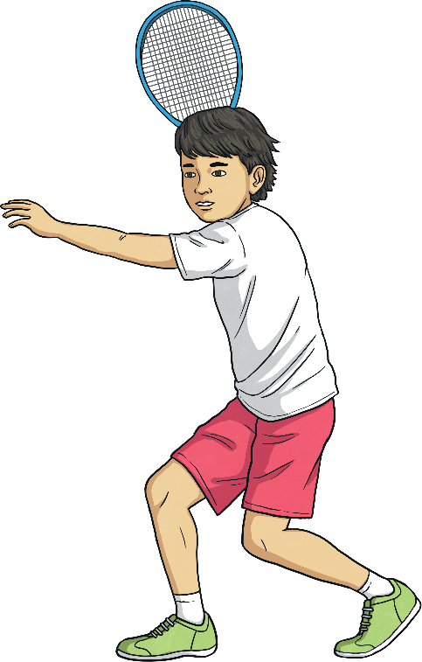
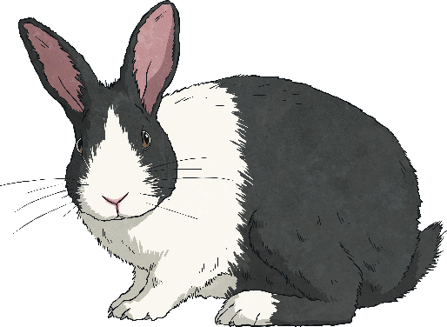
Use I when referring to yourself as the subject of a sentence.
I play tennis.
I like rabbits.
Subject
Subject

Slide 3
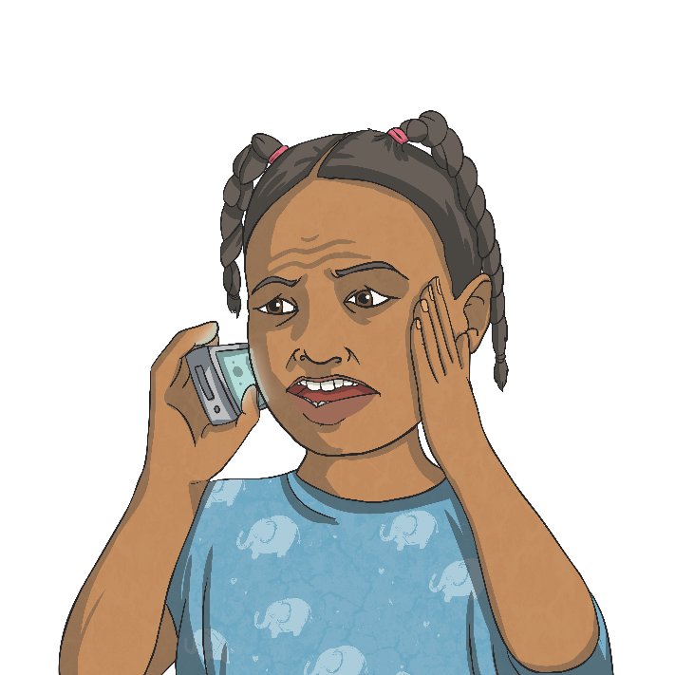
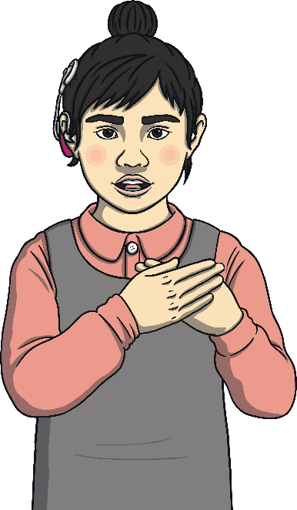
Use me when referring to yourself as the object of a sentence.
Can you hear me?
You love me.
Object
Object

Slide 4
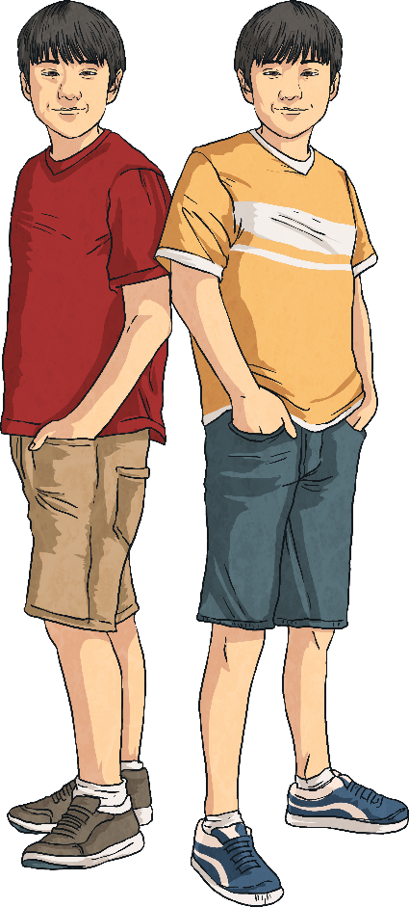
I or me?
Whether to use I or me often causes confusion.
For example:
Billy and I are twins.
Billy and me are twins.
In this example, ‘Billy and I’ forms the subject of the verb ‘to be’. Therefore I should be used rather than me.

Slide 5
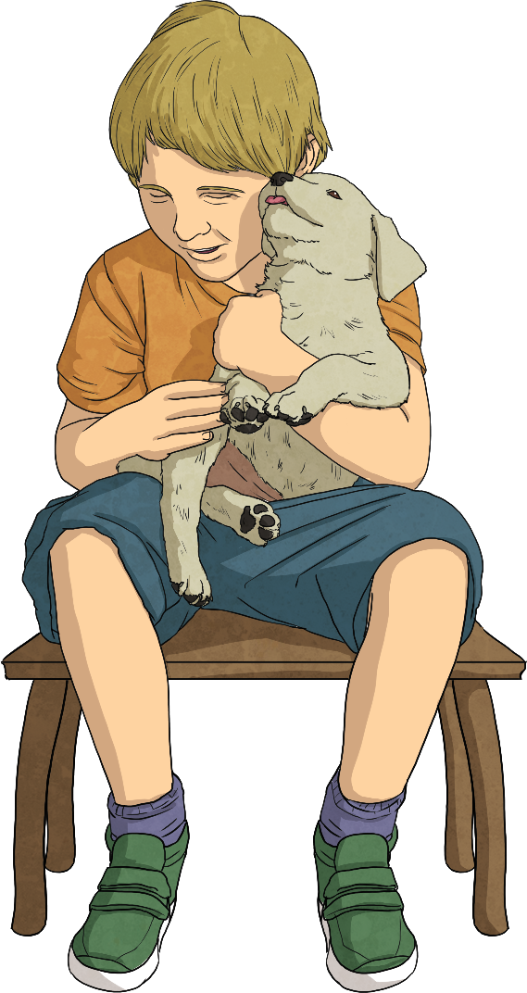
I or me?
In the following example, me forms part of the object of the verb ‘to follow’ and therefore should be used rather than I.
For example:
The dog followed Billy and me.
The dog followed Billy and I.

Slide 6
I or me?
A pronoun used after a preposition must be the object of that preposition, so me should be always used in this context too.
For example:
The dog sat behind Billy and me.
The dog sat behind Billy and I.
Between you and me, I don’t like him much.
Between you and I, I don’t like him very much.

Slide 7
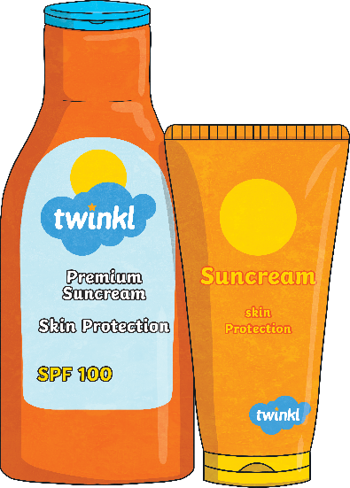
Use myself when you are doing something to you!
For example:
I covered myself in sun lotion.
I asked myself a question.

Slide 8
Myself is a reflexive pronoun.
This means that it is used when the object is the same person as the subject.
I hurt myself.
subject
object and reflexive pronoun
Reflexive pronouns are ‘mirror words’ which reflect a word already expressed (hence the name ‘reflexive’).

Slide 9
Myself can also be used as an emphatic pronoun.
When used in this way, myself restates or emphasizes another pronoun in the sentence.
For example:
I made this myself, or
I myself made this.

Slide 10
These are the only times you can use myself.
Don’t be tempted to use myself because you think it sounds more formal or polite!
For example:
Please contact myself if you have any questions.

Slide 11
Me, Myself and I?
My dad and are hoping to go camping.
me
myself
I

Slide 12
Me, Myself and I?
I cooked this meal for you .
me
myself
I

Slide 13
Me, Myself and I?
My brother wants to come camping with my dad and .
me
myself
I

Slide 14
Me, Myself and I?
If you would like to discuss this further, please contact immediately.
me
myself
I

Slide 15
Me, Myself and I?
I try to look after by eating healthily and exercising.
me
myself
I

