Slide 1
Fake
News
24/02/20
Skip to Quiz

Slide 2
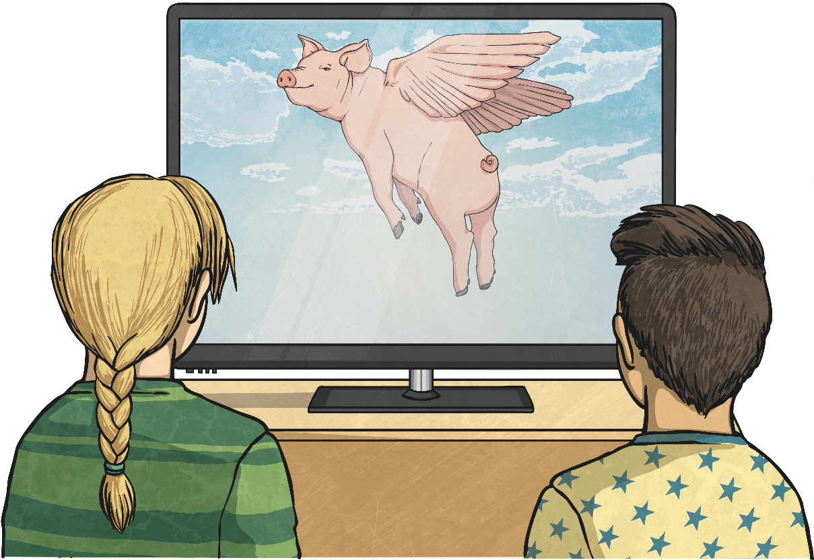
What Is Fake News?
Fake News is exactly what it says – news that is fake, not true or made up.
It works by shocking people into reading it, just like gossip.
Fake news is designed to get people’s attention; they want as many readers as possible. This is so they can:
make money through advertising;
make a person, argument or cause look better;
simply trick people.

Slide 3
How Can We Spot Fake News?
Think about where the news comes from. Is it from a news source you can trust? What could their biases be?
Has the story been covered by other trusted news sources?
Check the ‘facts’ in the story using trusted sources.
Check the date! Old news stories might not be relevant any more.
If it sounds too shocking to be true, it probably is.
Is it a joke? Some websites create fake news, or satire to be funny.

Slide 4
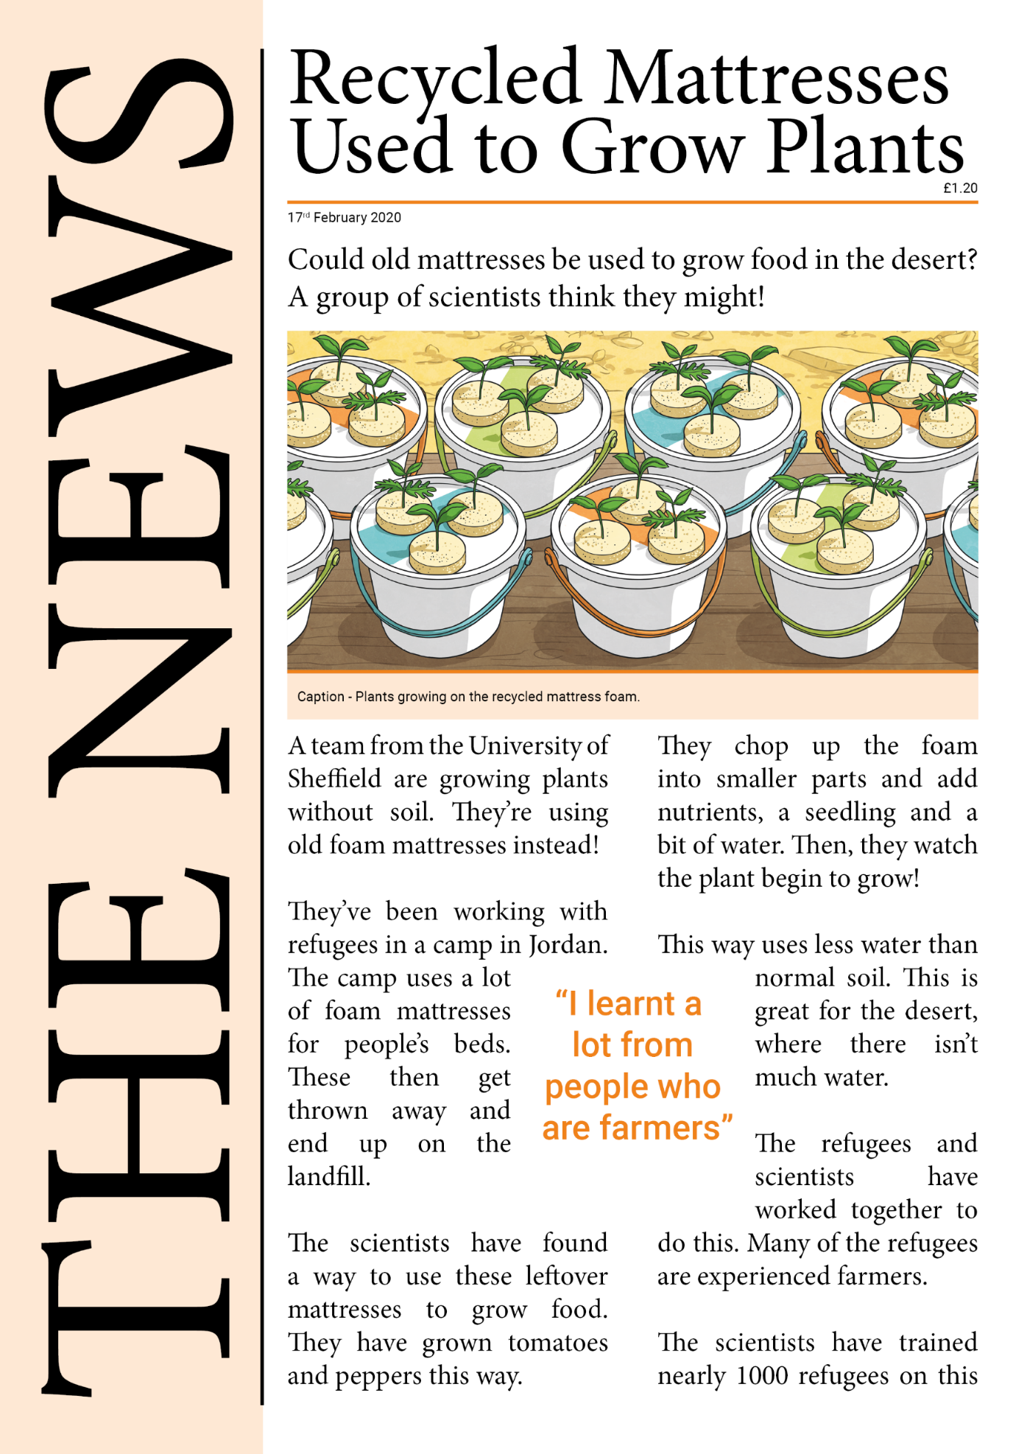
Fake
or
Real

Slide 5
Scientists are excited by this new way of growing food! It could use less water and be perfect for the desert.
Real
Experts
This news story tells you where the scientists are from. This makes it easier to check.
Check the Facts
We could check the facts mentioned here on a search engine.
Find out more about this story here.

Slide 6
Fake
or
Real

Slide 7
Fake
No, the government aren’t using goldfish to spy on ships or people! Not everything shared on social media is true.
Facts
Where could you check the facts?
News Source
Have you heard of this news site before?
Promoted
Some posts come higher not because they’re true, but because a company has paid to promote them.

Slide 8
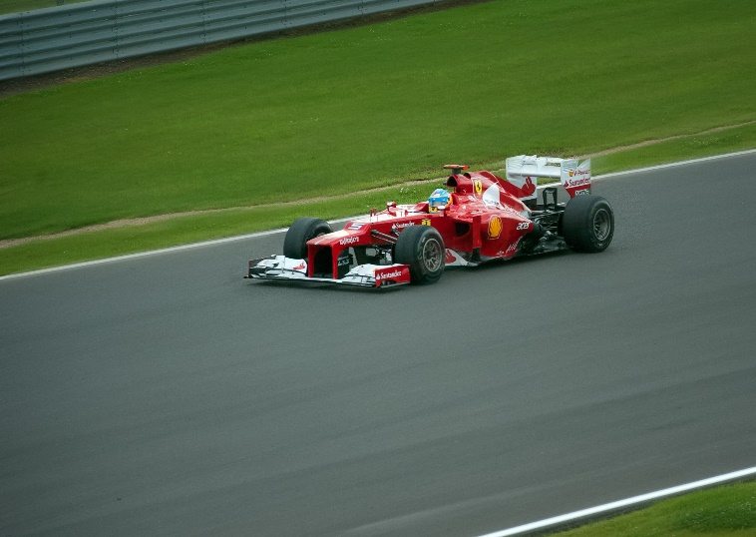
Fake
or
Real
gigglenews.com
Giggle News
News
Sport
Films
Music
F1 Not Really a Sport,
Admits Lewis Hamilton
Top F1 driver Lewis Hamilton has just admitted that F1 isn’t really a sport.
“It’s just cars going fast, isn’t it?” He said.
“It’s not like there’s anything to kick or hit with a bat, like in proper sports.”

Slide 9
No, Lewis Hamilton never said this! This is from a satire website, which features joke stories to make people laugh.
Fake
Satire
Does this sound like a real or joke website?
gigglenews.com
Giggle News
News
Sport
Films
Music
Read the Details
Does it seem realistic?
F1 Not Really a Sport,
Admits Lewis Hamilton
Top F1 driver Lewis Hamilton has just admitted that F1 isn’t really a sport.
“It’s just cars going fast, isn’t it?” He said.
“It’s not like there’s anything to kick or hit with a bat, like in proper sports.”

Slide 10
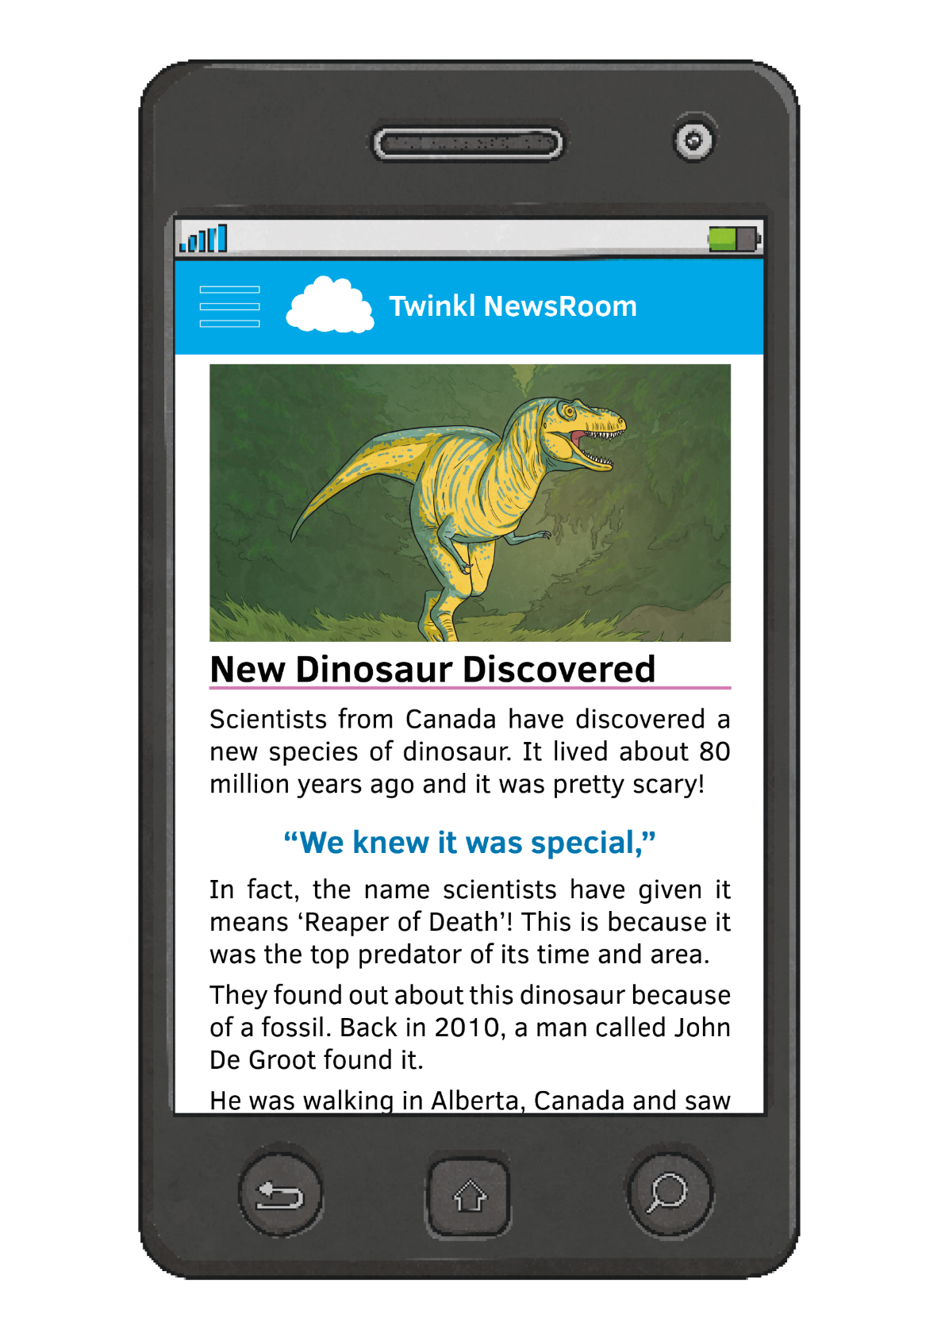
Fake
or
Real

Slide 11
Real
Yes, scientists have discovered a new dinosaur – they’ve named it the ‘Reaper of Death’!
Trusted News Site
Twinkl NewsRoom is a trusted news source.
Check the Details
We can check the details using a search engine.
Find out more about this story here.

Slide 12
Fake
or
Real
THE POST
STAY AWAY FROM FRUIT!
Red fruit can cause serious problems for your health! Doctors say stay away!
“Red fruit just isn’t safe anymore”
Strawberries, berries and other red fruits could make you unwell. Doctors say you should only eat them on Saturdays.

Slide 13
Fake
No, red fruit isn’t harmful to you. In fact, fruit is needed as part of a well-rounded diet! Some news sources use scary headlines to get people to read their content.
THE POST
Experts
Do we know who these doctors are?
STAY AWAY FROM FRUIT!
Red fruit can cause serious problems for your health! Doctors say stay away!
“Red fruit just isn’t safe anymore”
Read the Details
Does it seem realistic?
Quote
Who is saying this? Do we know?
Strawberries, berries and other red fruits could make you unwell. Doctors say you should only eat them on Saturdays.

Slide 14
How Did You Do?
0-2 Oh Dear!
You might need a bit more practice in spotting fake news.
3-4 Journalist.
You’re getting really good at telling the real and fake apart.
5 News Whizz!
You’re a top newshound! You know how to spot fake news from a mile away.

