Slide 2
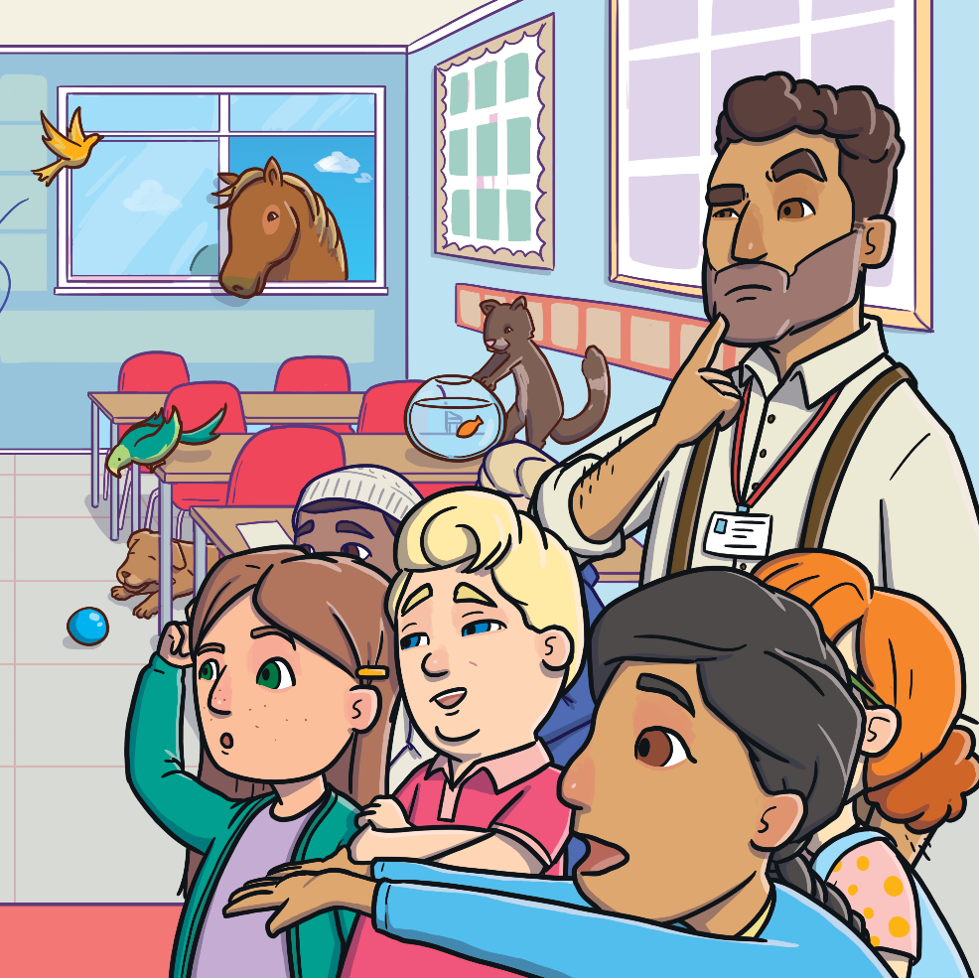
What Am I?
Can you follow the clues to work out which pet is being described?
Click on the paw prints to reveal each clue!
Start

Slide 3
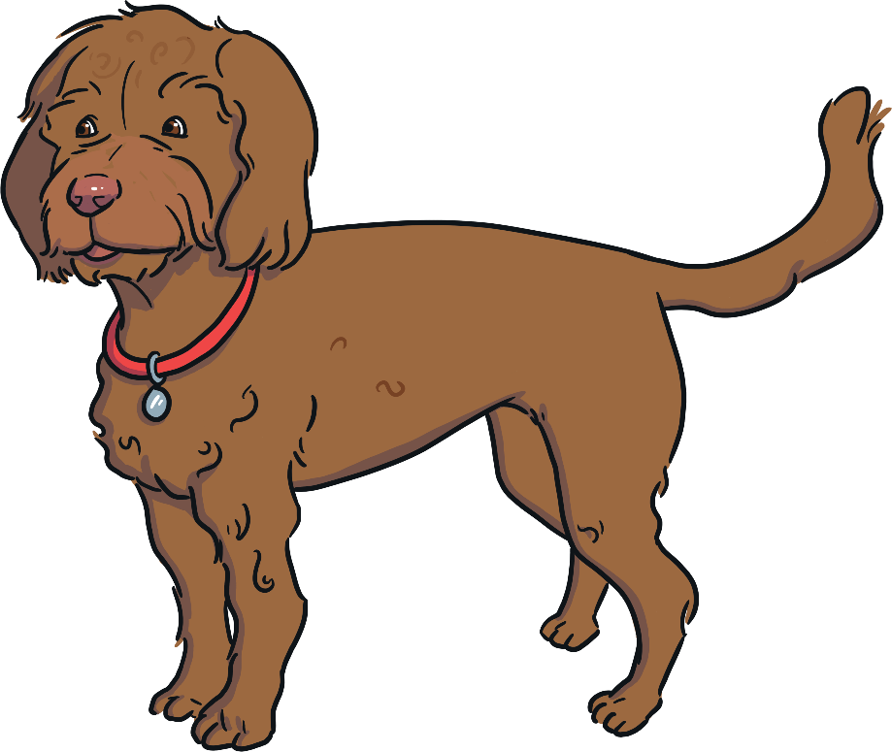
What Am I?
I have four legs.
I am a dog!
I like to go for walks.
I bark.
What am I?
Click to reveal the answer.
Previous
Next

Slide 4
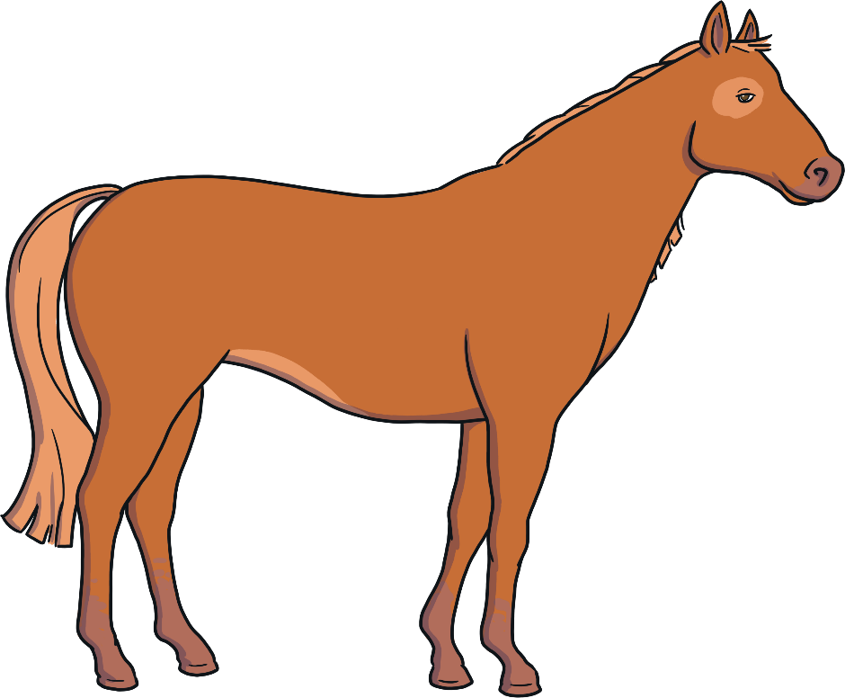
What Am I?
I am a horse!
I have long hair.
I have hooves.
I gallop.
What am I?
Click to reveal the answer.
Previous
Next

Slide 5
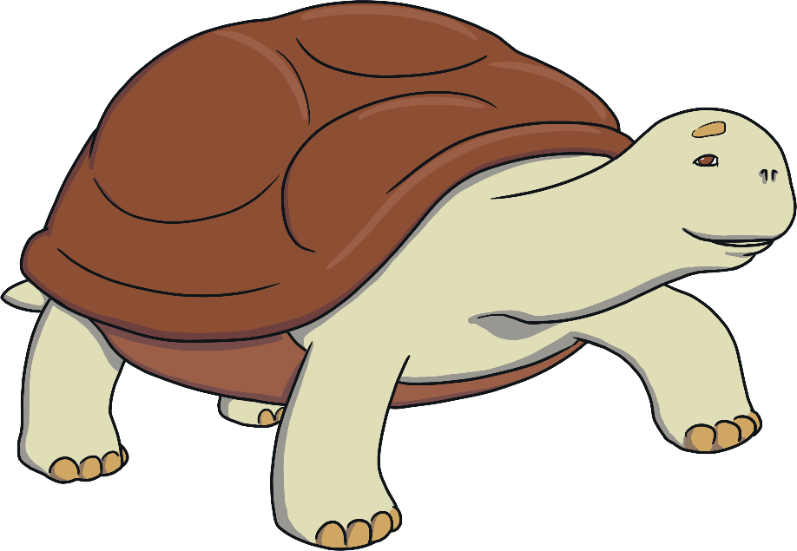
What Am I?
I am a tortoise!
I move very slowly.
I eat fruits and vegetables.
I have a hard shell.
What am I?
Click to reveal the answer.
Previous
Next

Slide 6
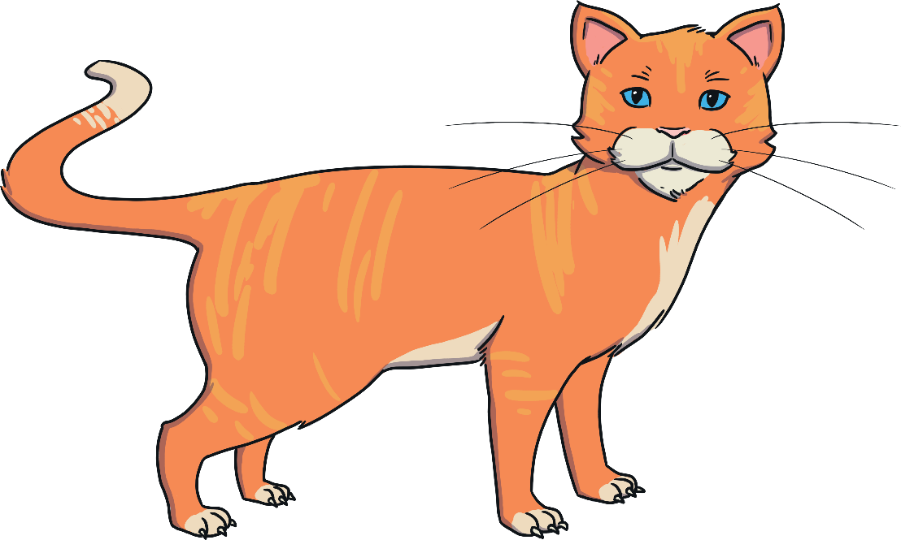
What Am I?
I have whiskers.
I am a cat!
I have sharp claws.
I purr.
What am I?
Click to reveal the answer.
Previous
Next

Slide 7
What Am I?
I have scales.
I am a goldfish!
I have fins.
I live in water.
What am I?
Click to reveal the answer.
Previous
Next

Slide 8
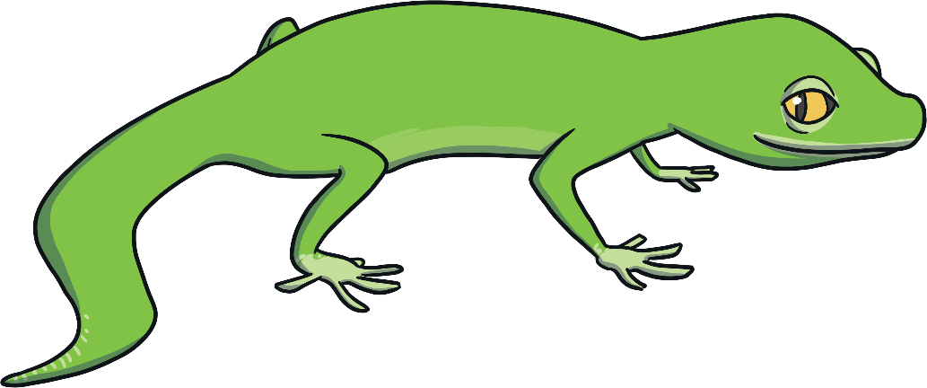
What Am I?
I have a long tail.
I am a lizard!
I am very fast.
I am usually green or brown.
What am I?
Click to reveal the answer.
Previous
Next

Slide 9
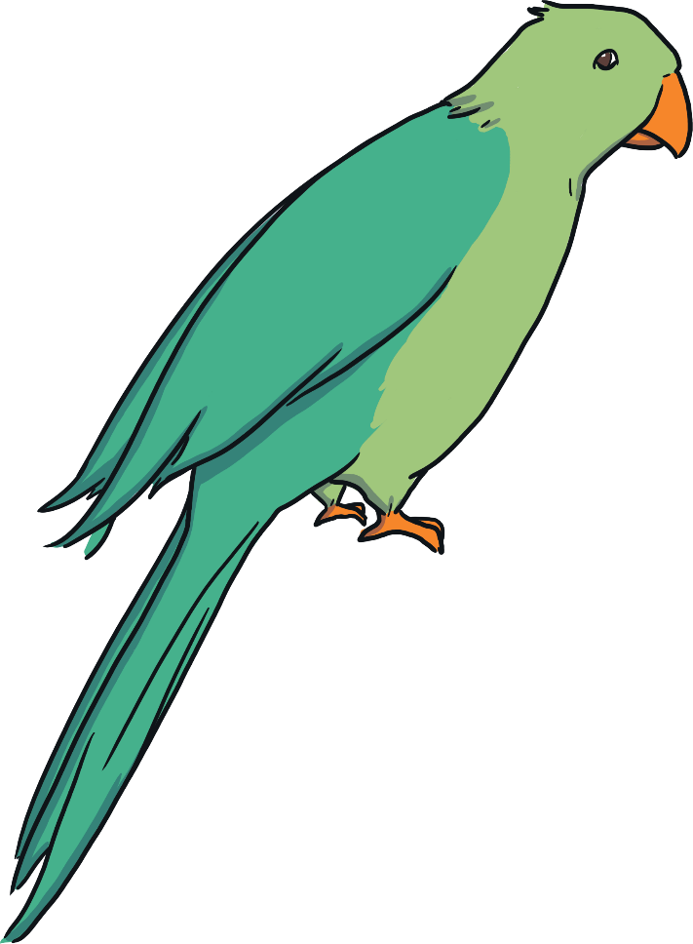
What Am I?
I am a parrot!
I can be very colourful.
I can talk.
I have wings.
What am I?
Click to reveal the answer.
Previous
Next

Slide 10
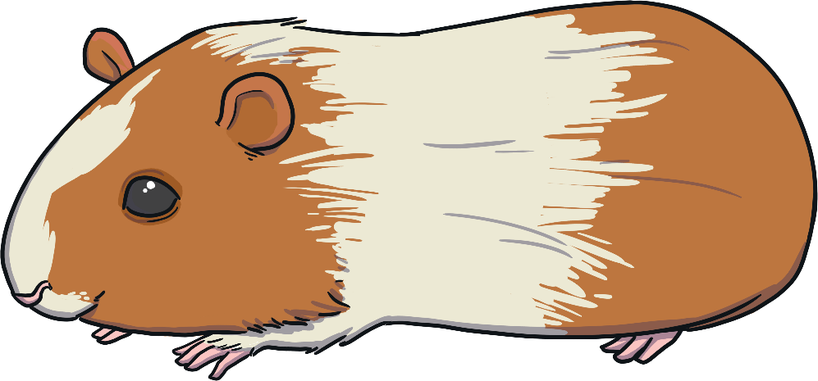
What Am I?
I squeak.
I am a guinea pig!
I eat hay.
I live in a hutch.
What am I?
Click to reveal the answer.
Previous
Next

Slide 11
What Am I?
I have a long tongue.
I am a snake!
I have no legs.
I have scales.
What am I?
Click to reveal the answer.
Previous
Next

Slide 12
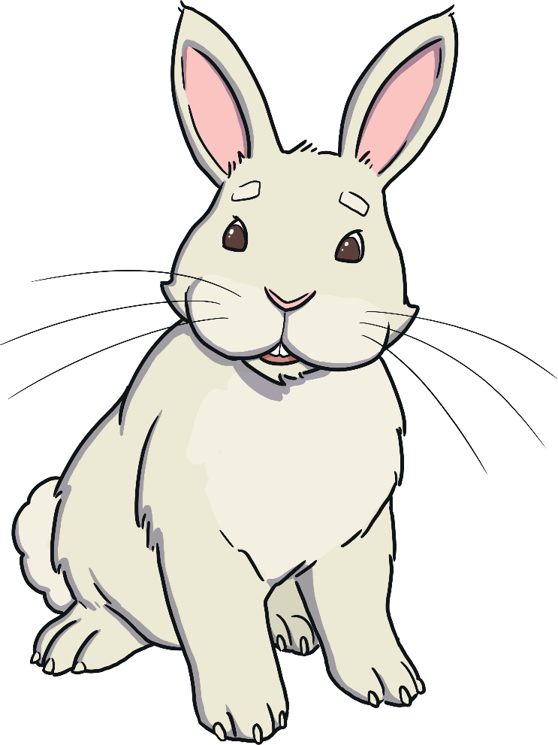
What Am I?
I have big ears.
I am a rabbit!
I eat carrots.
I have a fluffy tail.
What am I?
Click to reveal the answer.
Previous
End

