Slide 2
What are they doing?
Next
They are…
eating
swimming
jumping
running

Slide 3
What are they doing?
Next
They are…
watching TV
swimming
eating
playing football

Slide 4
What are they doing?
Next
They are…
singing
making a sandcastle
running
gardening

Slide 5
What are they doing?
Next
They are…
eating
jumping
making a sandcastle
running

Slide 6
What are they doing?
Next
They are…
eating
making a snowman
jumping
singing

Slide 7
What are they doing?
Next
They are…
gardening
swimming
playing football
making a sandcastle

Slide 8
What are they doing?
Next
They are…
jumping
making a snowman
eating
running

Slide 9
What are they doing?
Next
They are…
swimming
running
eating
making a sandcastle

Slide 10
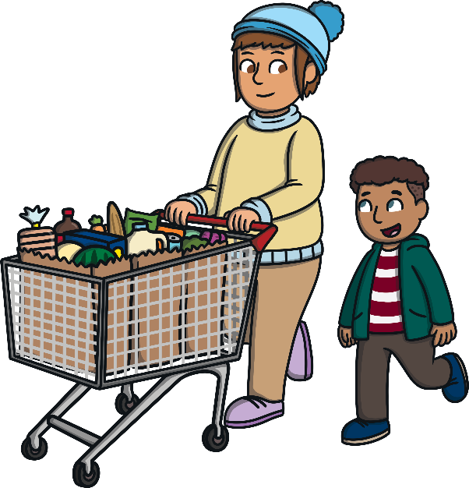
What are they doing?
Next
They are…
jumping
shopping
eating
running

Slide 11
What are they doing?
Next
They are…
swimming
cycling
eating
making a sandcastle

Slide 12
What are they doing?
Next
They are…
eating
making a sandcastle
brushing their teeth
gardening

Slide 13
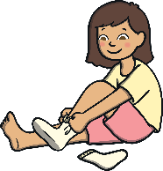
What are they doing?
Next
They are…
jumping
making a snowman
eating
getting dressed

Slide 14
What are they doing?
Next
They are…
swimming
running
eating
painting

