Slide 1
Disclaimer
We hope you find the information on our website and resources useful.
Animations
This resource has been designed with animations to make it as fun and engaging as possible. To view the content in the correct formatting, please view the PowerPoint in ‘slide show mode’. This takes you from desktop to presentation mode. If you view the slides out of ‘slide show mode’, you may find that some of the text and images overlap each other and/or are difficult to read.
To enter slide show mode, go to the slide show menu tab and select either from beginning or from current slide.
You may wish to delete this slide before beginning the presentation.

Slide 3
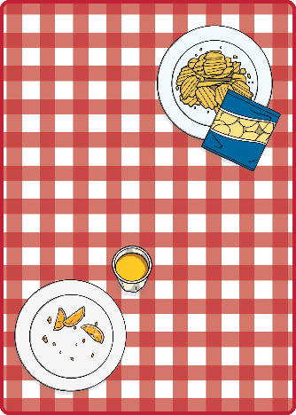
apple
strawberry
strawberry
football
apple
Turn Card
Turn Card
Turn Card
Turn Card
Turn Card
cheese
hat
football
hat
cheese
Turn Card
Turn Card
Turn Card
Turn Card
Turn Card

Slide 4
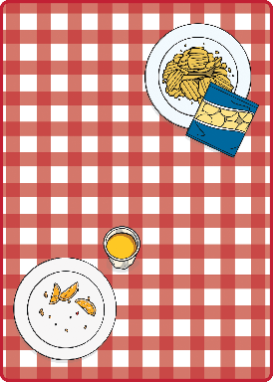
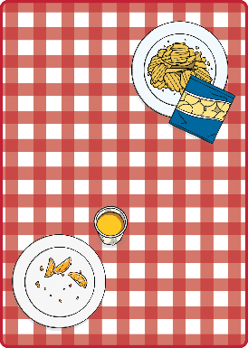
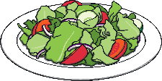
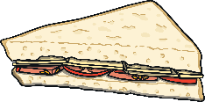
salad
crisps
bananas
sandwich
lemonade
grapes
Turn Card
Turn Card
Turn Card
Turn Card
Turn Card
Turn Card
grapes
crisps
biscuit
cupcake
bananas
cupcake
Turn Card
Turn Card
Turn Card
Turn Card
Turn Card
Turn Card
salad
sunscreen
lemonade
sunscreen
sandwich
biscuit
Turn Card
Turn Card
Turn Card
Turn Card
Turn Card
Turn Card

