Slide 2
Where Is Africa?
Africa is one of the world’s seven continents. Africa is shown in dark green on this map of the world. It is made up of lots of countries.
Africa
Discuss It
Do you know the names of the other continents?
“Title of Image Used” by [Author] is licensed under CC BY 2.0

Slide 3
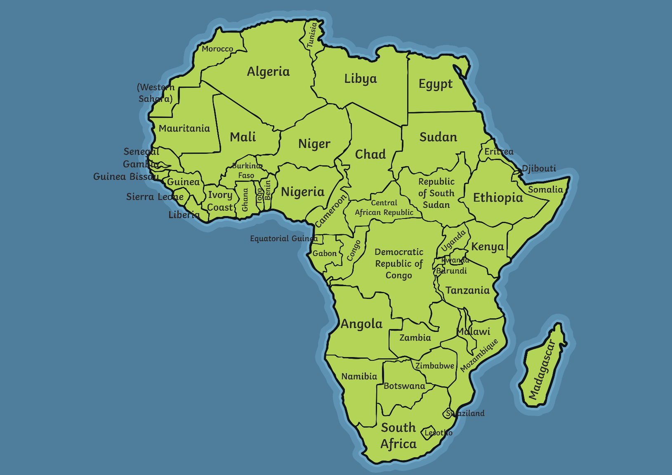
Africa
Have you ever been to an African country?
“Title of Image Used” by [Author] is licensed under CC BY 2.0

Slide 4
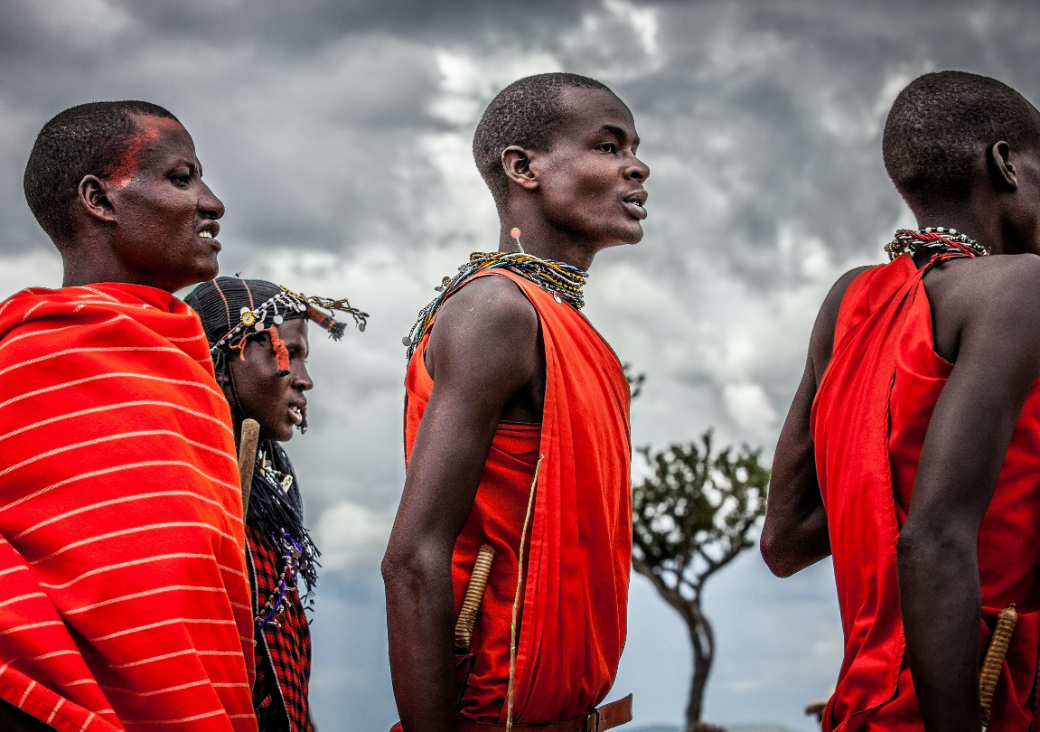
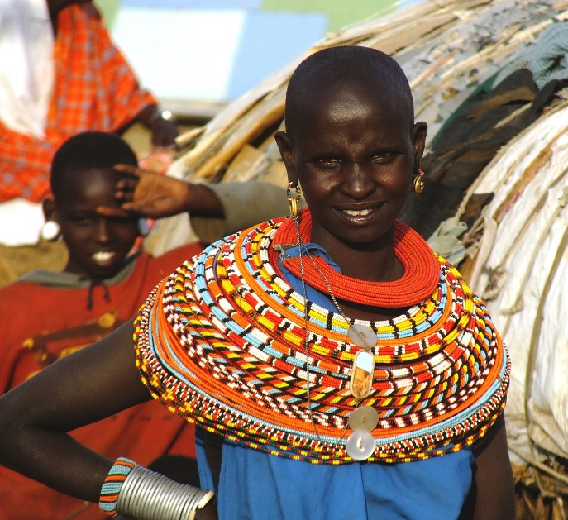
African Tribes
In Africa, there are about 3000 different tribes. A tribe is group of people who share similar ways of life.
Some tribes no longer exist while others have joined together.
A lady from the Samburu tribe in Kenya.
“Title of Image Used” by [Author] is licensed under CC BY 2.0

Slide 5
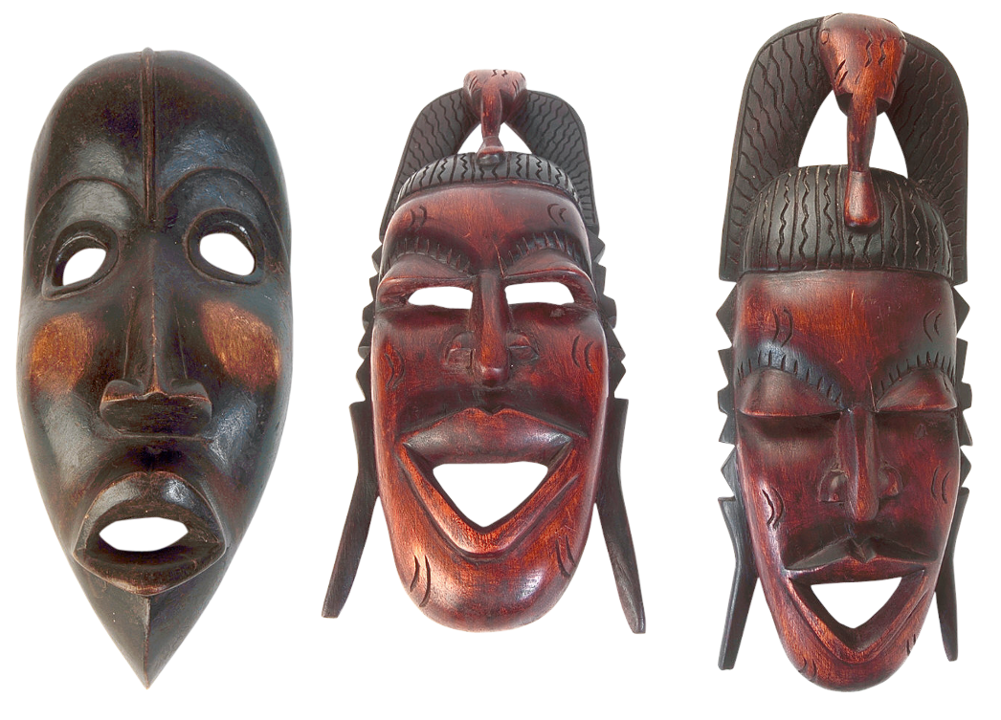
African Masks
A mask is a face or head covering. Masks are an important part of African tribal life. They have been used for thousands of years.
African tribal artists train for many years to learn how to make them. They are trained by master carvers or taught by an older family member. The artists are very well respected. It is the artist’s job to make the masks for use in special tribal ceremonies. Masks can be very detailed so they take a long time to make.
“Title of Image Used” by [Author] is licensed under CC BY 2.0

Slide 6
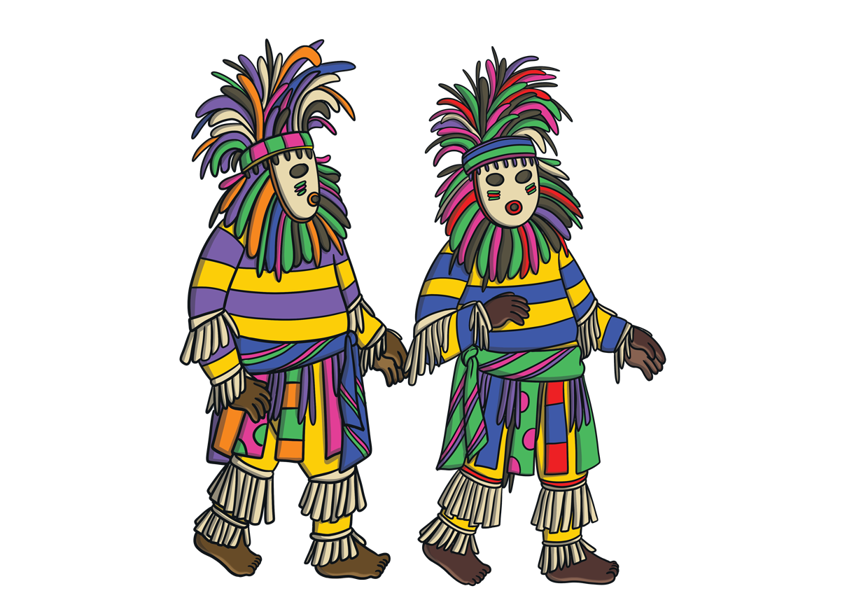
Dance
In many African tribes, dancers wear masks. The dancers perform in special ceremonies that include songs and prayers.
Some ceremonies are to celebrate children’s coming of age. This means when children become adults.
Other special ceremonies include harvest and funerals.
“Title of Image Used” by [Author] is licensed under CC BY 2.0

Slide 7
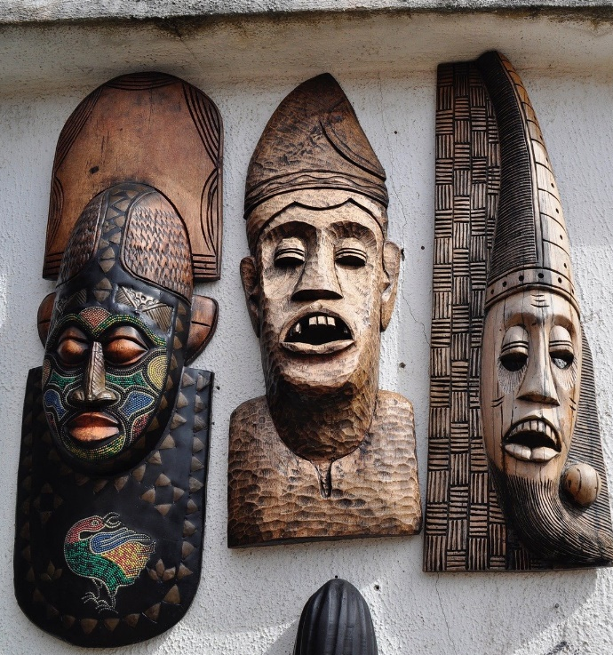
Mask Styles
African masks come in many different styles, shapes and designs.
Different tribes have different styles of mask. Some masks may look fierce or funny and some may be for important people within the tribe.
Masks can cover the entire head, like a helmet, or can cover the face. They can be oval, circular, rectangular or heart-shaped and some can be very long.
Some masks have both human and animal features to link together people and nature.
“Title of Image Used” by [Author] is licensed under CC BY 2.0

Slide 8
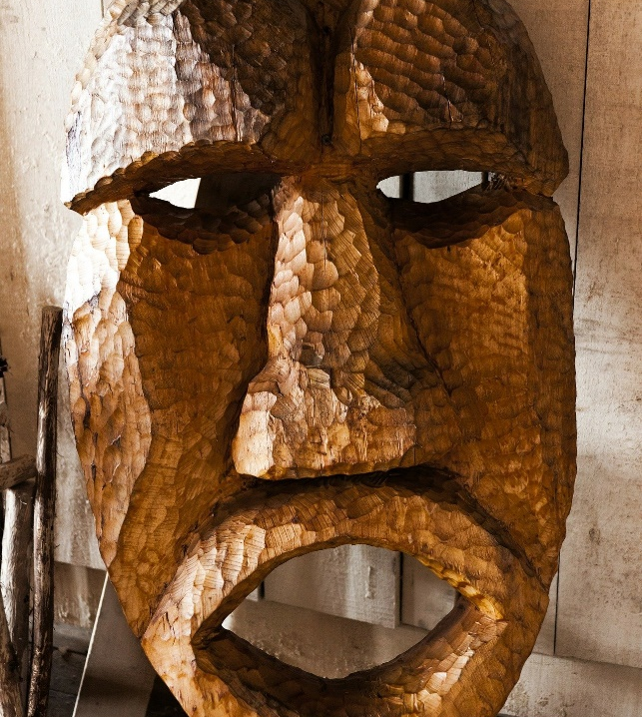
Mask Patterns
African masks have bold painted or carved patterns.
African masks are usually geometrical and symmetrical. Sometimes, the patterns are different on male and female masks. The patterns on masks can show how important someone is.
geometrical — A collection of repeating shapes.
symmetrical — The same on both sides.
“Title of Image Used” by [Author] is licensed under CC BY 2.0

Slide 9
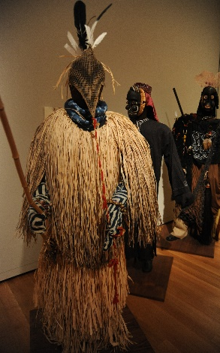
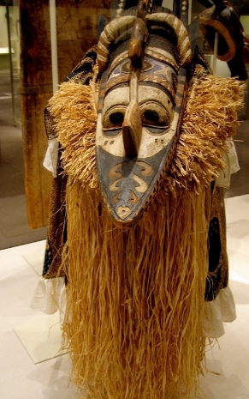
Mask Materials
The masks are most commonly made from wood but can also be made from leather, fabric and metal. They can be decorated with details, such as shells, horns or beads. Some even have hairstyles.
The wooden masks are coloured with natural dyes and pigments made from plants, vegetables, seeds or soil. They can be polished to look like smooth, healthy skin.
“African traditional full body suits, masks, gloves, hats, implements, grass, fethers, woven, fabrics, leather, Seattle Art Museum, Seattle, Washington, USA” by [Wonderlane] is licensed under CC BY 2.0
The tools used to carve are believed to be very sacred. They are passed down through generations.
sacred — Something very special, sometimes relating to a god.
“africa - mask” by [Xuan Che] is licensed under CC BY 2.0
“Title of Image Used” by [Author] is licensed under CC BY 2.0

Slide 10
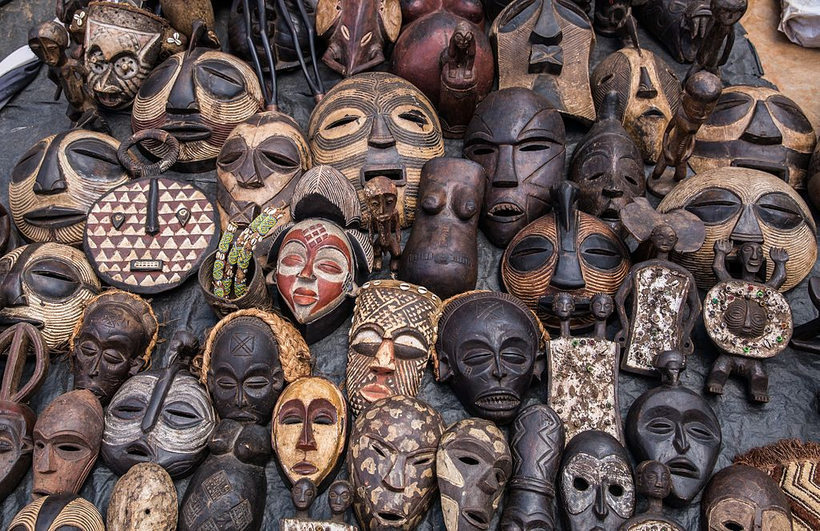
Masks
“African masks in Nairobi 01.jpg” by [Ninaras] is licensed under CC BY 4.0
Discuss It
Which mask do you like the best? Why?
“Title of Image Used” by [Author] is licensed under CC BY 2.0

Slide 11
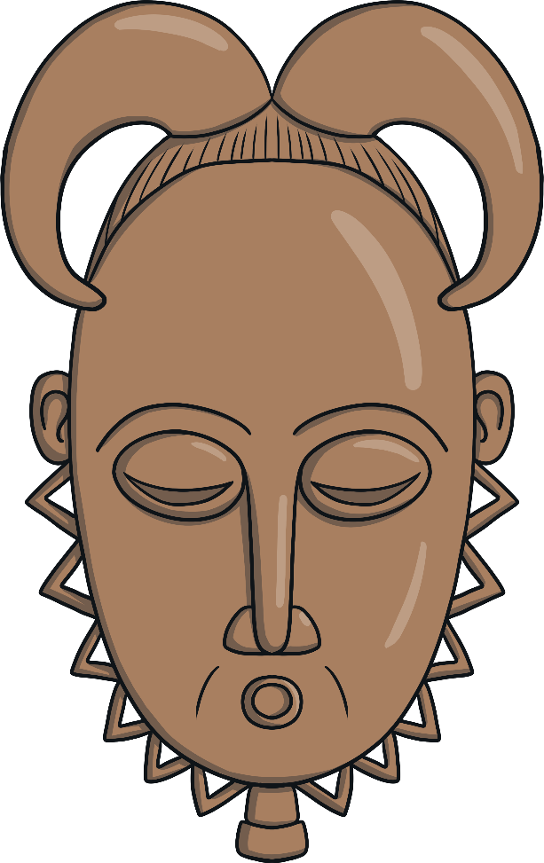
Yohure Mask
The Yohure tribe are known for their beautiful masks that have both human and animal features. They can also have hairstyles and horns.
The masks are long with arched eyebrows.
They have a triangular zigzag pattern.
These masks are used in dance rituals to help villagers deal with the death of one of their people.
“Title of Image Used” by [Author] is licensed under CC BY 2.0

Slide 12
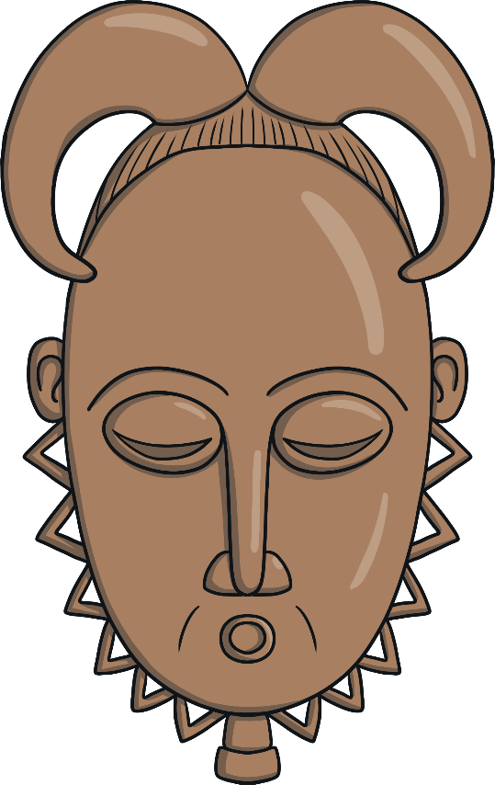
Yohure Mask
The Yohure people live in the Ivory Coast.
“Title of Image Used” by [Author] is licensed under CC BY 2.0

Slide 13
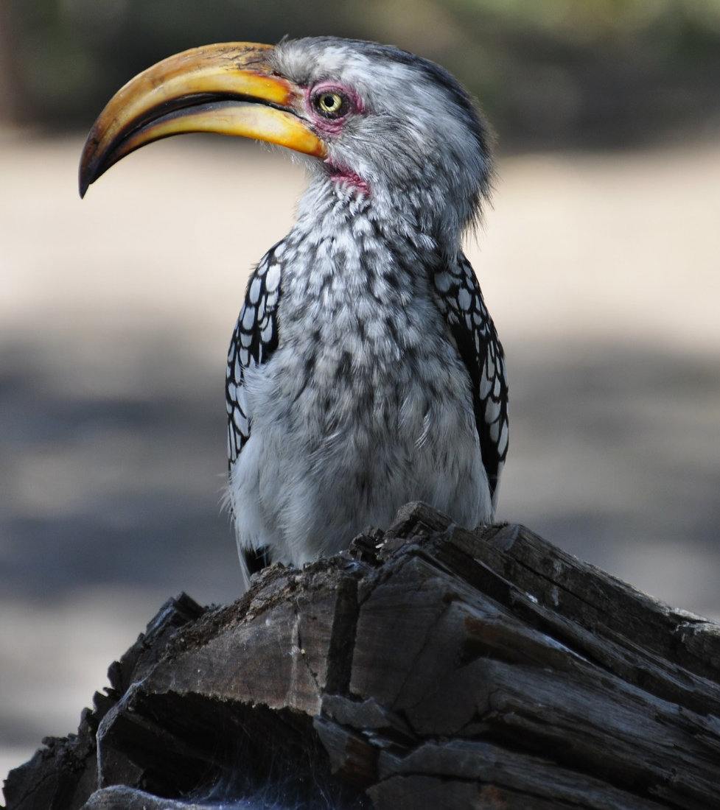
Bwa Mask
The Bwa (bwar) people believe that the owl and hornbill have magical powers. Their masks have a circular face at one end and a crescent moon at the other. The eyes are made to look that those of an owl and the hook nose is similar to that of a hornbill. The person who wears the mask looks through the hole in the mouth.
Hornbill
“Title of Image Used” by [Author] is licensed under CC BY 2.0

Slide 14
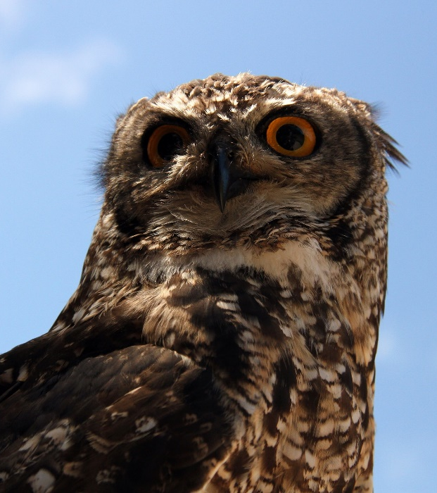
Bwa Mask
Owl
The Bwa people come from Mali and Burkina Faso.
“Title of Image Used” by [Author] is licensed under CC BY 2.0

Slide 15
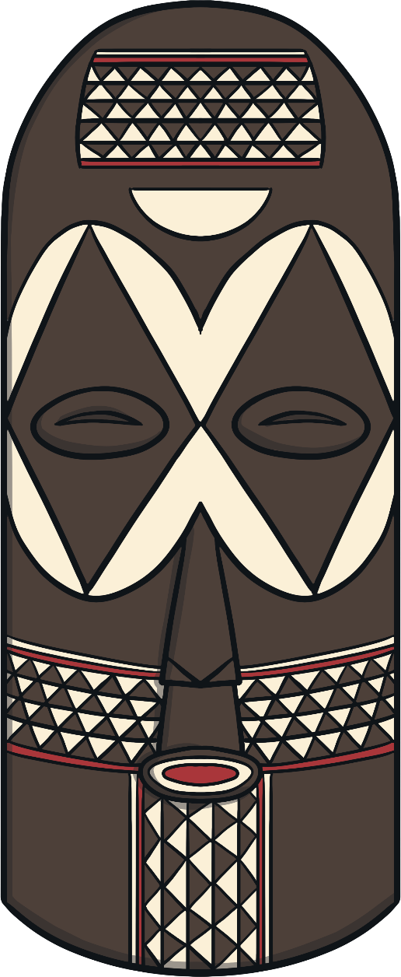
Goma Mask
Goma masks are long with domed heads. They are decorated with geometric patterns.
The masks can be used during celebration dances but only by carefully chosen members of the tribe
“Title of Image Used” by [Author] is licensed under CC BY 2.0

Slide 16
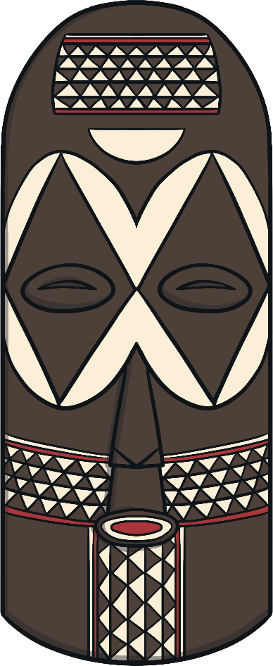
Goma Mask
The Goma people come from the eastern part of the Democratic Republic of the Congo.
“Title of Image Used” by [Author] is licensed under CC BY 2.0

Slide 17
Dan Mask
The Dan people wear this type of mask. The masks have a high forehead, pouting mouth and pointy chin. They are guarded when they are not being used.
There are different Dan masks for certain rituals or festivals. Some are simply used for
entertainment.
“Title of Image Used” by [Author] is licensed under CC BY 2.0

Slide 18
Dan Mask
The Dan people’s territory goes from the west of the Ivory Coast and into Liberia.
“Title of Image Used” by [Author] is licensed under CC BY 2.0

Slide 19
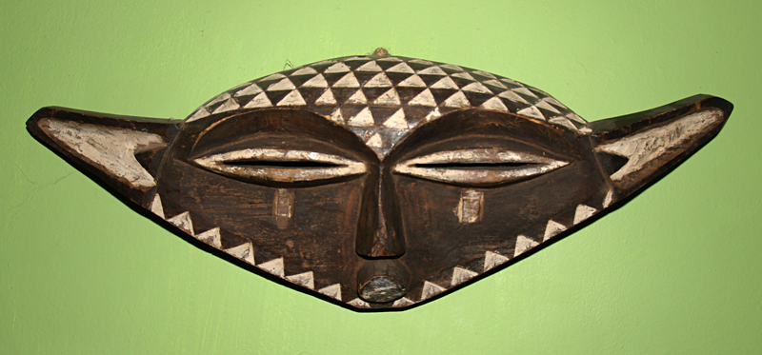
Pende Mask
This Pende mask has a mixture of human and buffalo features. They have a pattern made up of triangles.
It would be hung above the door or window of a chief’s home.
“PendeMask2” by [Ji-Elle ] is licensed under CC BY 2.0
“Title of Image Used” by [Author] is licensed under CC BY 2.0

Slide 20
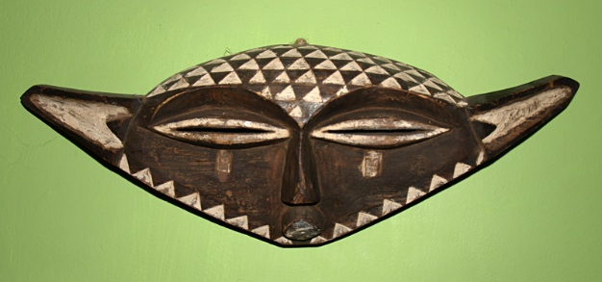
Pende Mask
“PendeMask2” by [Ji-Elle ] is licensed under CC BY 2.0
The Pende people live in the south-west of the Democratic Republic of the Congo.
“Title of Image Used” by [Author] is licensed under CC BY 2.0

Slide 21
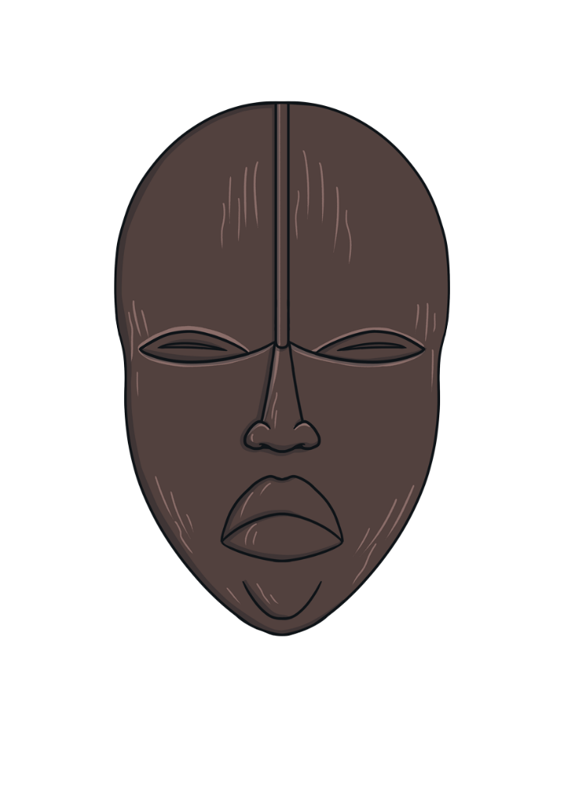
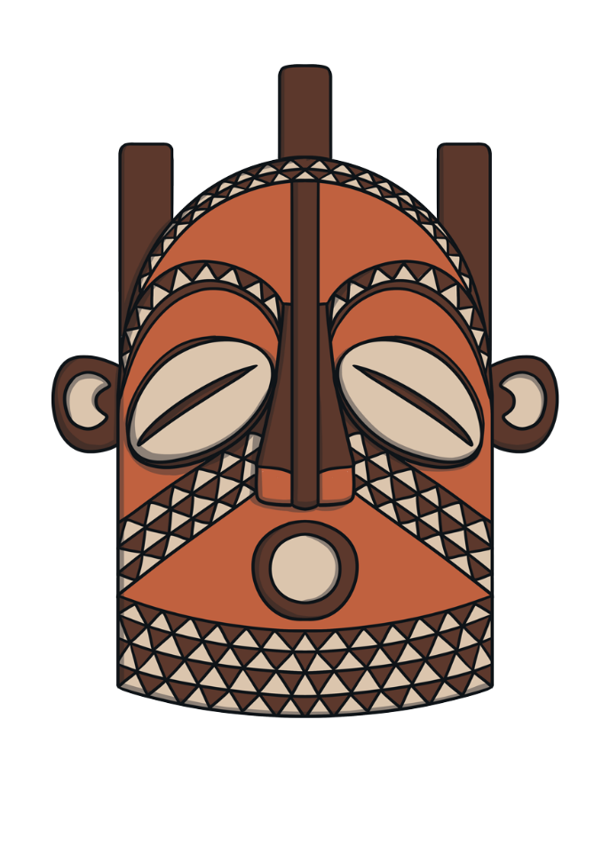
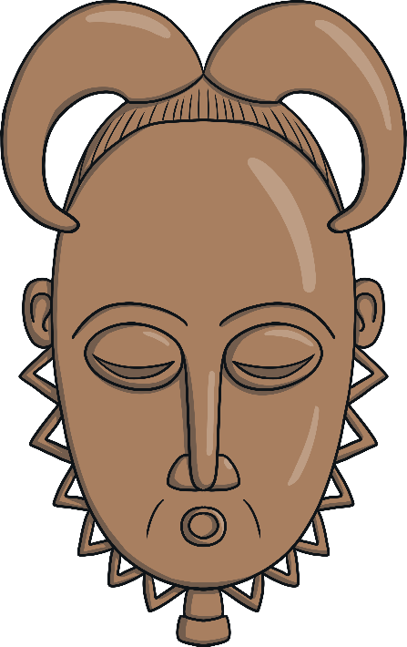
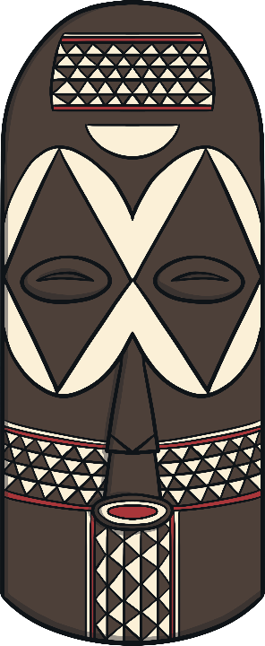
Original Masks
You might spot African masks in museums or art galleries all over the world.
People make copies of the masks to sell as souvenirs. The original masks are owned by the tribe and passed from generation to generation.
“Title of Image Used” by [Author] is licensed under CC BY 2.0

