Slide 2
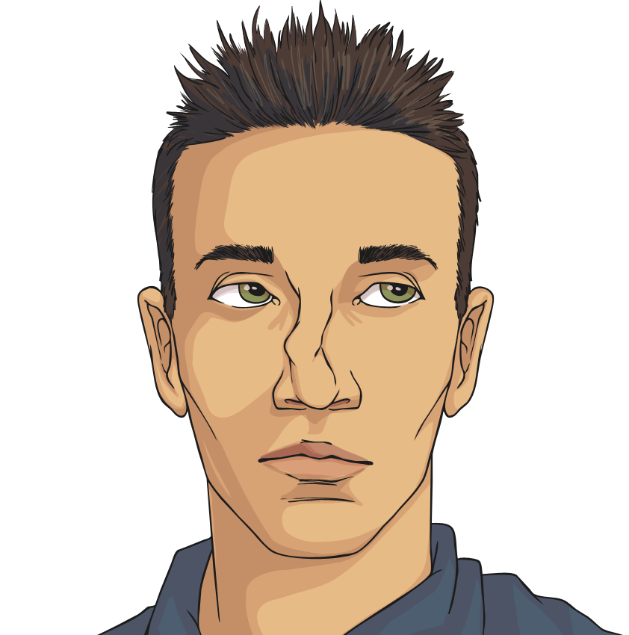
Communities and the Wider World
Sometimes, there are disagreements and conflicts within our local community and in the wider world. Misinformation and misunderstanding can also cause problems between groups of people - which can cause concern for adults and can worry us too.

Slide 3
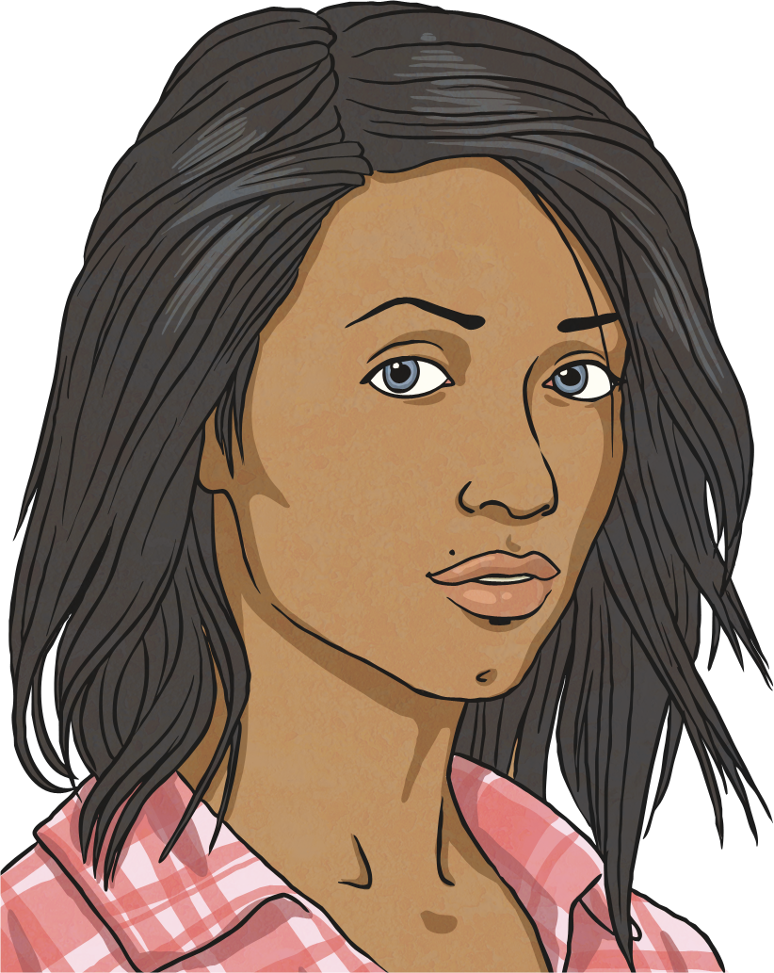
Differences in Society
Within society, people don’t always get along. Sometimes, people forget that it is other people’s differences that make them unique and special.
Click on the words in bold to find out more.

Slide 4
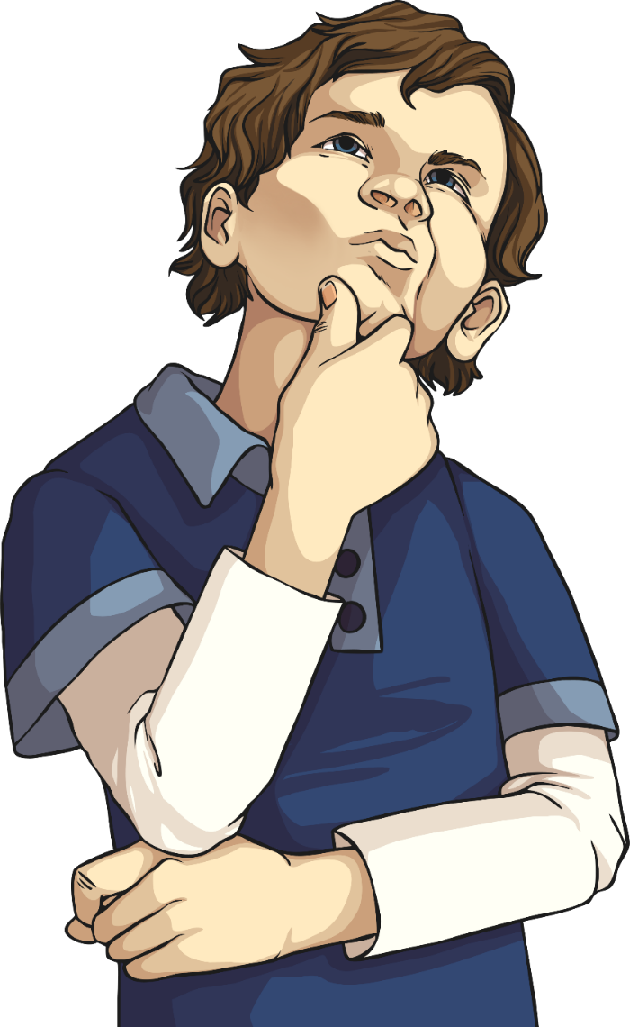
We Are All Unique
Think about your best friend.
How are you similar to them?
How are you different?

Slide 5
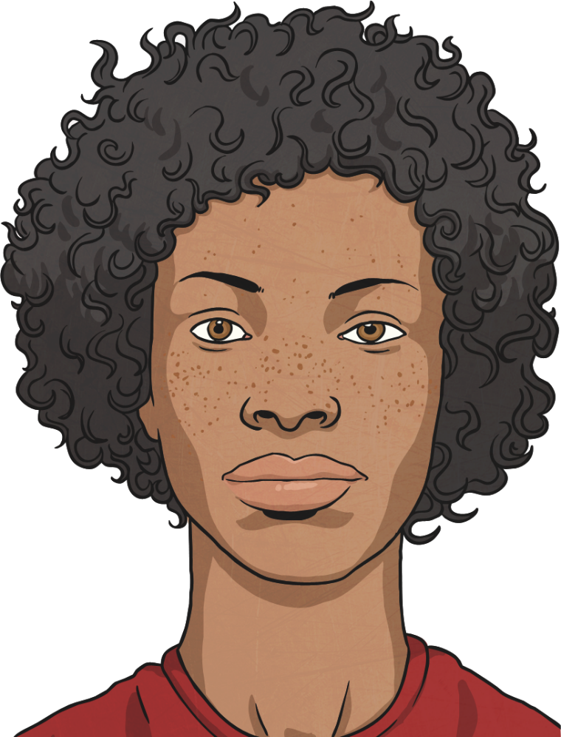
What Are Our Human Rights?
After the Second World War, the Universal Declaration of Human Rights was agreed by almost every country in the world. It is a list of rights and freedoms for all people. There are 30 rights in total.
Number 1: We all have the right to our own thoughts and ideas and we should all be treated fairly.
Number 30: Nobody can take these rights and freedoms away from us. They belong to everybody.

Slide 6
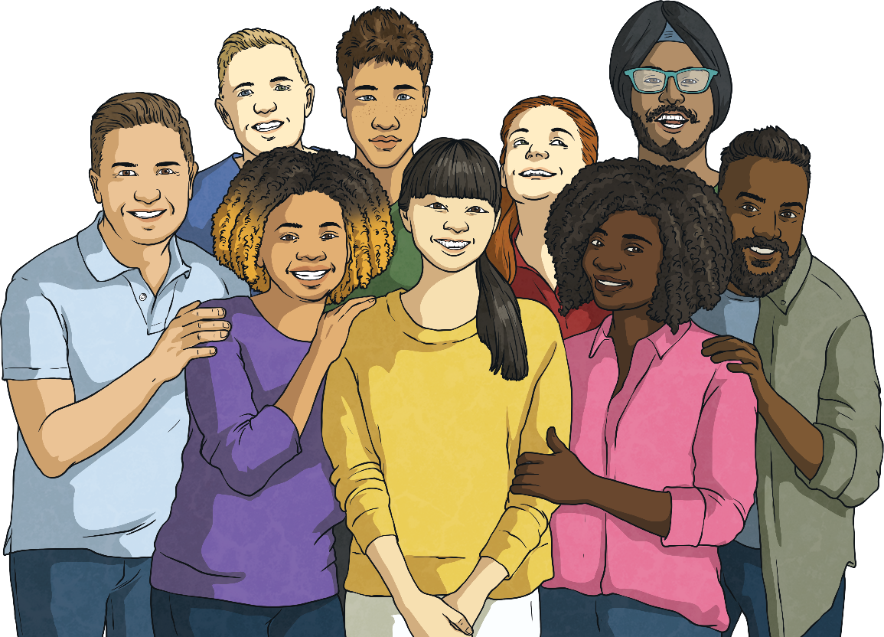
Identity and Race
What makes you who you are? Is it your interests and hobbies? Your talents? How about your beliefs or appearance?
Everyone has an identity that is dependent on many factors. Race is one of those factors.
A race is a grouping of people who share some of the same physical features (such as skin colour and hair texture) and non-physical features (such as culture, history, religious beliefs and language).

Slide 7
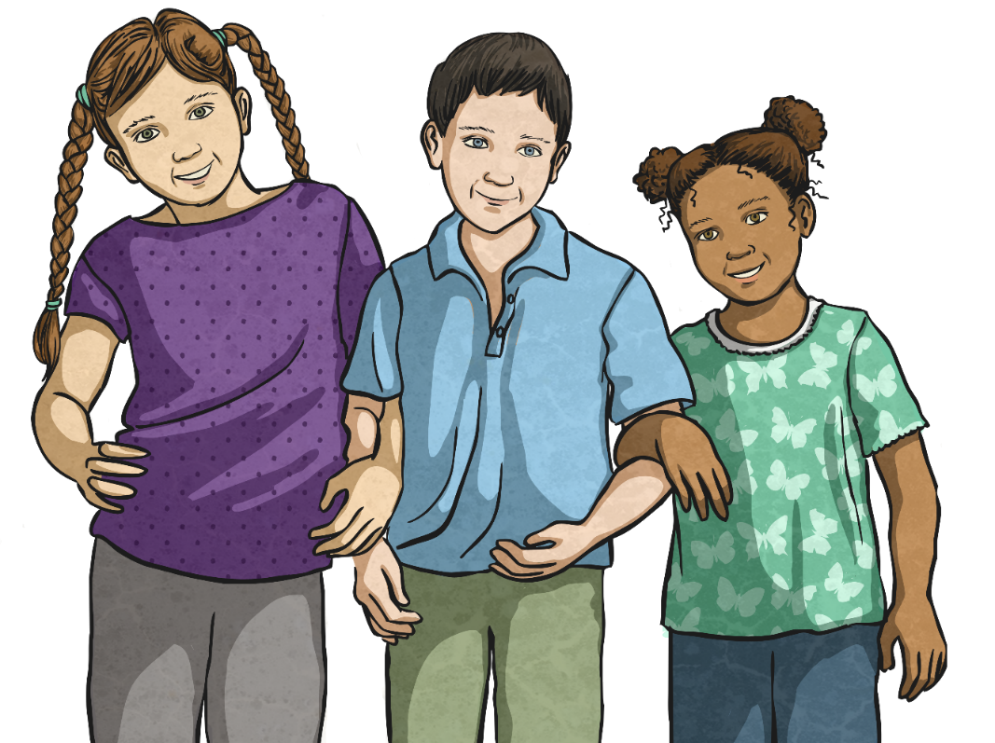
What Is Equality?
Equality is when people are treated fairly. Everybody around the world should be treated as equals, no matter where they live, where they are from, the colour of their skin, the language they speak or their accent.

Slide 8
What Is Equality?
Equality is about everyone being entitled to the same rights. It is not about giving certain people extra rights.
It means treating everyone as individuals, with respect and consideration. It is about acknowledging and appreciating diversity and difference.
The opposite of equality is discrimination.
Everyone has a right to live happily and be free from discrimination.

Slide 9
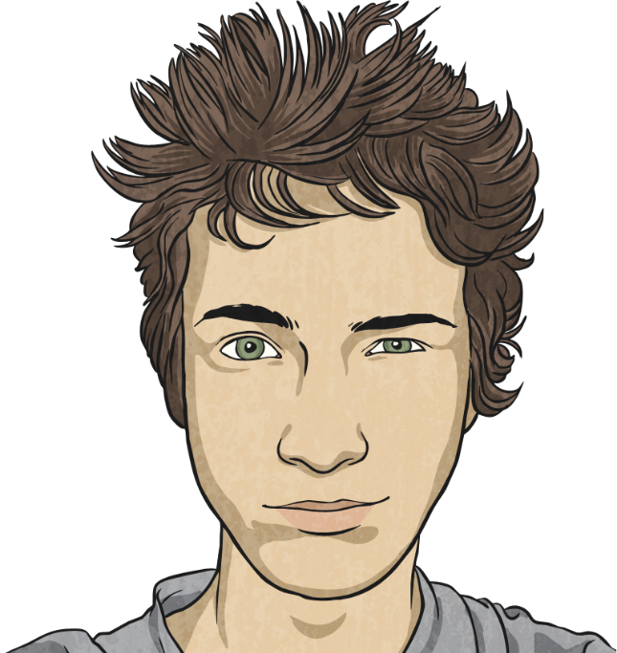
Where Does Our Uniqueness Come From?
People have different influences in their lives. This might be through their family, where they (or their parents) have lived, the friends they have made or through exploring different cultures and countries.
All these influences play a part in who we are and how we feel about ourselves.
Lots of people who live in the United Kingdom come from countries all over the world. Also, many people from the UK, move to live and work in other countries.
This means that we can learn about lots of different places, people, customs and beliefs.

Slide 10
What Is Racism?
Have you ever heard someone use a word in a negative way to describe someone because of their skin?
Maybe you have seen someone be unkind to another because they have a different accent.
Perhaps you have heard nasty comments, or seen them on social media, aimed at a whole group of people.
Why do you think people do this?
Do you think their beliefs and actions reflect the Declaration of Human Rights?
This is racism.
This is not acceptable.
Racism can happen anywhere.
Racism is when people are not given respect, their rights, dignity or value because of their race.

Slide 11
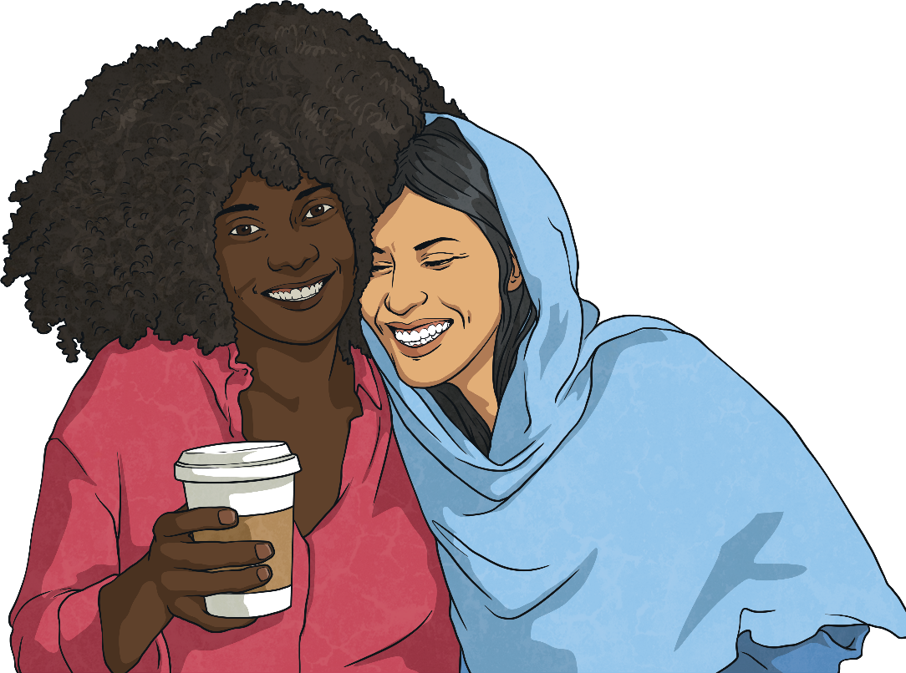
What Is Racial Discrimination?
Discrimination is when someone, or a group of people, is treated unfairly because of gender, religion, disability, nationality, appearance or any factor when they are compared to other people.
Racial discrimination is when people are treated unfairly because of their race.
Perhaps you can think of occasions where people have been treated unfairly because of their race.

Slide 12
What Is Racial Discrimination?
Racial discrimination has happened for hundreds of years and due to this, people have been disadvantaged for the whole of their lives because of their race.
Many people who are racially discriminated against, often do not have access to adequate healthcare, suffer injustice and are restricted on where they are able to live.
Some of the biggest organisations in the UK were found to be guilty of something called ‘institutional racism’. This is when an entire organisation allows racism to take place and it isn’t challenged. This results in instances where people from Black and Minority Ethnic communities aren’t given promotions at work when they are the best person for the job; are paid less than others when they are doing the same job and their experiences of racial discrimination are not dealt with properly, if at all.
Racism and racial discrimination has been allowed to become part of society and everyday culture, which is not acceptable, fair or equal.

Slide 13
How Might Someone Discriminate against Another Because of Their Race?
Saying mean things to someone because of their skin colour.
Leaving someone out of games or not letting them join in because of their skin colour.
Unfairly blaming or accusing someone of something because of their race.
Making fun of someone because of the customs and traditions they practise.
Making fun of someone because of their language or accent.
Being prejudiced against someone because of their race.

Slide 14
What Can We Do to Help Eliminate Racial Discrimination?
Recognise that no matter what our skin colour, accent, language we speak or the place we are from, we are all equal and deserve the same rights and treatment.
Make sure everybody feels included and welcome.
Encourage people to tell someone if they feel they are being racially discriminated against.
Have conversations about how racial discrimination affects you or your friends.
Be aware of our own prejudices and make an effort to change them.
If you think you see racism happening, tell a responsible adult and get help.

Slide 15
What Is Being Done to Tackle Racial Discrimination?
There are several projects taking place which tackle racial discrimination.
Show Racism the Red Card is a charity which leads the way in educating children about anti-racism. They provide workshops in schools with ex-professional footballers to help children learn about the causes and consequences of racism. They also lead training sessions to give teachers ideas about how to help their classes learn about anti-racism.
UEFA – Union of European Football Associations – run a campaign called ‘No to Racism’. This aims to remove racism, intolerance and discrimination in football. They work hard to get the message across to the public that there is zero tolerance of racism. They have brought in tough penalties for spectators and players who demonstrate racist behavior.

Slide 16
What Is Being Done to Tackle Racial Discrimination?
In 2010, The Equality Act came into force. This is a legal policy which ensures that:
‘All workers within an organisation should be entitled to and have access to all of the organization’s facilities at every stage of employment.’
This means that all people who work within an organisation should expect to be treated fairly and given the same equal opportunities as everyone else. They will have:
an equal chance to apply and be selected for jobs;
an equal chance to be trained and promoted while employed with the organisation;
an equal chance to have their employment come to an end equally and fairly.
All organisations have to legally agree to this policy.

Slide 17
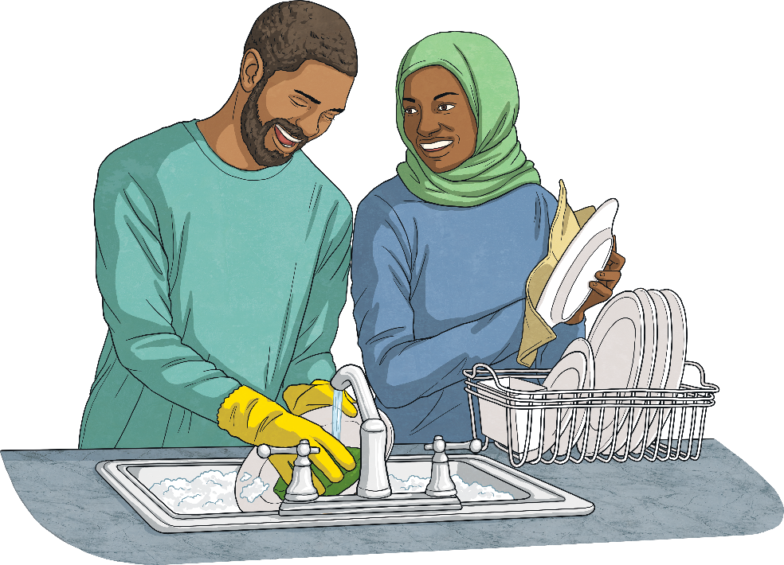
What Does It Mean to Be Race Conscious?
Being race conscious is a way to make sure everyone is treated equally.
How can we be race conscious?
Talk to your friends and family about race and racial inequality.
Be aware of racism, where it occurs, how people speak to and about others and how they treat them depending on their race.
Make sure that when you talk about race you are using the right words.
Research all of your facts carefully to make sure they are true.

Slide 18
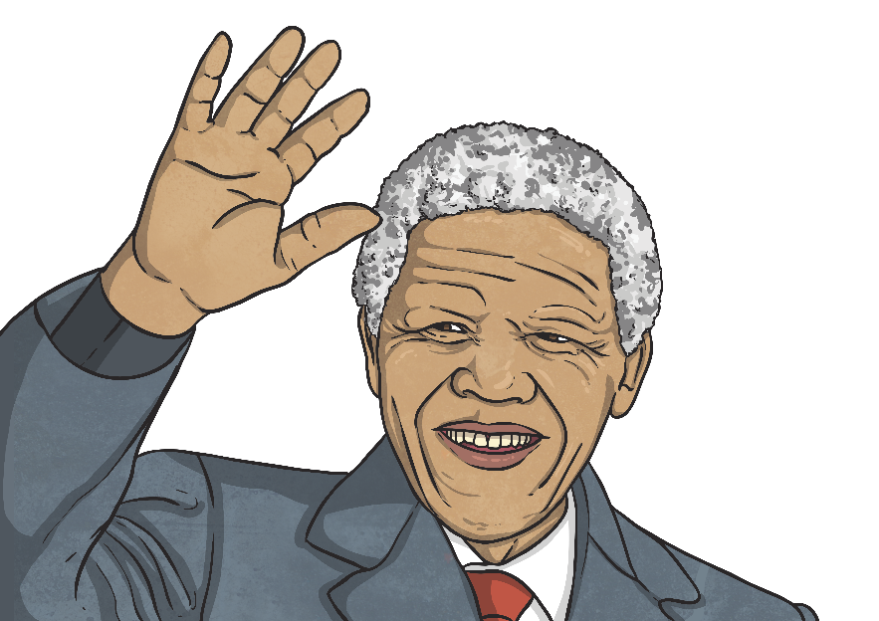
People Who Have Fought Against Racial Discrimination
Nelson Mandela was born in 1918 in South Africa. When he was growing up, Black people were treated differently to white people. The South African government kept Black people away from white people and this was called apartheid, which means ‘apartness’. A white person and a Black person were not allowed to get married, have a meal together in a restaurant or sit together on a bus. Black people had to also carry identity papers at all times and were only allowed to live in certain areas.
Nelson Mandela joined a group called the ‘African National Congress’ (ANC) and spent a lot of time trying to end apartheid. He was arrested and put in prison for 27 years. In 1988, the government ended apartheid and he was released from prison in 1990.
He went on to become the leader of the ANC and the first Black South African President. Nelson Mandela has been widely respected for fighting racial inequality and for bringing people together.

Slide 19
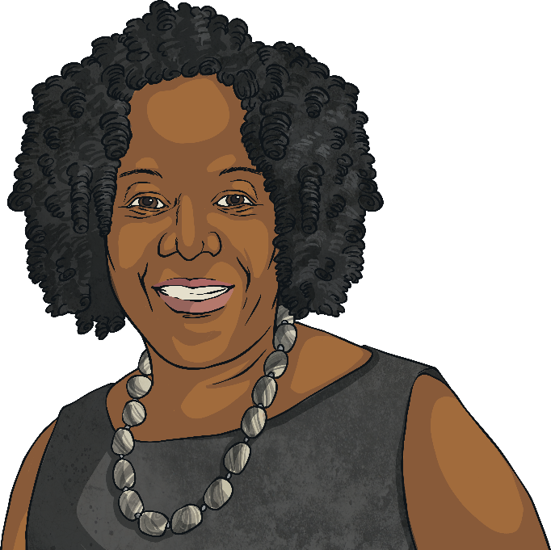
People Who Have Fought Against Racial Discrimination
Ruby Bridges was born in 1954 in Mississippi, US but her family moved to Louisiana two years later. Before 1954, Black children were not allowed to go to the same school as white children and their schools were often not as well equipped or as well taught as schools for white children.
In the year of her birth, the law changed so that Black children could attend schools for white children. The state of Louisiana resisted the changes until 1959. Ruby Bridges’ mother wanted her daughter to have the same opportunities as white children and walked her to school. Many white people were angry and for a long time, she was in a class on her own and ate lunch on her own. The family also suffered with her father losing his job and her grandparents being evicted from their farm.
Ruby Bridges became an activist for racial equality and in 1999, established the ‘Ruby Bridges Foundation’ to encourage tolerance and create change through education.

Slide 20
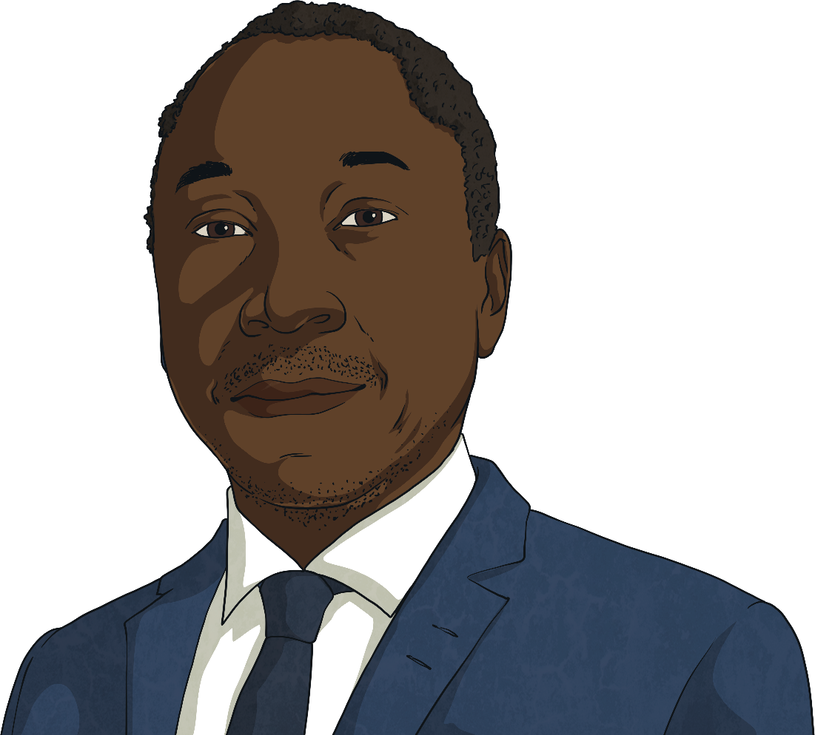
People Who Have Fought Against Racial Discrimination
Leslie Thomas QC was born 29th April 1965 in inner London. He went to a comprehensive school where he had to retake his A-Level exams. He studied law at Kingston University, London.
Mr Thomas soon realised that he wanted to represent people in court who had not been treated fairly – often due to their race. He became a barrister and a leading expert in human rights court cases.
In 2013, Leslie Thomas received an honorary doctorate from Kingston University for his ‘outstanding contribution to civil rights’.
Leslie Thomas has represented people in many high profile cases and continues to defend those who have been racially discriminated against.

Slide 21
Discuss It!
What have you learnt from this presentation?

Slide 22
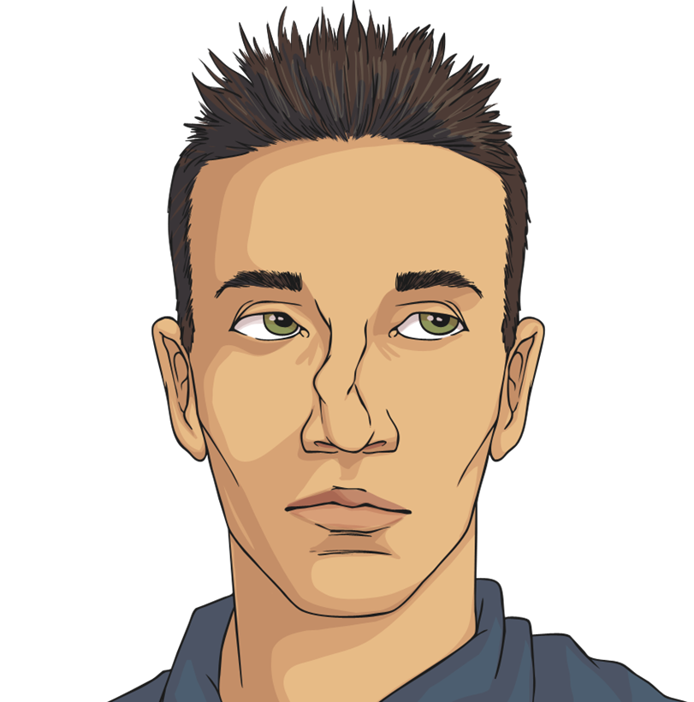
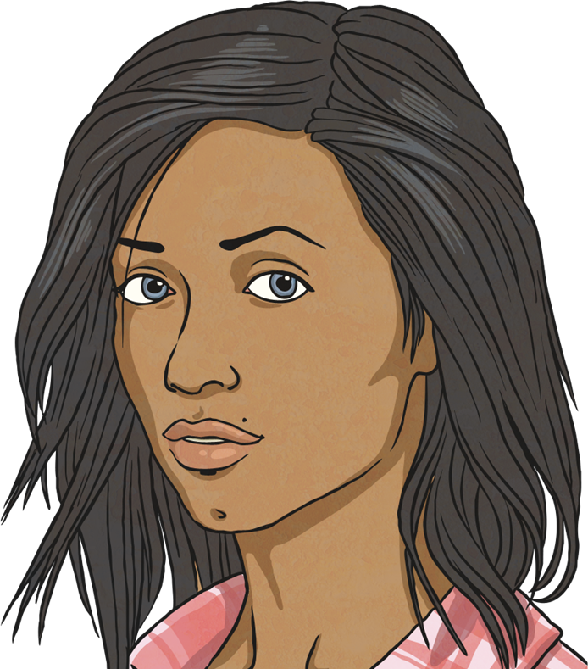
Talk About It
Share what you have learnt with a partner.

Slide 23
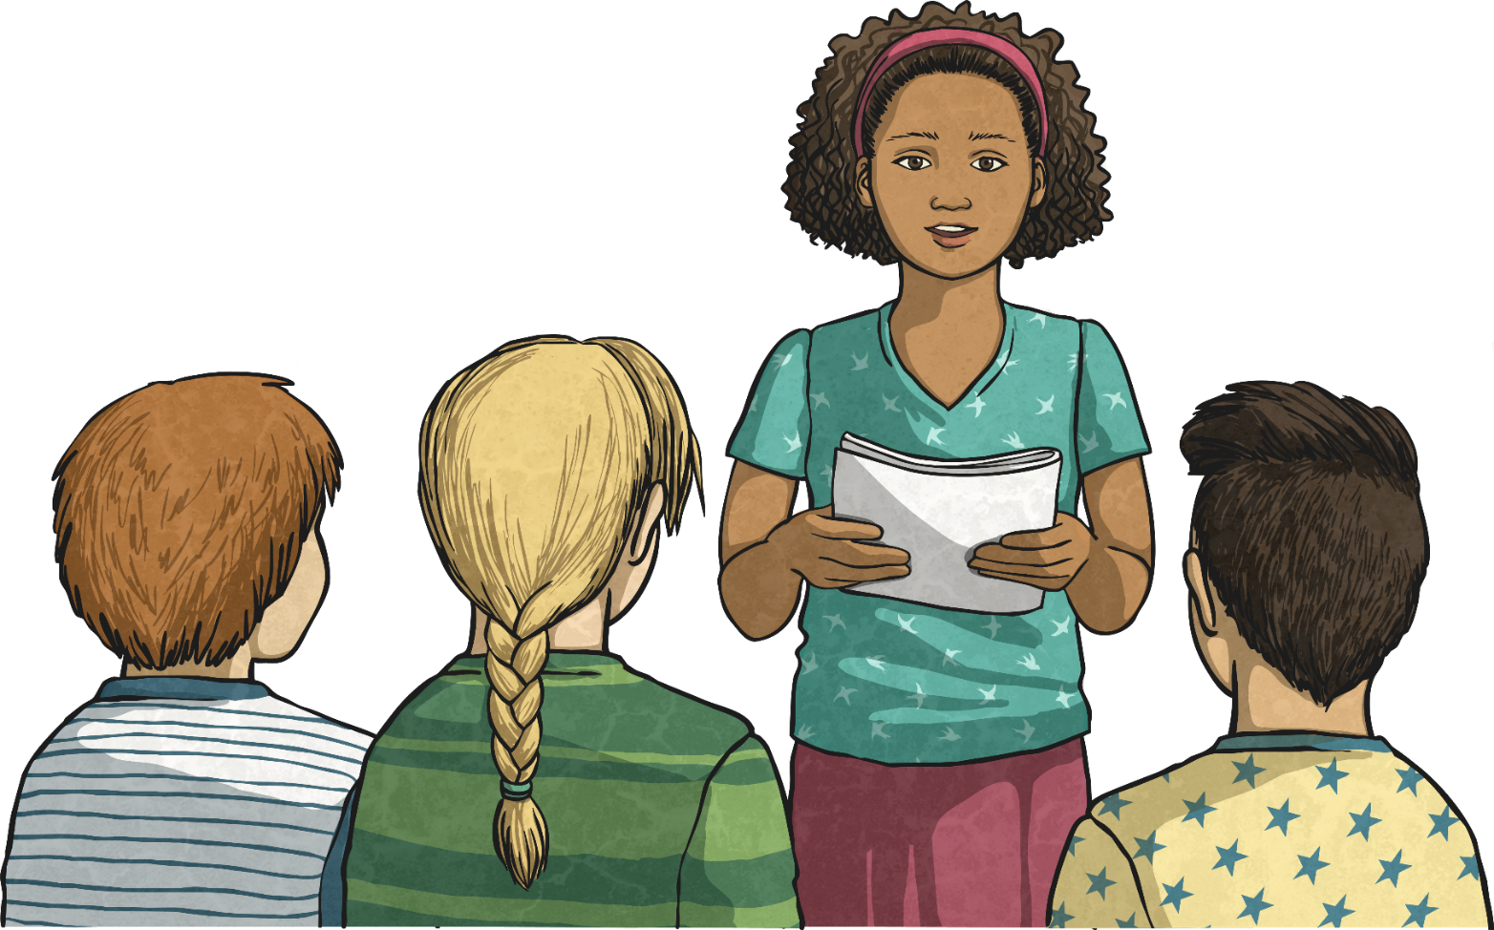
Share
If you want to, share your ideas with the class.

Slide 24
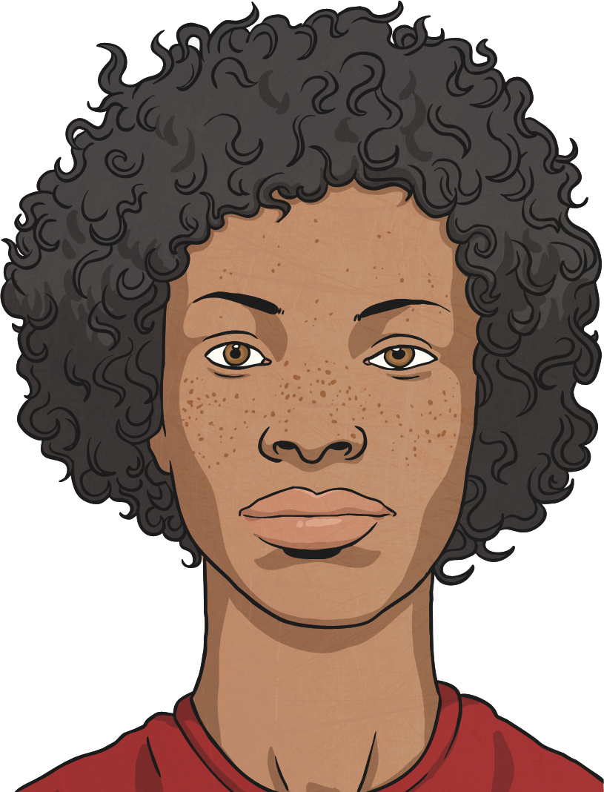
We Are All Unique
Everybody has the right to be treated fairly and equally.
We all have a responsibility to make sure this happens.
We also have a responsibility to challenge discrimination.
We should all reflect on how our words and actions impact on other people.

Slide 25
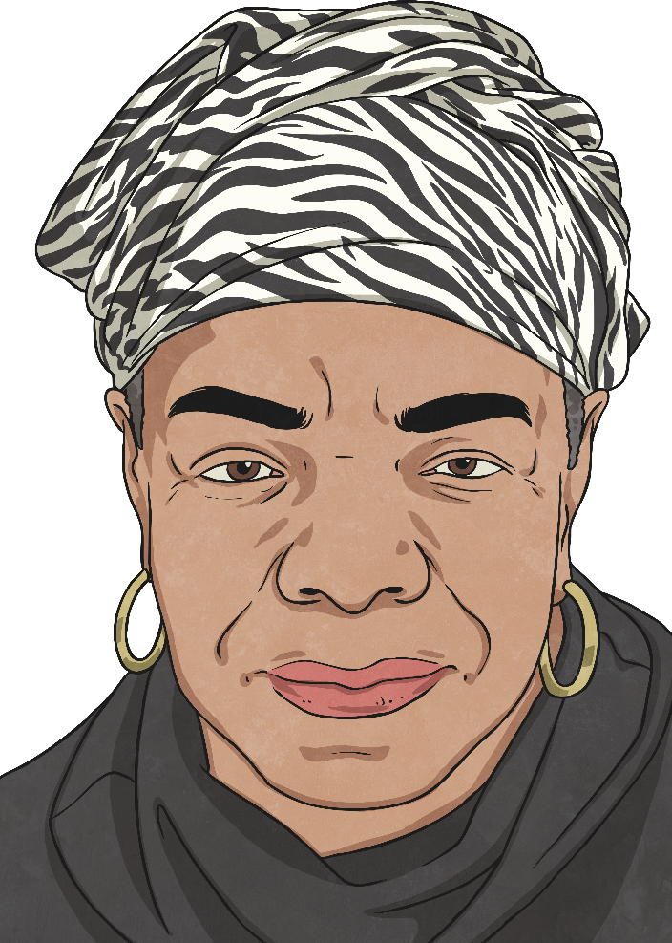
“We all should know that diversity makes for a rich tapestry, and we must understand that all the threads of the tapestry are equal in value, no matter what their colour.”
Maya Angelou

Slide 26
Glossary
Click on the words in bold to return to the original slide.
apartheid – A political and social system in South Africa from 1948-1994, segregating white and Black people and discriminating against Black people.
BAME – This is an abbreviation for Black, Asian and Minority Ethnic.
prejudice – To have an opinion of something that isn’t based on reason or actual experience of something.
unique – Something which is one of a kind. There is nothing else the same.

