Slide 1
Medical Advice Resource Disclaimer
We hope that you find the information on our website and resources useful. This resource is provided for informational and educational purposes only. It is intended to offer general information and should never be taken as medical advice.
As medical information is situation-specific and can change, we do not warrant that the information provided will always be up to date, accurate or appropriate for every situation. You and your students should not rely on the materials included within this resource and we do not accept any responsibility if you or your students do.
It is up to you to contact a suitably qualified health professional if you are concerned about your health and it is up to you to advise your students to contact a suitably qualified health professional if they are concerned about their health.
It is up to you to ensure that the policies and procedures of your specific educational setting are being followed and it is up to you to ensure that all additional medical paperwork and consent forms have been completed.

Slide 2
Food or Drink Making and Eating Resource Disclaimer
We hope you find the information on our website and resource useful. The description of any food or drink preparation or consumption activity contained within this resource is intended as a general guide only. It may not fit your specific situation.
You should not rely on the resource to be right for your situation. It is your responsibility to decide whether to carry out the activity at all and, if you do, to ensure that the activity is safe for those participating. You are responsible for carrying out proper risk assessments on the activities and for providing appropriate supervision.
We are not responsible for the health and safety of your group or environment so, insofar as it is possible under the law, we cannot accept liability for any loss suffered by anyone undertaking the activity or activities referred to or described in this resource.
It is also your responsibility to ensure that those participating in the activity are able to do so and that you or the organisation you are organising it for has the relevant insurance to carry out the activity.
It is also your responsibility to note that ingredients or materials used might cause allergic reactions or health problems and to ensure that you are fully aware of the allergies and health conditions of those taking part. If you are unsure, always speak to a suitably qualified health professional.

Slide 4
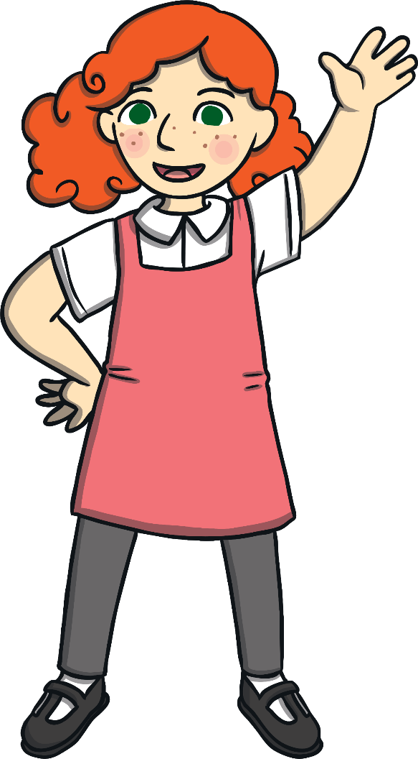
This is Ella. Ella is allergic to tree nuts.

Slide 5
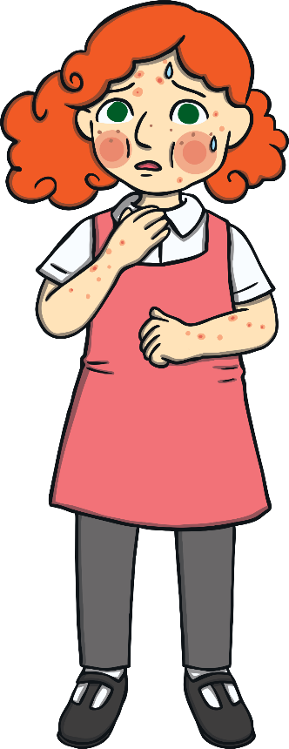
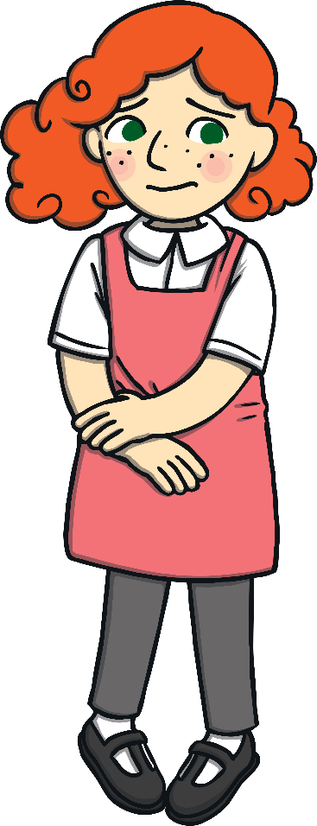
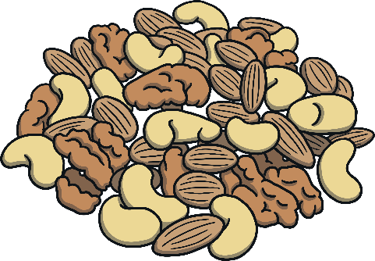
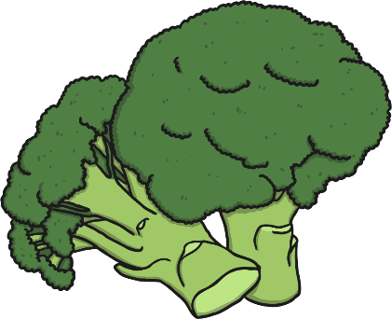
I am allergic to tree nuts. They make me poorly if I come into contact with them.
I do not like broccoli but it does not make me poorly. I just think it tastes disgusting!
This does not mean that Ella doesn’t like to eat tree nuts. It means that Ella’s body makes her very poorly if she does. There is a big difference between being allergic to a food and just not liking it.

Slide 6
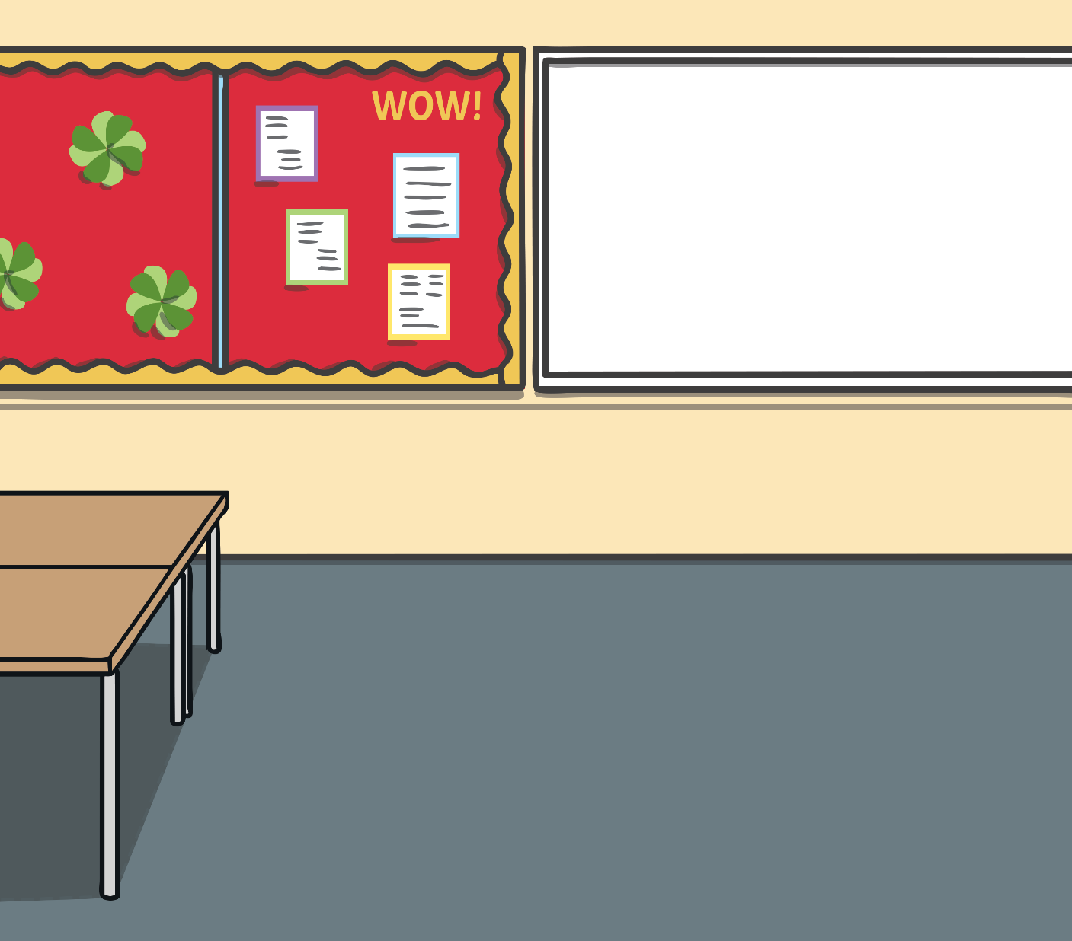
If Ella eats or touches tree nuts, she can be sick, she can get itchy, she might get very hot and she might not be able to breathe properly. This can be very serious.

Slide 7
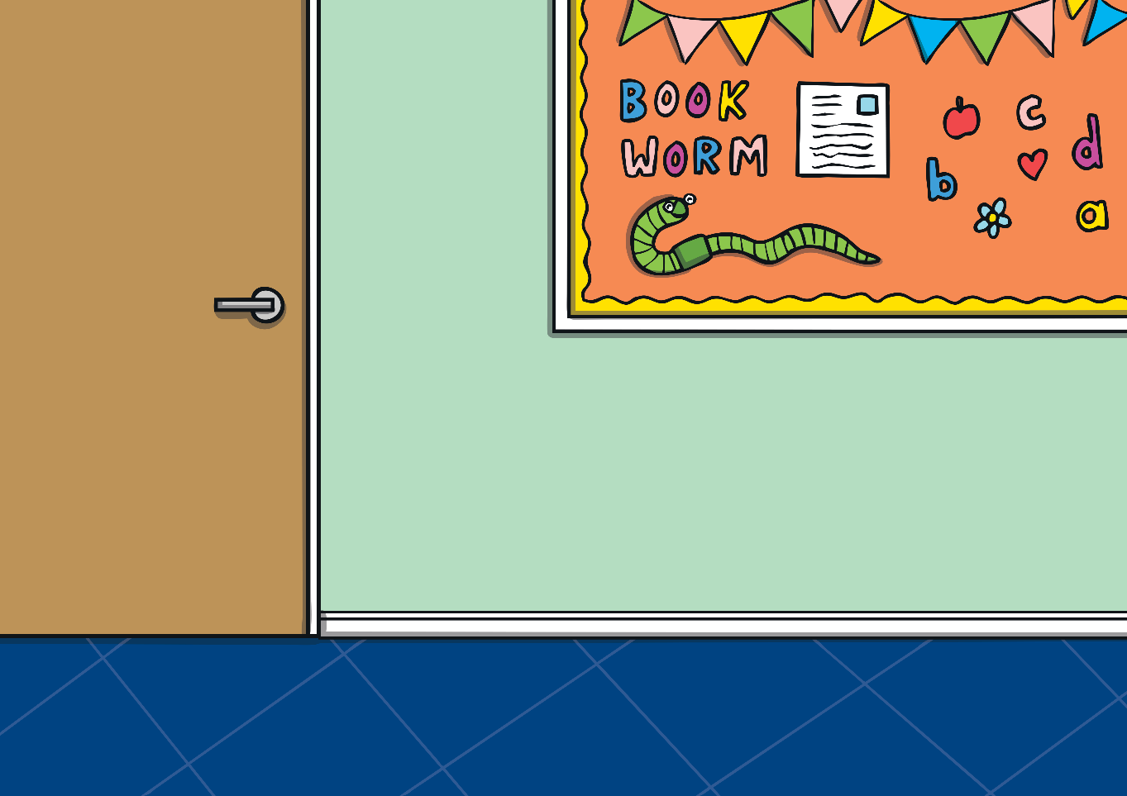
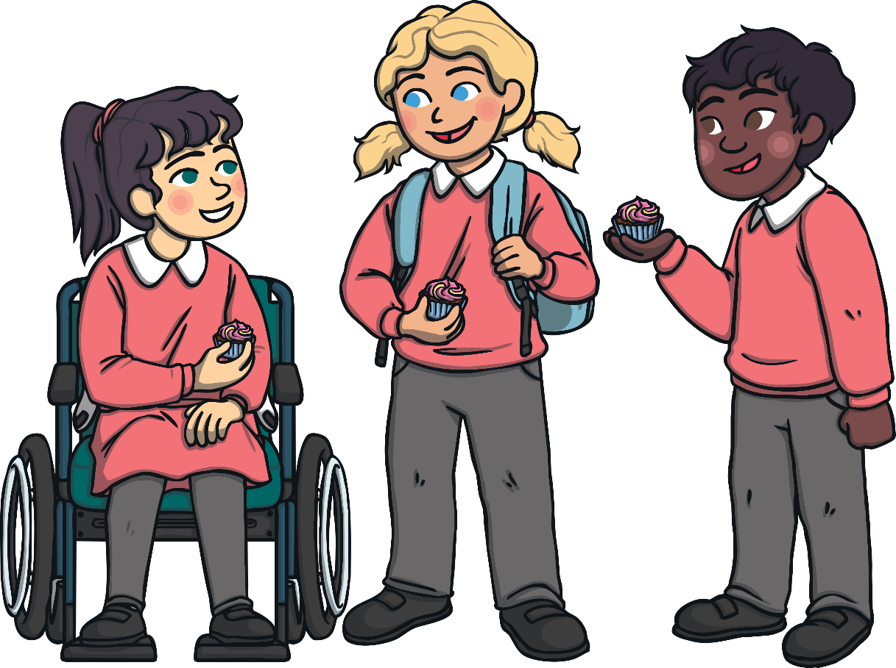
Sometimes, this can happen even if Ella doesn’t eat or touch tree nuts. If someone she is playing with has eaten tree nuts, or if they are nearby, this can also make Ella poorly.

Slide 8
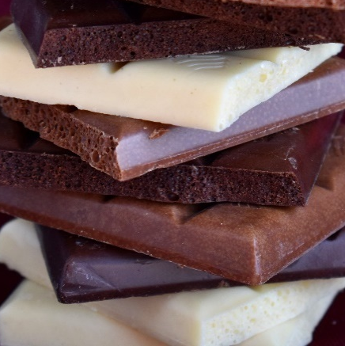
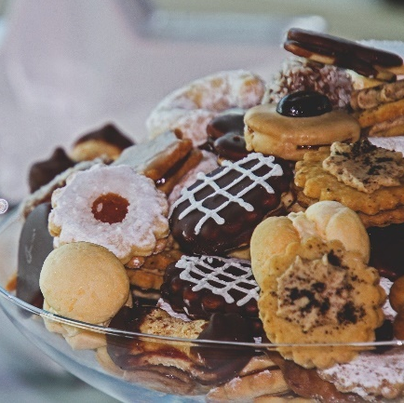
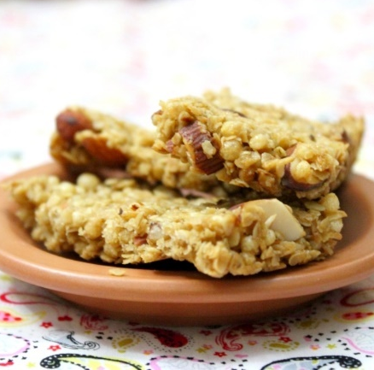
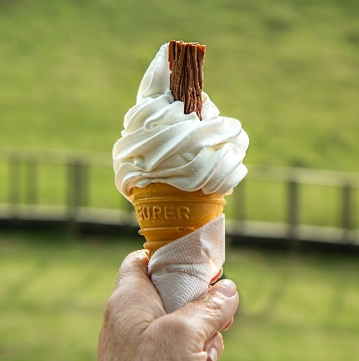
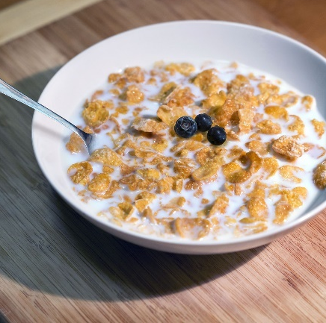
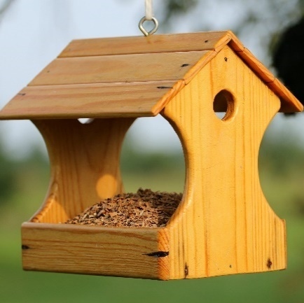
Tree nuts are used in lots of different foods, such as breakfast cereals, cereal bars, biscuits, chocolate bars and ice cream. Sometimes, people put tree nuts on their bird table.

Slide 9
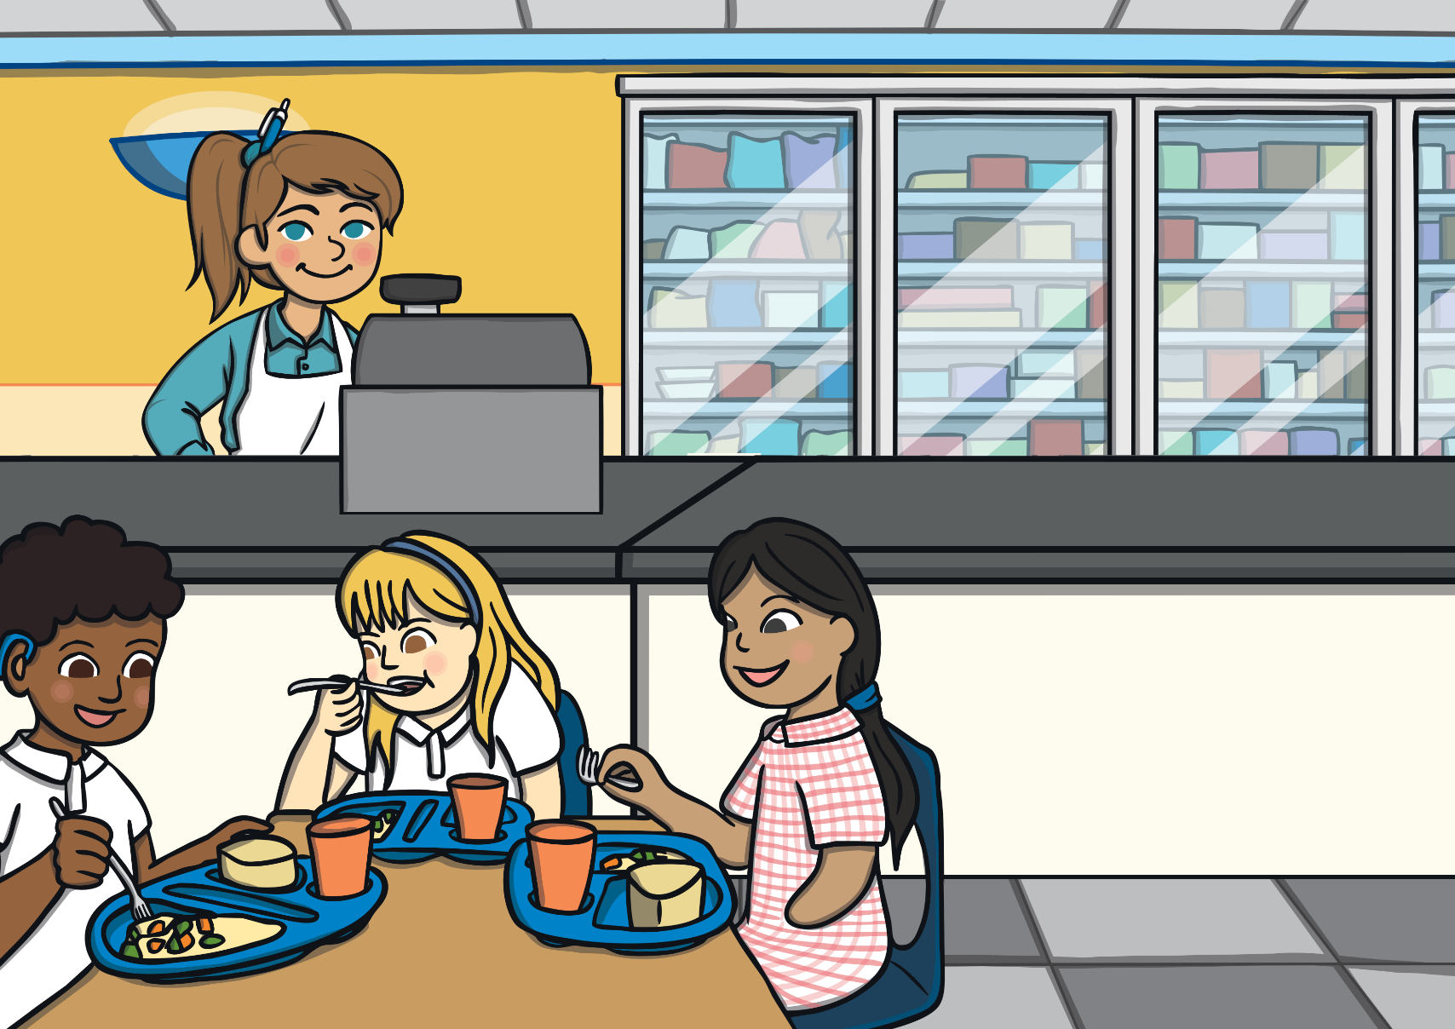
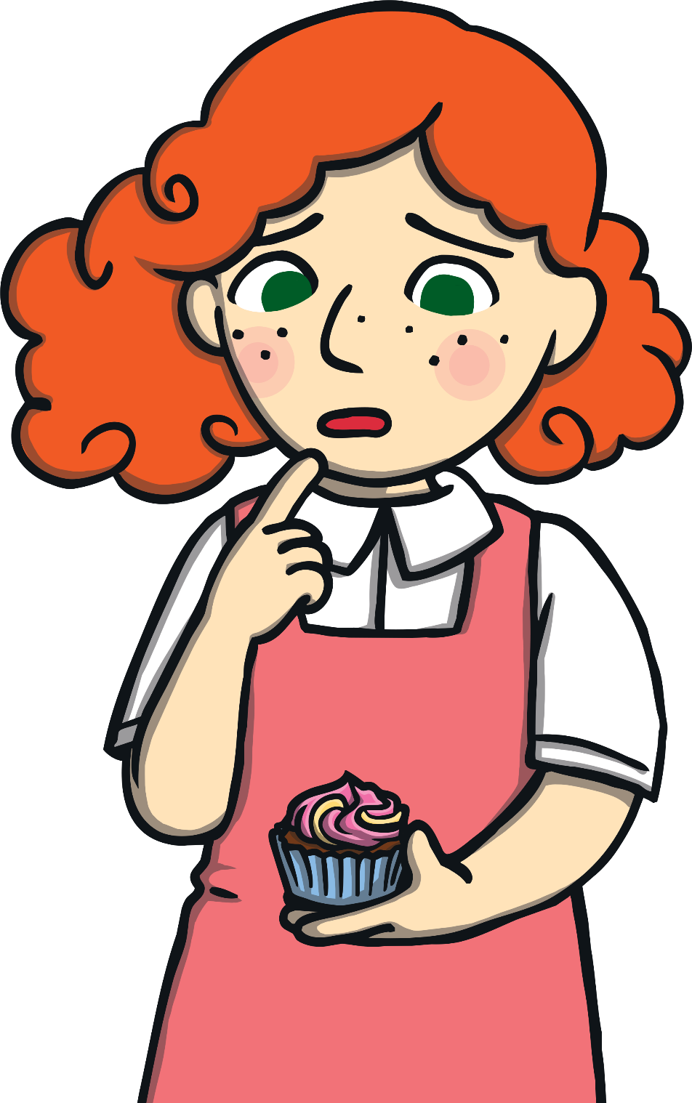
Every day, Ella and her family work hard to keep her safe. This means that they have to check everything Ella eats to make sure that it does not contain any tree nuts.

Slide 10
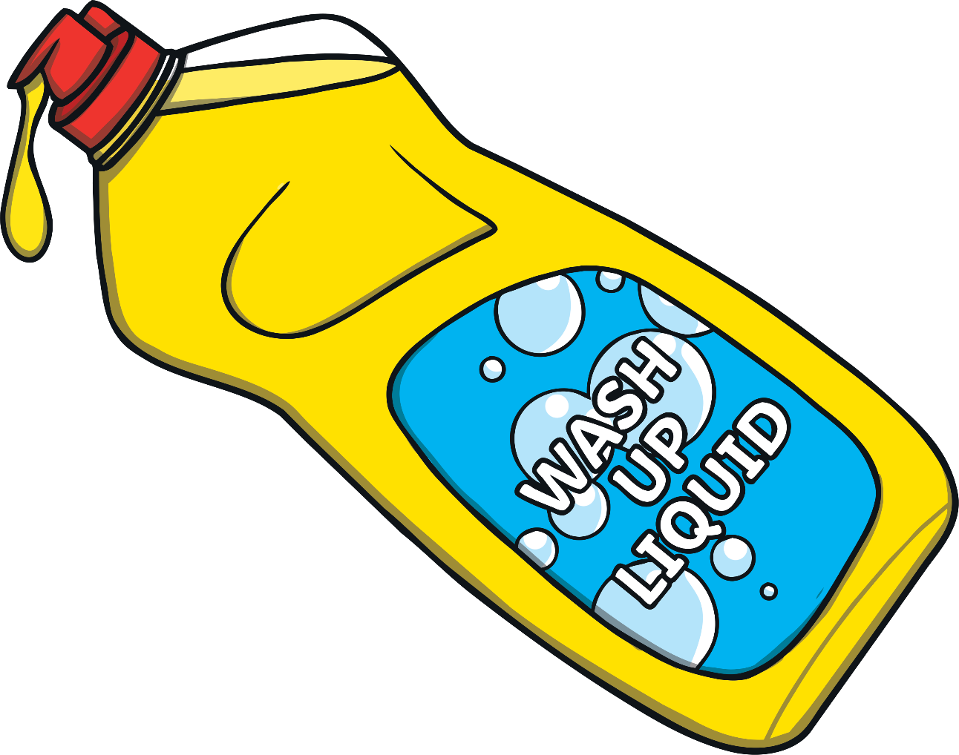
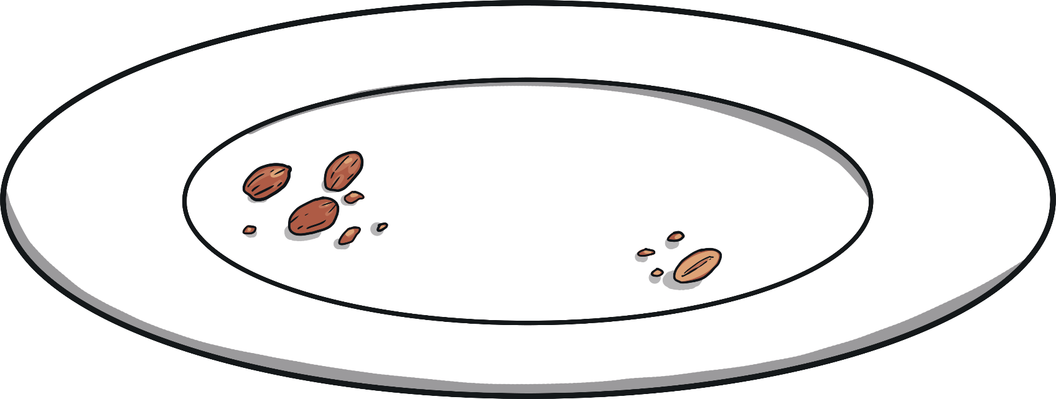
If someone puts tree nuts onto a plate, Ella cannot use that plate until it has been washed very carefully.

Slide 11
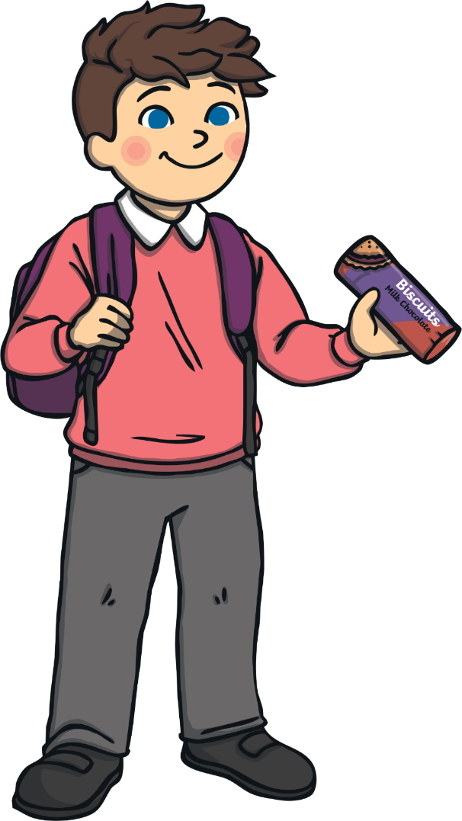
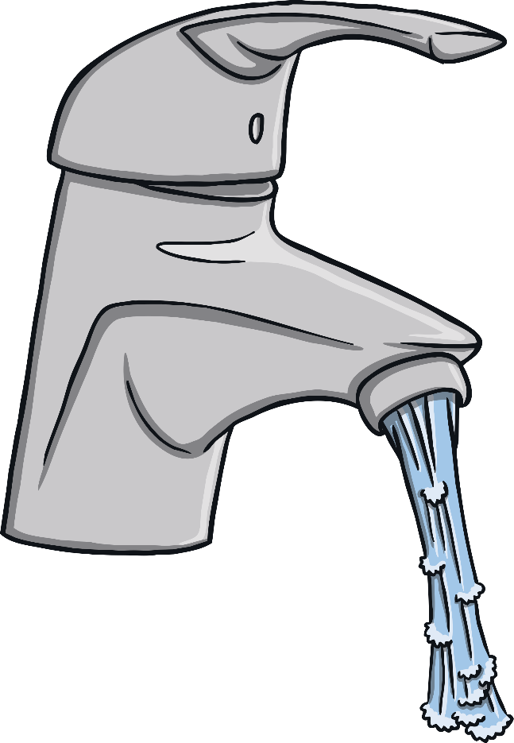
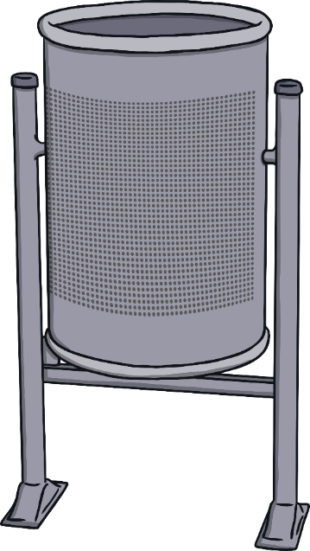
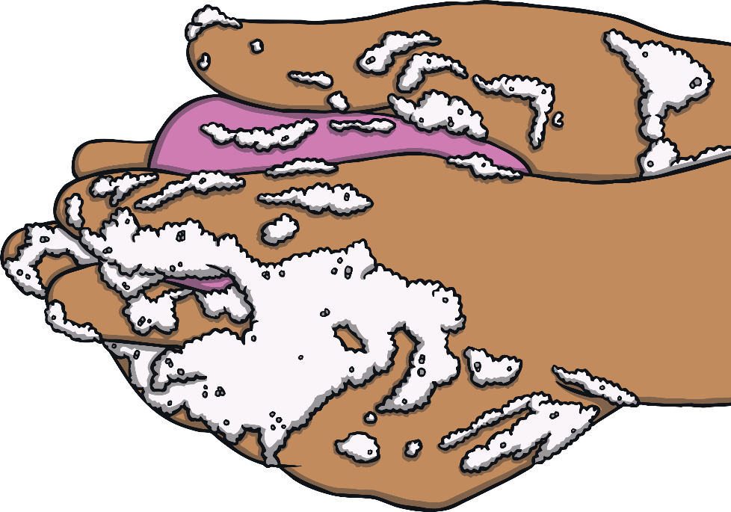
If someone around Ella eats tree nuts, they must put the packet in the outside bin and wash their hands thoroughly so that they can keep Ella safe.

Slide 12
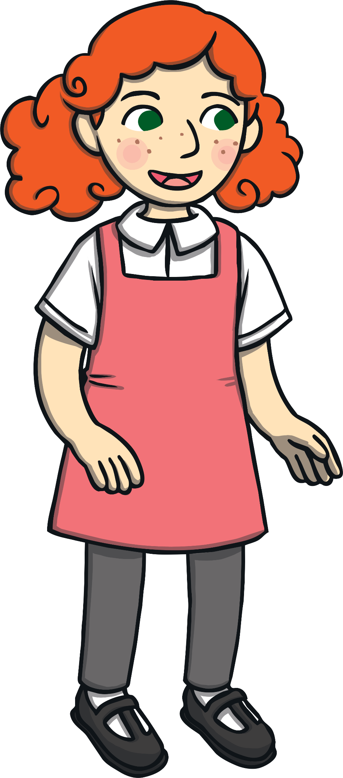
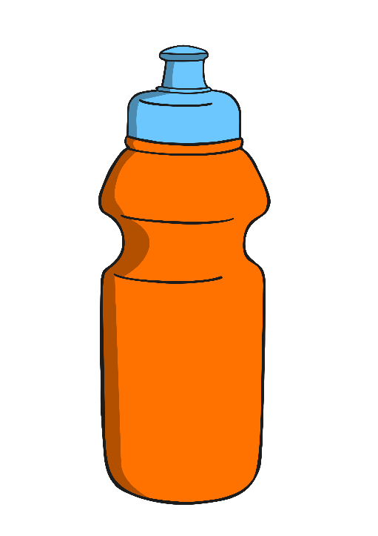
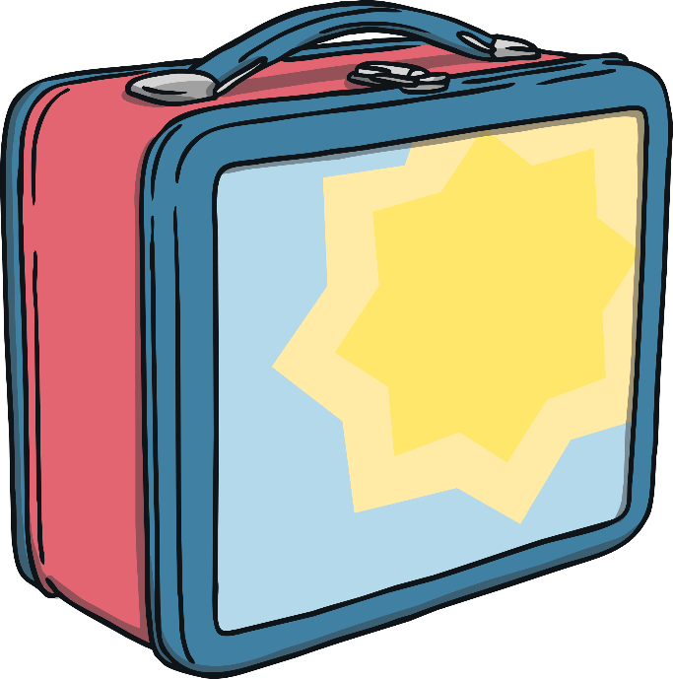
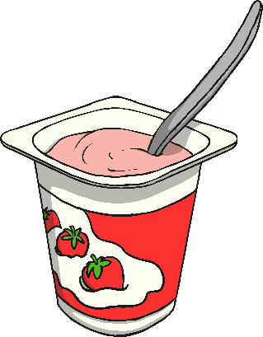
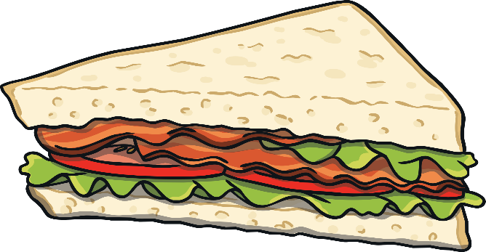
Ella has to be very careful about what she brings to school in her lunch box. Everything that Ella eats at snack time and for lunch has been checked carefully to make sure that it is safe.

Slide 13
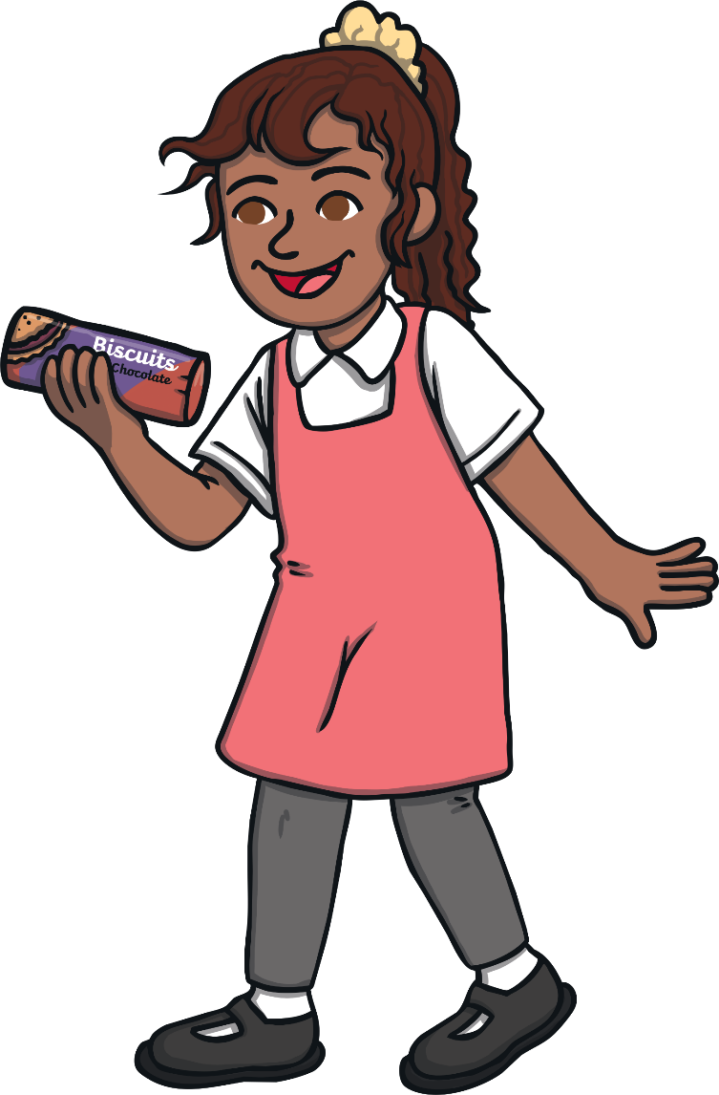
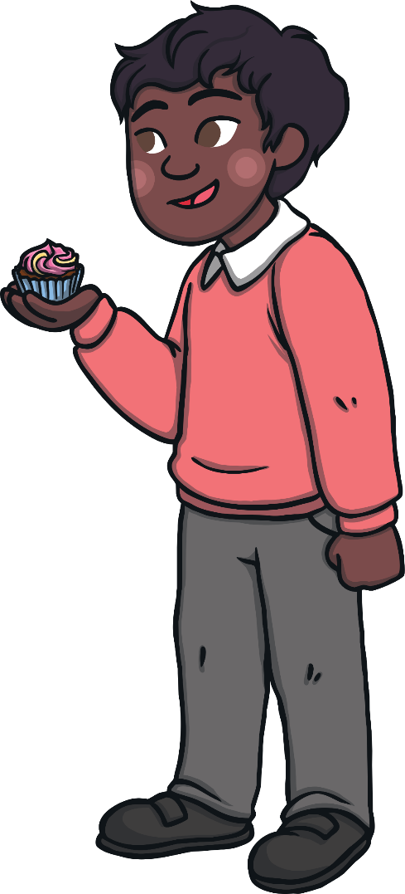
Sometimes, Ella’s friends bring special treats into school to share. It is very kind of them to share, but if Ella eats the treats, they could make her poorly.

Slide 14
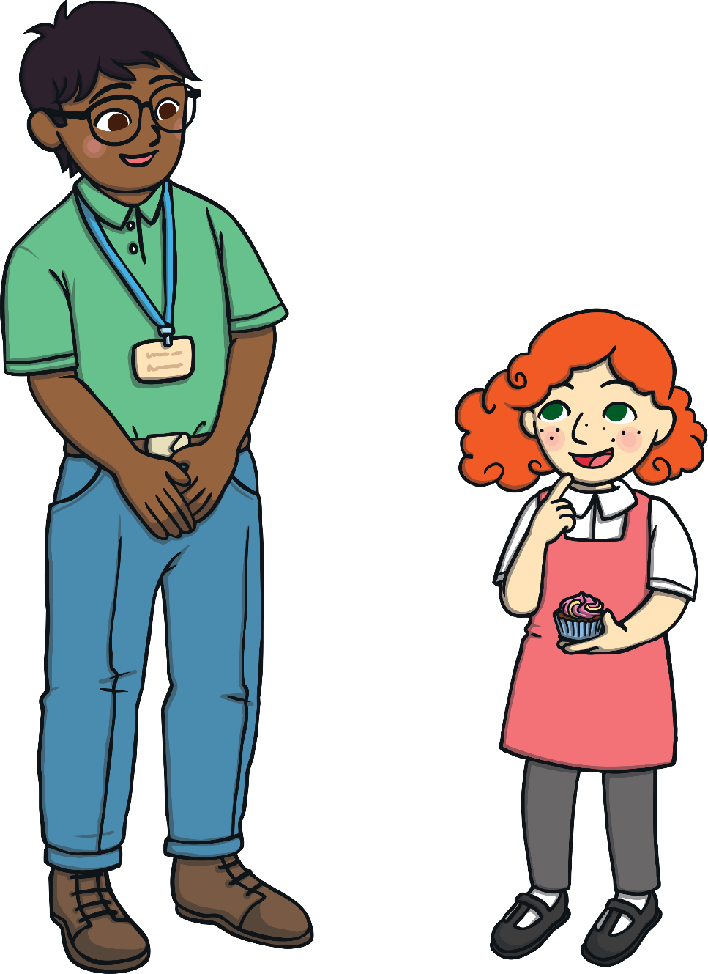
Ella’s teachers have to check to see if the treats contain tree nuts. If they do, Ella cannot have any. This might make her feel left out.

Slide 15
It is everyone’s job to make sure that Ella stays safe at school. Let’s see if you can help to keep Ella safe in these scenarios.

Slide 16
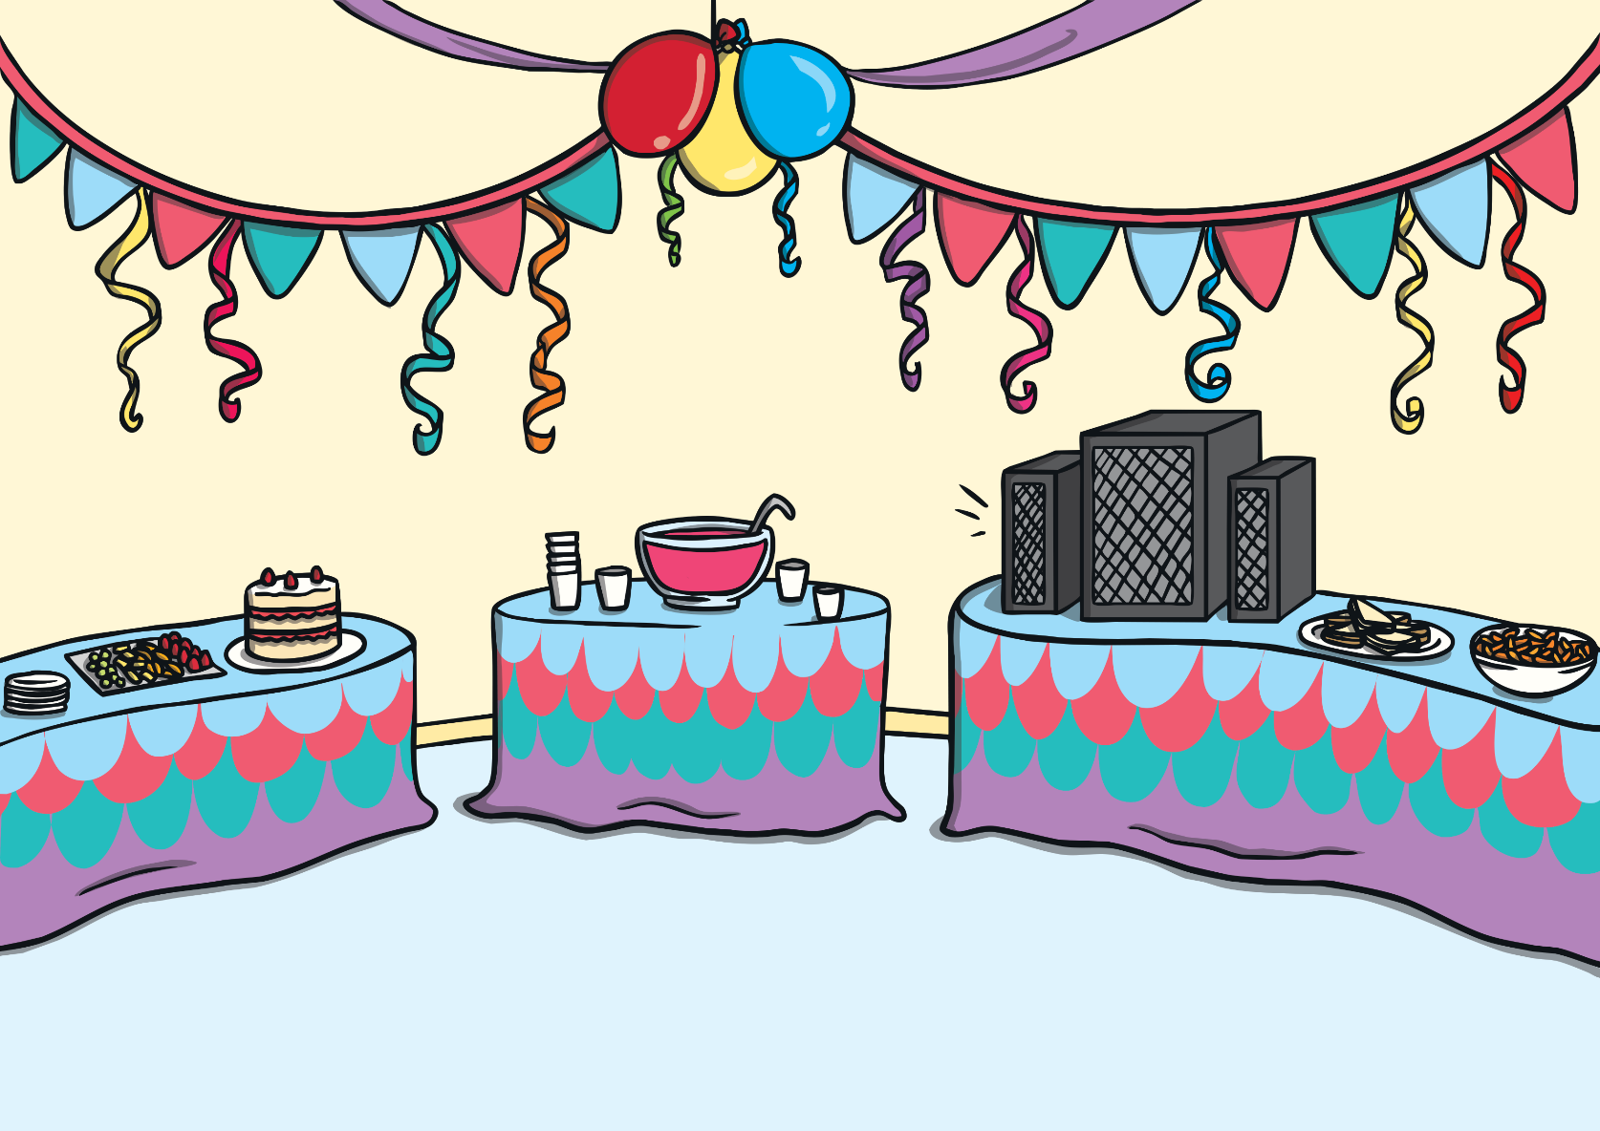
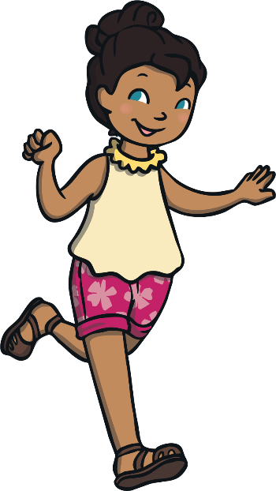
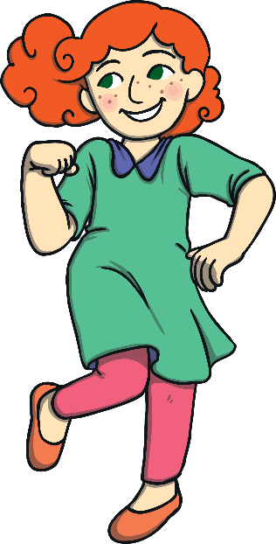
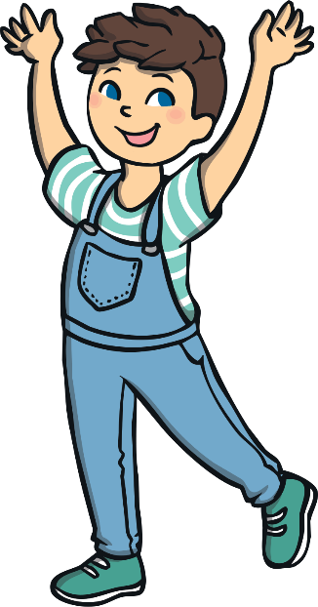
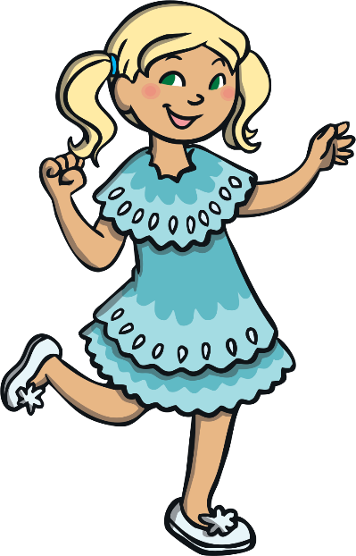
Scenario One: Fred’s Birthday
It is Fred’s birthday. He has brought a box of chocolates into school and wants to give one to all of his friends.
Can you keep Ella safe?
Fred and Ella could ask the teacher to check the packet to see if there are any tree nuts in the chocolates. If there are, Fred could be a good friend to Ella in a different way.
Next year, Fred will bring a different treat that he knows Ella can eat. He does not want his friend to feel left out.

Slide 17
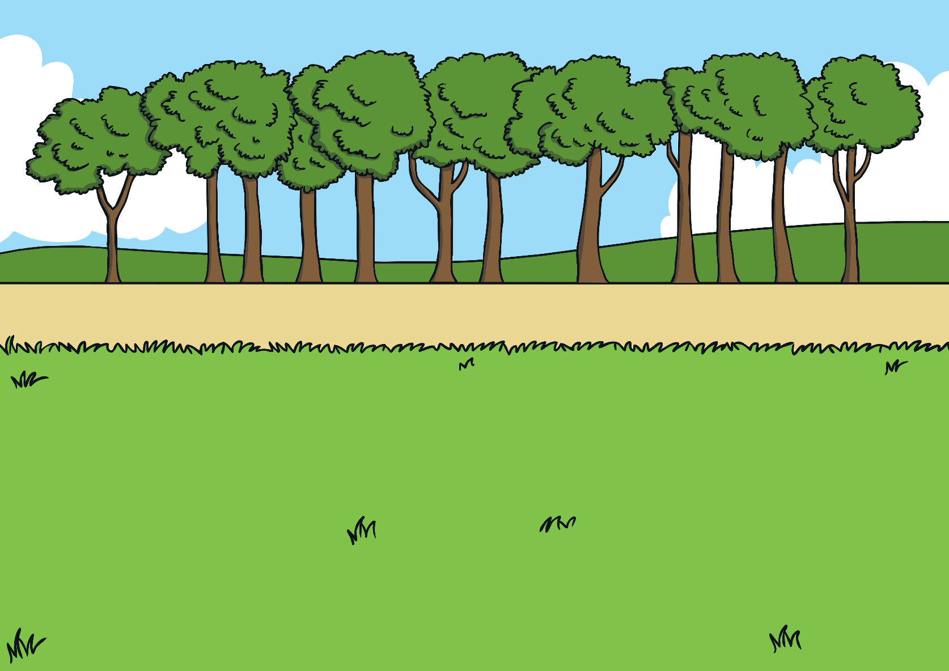
Scenario Two: School Trip
The class are on a school trip and each child has 50p to spend. Everyone wants a cupcake.
Can you keep Ella safe?
Ella could ask an adult to check if there are any tree nuts in the cupcakes. If there are, it would keep Ella safe if everybody chose a different thing to buy.
Ella could spend her 50p on another treat instead. She could buy herself a pencil or a bouncy ball.

Slide 18
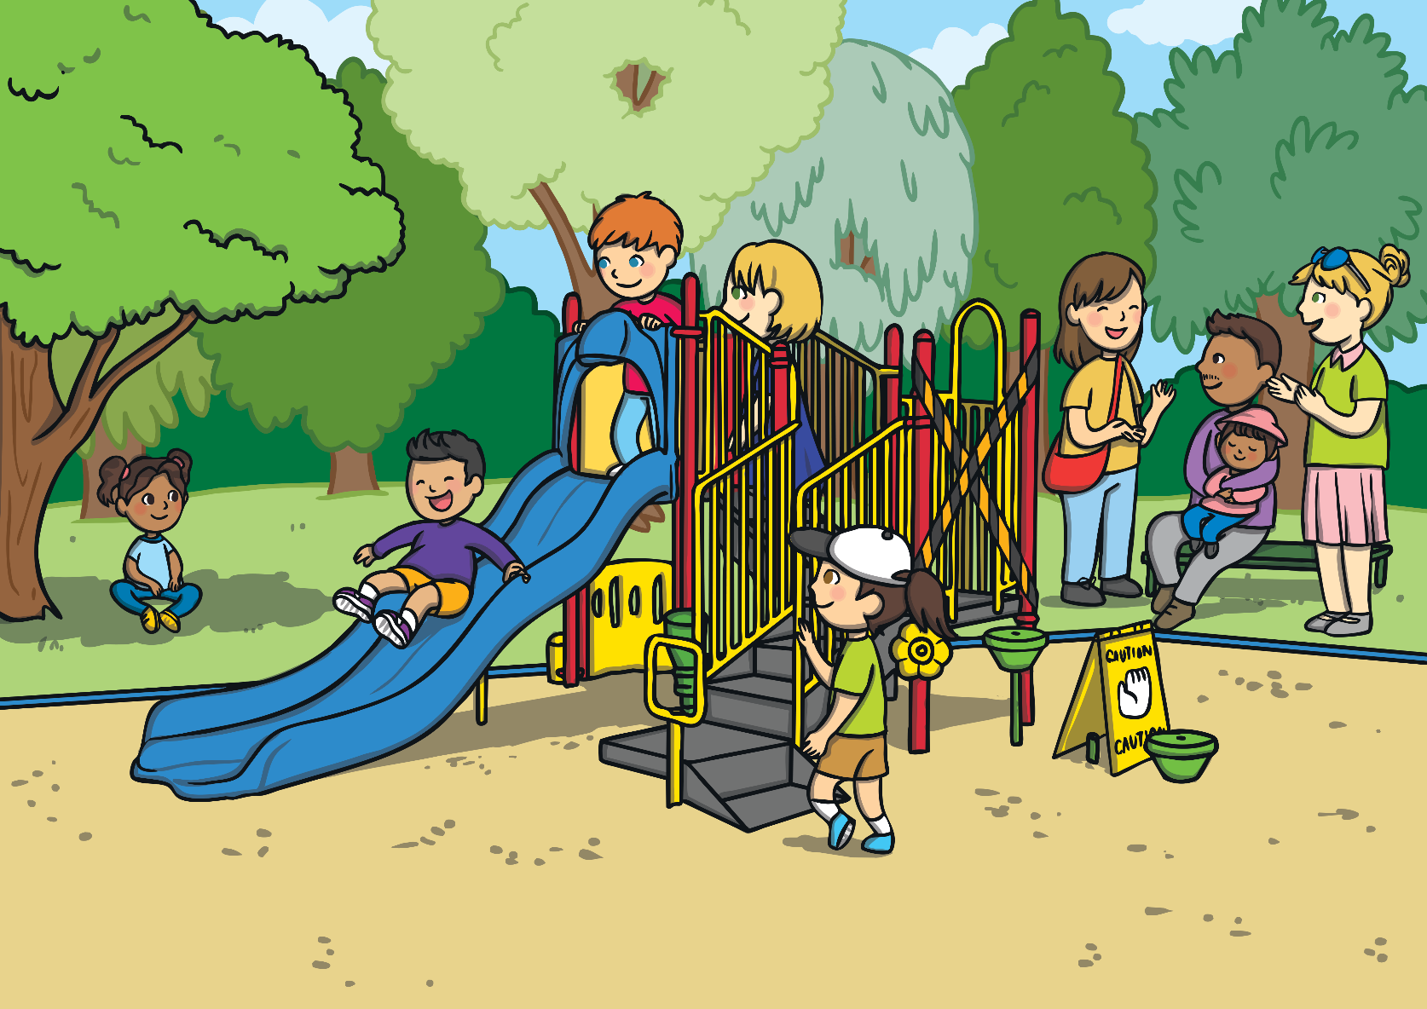
Scenario Three: The Playground
Everyone is in the playground. Carla has a packet of biscuits and she offers one to Ella.
Can you keep Ella safe?
Although it is kind of Carla to share her biscuits, Ella should not eat any until she has checked with an adult that it is safe.
Carla could show friendship to Ella by playing with her and by being kind in other ways.

Slide 19
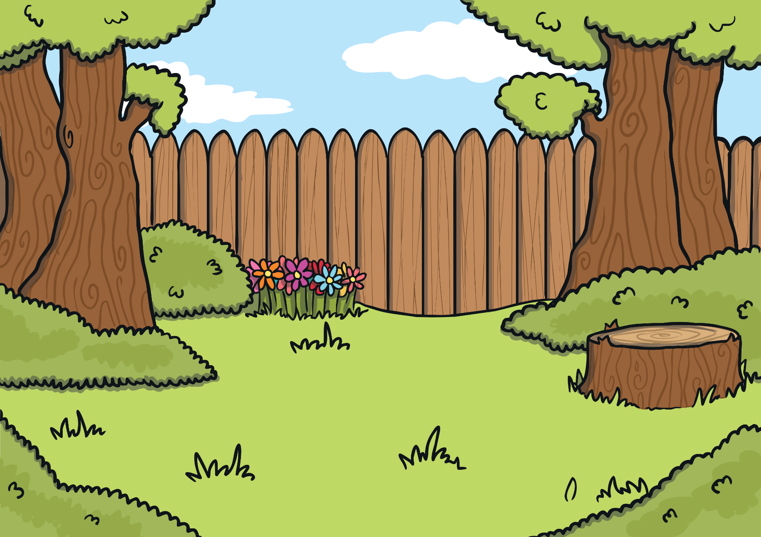
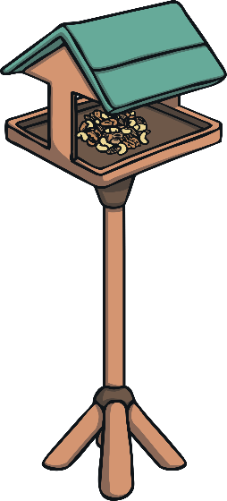
Scenario Four: Outdoor Learning Time
After lunch, it is circle time. Hassan has eaten tree nuts at lunchtime and now he must hold hands with Ella.
Can you keep Ella safe?
Hassan should tell the teacher that he needs to wash his hands because he has held tree nuts and he wants to keep Ella safe.
Hassan could suggest to the teacher that they should use a different food for the birds because Ella is allergic to tree nuts.

Slide 20
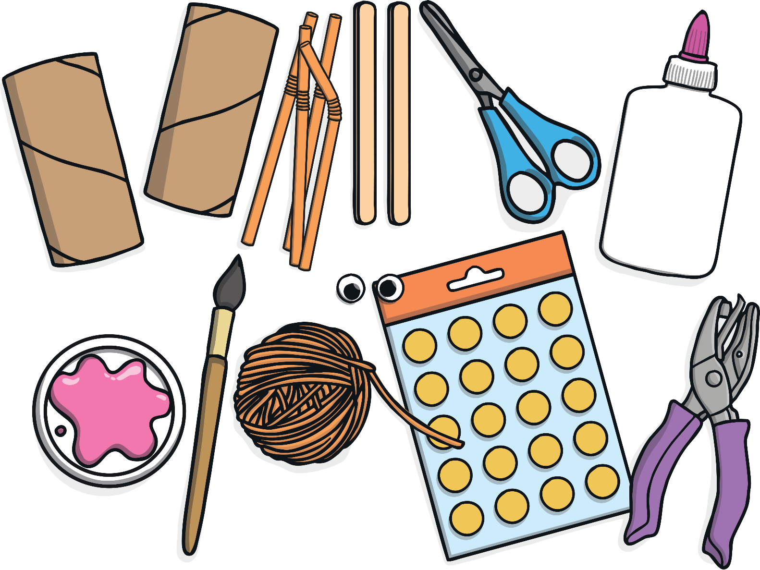
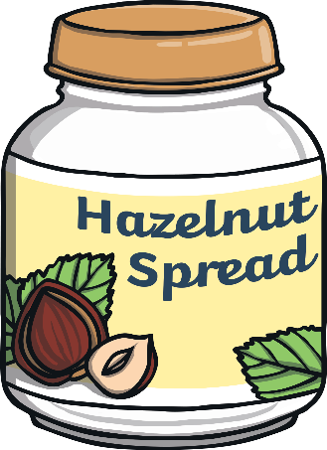
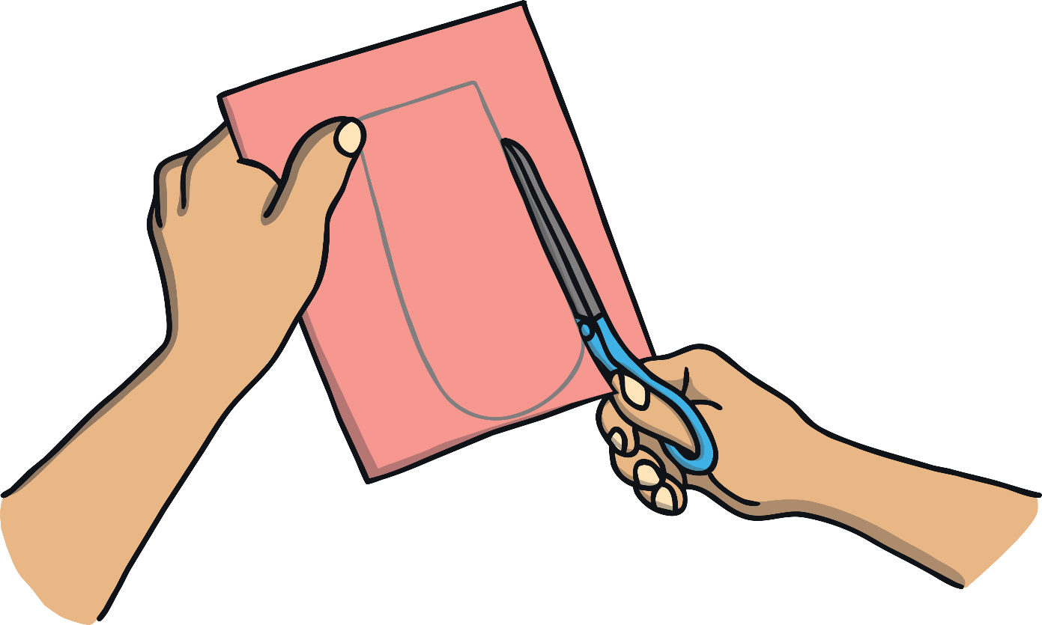
Scenario Five: Junk Models
Kylie’s mum has sent in lots of jars for the junk modelling area. One of the jars used to contain hazelnut spread.
Can you keep Ella safe?
The teacher and the children should check the jars to make sure which of them used to contain tree nuts. It is safest to put these jars in the bin.
Kylie could explain to her mum that they need to check which jars are OK for school because her friend has an
allergy to tree nuts.

Slide 21
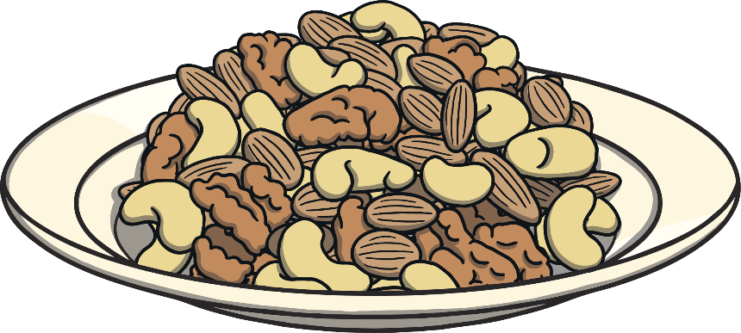
Do you know anybody who has
an allergy?
What are you going to do to keep them safe?

