Slide 1
Disclaimer
We hope you find the information on our website and resources useful.
Animations
This resource has been designed with animations to make it as fun and engaging as possible. To view the content in the correct formatting, please view the PowerPoint in ‘slide show mode’. This takes you from desktop to presentation mode. If you view the slides out of ‘slide show mode’, you may find that some of the text and images overlap each other and/or are difficult to read.
To enter slide show mode, go to the slide show menu tab and select either from beginning or from current slide.
You may wish to delete this slide before beginning the presentation.

Slide 3
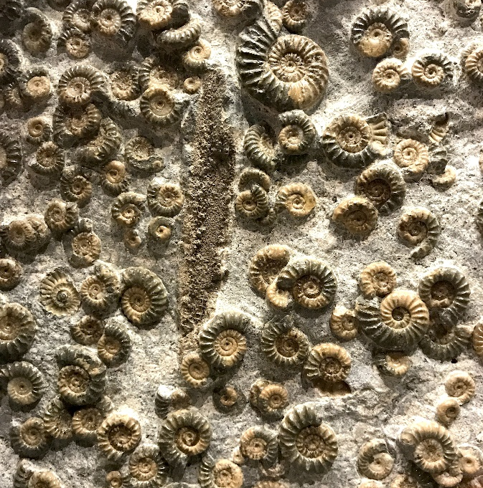
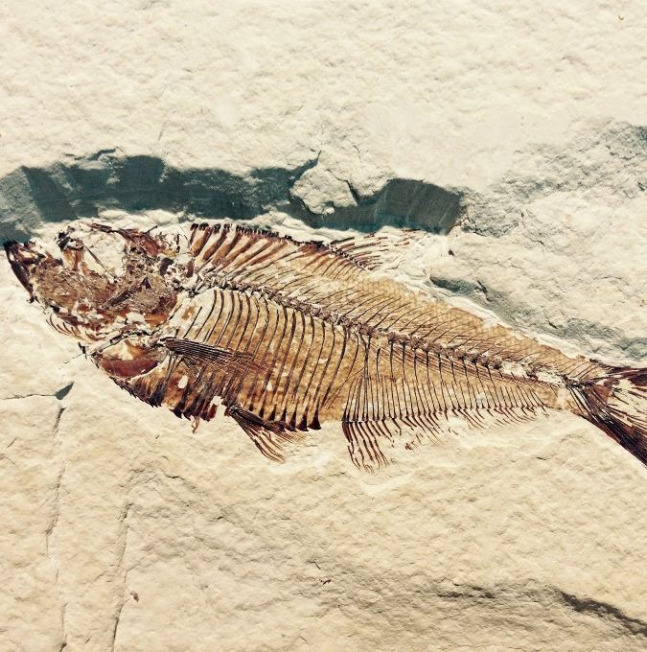
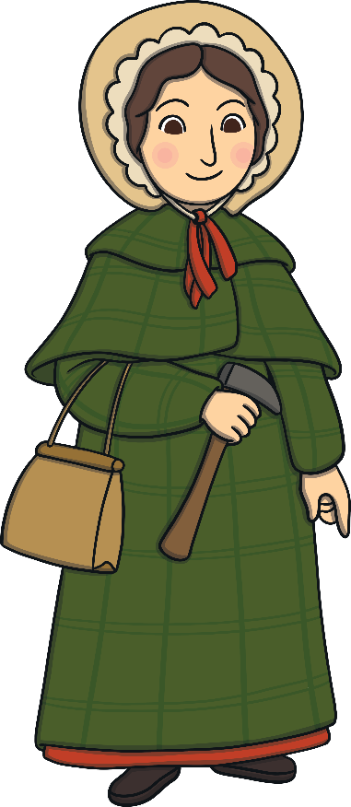
Fascinating Fossils
Have you ever seen a fossil?
Do you know any facts about fossils? Does anyone think they know who I am?
What did it look like?
Where was it?

Slide 4
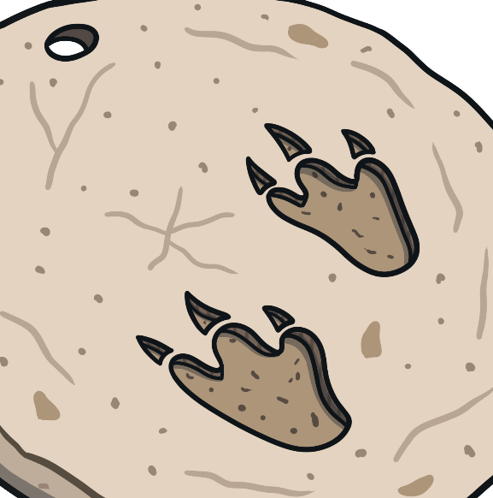
Fossil Facts
Fossils have been found in every continent all over the world.
Animals can fossilise but so does poo! These are called coprolites and fossilised dinosaur poo has even been found!
Fossilised dinosaur footprints have also been discovered. These are called ichnites.
If you knew I was Mary Anning, well done! I died over 150 years ago but I was an English fossil collector and palaeontologist. I am going to teach you all about fossils today!

Slide 5
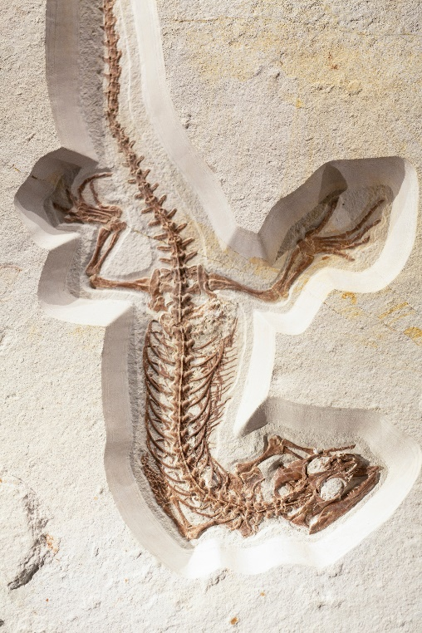
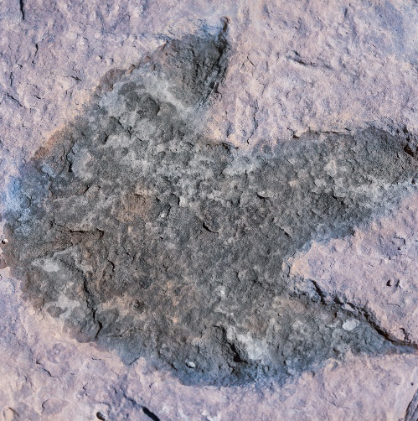
What Are Fossils?
Body Fossils
These are the remains of a plant or animal that was once alive.
Fossils are the remains or traces of animals or plants that were once alive. Fossils do not just have to include dinosaurs - they can include all living things. There are two types of fossil.
Trace Fossils
These are signs of something that was once alive, such as poo or footprints.
Look at the clues on the picture. What different types of fossils do you think you might find?

Slide 6
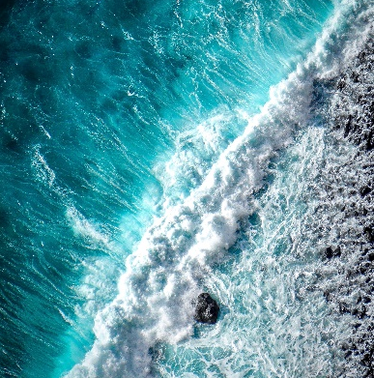
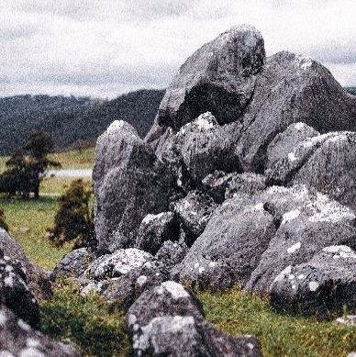
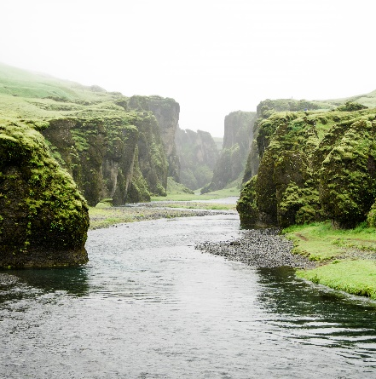
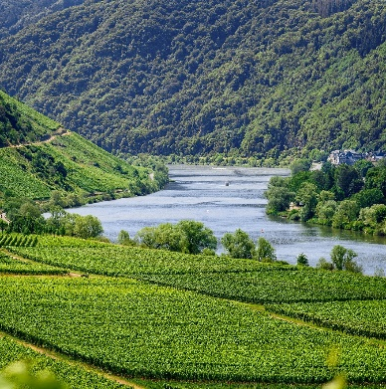
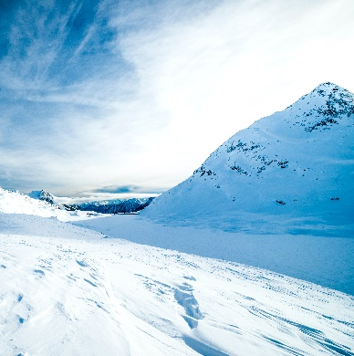
Where Can Fossils Be Found?
oceans
mountains
rocks and stones
rivers
Can you name some places where you think fossils might have been found?
valleys
ice

Slide 7
How Are Fossils Formed?
It’s very rare for living things to fossilise so if you have ever found a fossil you are very lucky! After animals die usually their bodies just rot away until nothing is left. Sometimes though, a fossil can be formed. This usually happens when an animal dies in a watery place and is then buried in mud.
After an animal dies the soft parts of its body rots away. This leaves the hard parts behind, such as the skeleton and over time this is buried by small pieces of rock. Over the years more and more pieces of rock, called sediment, form on top and gradually the sediment around the skeleton compresses down and turns to rock. The skeleton bones are then dissolved by water that washes through the rock and eventually the bones are replaced by minerals in the water and the fossil is formed.
How do you think fossils are formed?

Slide 8
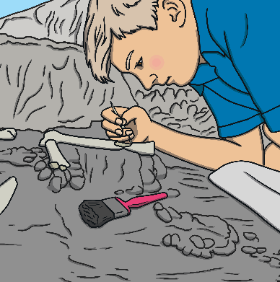
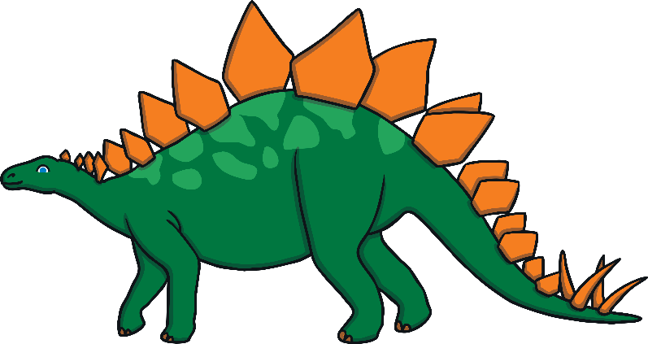
What Can We Learn From Fossils?
Palaeontologists study fossils.
We can learn what Earth used to be like.
We can discover what animals and plants used to live on Earth.
We can learn how animals have changed over time. We now know that birds evolved from small dinosaurs.
What do you think we can learn from fossils?

Slide 9
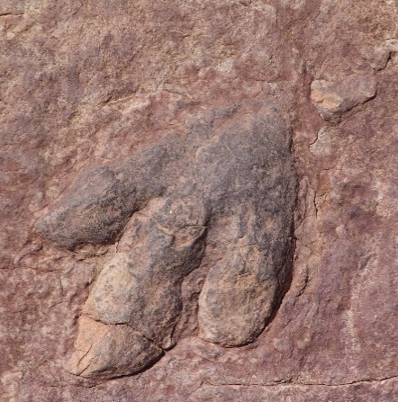
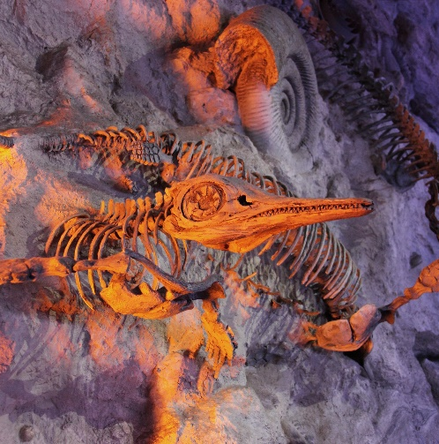
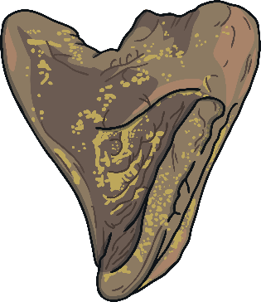
Facts About
Fossils
For something to be a fossil it usually has to be over 10,000 years old.
The oldest fossils are around 4 billion years old.
It is rare to find a whole fossilised animal. Scientists and palaeontologists usually discover parts of an animal, such as bones or teeth.

Slide 10
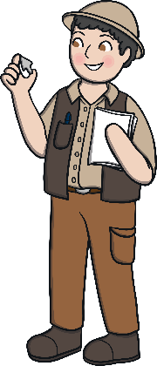
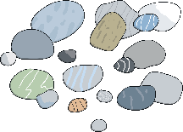
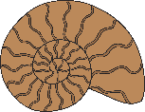
What Do We Know About Fossils?
What have you learned about fossils?

