Slide 2
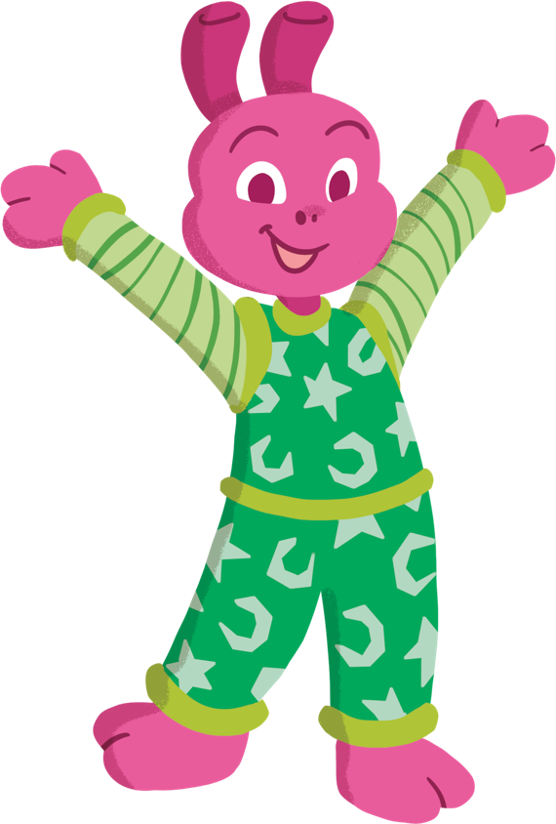
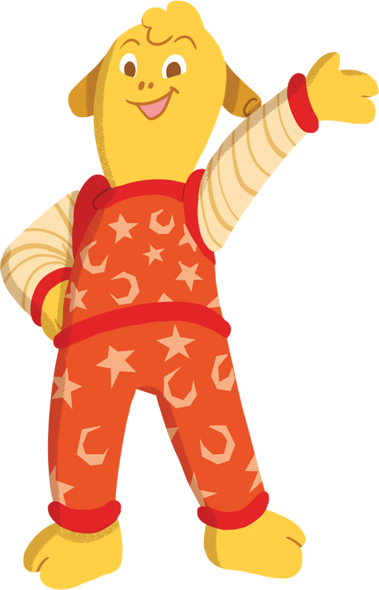
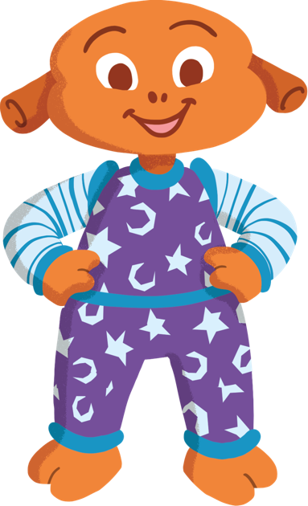
Hello! We’re Yoff, Zid and Mab. We are aliens!
Would you like to come and explore space with us?
You’ll need to be in a big space, like a hall.

Slide 3
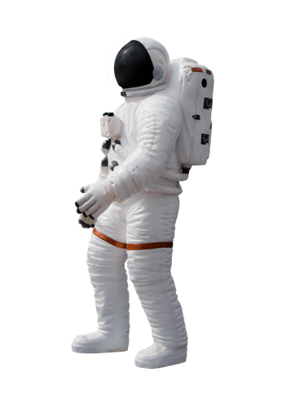
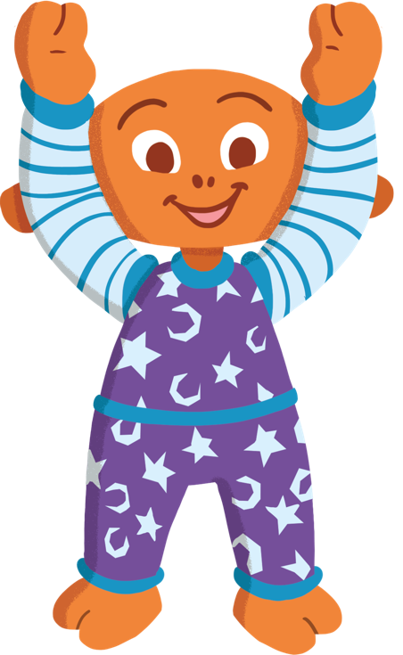
First, you’ll need to put on your imaginary spacesuit.
Put on your boots.
Put on your gloves.
Put on your oxygen pack.
Put on your helmet.

Slide 4
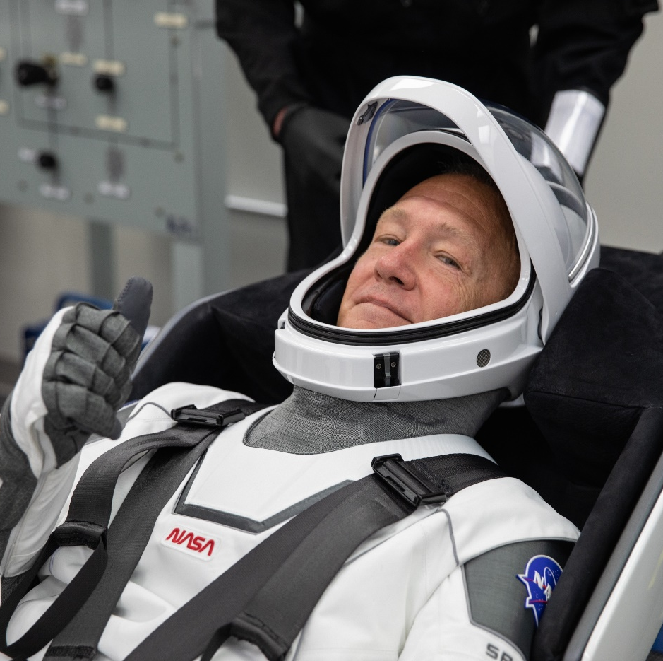
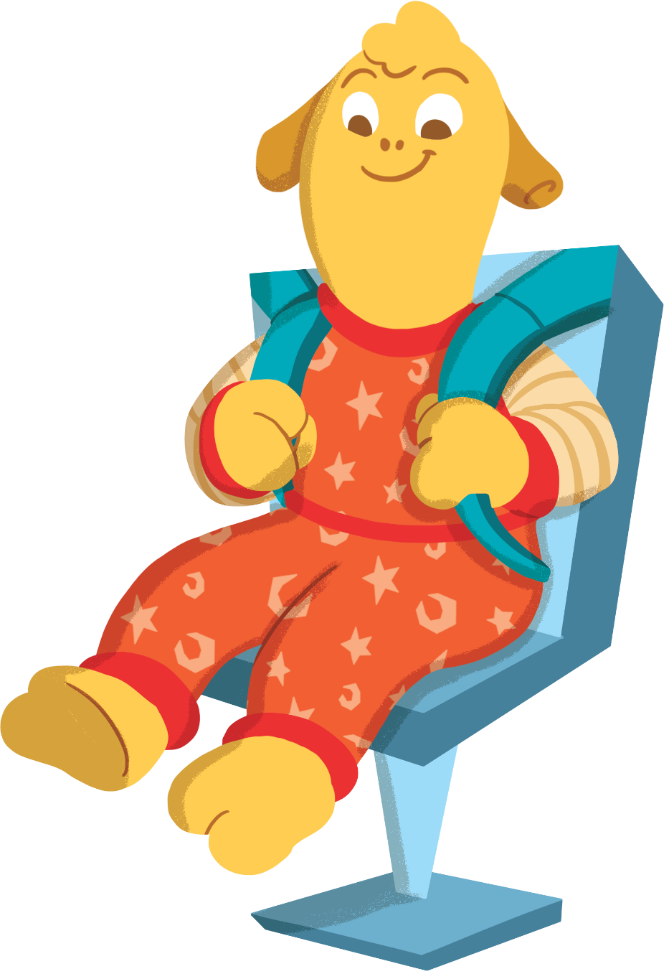
Next, it’s time to get into your rocket.
Climb in and find a seat.
Make sure you strap yourself in!

Slide 5
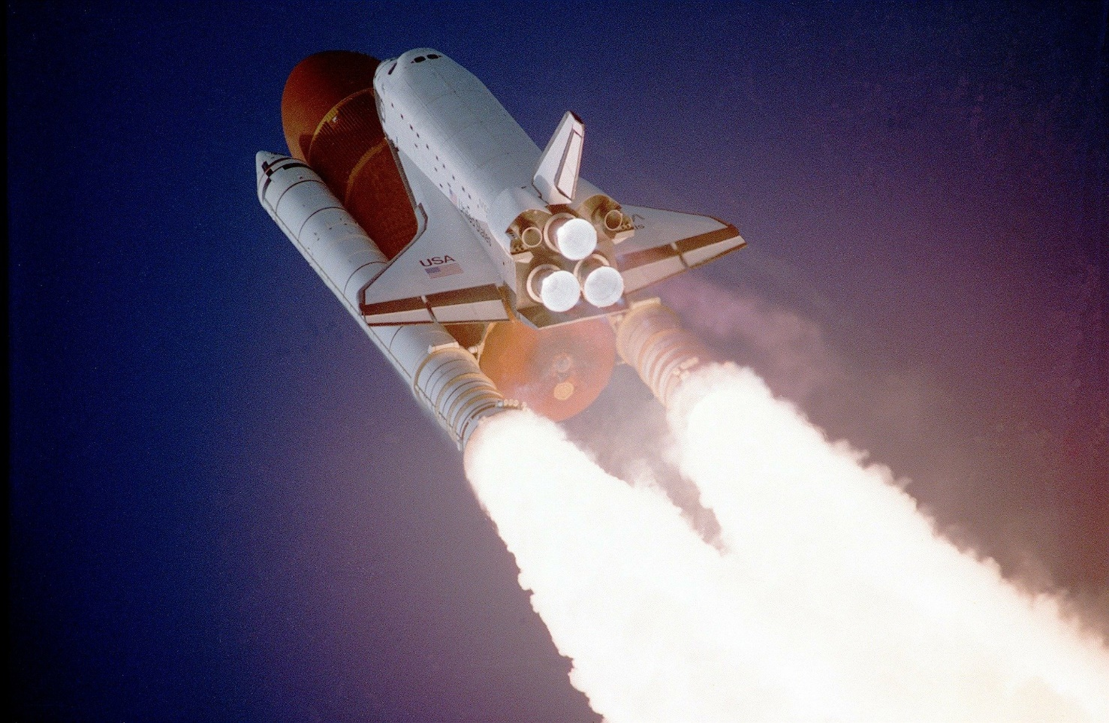
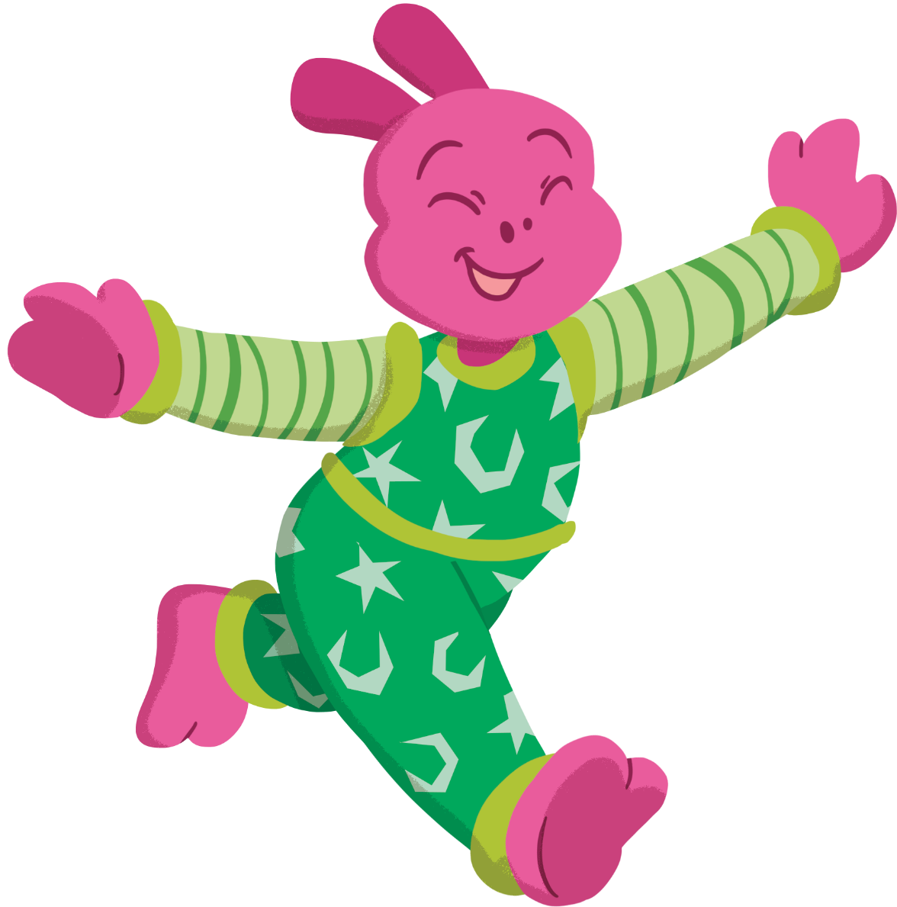
Get ready to launch!
5, 4, 3, 2, 1, blast off!
Zoom around like a rocket blasting into space!

Slide 6
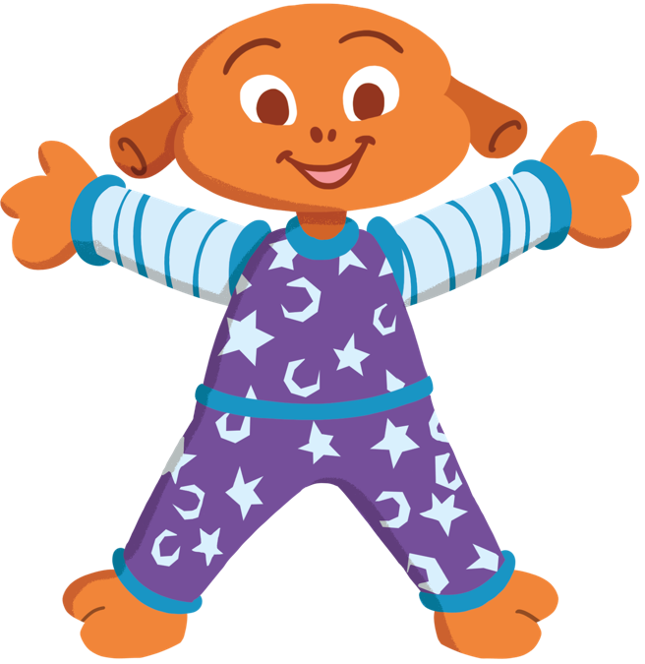
Wow! Here we are in space.
Can you twinkle like a star in the sky?

Slide 7
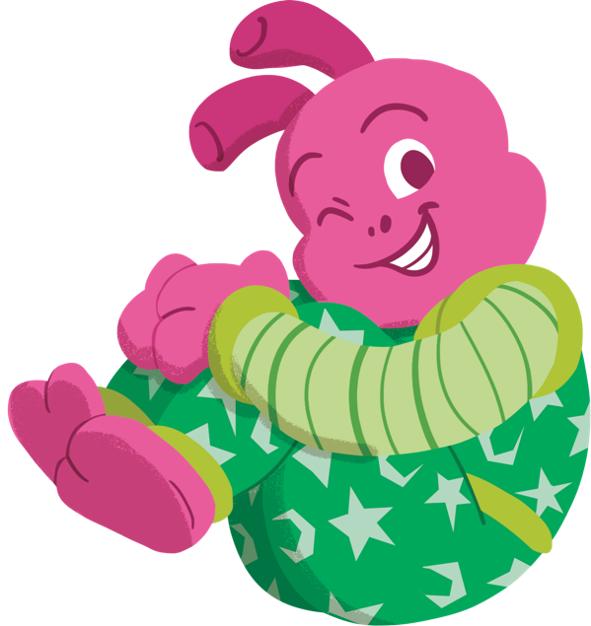
There’s Mercury! Mercury is the smallest planet in our solar system.
Can you make your body small like Mercury?

Slide 8
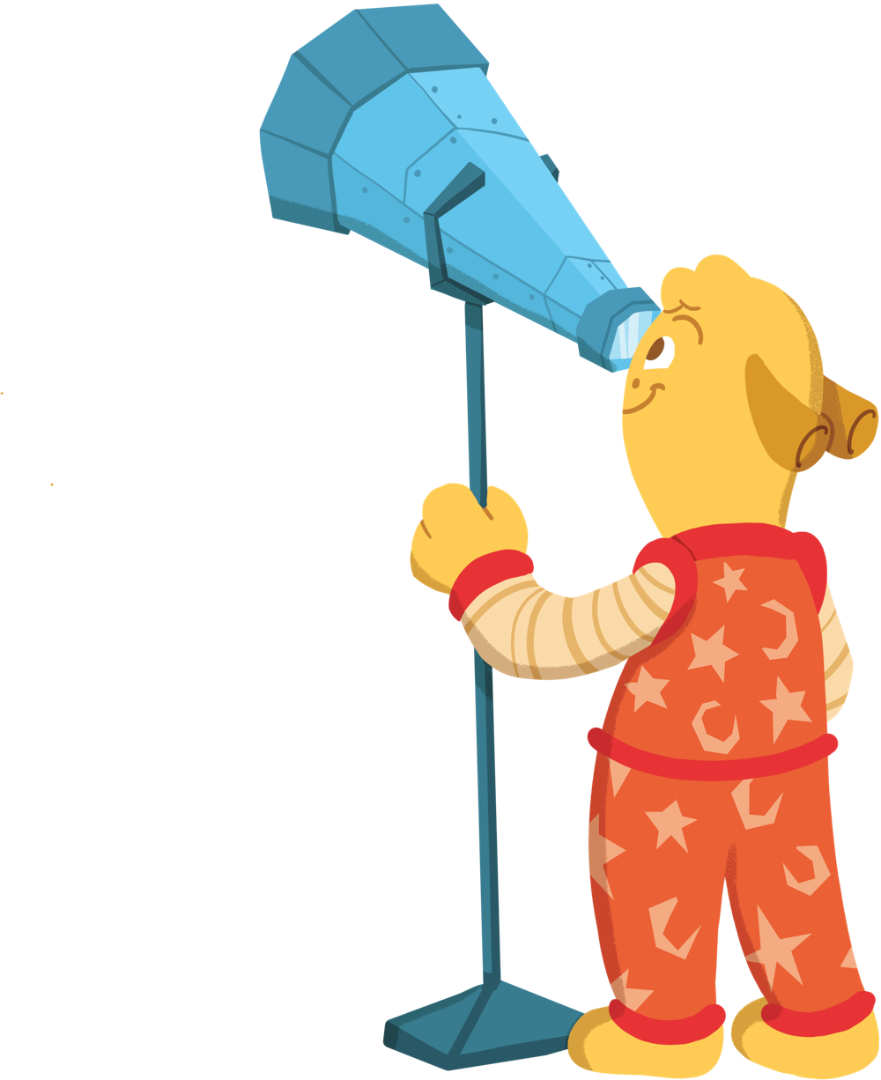
Use your hands to make a telescope and look into space.
Can you spot Venus over there?
It’s the hottest planet in our solar system!

Slide 9
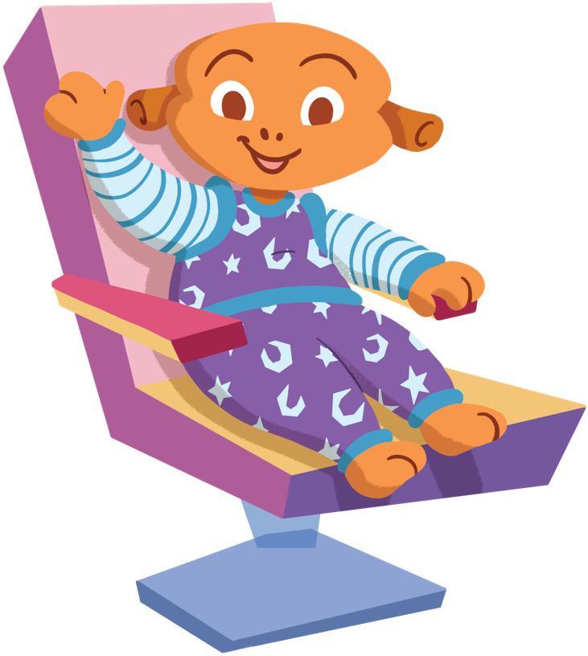
Time to head over to Mars.
Could there be any Martians living here?
Give them a big smile and a wave just in case.

Slide 10
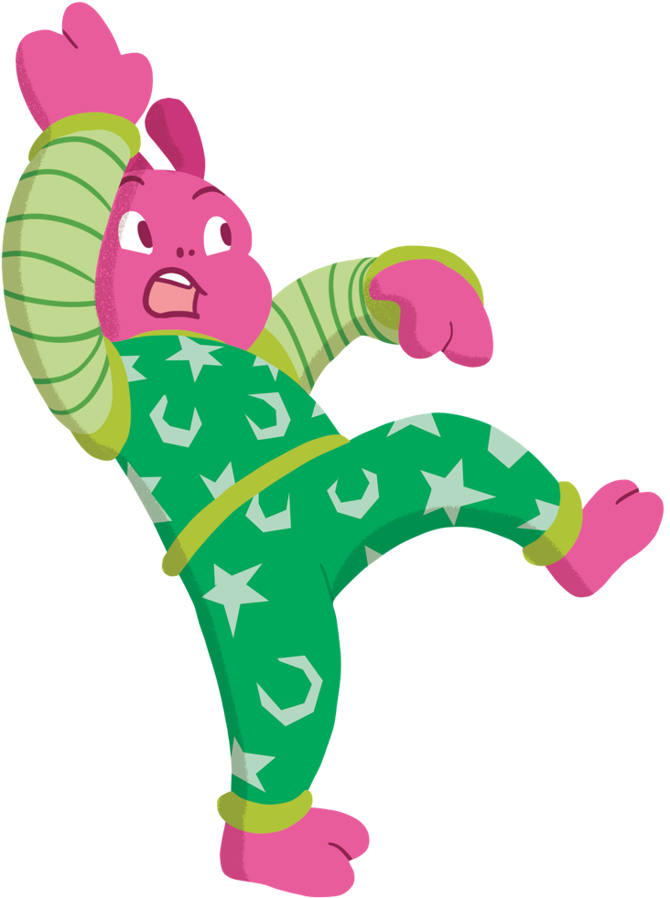
We’re just heading over to Jupiter now.
It has a giant storm that never ends!
Can you move like you are being
blown around in a storm?

Slide 11
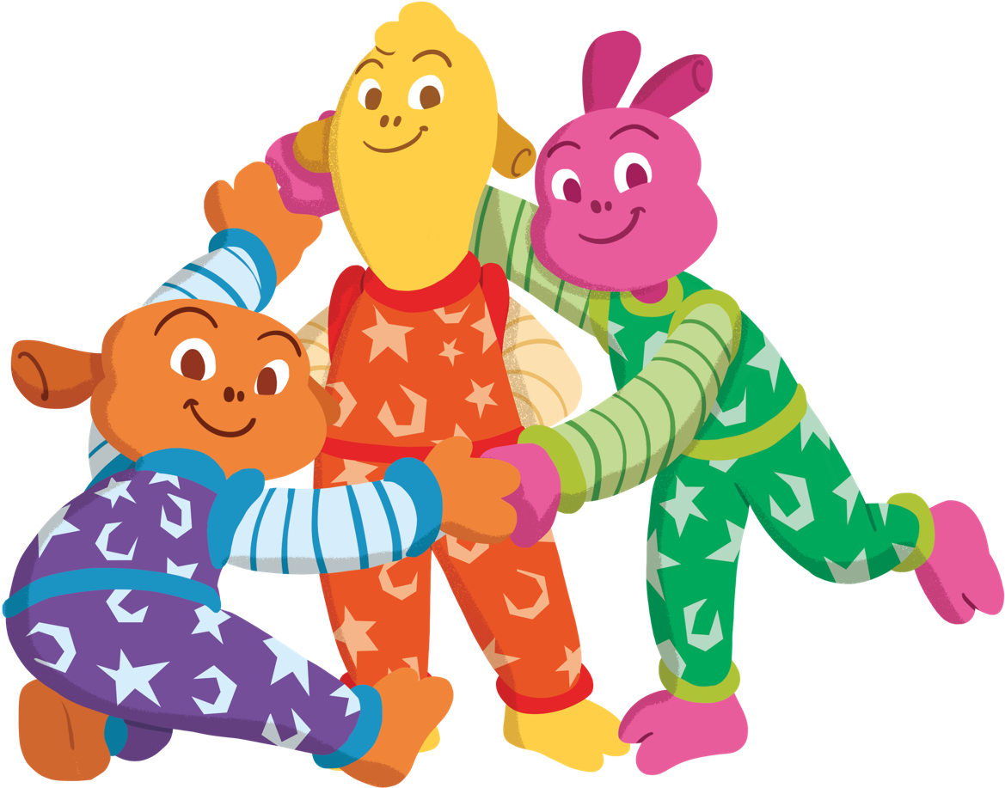
I see Saturn up ahead.
Get into groups of three or four.
One person stands still.
The other people hold hands
to make a ring around them.
Now, you look just like Saturn!

Slide 12
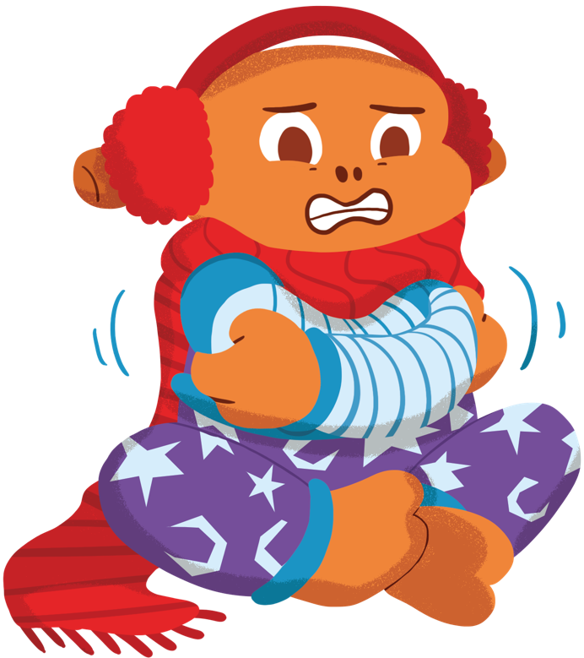
I spy Uranus.
This is the coldest planet in
our solar system.
Brr! How can you show that
you are cold?

Slide 13
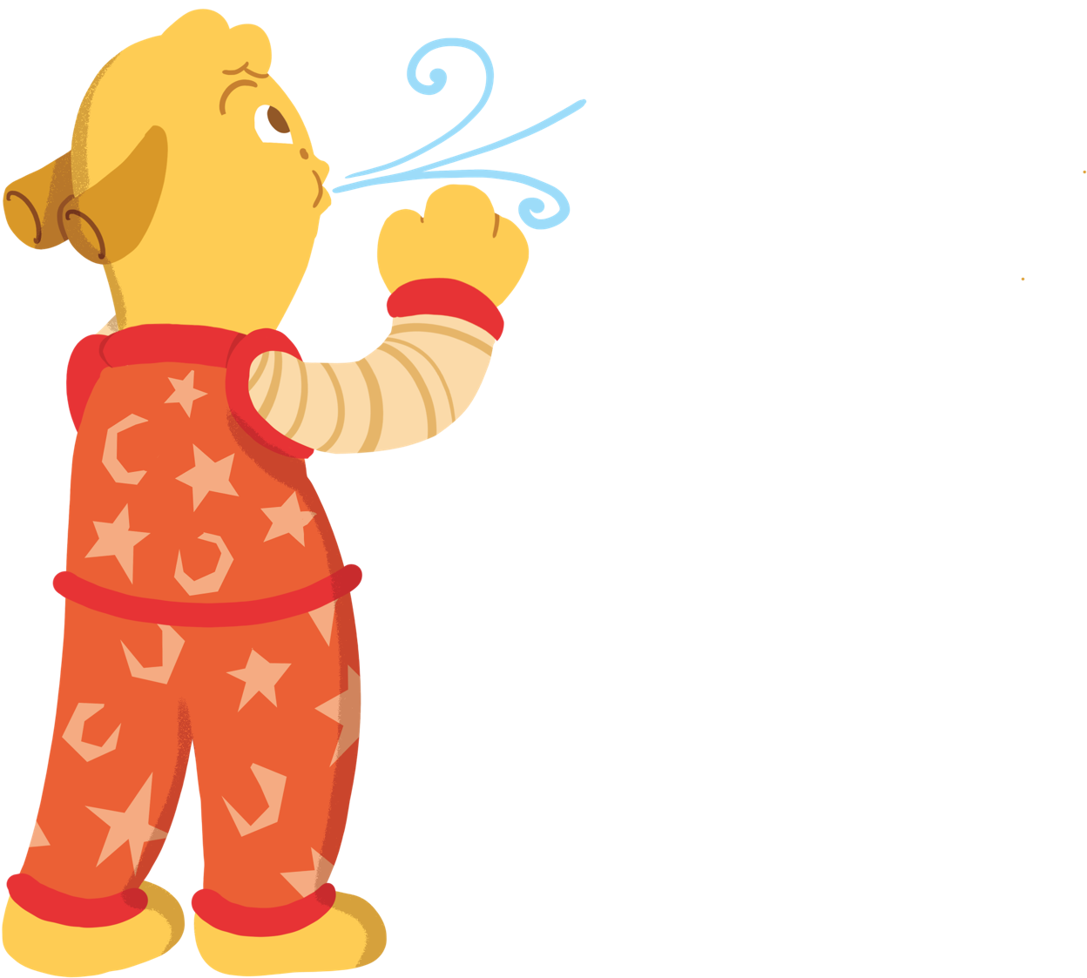
The furthest planet from the Sun is Neptune.
Neptune has the strongest winds in our solar system.
Can you use your mouth to blow a strong wind?

Slide 14
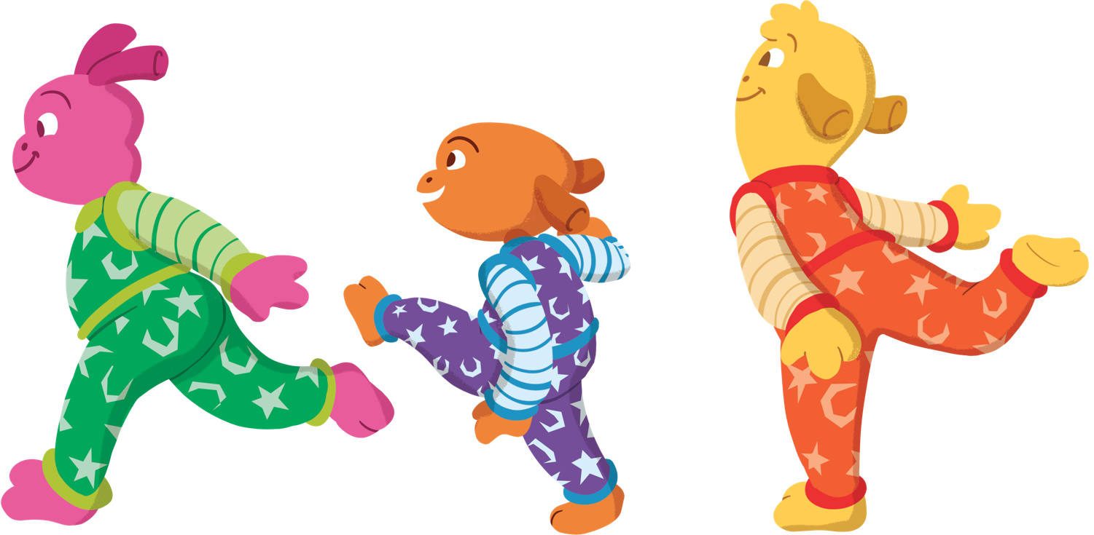
As we head back towards Earth, we might see some comets.
Can you make a comet shape with a group of friends?
One person should be at the front.
The others then make the tail.
Move your comet slowly through space.

Slide 15
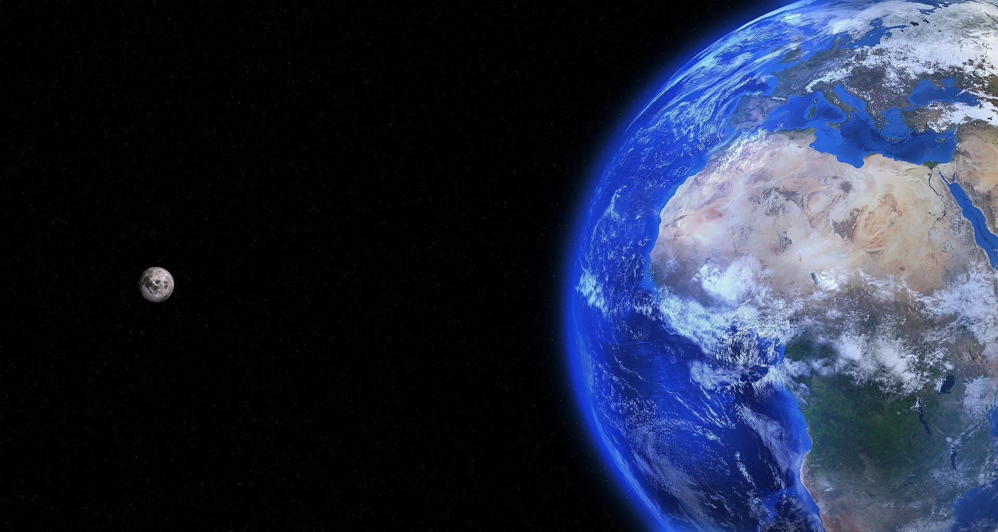
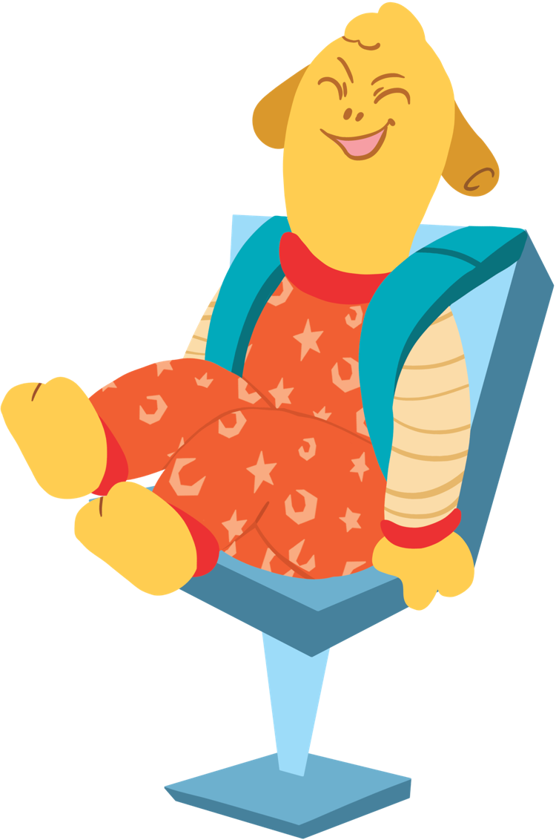
Before we land back on Earth, we
have time to visit the Moon.
Hold on tight and prepare for landing!

Slide 16
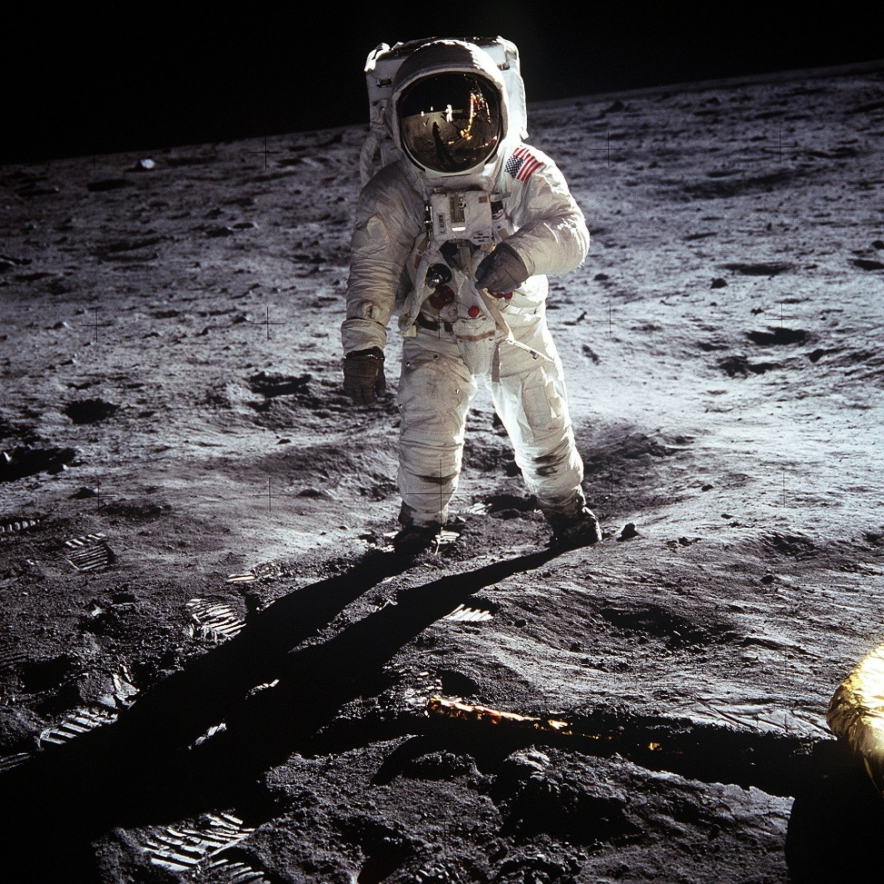
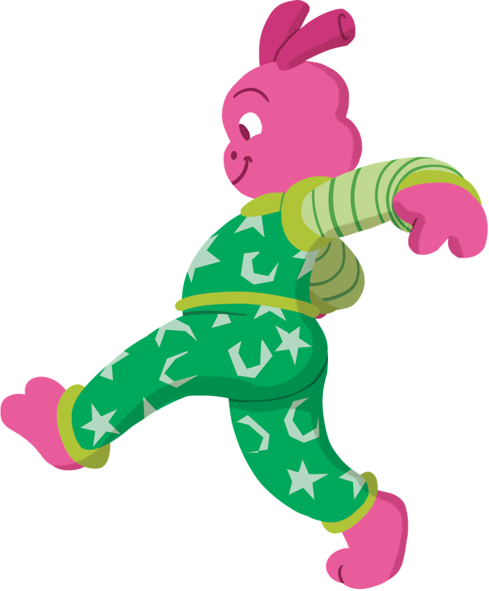
Here we are on the Moon. Step out of the rocket.
There is hardly any gravity on the Moon. Try taking big slow steps like you are on the Moon!

Slide 17
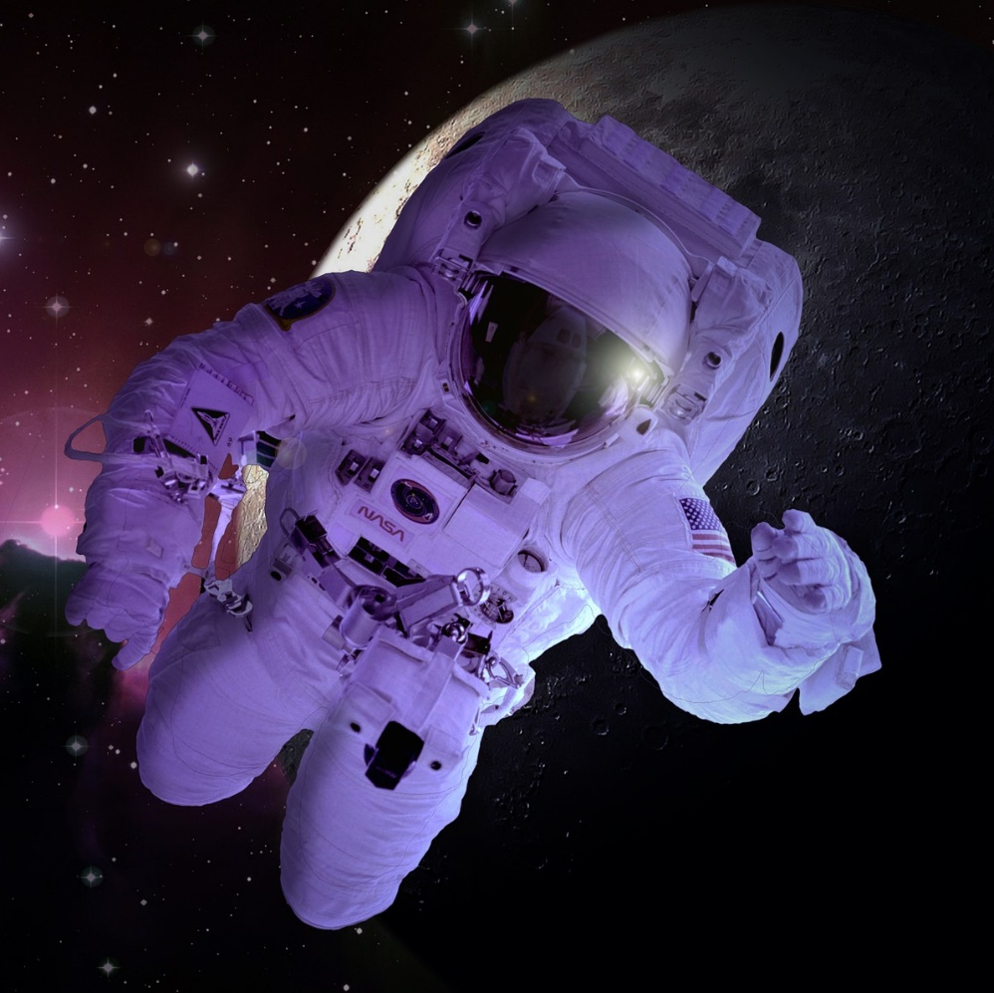
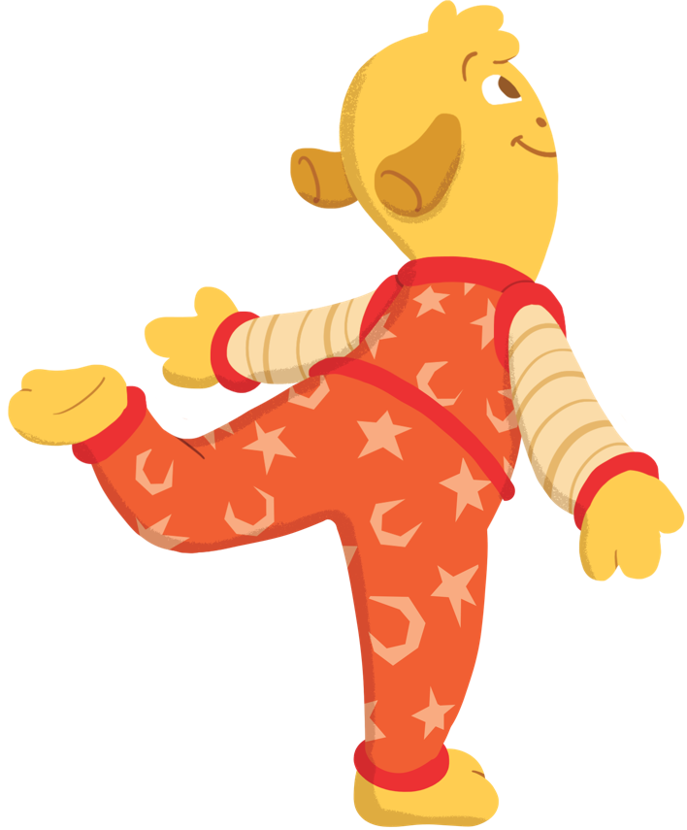
Before we head back to Earth, we can try one last thing.
Step outside of the rocket and leap into space. There is very little gravity here so it feels like you’re floating!
Can you float through the room like you are floating through space?

Slide 18
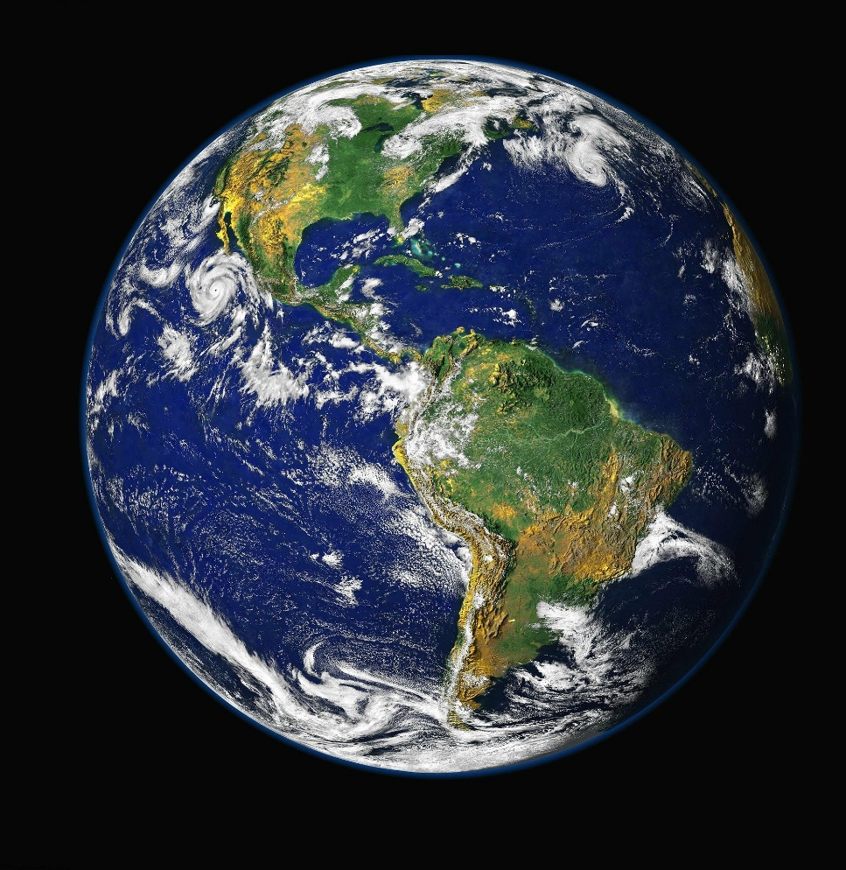
That’s the end of our space mission!
Let’s get back in the rocket and zoom back to Earth.

Slide 19
Thank you so much for coming to explore space with us.
Have fun on Earth!

