Slide 2
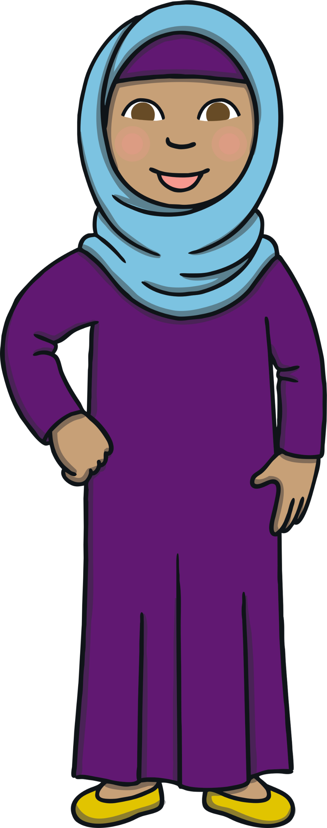
This Is Shamsa
Hello. My name is Shamsa. This is a very special time for my family because it is Ramadan. My family and I are Muslim.

Slide 3
What Is Ramadan?
During Ramadan, grown-ups and older children do not eat when the sun is in the sky. This is called fasting.
My mum and dad eat a meal before the sun rise, called suhoor, and a meal when the sun sets, called Iftar.
I am too young to fast at the moment.

Slide 4
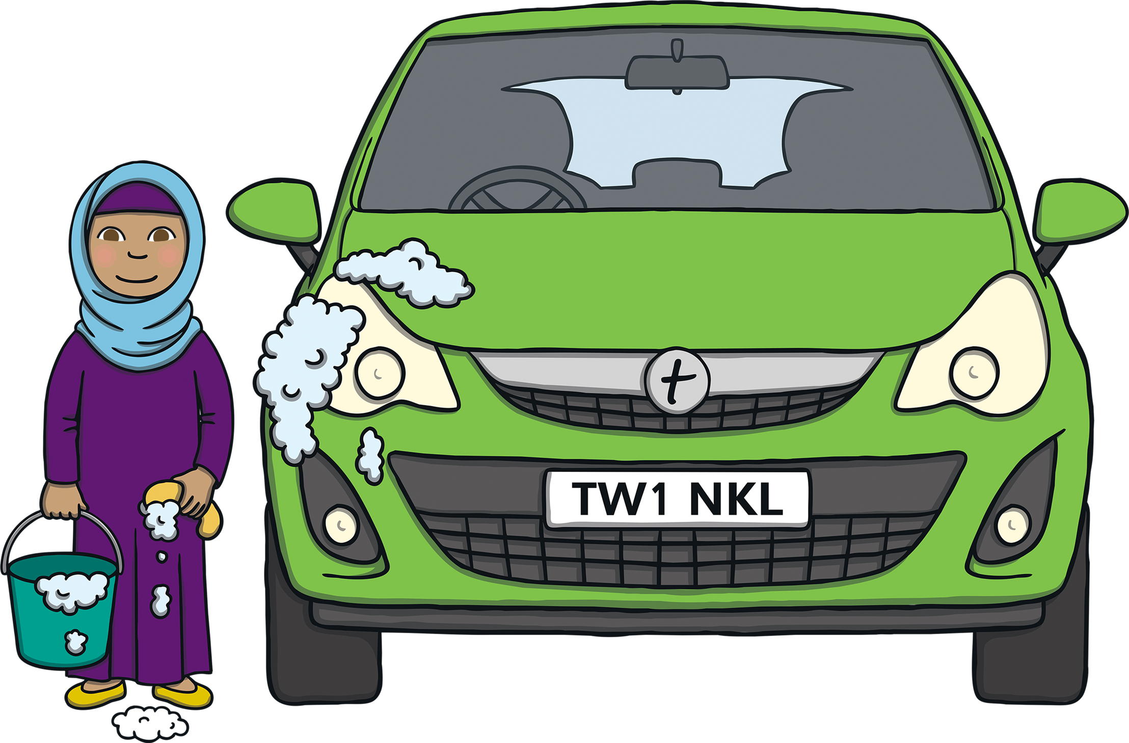
Being Kind
During Ramadan, I try to be really kind to other people. Everyday, I try to do a good deed.
Today, I am helping my dad by cleaning his car.

Slide 5
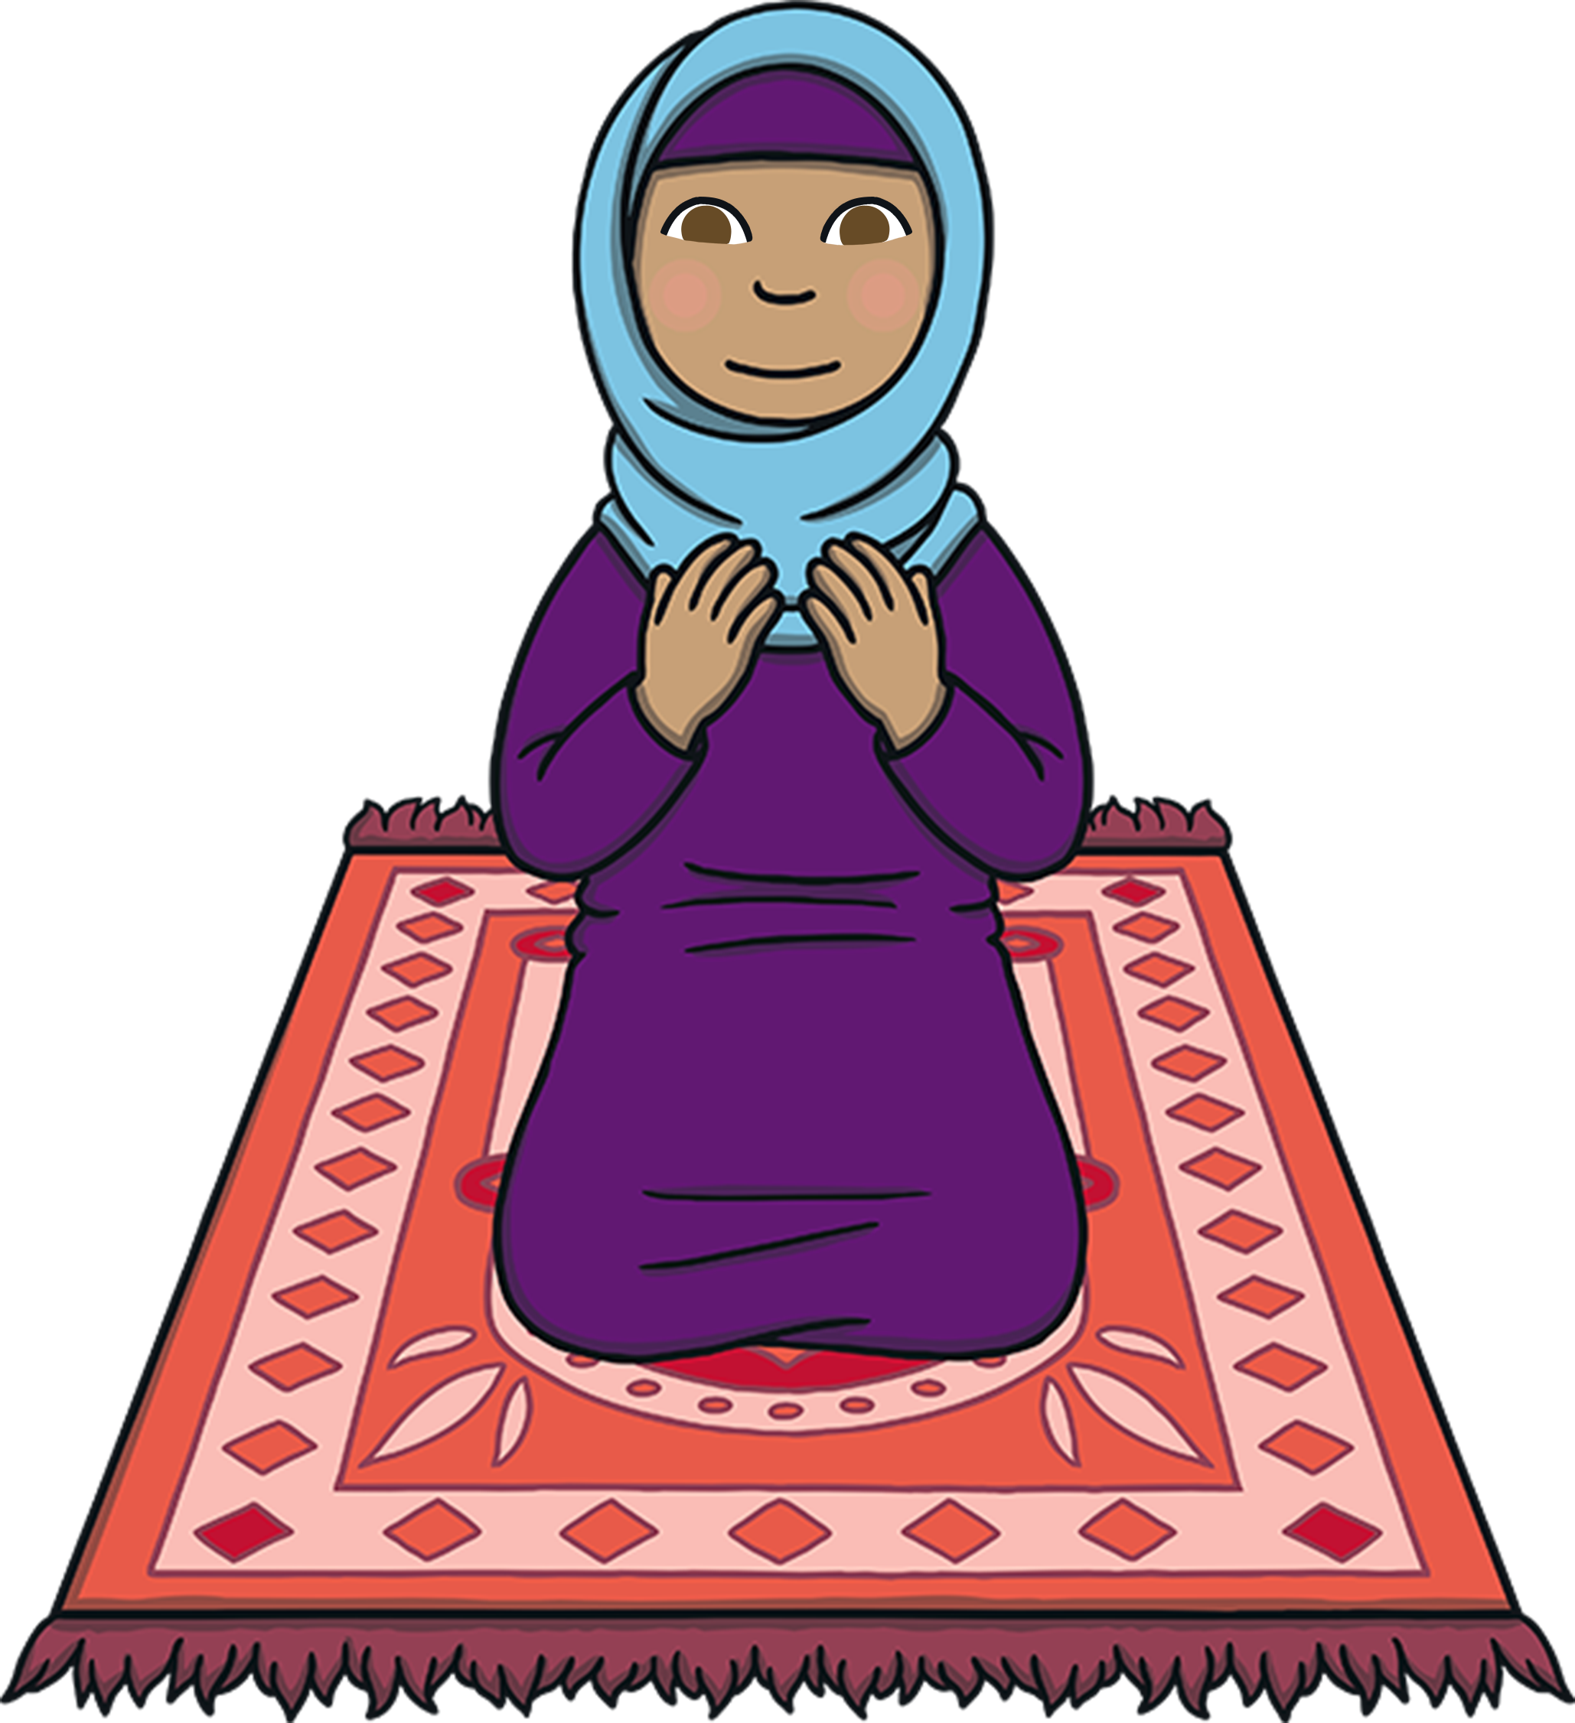
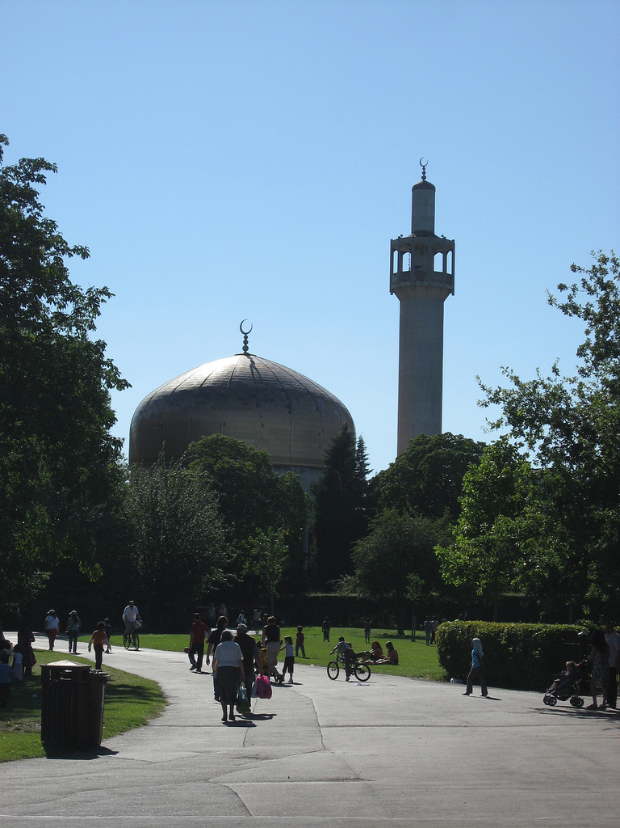
Prayer
During Ramadan, we pray more than normal. Sometimes, I pray at the Mosque and sometimes, I pray at home.
This is my Mosque. It has a domed roof and a Minaret. The Minaret is a tall tower, which is used to call everyone to prayer.
Photo courtesy of Kai Hendry (@flickr.com) - granted under creative commons licence – attribution

Slide 6
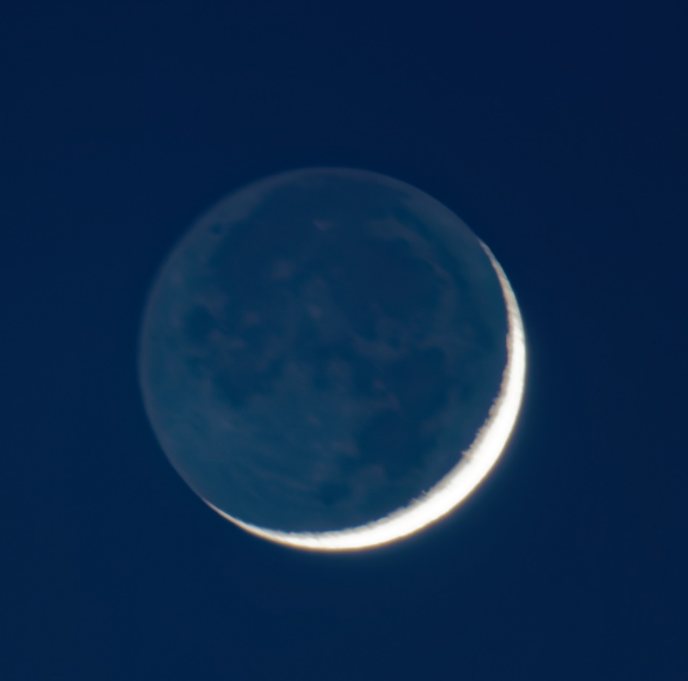
How Long Does Ramadan Last For?
Ramadan last for 29 or 30 days. We know that it is the end of Ramadan when a new crescent moon is spotted in the sky.
I look in the sky for the new crescent moon.
Photo courtesy of Pascal Volk (@flickr.com) - granted under creative commons licence – attribution

Slide 7
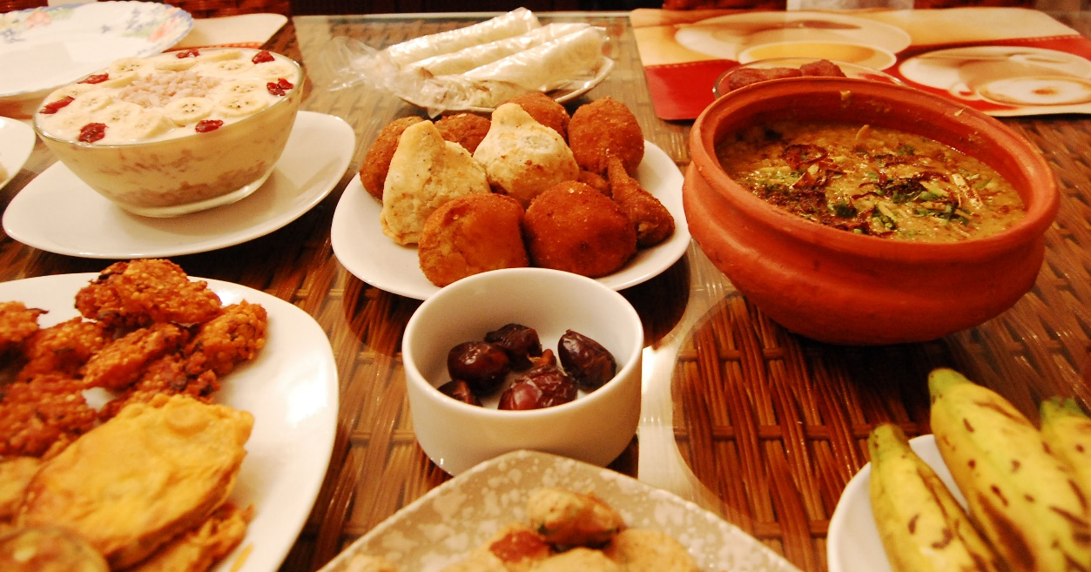
Eid Al-Fitr
At the end of Ramadan, we have a big celebration, called Eid al-Fitr. We wear our best clothes and eat lots of yummy foods.
I help my mum to cook food for our family.
Eid Mubarak
Photo courtesy of raasiel (@flickr.com) - granted under creative commons licence – attribution

