Slide 2
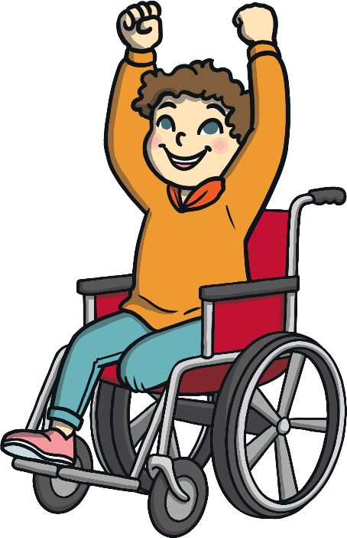
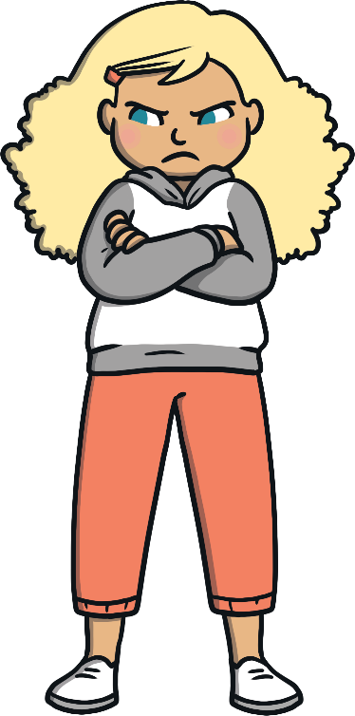
Feelings
happy
sad
scared
angry
“Title of Image Used” by [Author] is licensed under CC BY 2.0

Slide 3
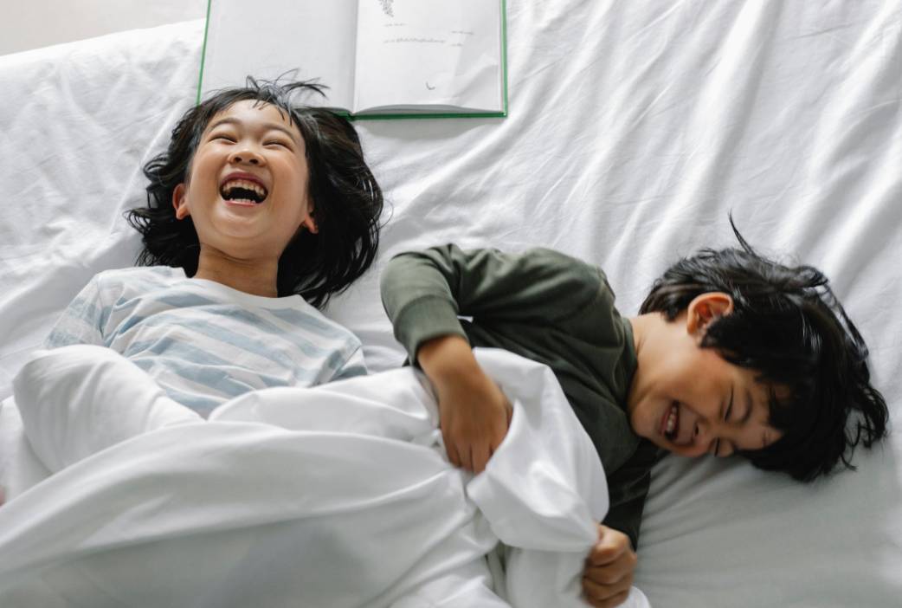
Feelings
How do these children feel?
Why do you think they feel like this?
What makes you feel happy?

Slide 4
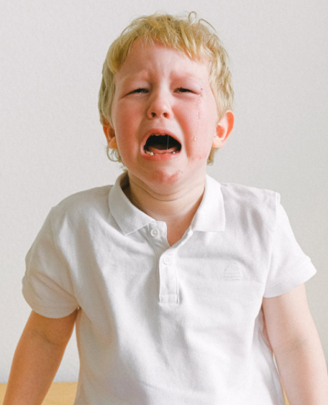
Feelings
How does this boy feel?
Why do you think he feels like this?
What cheers you up when you feel sad?

Slide 5
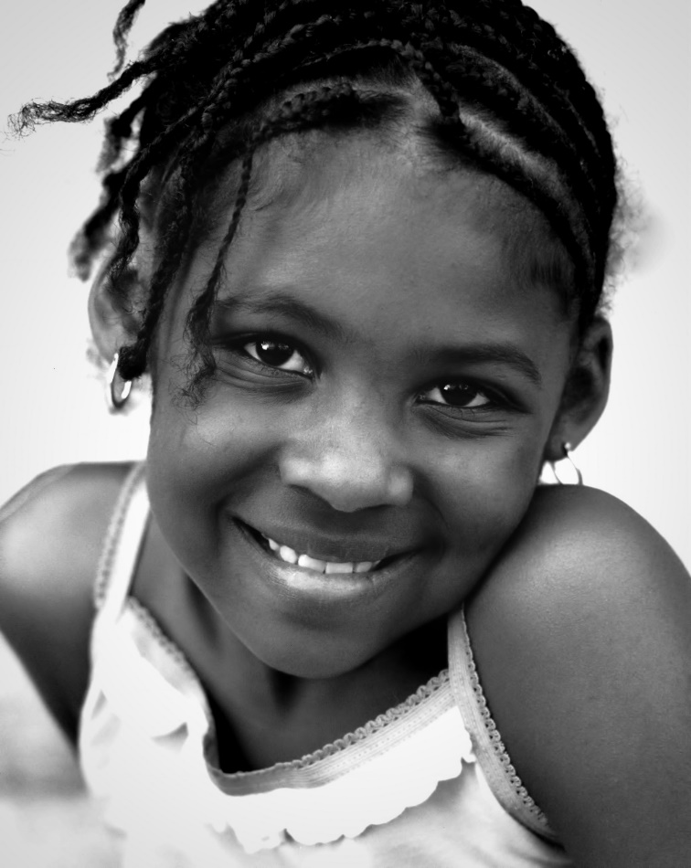
Feelings
How does this girl feel?
Why do you think she feels like this?
What is another word for happy?

Slide 6
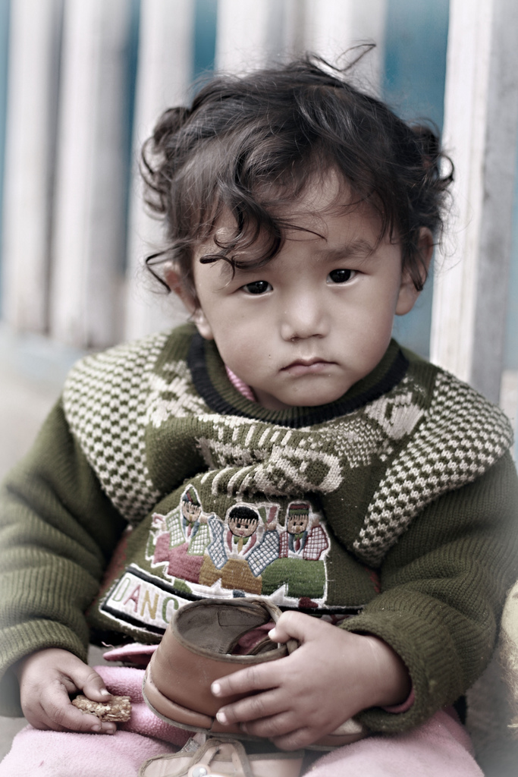
Feelings
How does this boy feel?
Why do you think he feels like this?
What cheers you up when you feel sad?

Slide 7
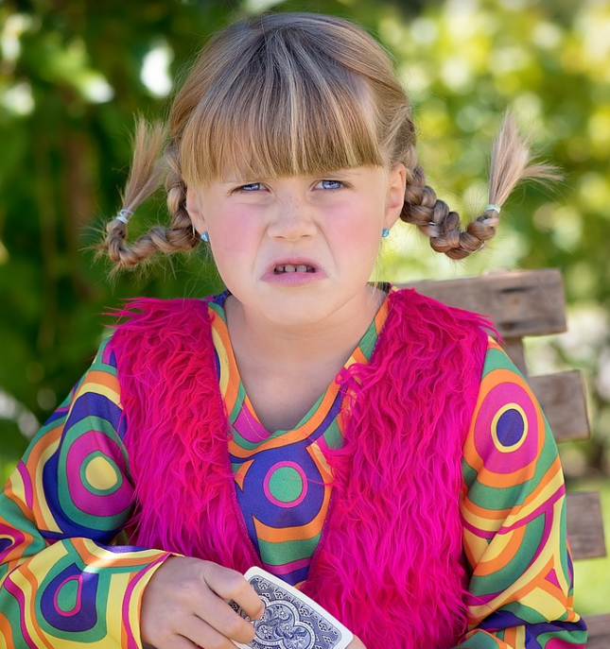
Feelings
How does this girl feel?
Why do you think she feels like this?
What is another word for angry?

Slide 8
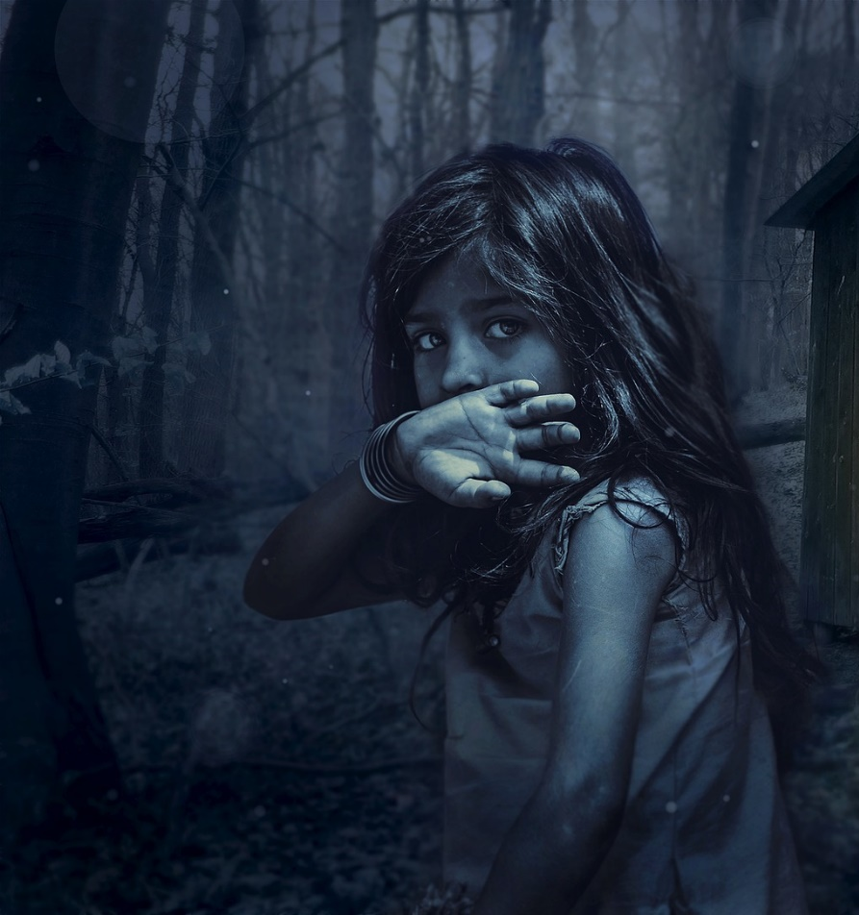
Feelings
How does this girl feel?
Why do you think she feels like this?
What makes you scared?

Slide 9
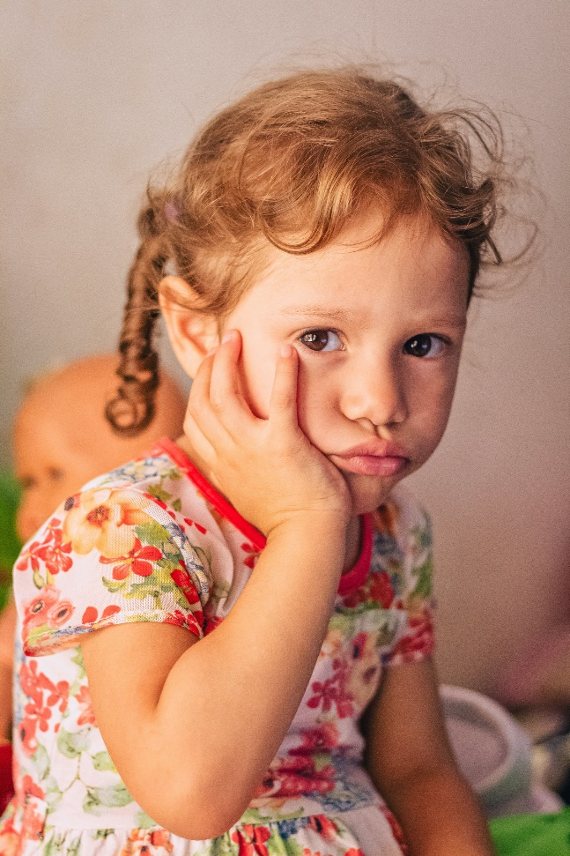
Feelings
How does this girl feel?
Why do you think she feels like this?
What is another word for sad?

Slide 10
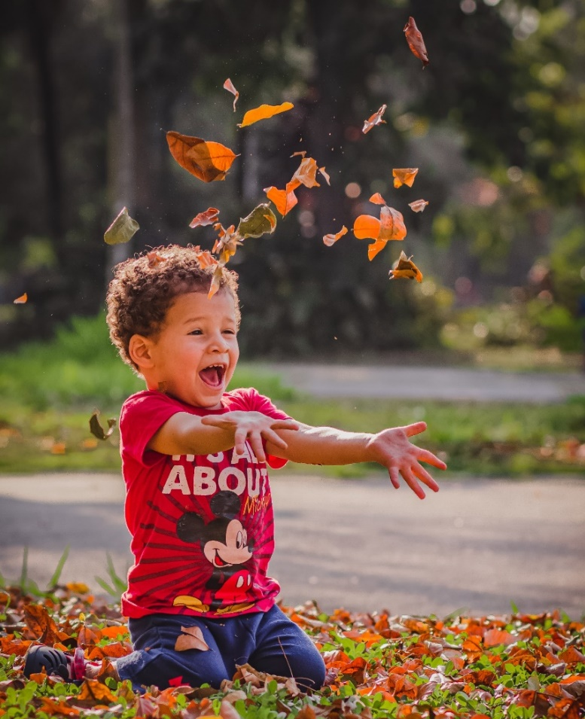
Feelings
How does this boy feel?
Why do you think he feels like this?
What makes you feel happy?

Slide 11
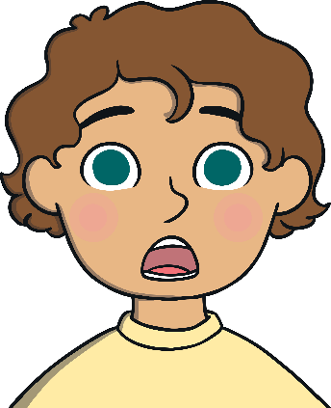
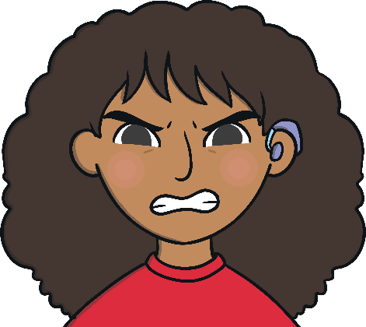
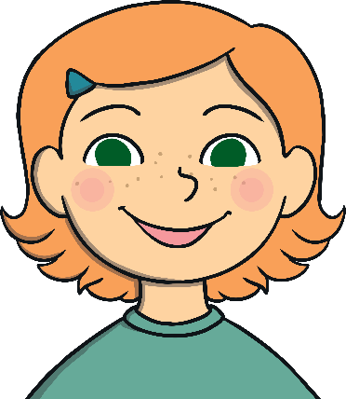
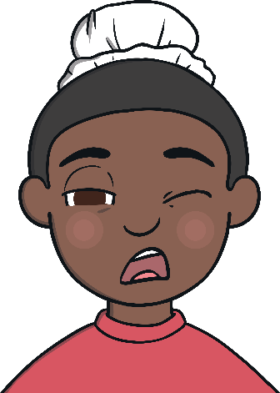
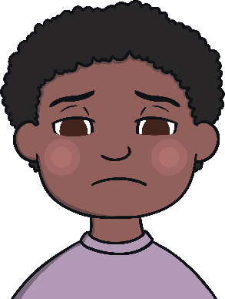
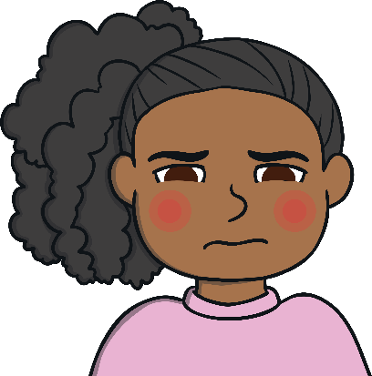
Feelings
shocked
angry
happy
tired
sad
embarrassed

