Slide 1
Disclaimer/s
We hope you find the information on our website and resources useful.
Animations
This resource has been designed with animations to make it as fun and engaging as possible. To view the content in the correct formatting, please view the PowerPoint in ‘slide show mode’. This takes you from desktop to presentation mode. If you view the slides out of ‘slide show mode’, you may find that some of the text and images overlap each other and/or are difficult to read.
To enter slide show mode, go to the slide show menu tab and select either from beginning or from current slide.
You may wish to delete this slide before beginning the presentation.

Slide 3
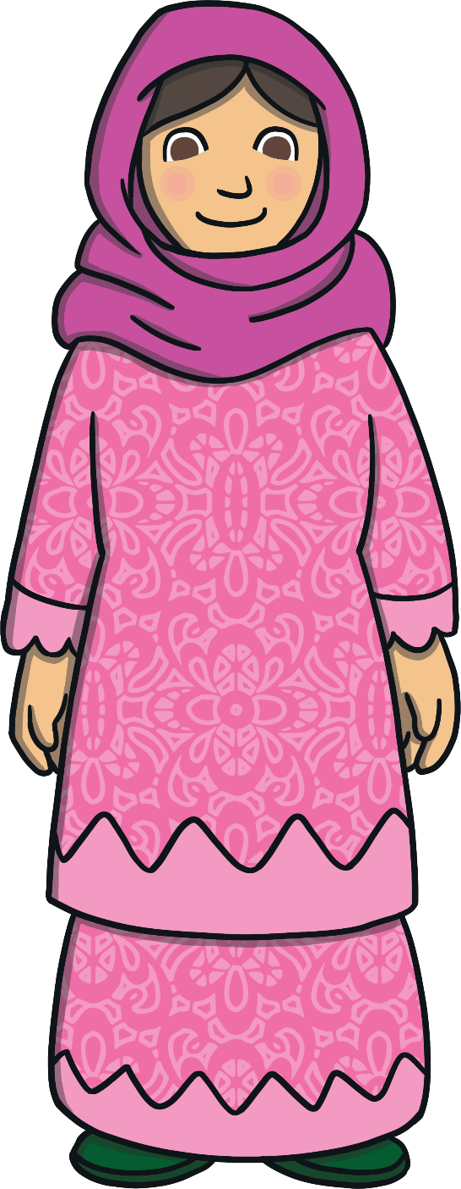
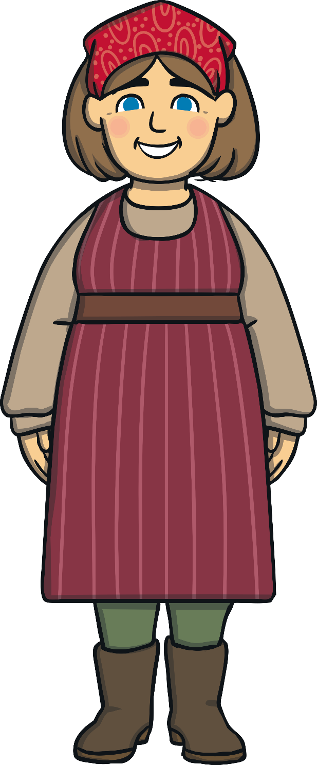
Mums Are Special

Slide 4
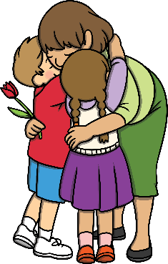
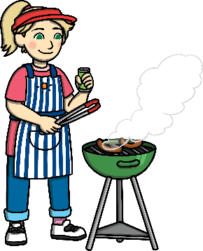
Mums Are Special
Every mum is a very special person. They take care of you and love you very much.
Mother's day is a chance for you to celebrate your mum and give them an extra special 'thank you'!
Every mum is different and every mum is special! How is your mum different to other mums?

Slide 5
How My Mum is Special
Can you think of some words that describe your mum?
kind
caring
thoughtful
lovely
funny
beautiful
clever
interesting
amazing

Slide 6
How My Mum is Special
What other ways is your mum special?
Talk About It
Talk to the person next to you about how your mum is special and the wonderful things she does.

Slide 7
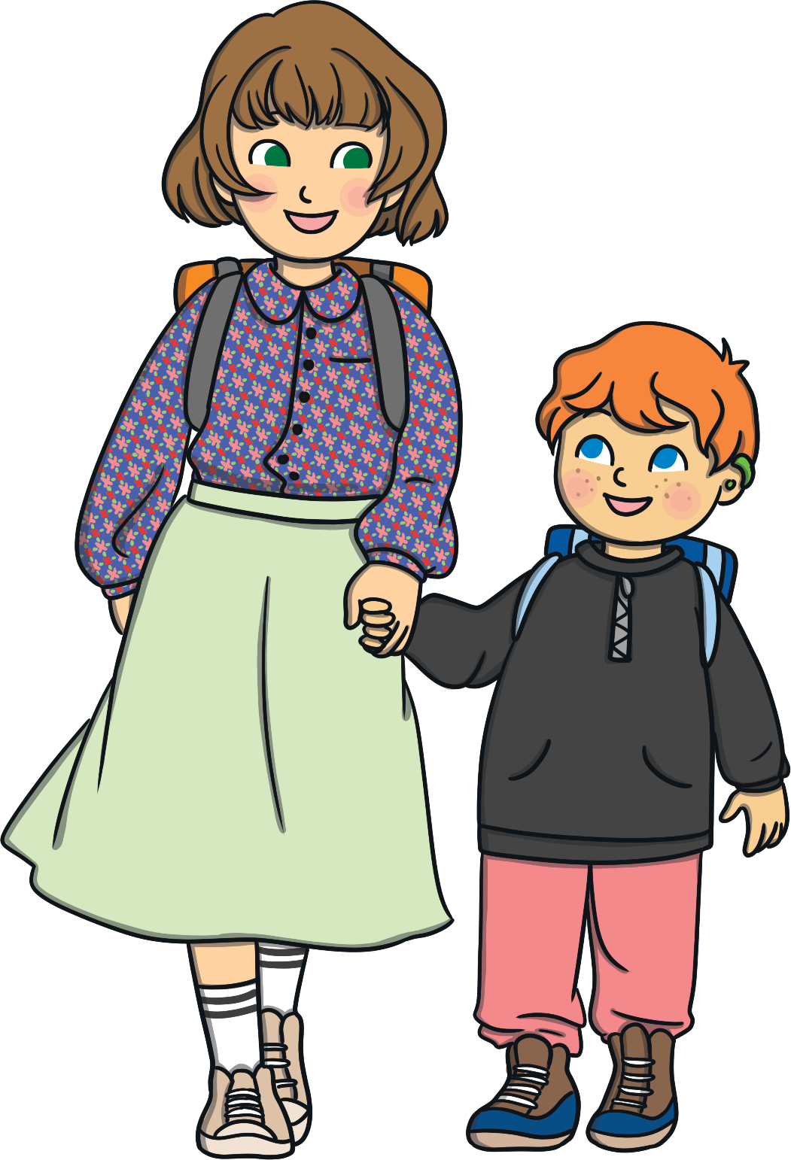
My Mum Helps Me
How does your mum help you?
Makes me food when I’m hungry.
Reads me bedtime stories.
Helps me to get dressed.
Cheers me up when I’m upset.
Buys me clothes or things I might need.
Can you think of any other ways your mum helps you?

Slide 8
How My Mum is Special
How can you be kind to your mum?
Get ready for school on time.
Make her a drink.
Draw her a picture.
Ask her how her day has been.
Put things away when you are asked to.

Slide 9
Have You Any Other Special People in Your Life?
We can have lots of special people in our lives who could be like a mum to us.
Can you name some of these other special people in your life?
grandad
step-parents
uncle
dad
cousin
granny
aunt
What makes them special?

