Slide 2
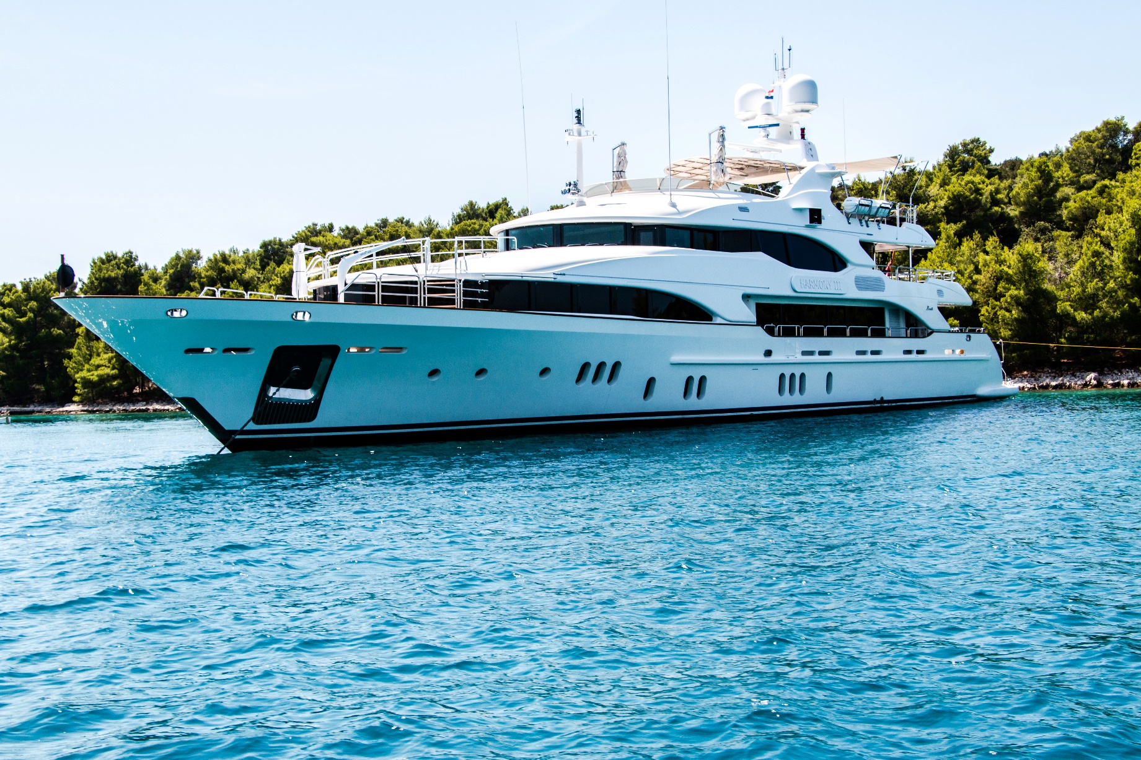
Yacht

Slide 3
Boat

Slide 4
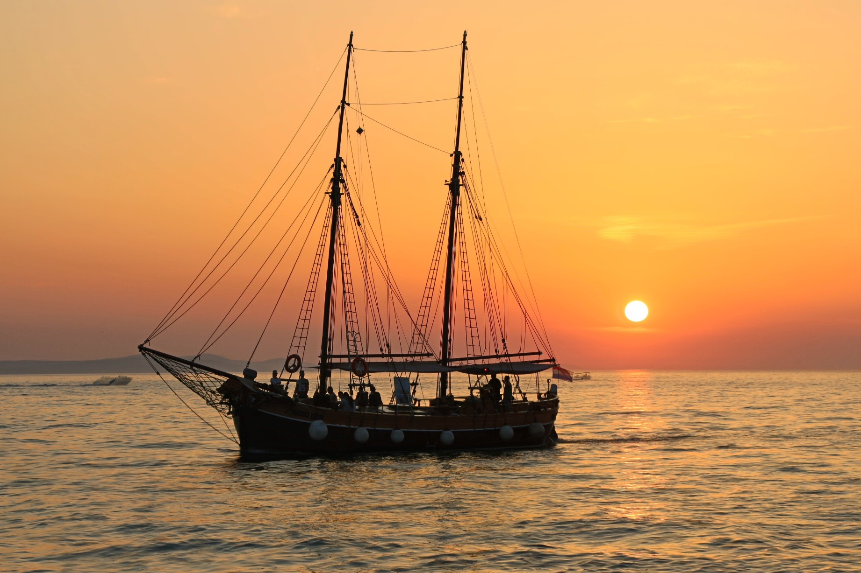
Ship

Slide 5
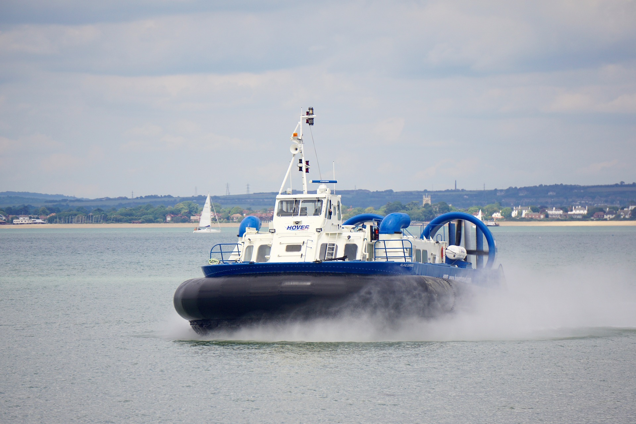
Hovercraft

Slide 6
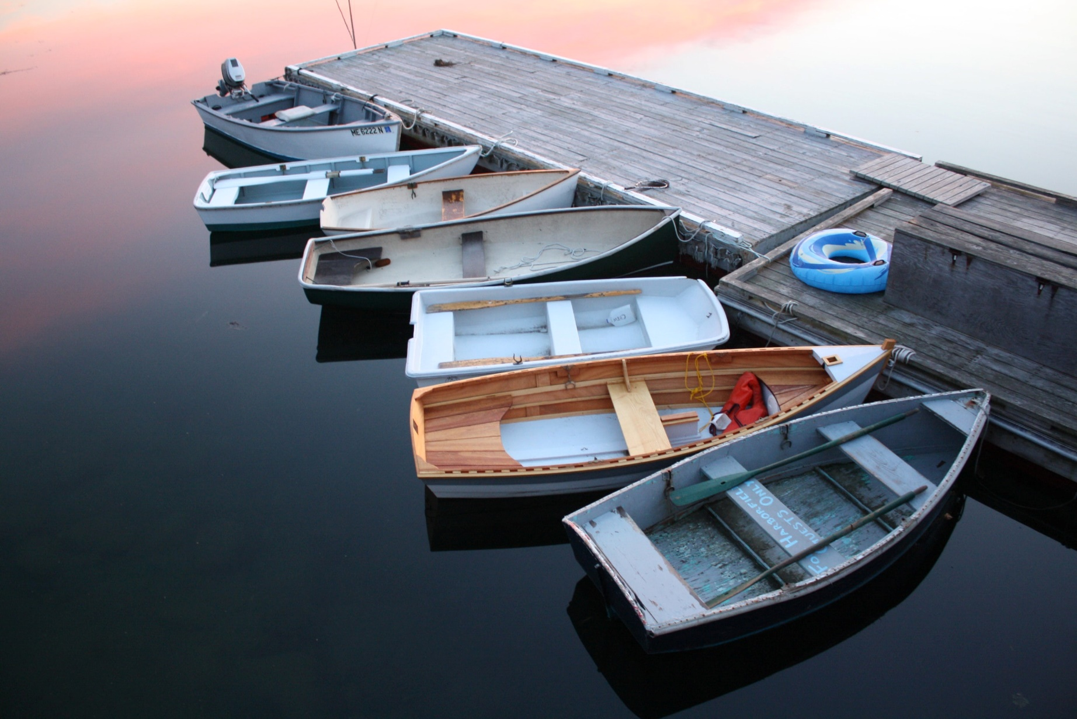
Dinghy

Slide 7
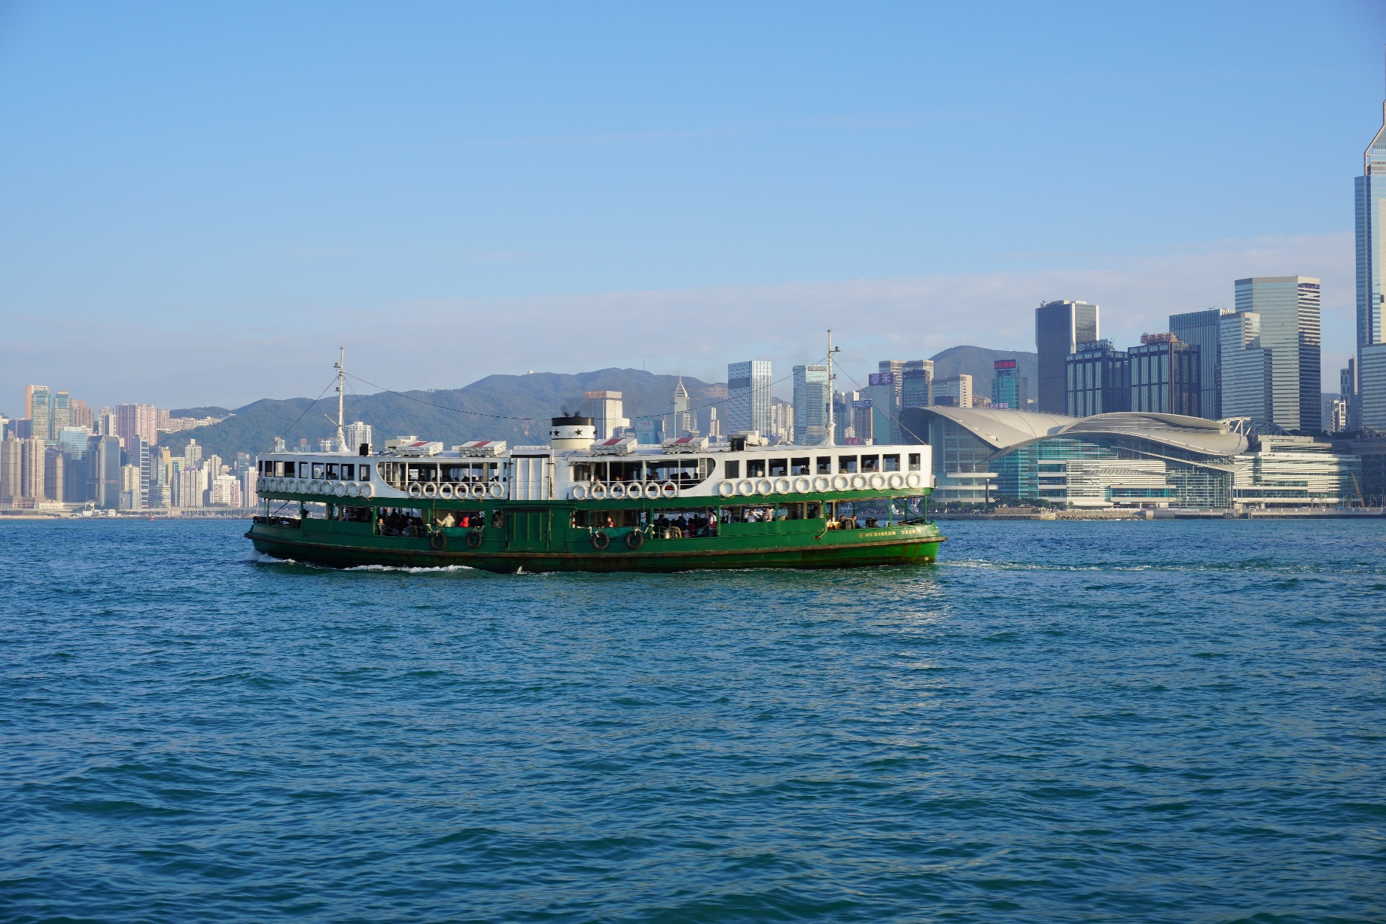
Ferry

Slide 8
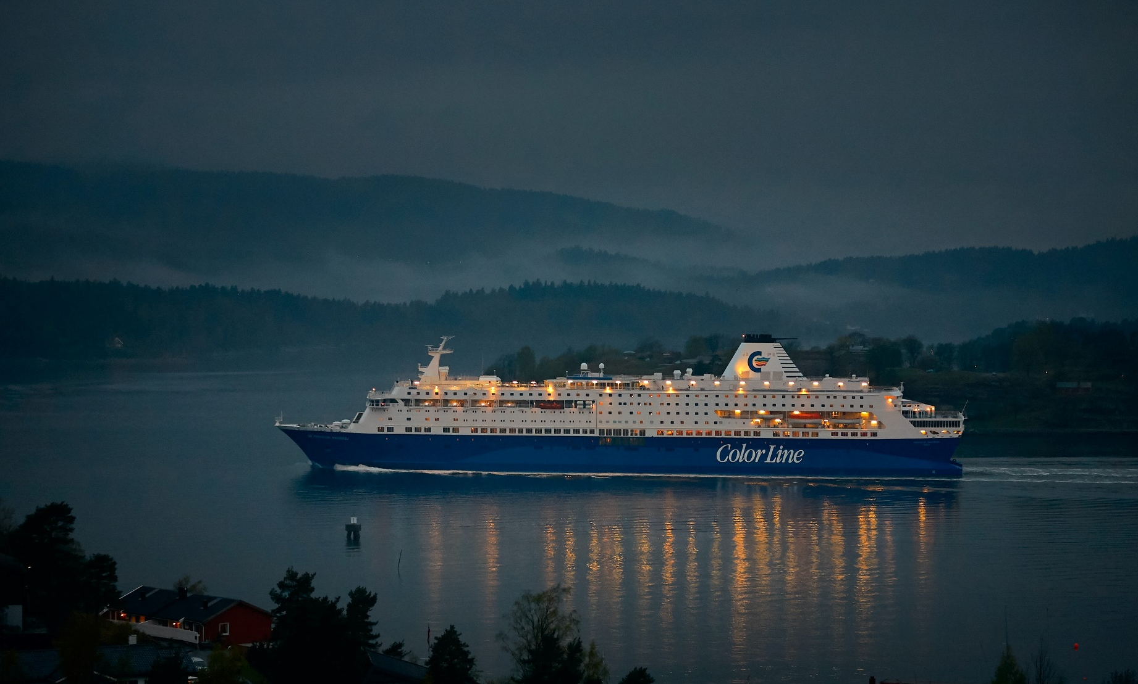
Cruise Ship

Slide 9
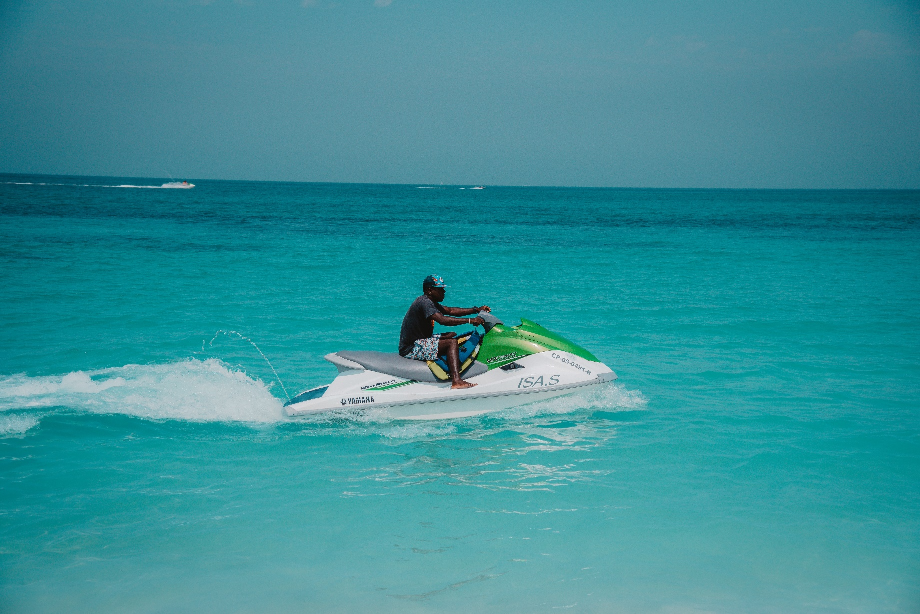
Jet Ski

Slide 10
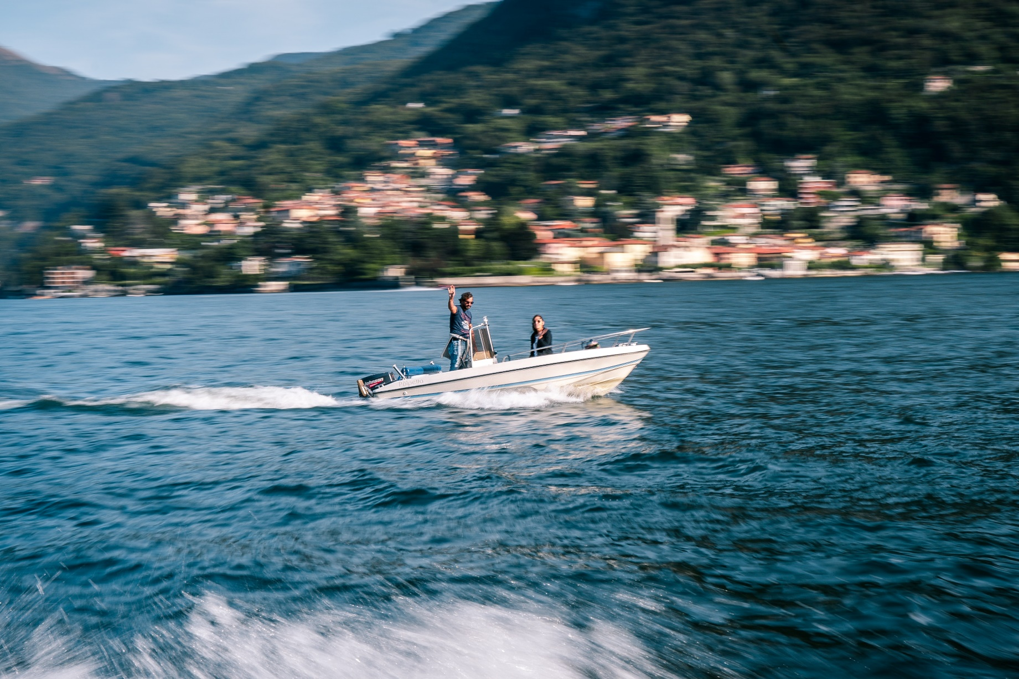
Speed Boat

Slide 11
Canoe

Slide 12
Kayak

