Slide 2
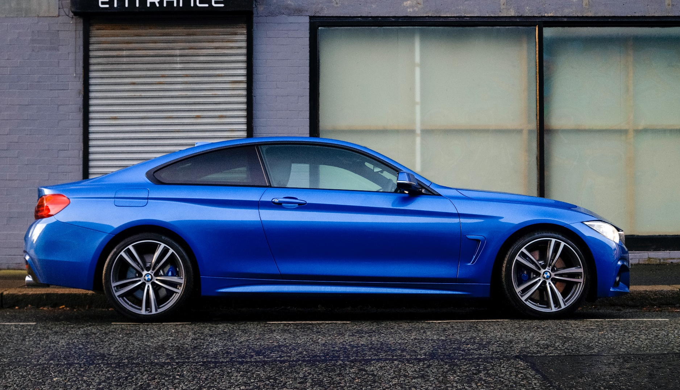
Car

Slide 3
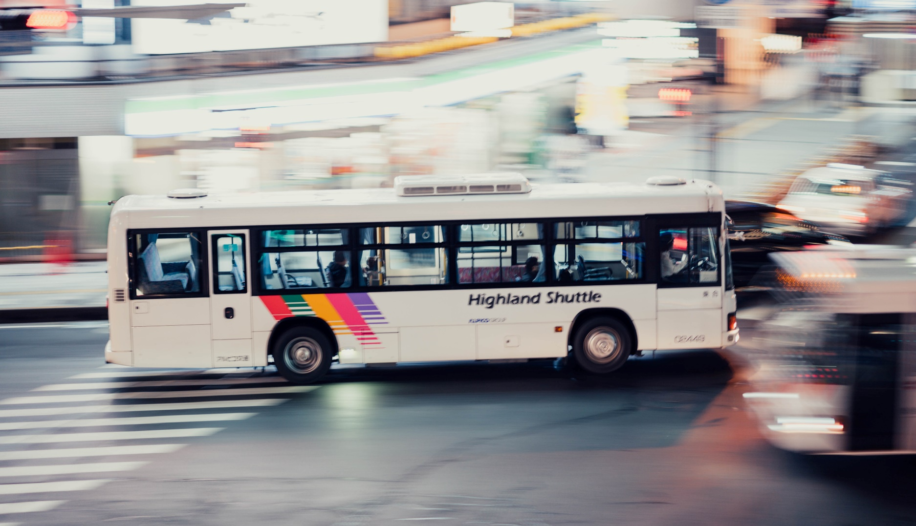
Bus

Slide 4
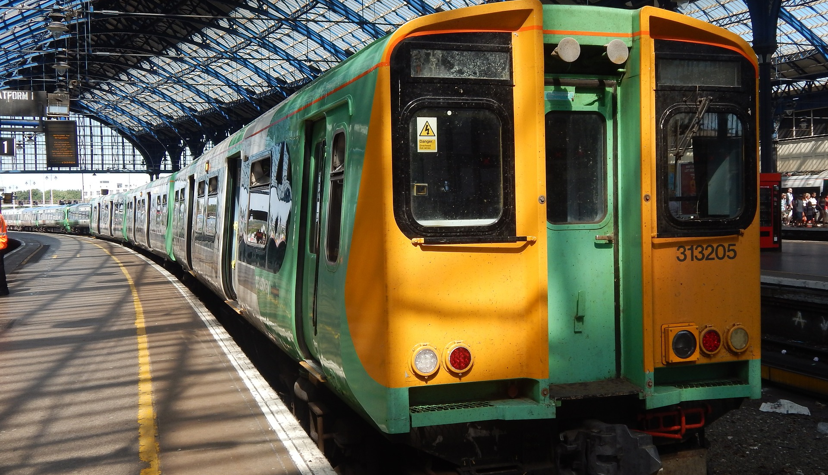
Train

Slide 5
Lorry

Slide 6
Van

Slide 7
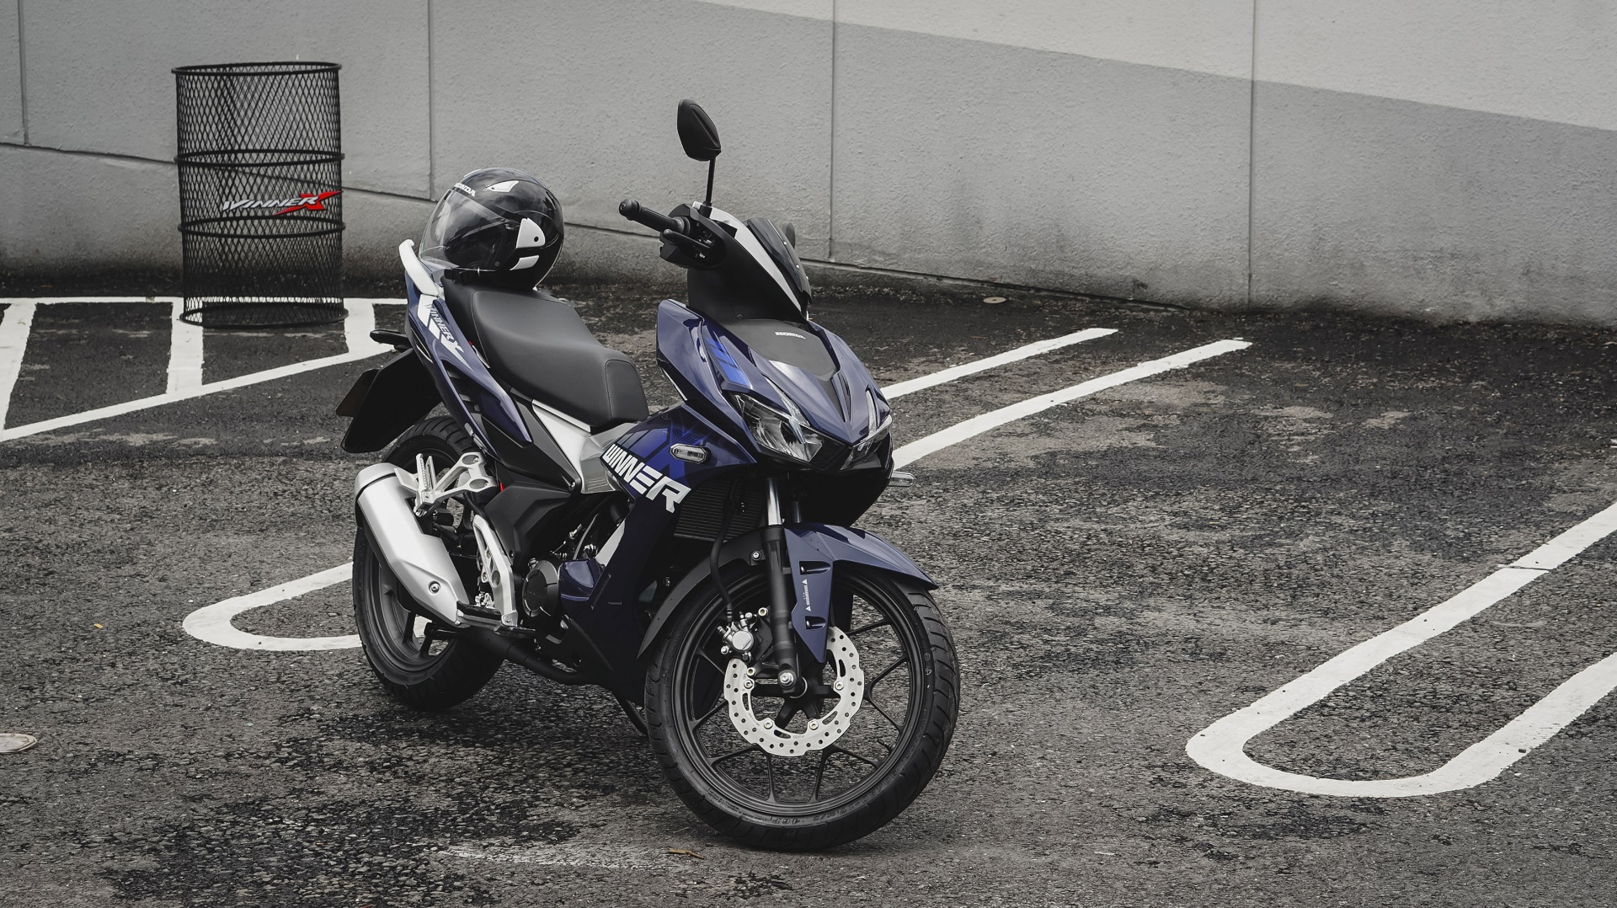
Motorbike

Slide 8
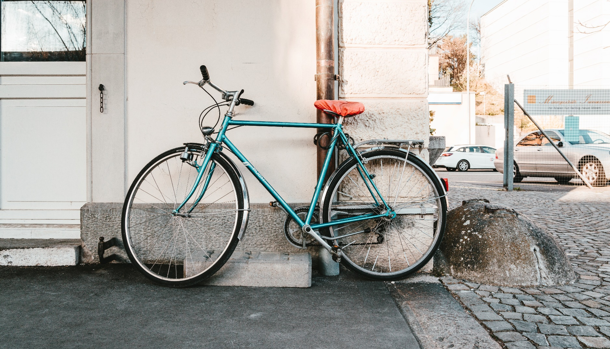
Bicycle

Slide 9
Walking

Slide 10
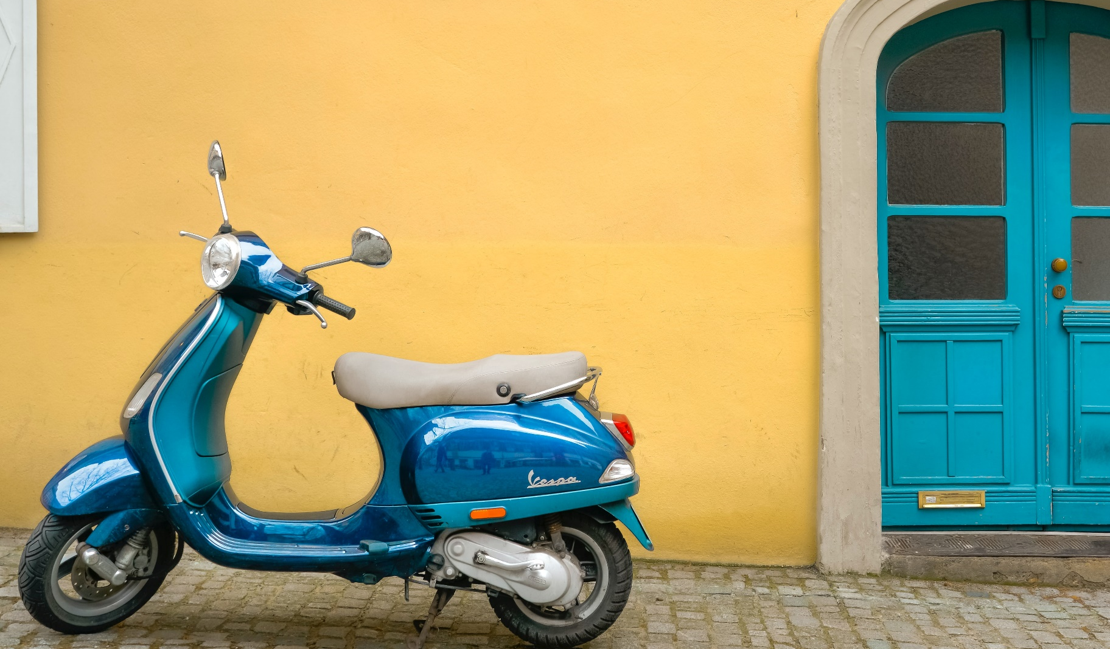
Scooter

Slide 11
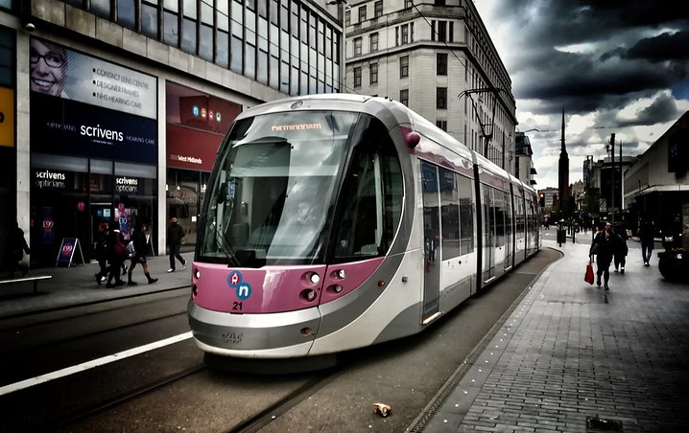
Tram
“Birmingham tram UK” by [newkemall] is licensed under CC BY 2.0

Slide 12
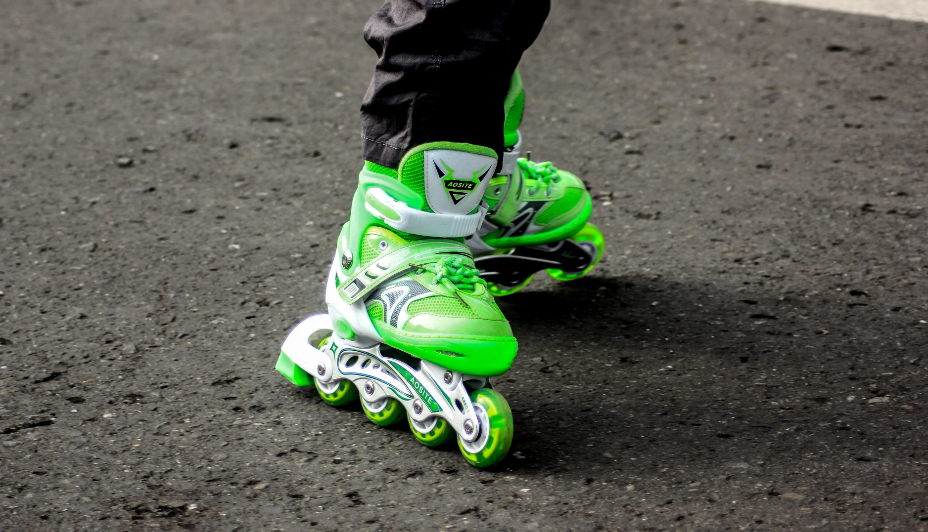
Rollerblades

Slide 13
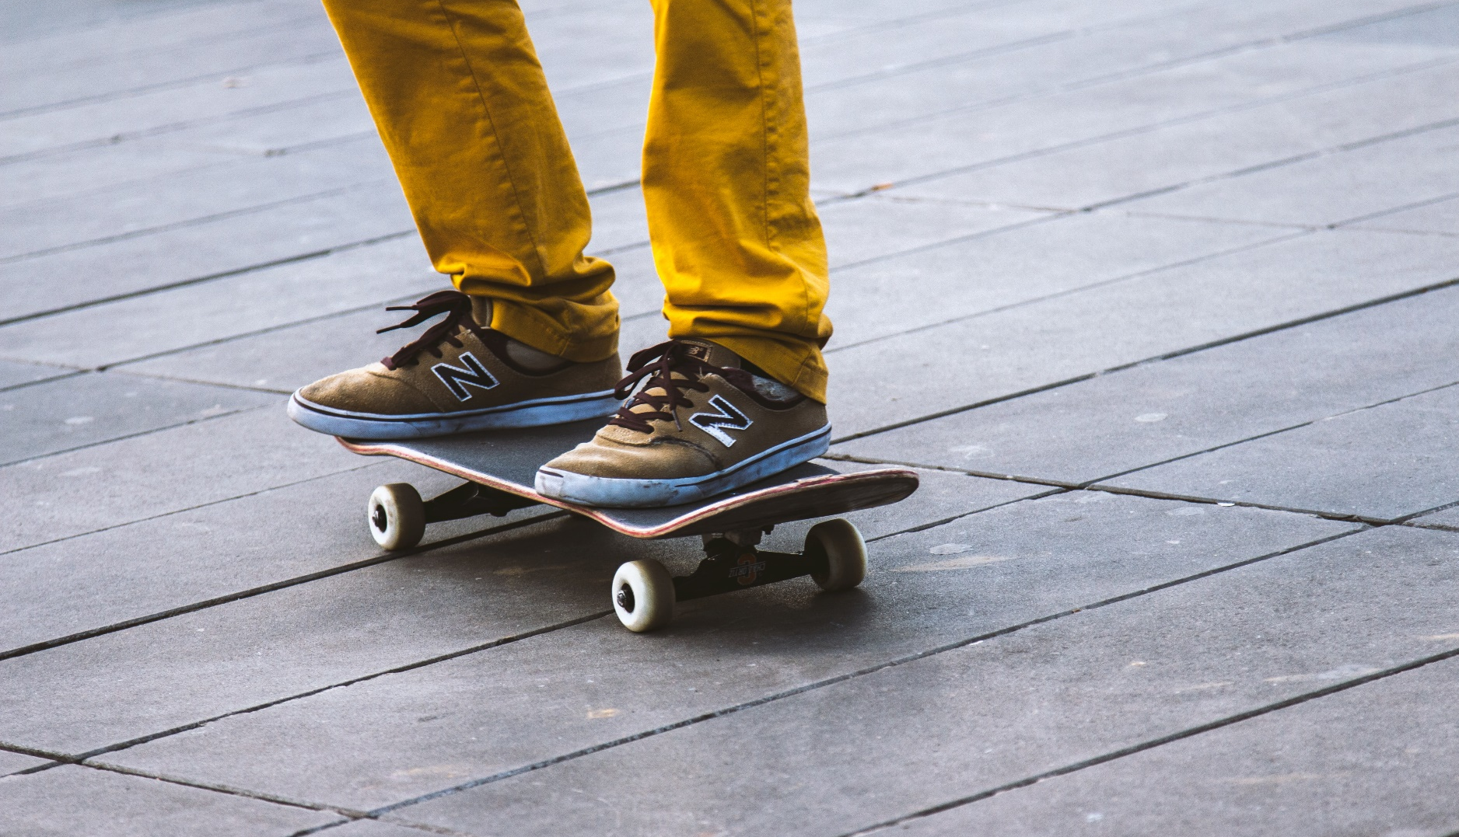
Skateboard

Slide 14
Sledge

Slide 15
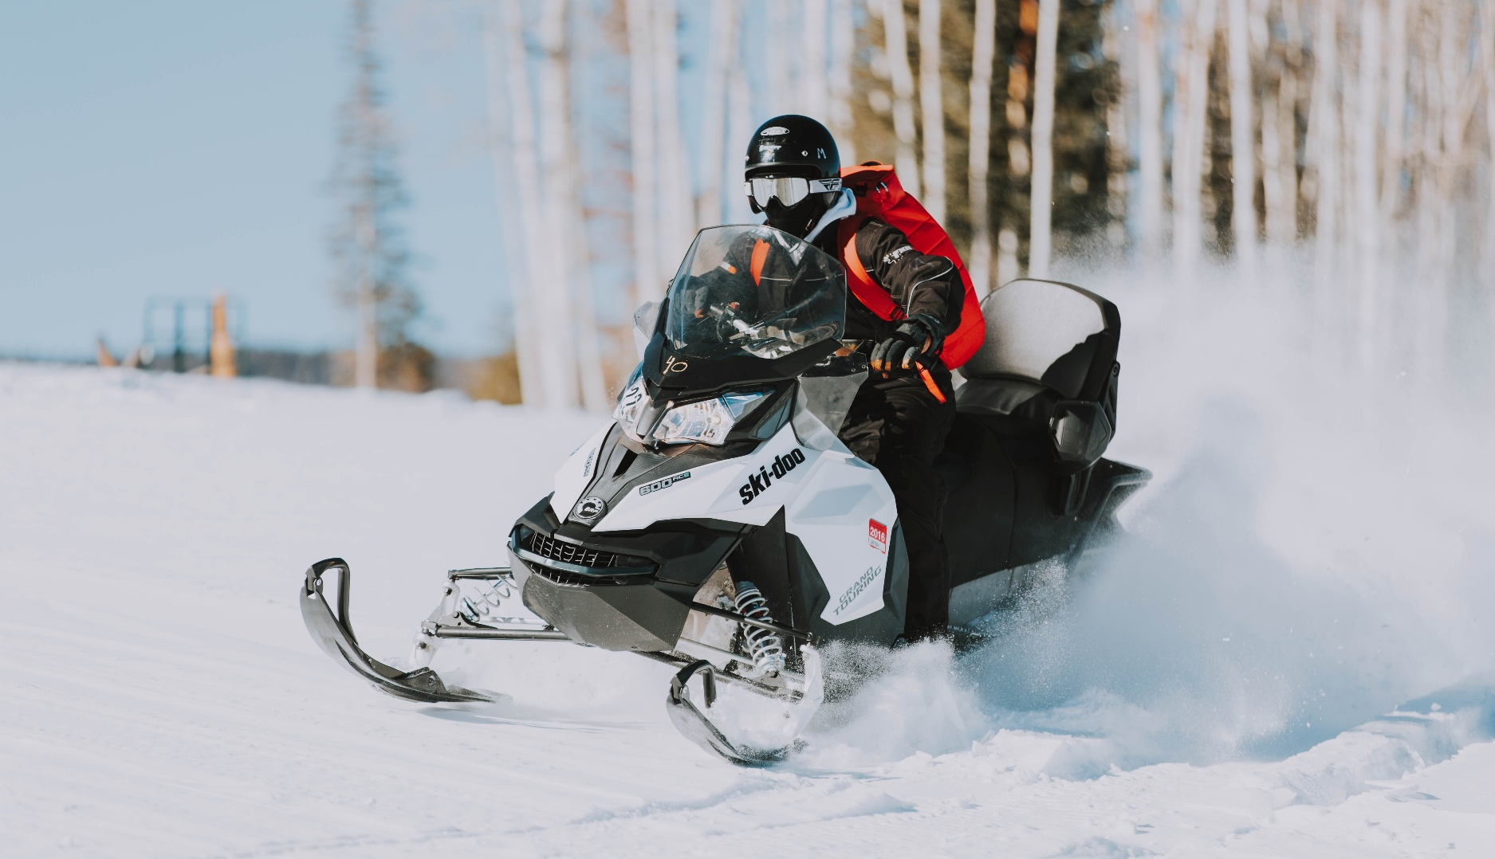
Skidoo

Slide 16
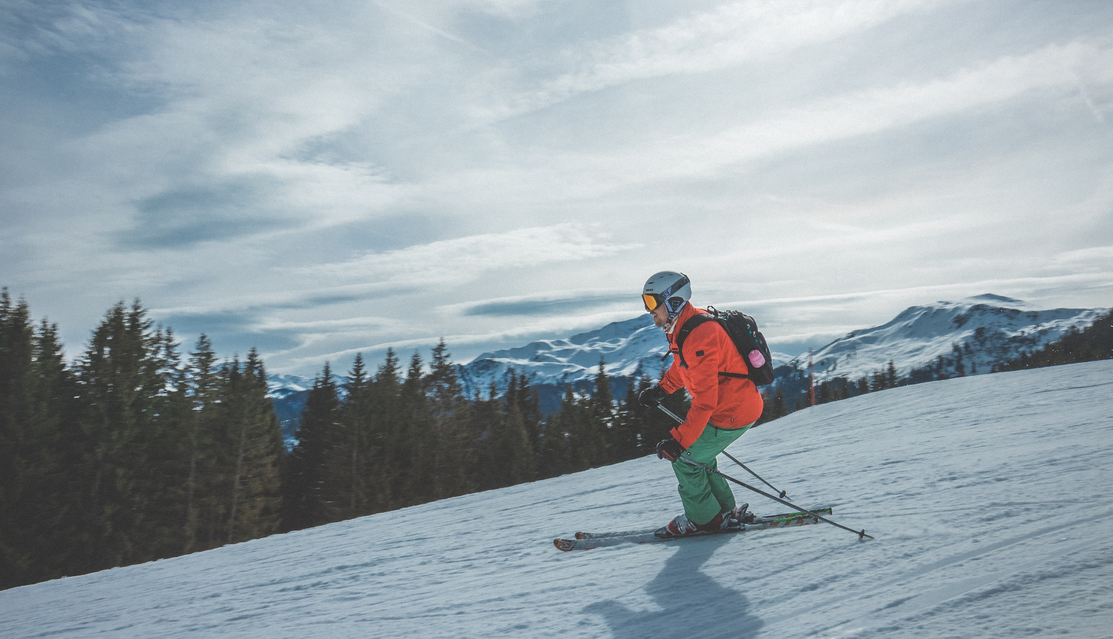
Skis

