Slide 2
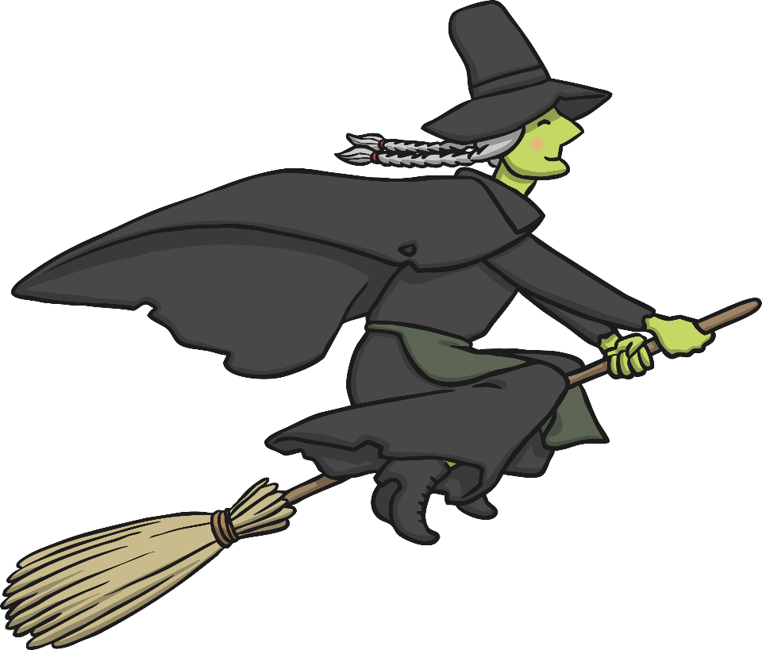
If I were a witch, I would climb on my broom,
And fly away with a zoom, zoom, zoom.
(Show the children walking fingers and tell them that is the witch. Next, explain that the pointer finger is the broom. Children need to put their 'witch' onto the 'broom' to make her fly!)

