Slide 3
Never throw fireworks.

Slide 4
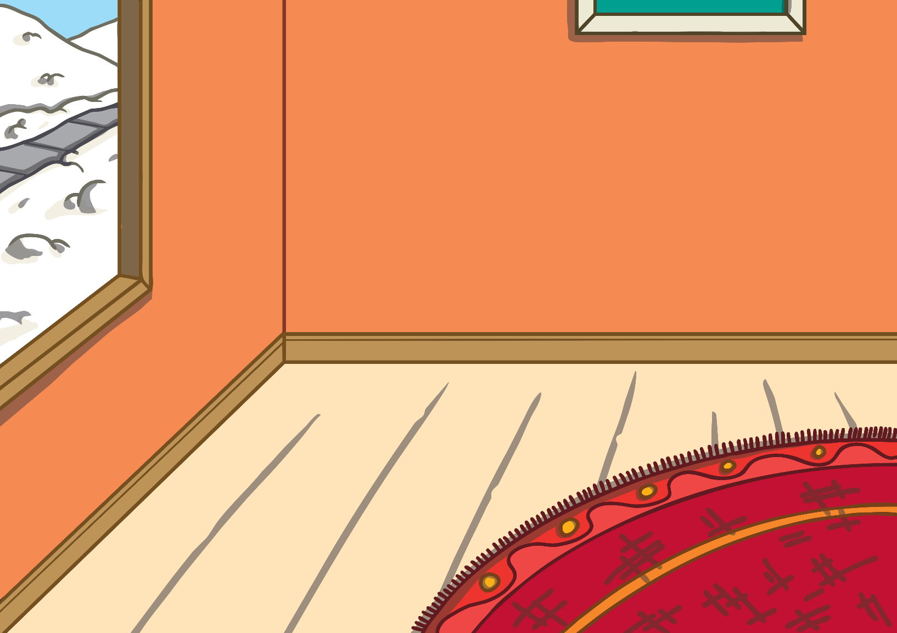
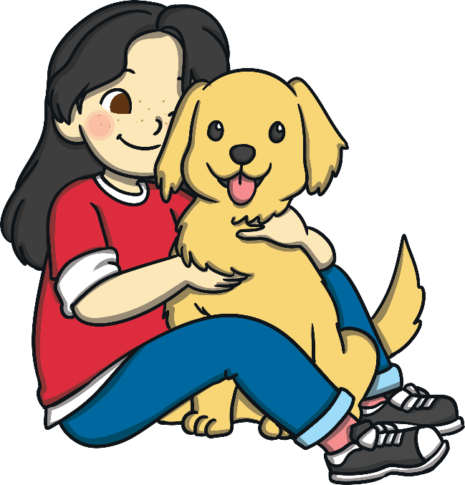
Keep pets indoors.

Slide 5
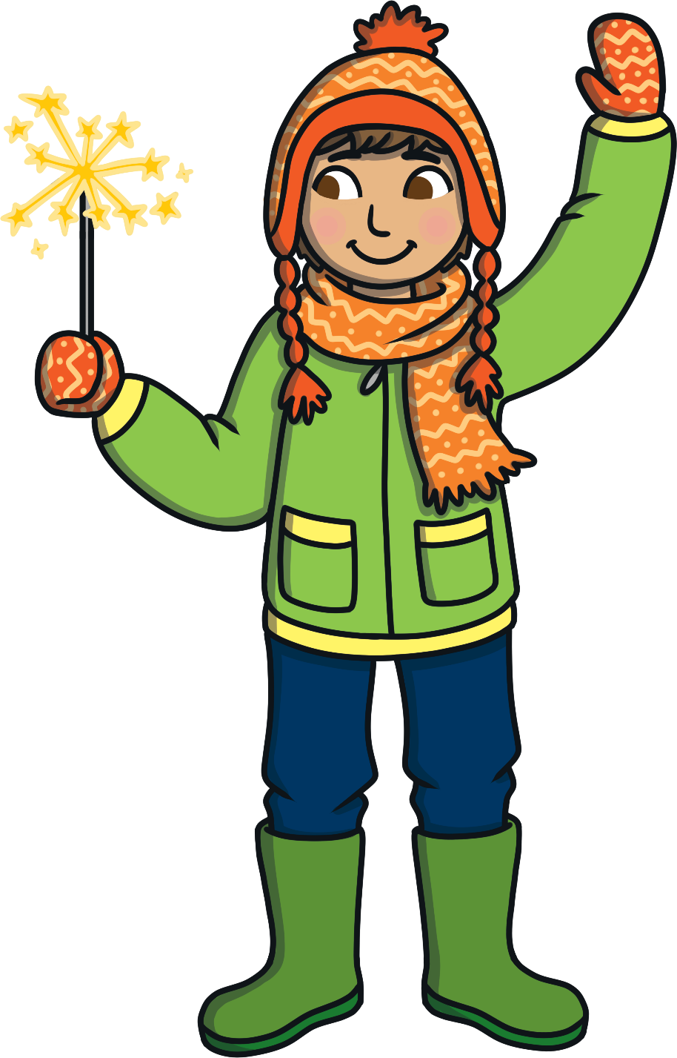
Always wear gloves when handling sparklers.

Slide 6
Keep fireworks in a closed box.
Fireworks

Slide 7
Stand well back.

Slide 8
Never go back to a lit firework.

