Slide 2
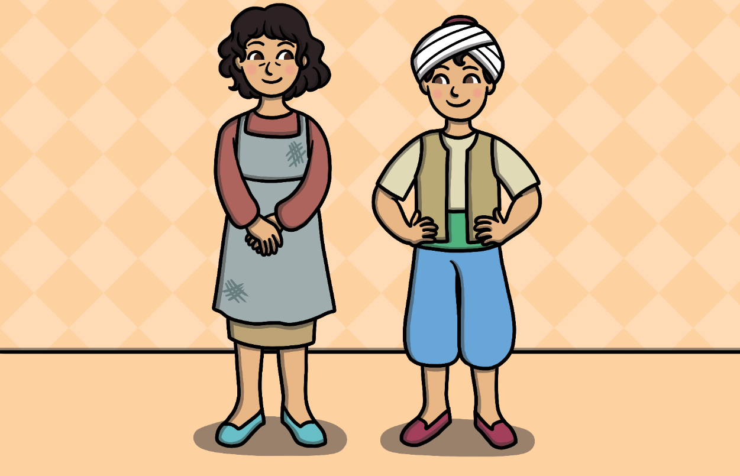
There was a poor widow woman who lived with her son Aladdin a long time ago.

Slide 3
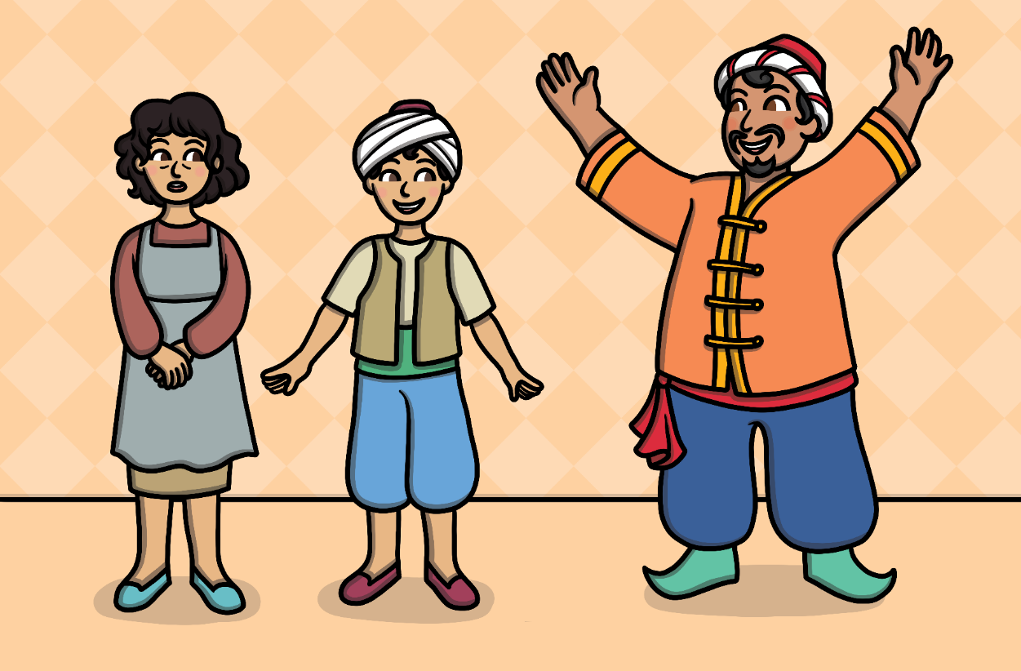
They met a mysterious stranger one day who claimed to be Aladdin's uncle. He said he could make them rich.

Slide 4
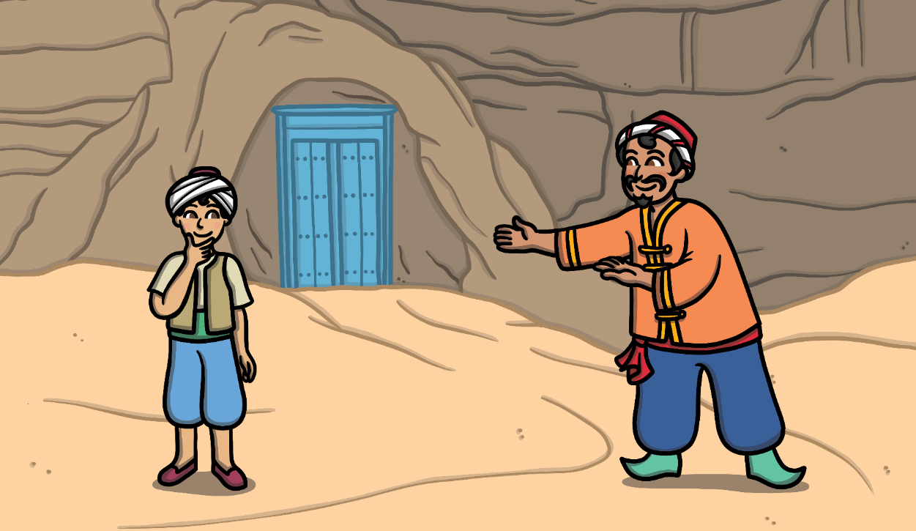
The uncle had a job for Aladdin so they travelled a long way until they reached a mountain. The man was really a magician. He said some magic words and a door to a cave appeared.

Slide 5
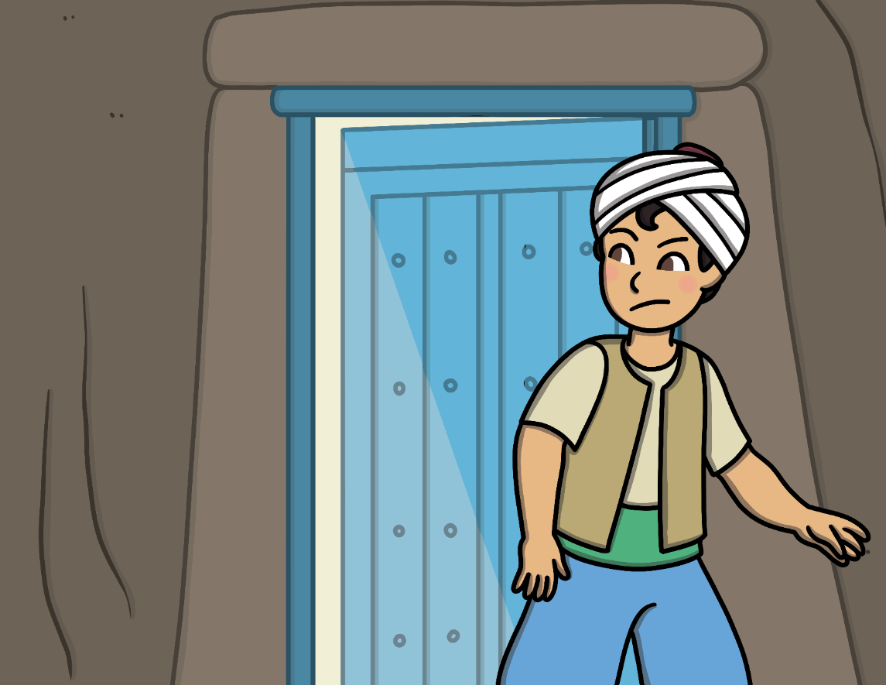
It was too small for the magician so he sent Aladdin inside. He told Aladdin not to touch anything but only to find and bring him a lamp.

Slide 6
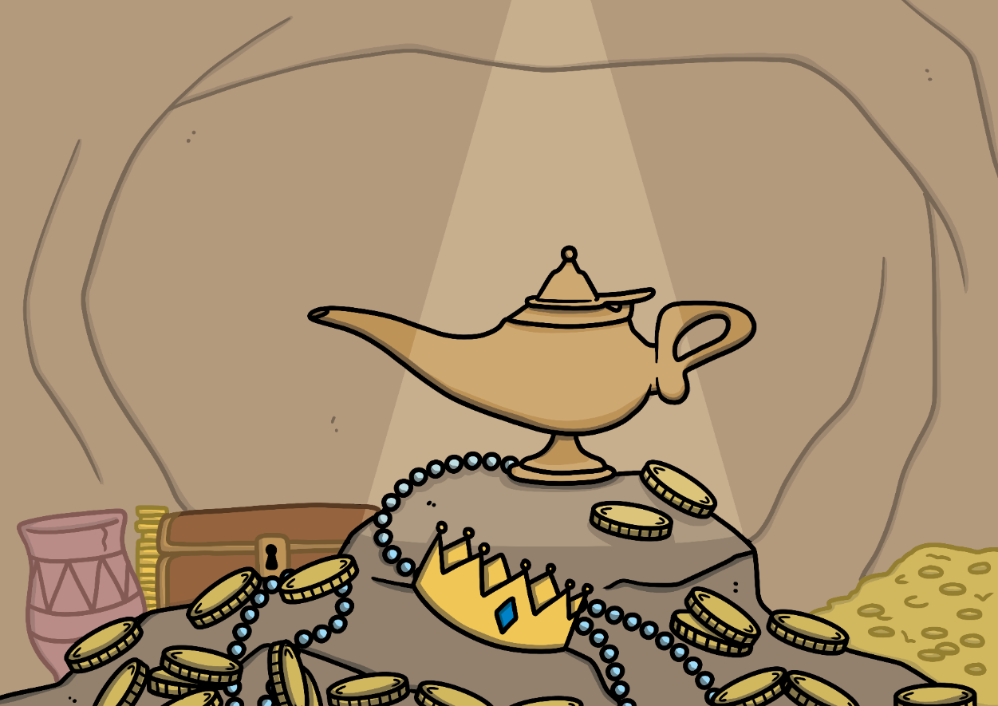
The magician wanted to take the lamp and leave Aladdin behind but Aladdin realised it was a trick.
Aladdin found a ring and put it on. Then, he found the lamp deep inside the cave.

Slide 7
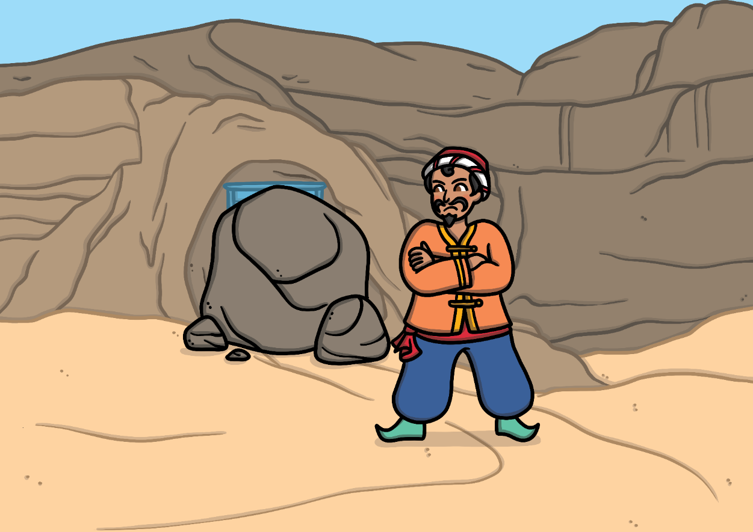
He refused to give away the lamp so the magician blocked the entrance with his magic.

Slide 8
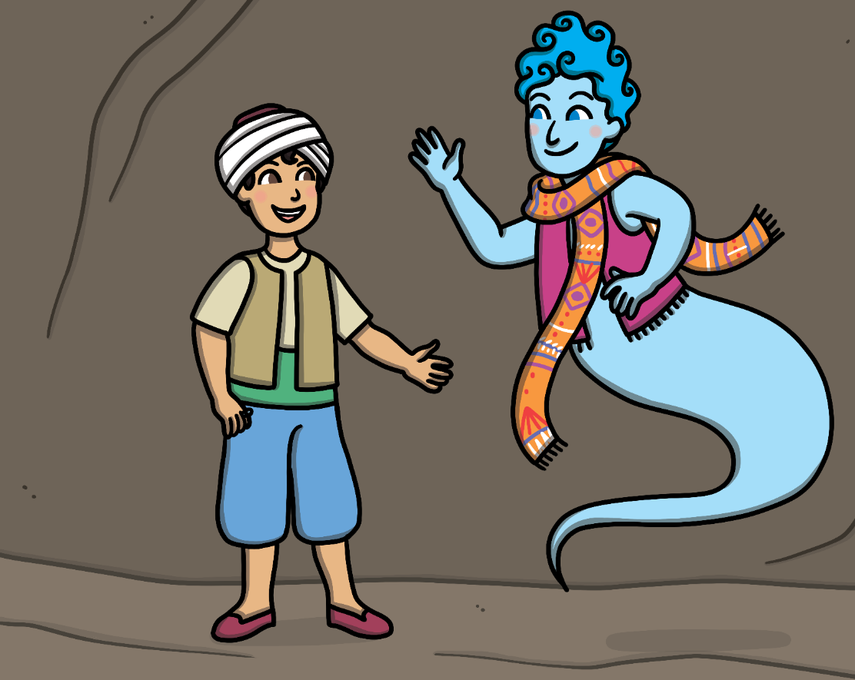
Aladdin rubbed the ring on his finger. He was surprised when a genie appeared and granted him a wish. Aladdin wished to be home and was soon back with his mother.

Slide 9
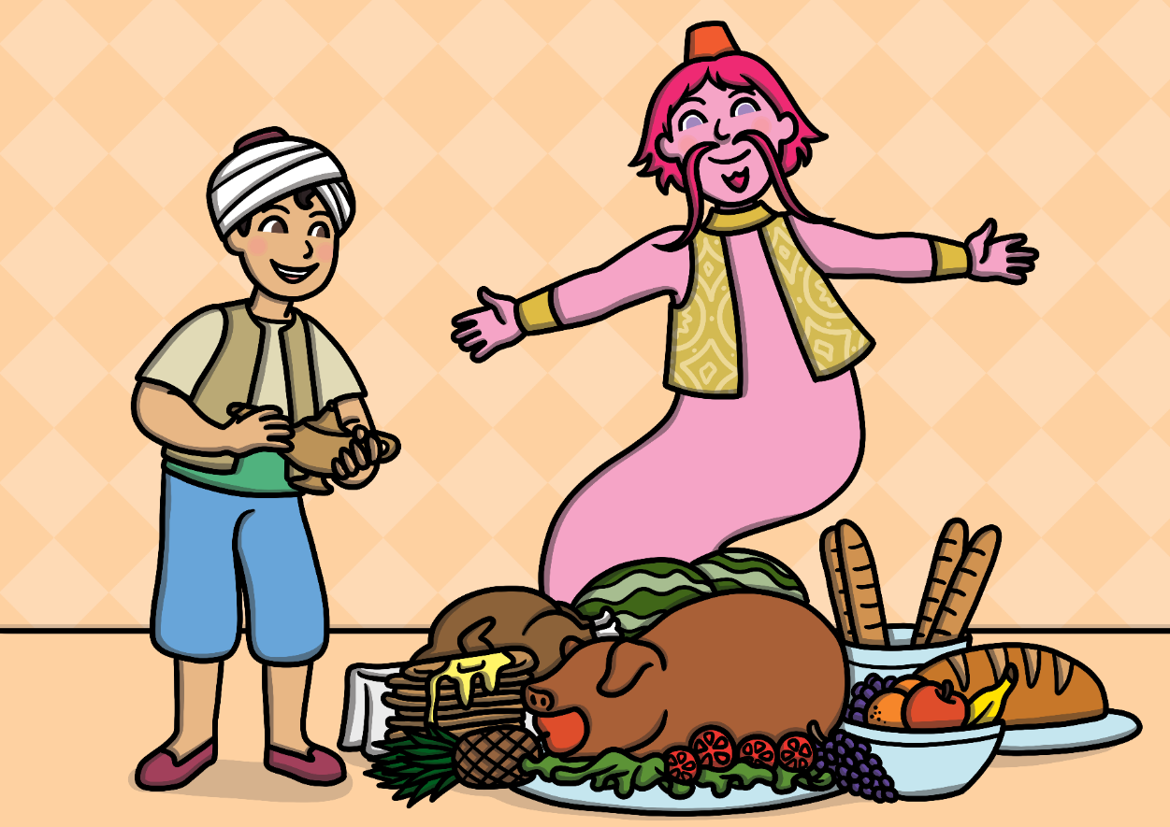
They needed to sell the lamp to buy some food.
Aladdin polished it and was shocked when a powerful genie appeared and granted him a wish. He wished for a table full of food.

Slide 10
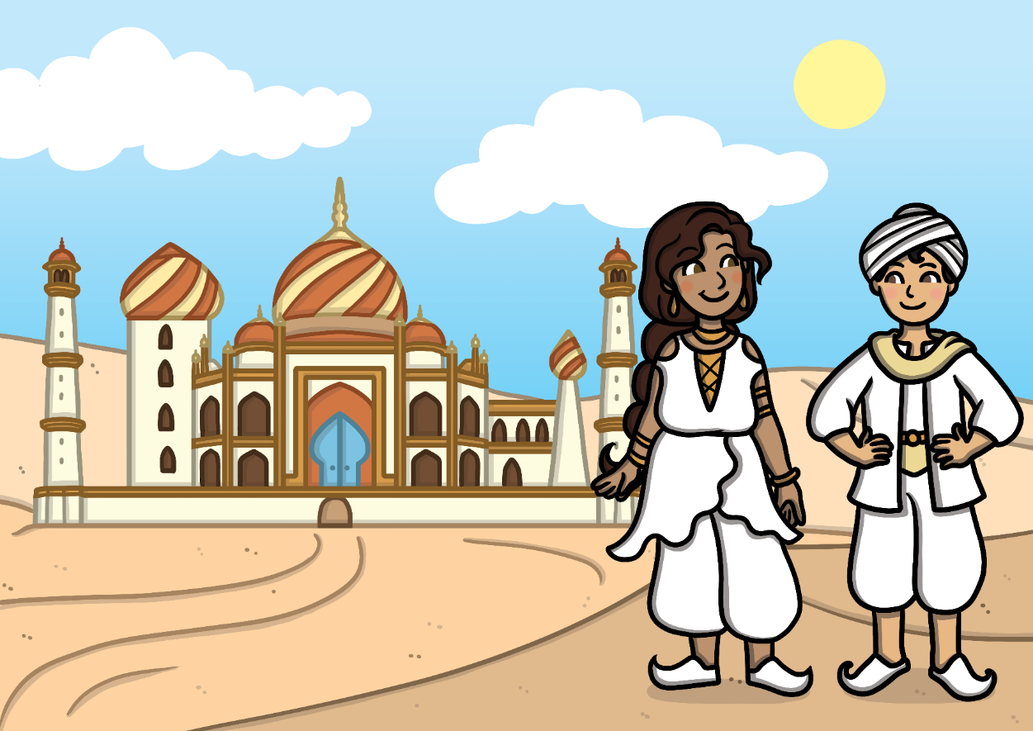
Aladdin became rich and powerful and married the Sultan’s daughter. They lived in a beautiful palace.

Slide 11
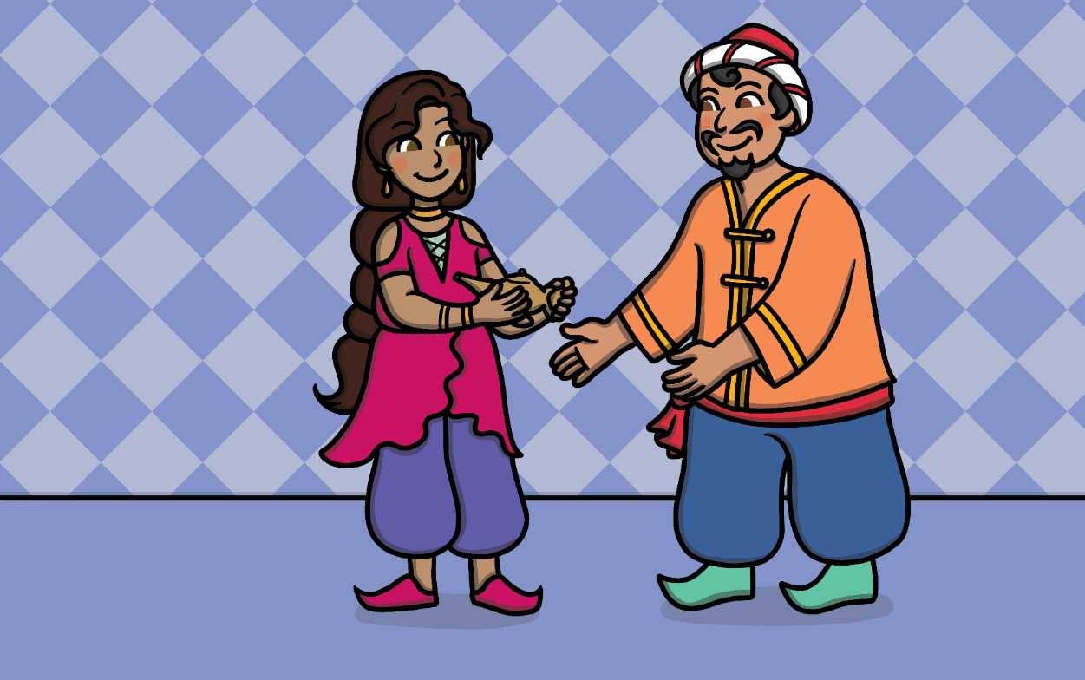
The magician heard about the lamp and wanted it for himself. He tricked Aladdin’s wife into swapping it for a new one.

Slide 12
Then, he used the lamp’s power to transport Aladdin’s wife and palace away.

Slide 13
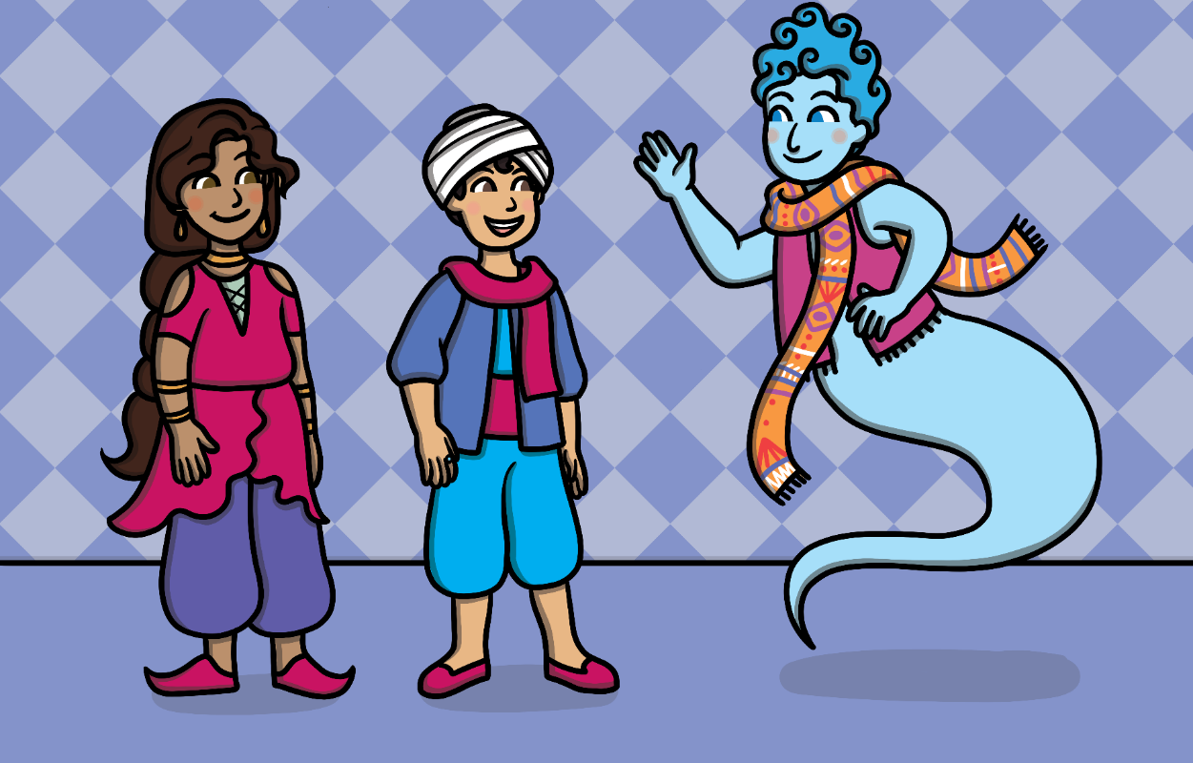
Aladdin returned to find everything gone but he still had the ring. He used the genie in the ring to take him to his wife.

Slide 14
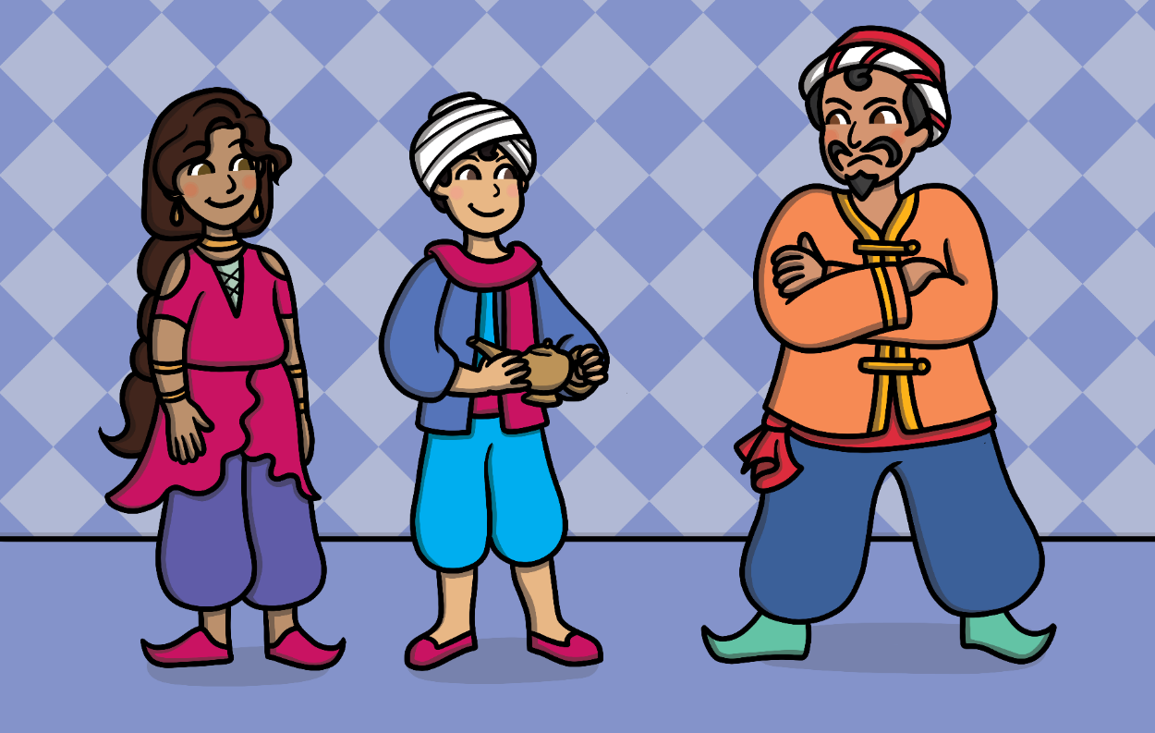
They took back the lamp and banished the magician from the kingdom.

Slide 15
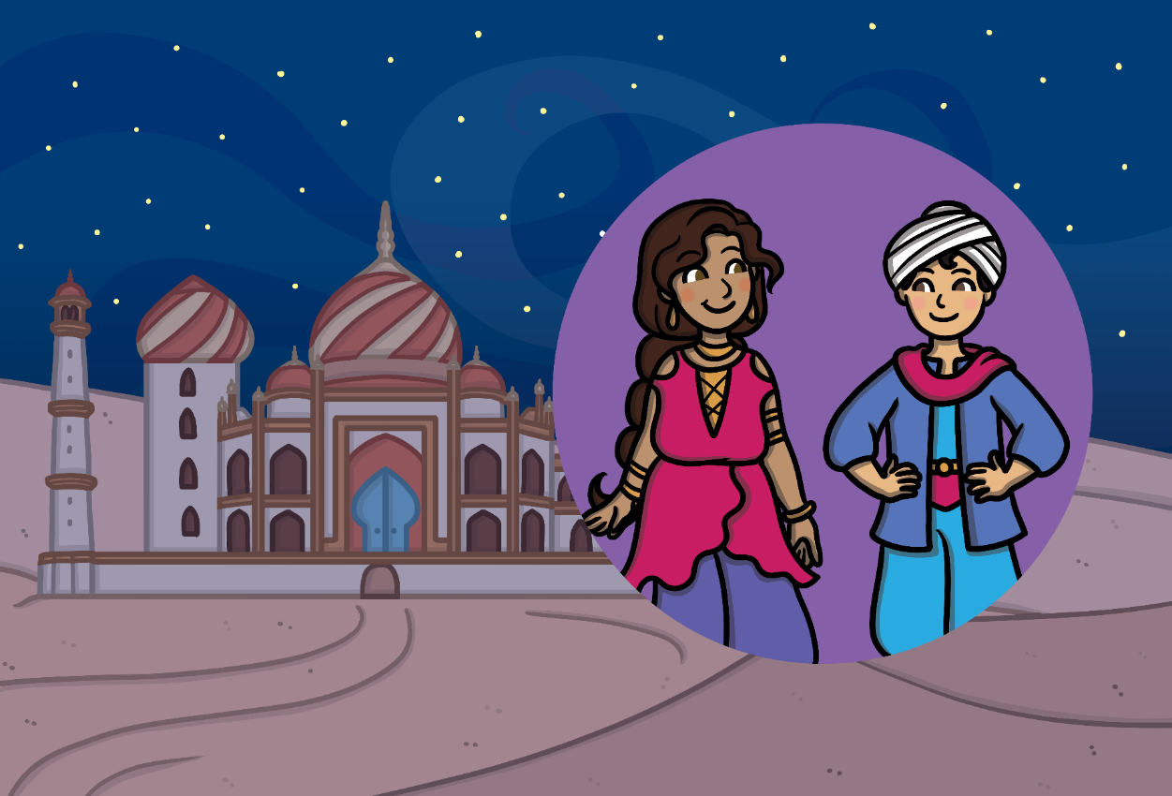
Then, Aladdin asked the genie to move the palace back to their home. They lived happily ever after.

