Slide 1
Disclaimer
We hope you find the information on our website and resources useful.
Animations
This resource has been designed with animations to make it as fun and engaging as possible. To view the content in the correct formatting, please view the PowerPoint in ‘slide show mode’. This takes you from desktop to presentation mode. If you view the slides out of ‘slide show mode’, you may find that some of the text and images overlap each other and/or are difficult to read.
To enter slide show mode, go to the slide show menu tab and select either from beginning or from current slide.
You may wish to delete this slide before beginning the presentation.

Slide 3
blueberries

Slide 4
Blue Whale

Slide 5
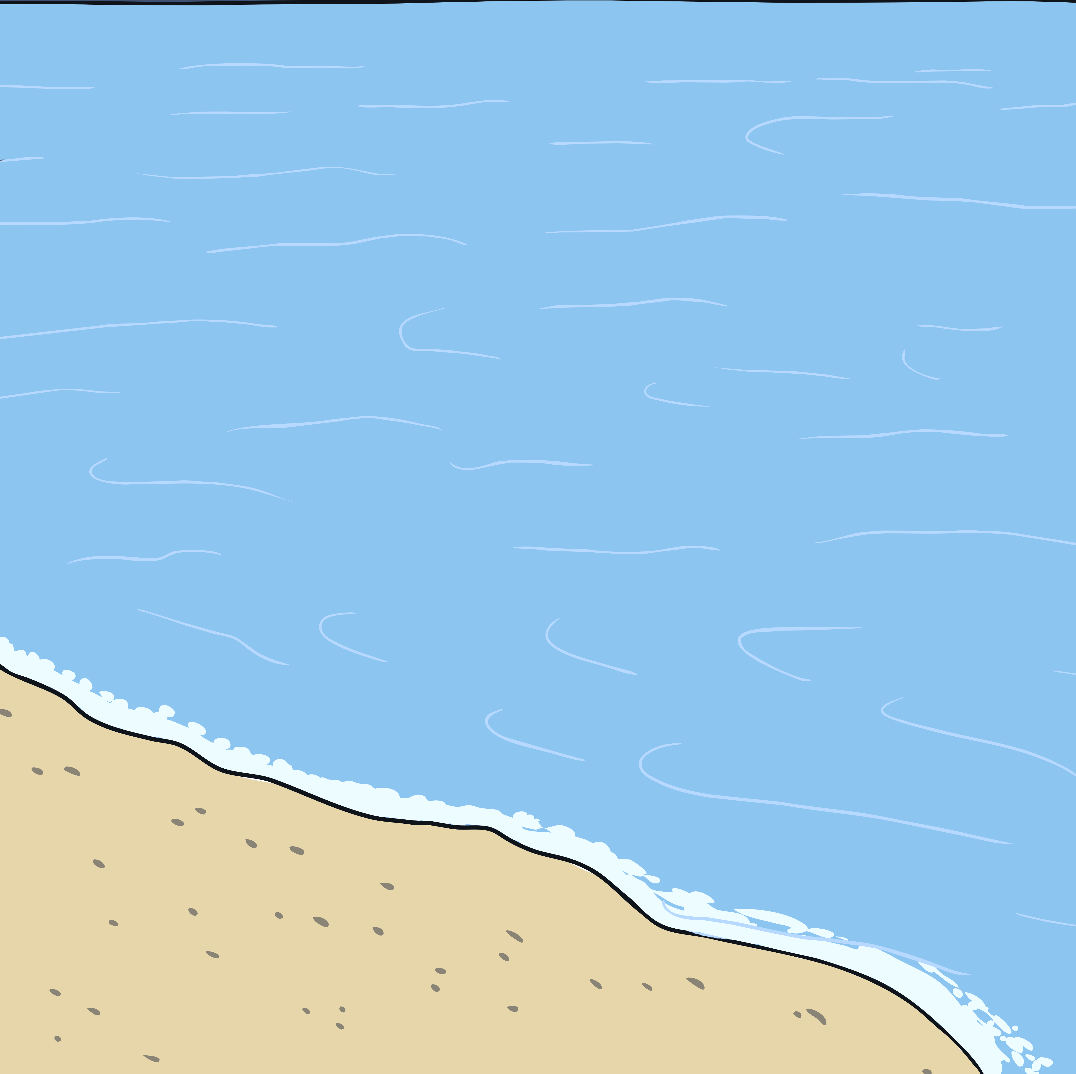
the sea
grapes

Slide 6
the sky

Slide 7
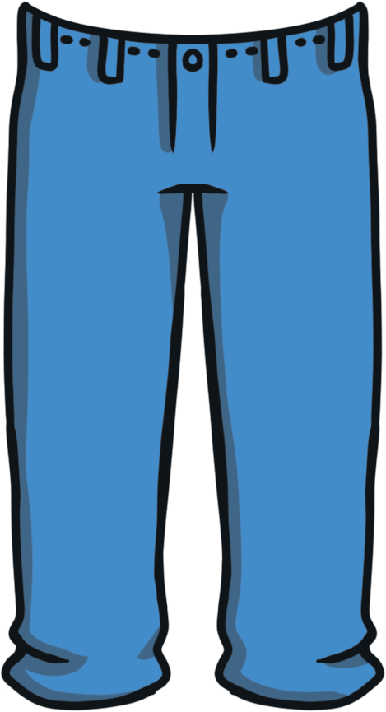
jeans

Slide 8

Common blue Butterfly

