Slide 1
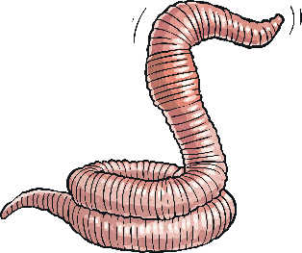

Slide 2
What Is an Earthworm?
Most people know what an earthworm is, but how much do we actually know about them? They are invertebrates (creatures with no backbone) and are found all over the world, except in extremely cold places or extremely dry places.
Where do you think earthworms are not found?
Click on the globe to reveal the answer.
Polar regions and deserts

Slide 3
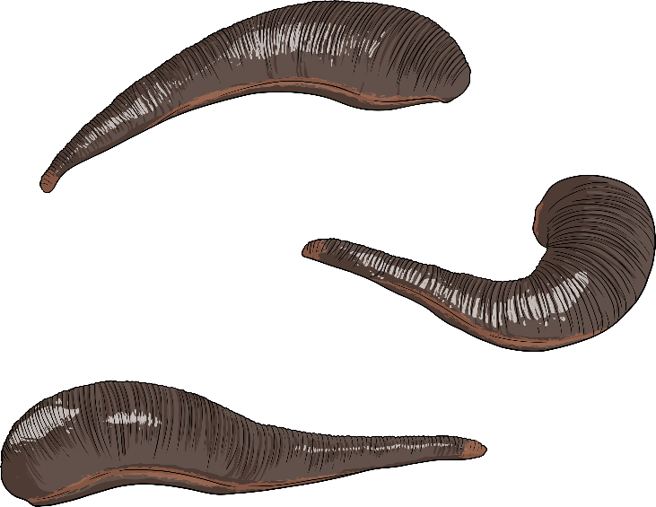
What Type of Animal Is an Earthworm?
Earthworms are a type of invertebrate called an annelid. Another example of an annelid is a leech.
leeches

Slide 4
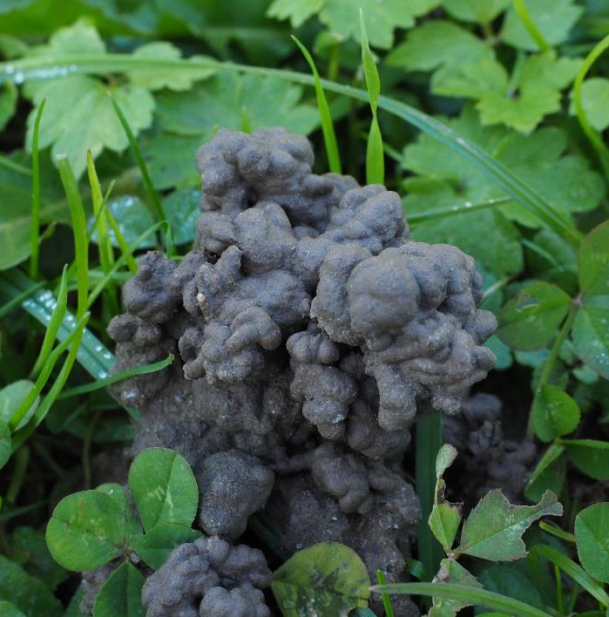
How Many Types of Earthworm Are There?
There are 5500 species of earthworm in the world. 29 of those are native to the UK. You can sometimes tell where an earthworm has been by the cast it creates as it digs its burrow.

Slide 5
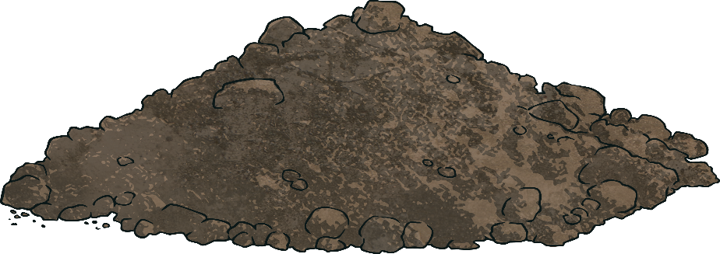
How Big Can They Grow?
UK earthworms can grow to around 25 centimetres long. How long do you think the biggest earthworm in the world is?
Click on the picture to find out.
The Giant Gippsland Earthworm is found in Australia. It can grow up to 3 metres long! The Bunwurrung people call this earthworm ‘karmai’.

Slide 6
Diagram of an Earthworm
head
no lungs
Click on each label to find out more.
clitellum
retractable bristles

Slide 7
Diagram of an Earthworm
head
no lungs
Click on each label to find out more.
clitellum
retractable bristles
The earthworm has a toothless mouth and no eyes. Instead, its skin has photoreceptors along its length, which are sensitive to light.

Slide 8
Diagram of an Earthworm
head
no lungs
Click on each label to find out more.
clitellum
retractable bristles
Forms the cocoon for the eggs.

Slide 9
Diagram of an Earthworm
head
no lungs
Click on each label to find out more.
clitellum
retractable bristles
Earthworms absorb oxygen through their skin.

Slide 10
Diagram of an Earthworm
head
no lungs
Click on each label to find out more.
clitellum
retractable bristles
Each of the earthworm’s body segments has retractable bristles that help it move.

Slide 11
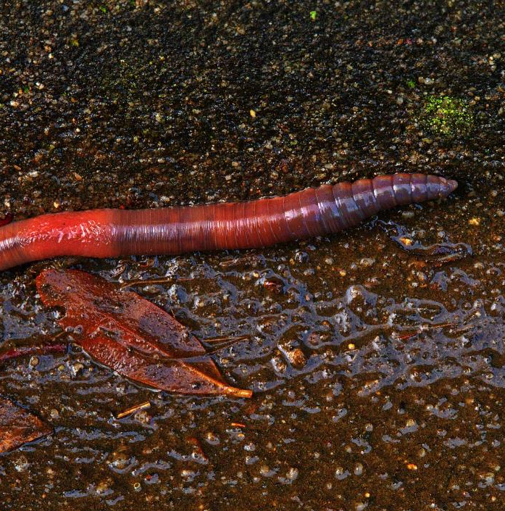
The Clitellum
The clitellum is the different coloured, smooth section of skin on an earthworm’s body. It’s only found on mature earthworms. Remember, the end of the worm nearest the clitellum is its head.

Slide 12
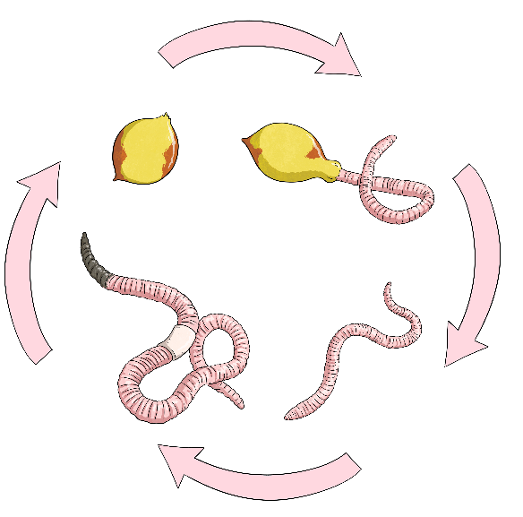
How Do Earthworms Reproduce?
Earthworms are hermaphrodites. This means that they have both male and female reproductive cells. All earthworms can carry eggs, fertilise another earthworm’s eggs or fertilise their own eggs. If they fertilise their own eggs, all their offspring will be clones, which means that they will be identical to their parent. While the earthworm’s eggs are maturing, it carries them in the clitellum. Once the eggs are mature, it sheds the clitellum with the eggs inside it and the baby worms hatch into the soil.
Cocoon Stage
Larvae Stage
Adult Stage
Juvenile Stage

Slide 13
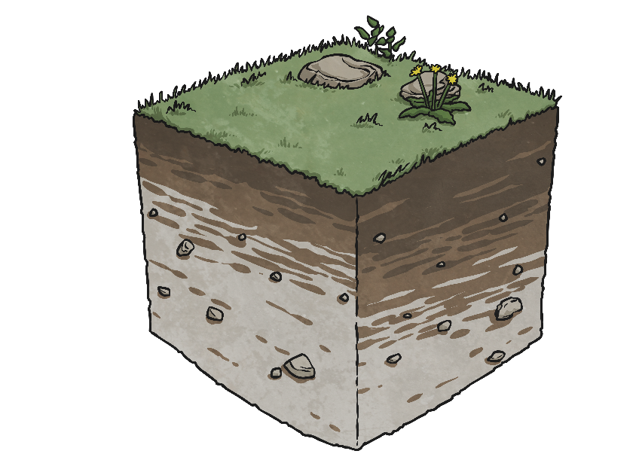
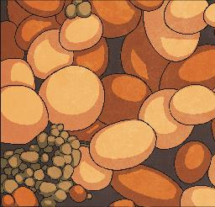
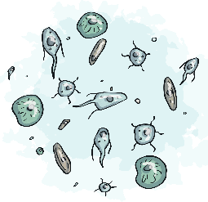
What Do Earthworms Eat?
decaying plant matter
microbial fungi
microscopic organisms

Slide 14
Why Are Earthworms Important?
Earthworms are important because they improve the quality of soil. Their burrows allow water and air to travel into (and out of) the earth. They eat decaying organic matter, such as leaves and dead animals, and pass the nutrients back into the soil. Also, they are an important source of food for ground-feeding birds.
Can you find out what type of bird is in the picture?

Slide 15
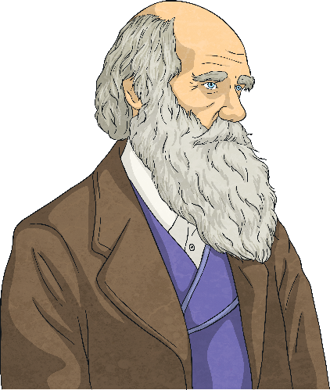
Final Thoughts
It may be doubted whether there are many other animals which have played so important a part in the history of the world, as have these lowly organised creatures.
The famous scientist Charles Darwin said about earthworms:
1.
2.
Can you think of two reasons Charles Darwin might have said this?
Earthworms fertilise the soil, allowing humans to grow food more effectively.
Earthworms are an important part of food chains.
?
?

