Slide 2
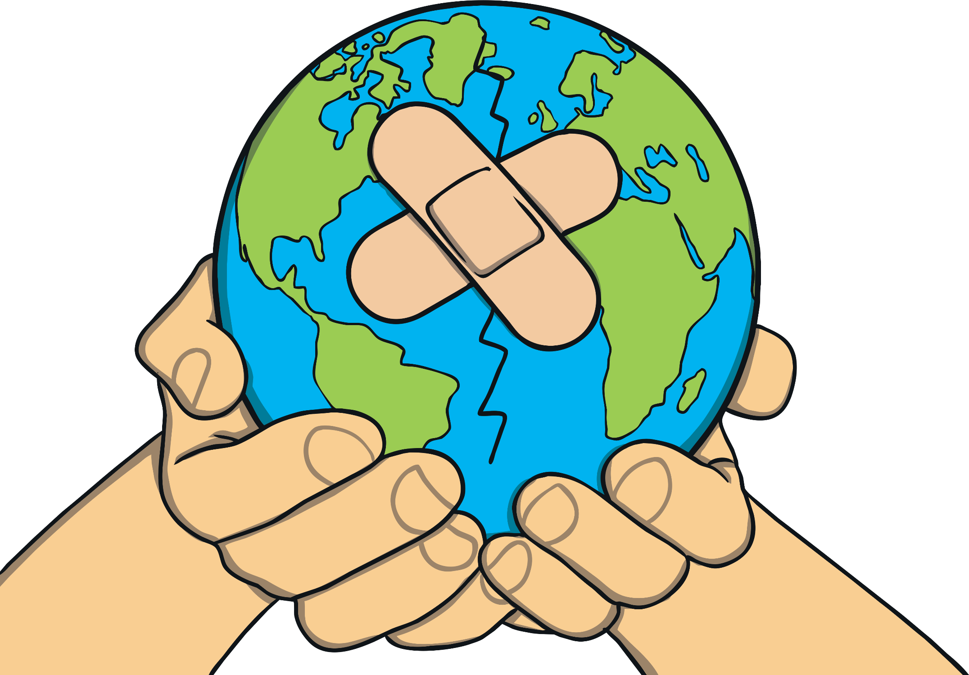
Earth Day 2023: Invest In Our Planet
The theme of Earth Day 2023 is Invest In Our Planet.
This is the idea that everyone should try to work together to help to look after our planet, Earth.

Slide 3
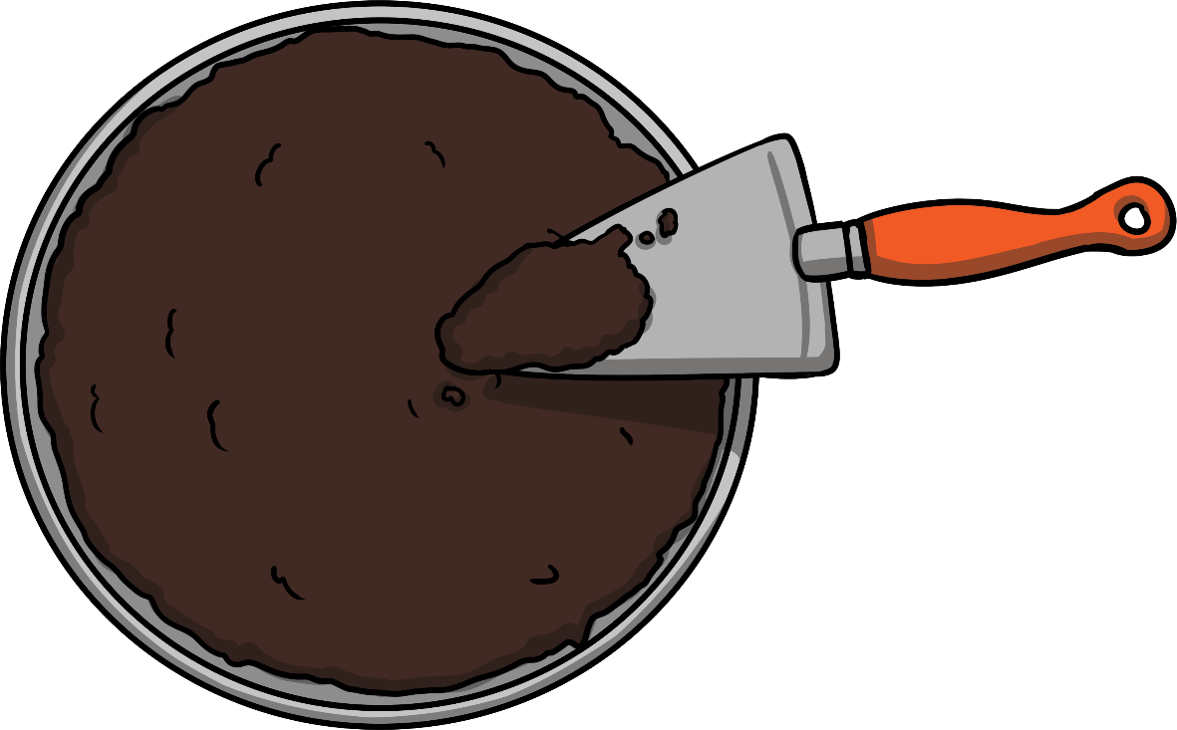
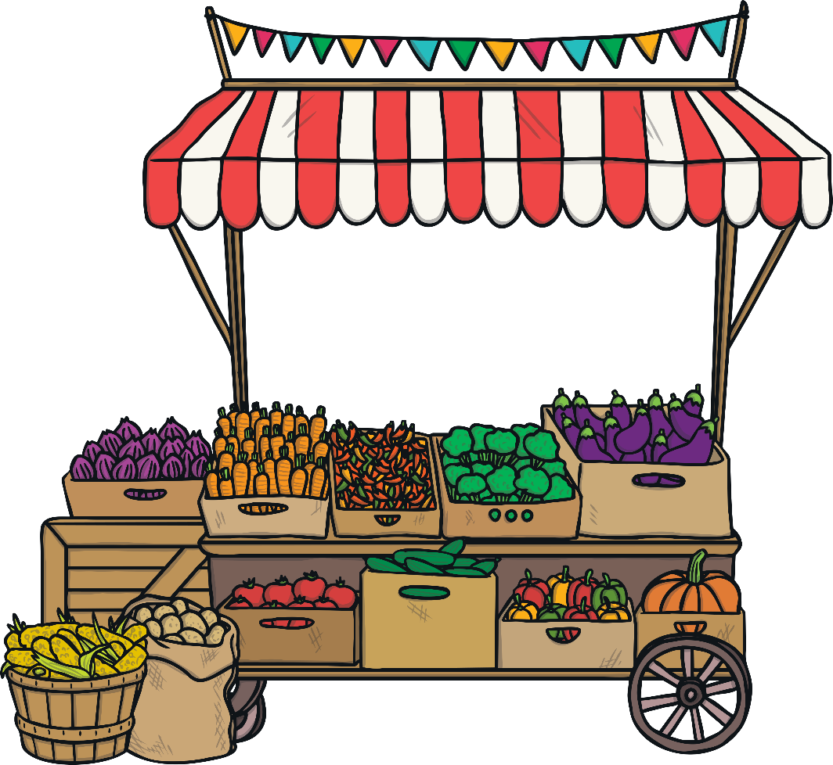
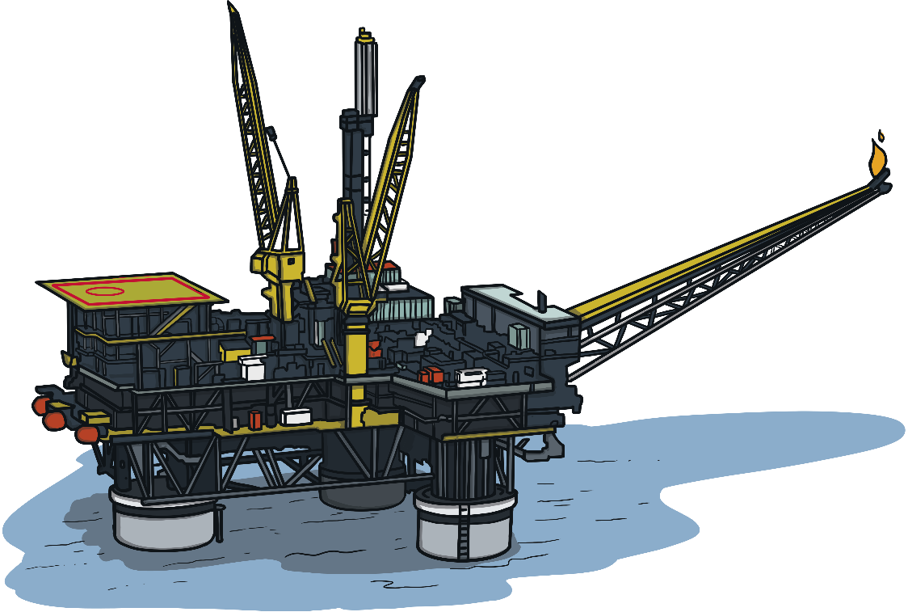
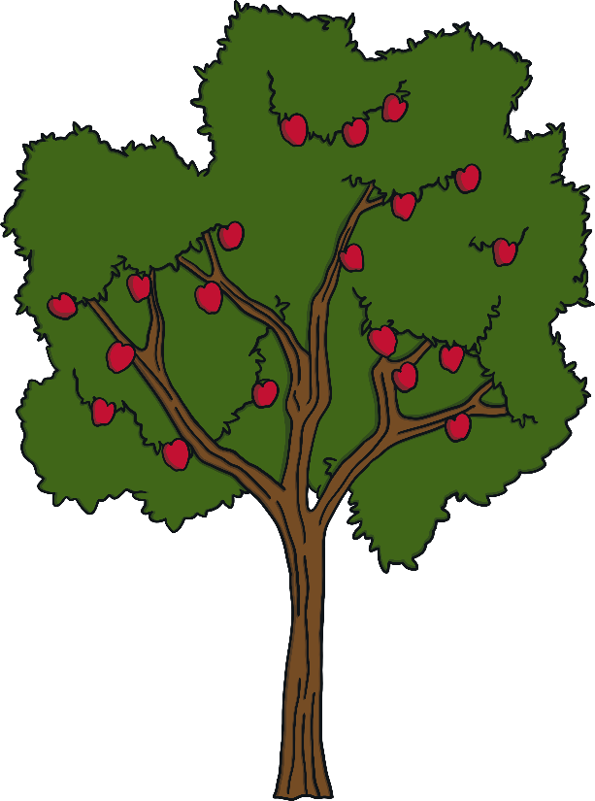
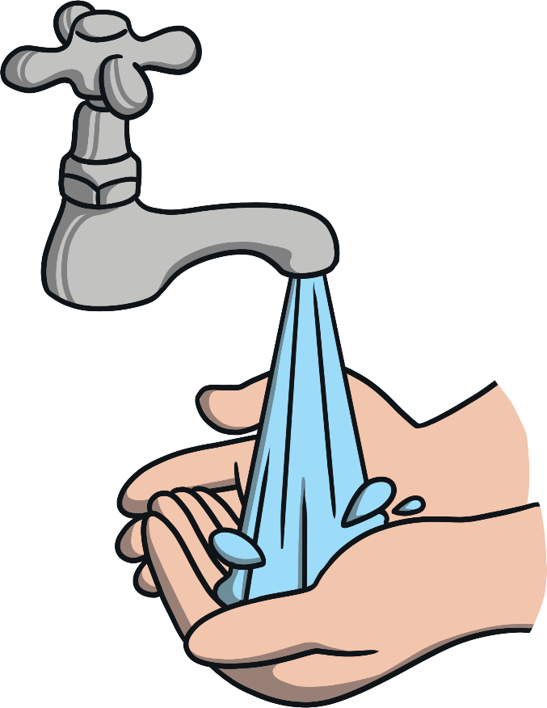
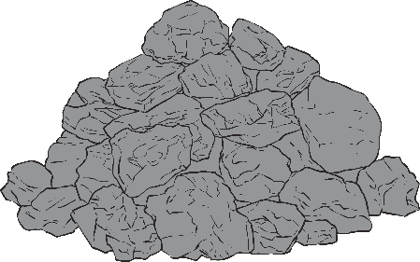
What Are Natural Resources?
There are billions of people living on planet Earth and this number is growing all the time. People use a lot of Earth’s natural resources.
These include:
food (from plants and animals)
oil
Natural resources are things that are found in nature and that are used by humans.
soil
water
trees
gas
oil
food (from plants and animals)
coal
coal
gas
trees
water
soil

Slide 4
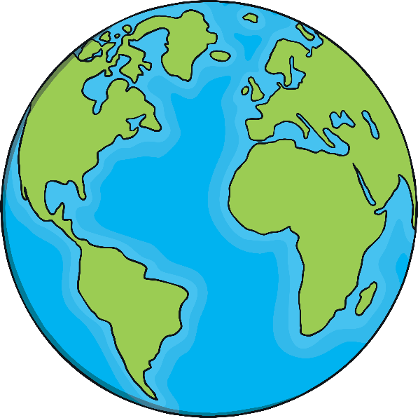
We Only Have One Earth
Some people have said we need more than one and a half Earths to provide us with all the natural resources that we use.
However, we only have one Earth. So, it is important that we look after it and share all of its natural resources. This should mean that there are enough materials from the natural world for everyone, including for people in the future.

Slide 5
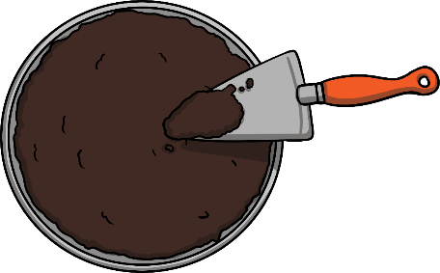
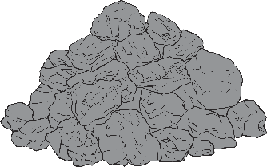
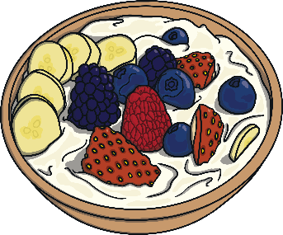
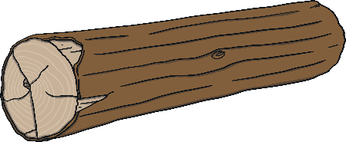
Once They’re Gone, They’re Gone
We need to take care of our planet’s natural resources because a lot of these cannot be replaced or can take a very long time to replace once they have been used up.
Non-renewable
(takes millions of years to be replaced)
Renewable over time
(can still take a long time to replace)
coal
soil
water
food (from plants and animals)
oil
gas
trees

Slide 6
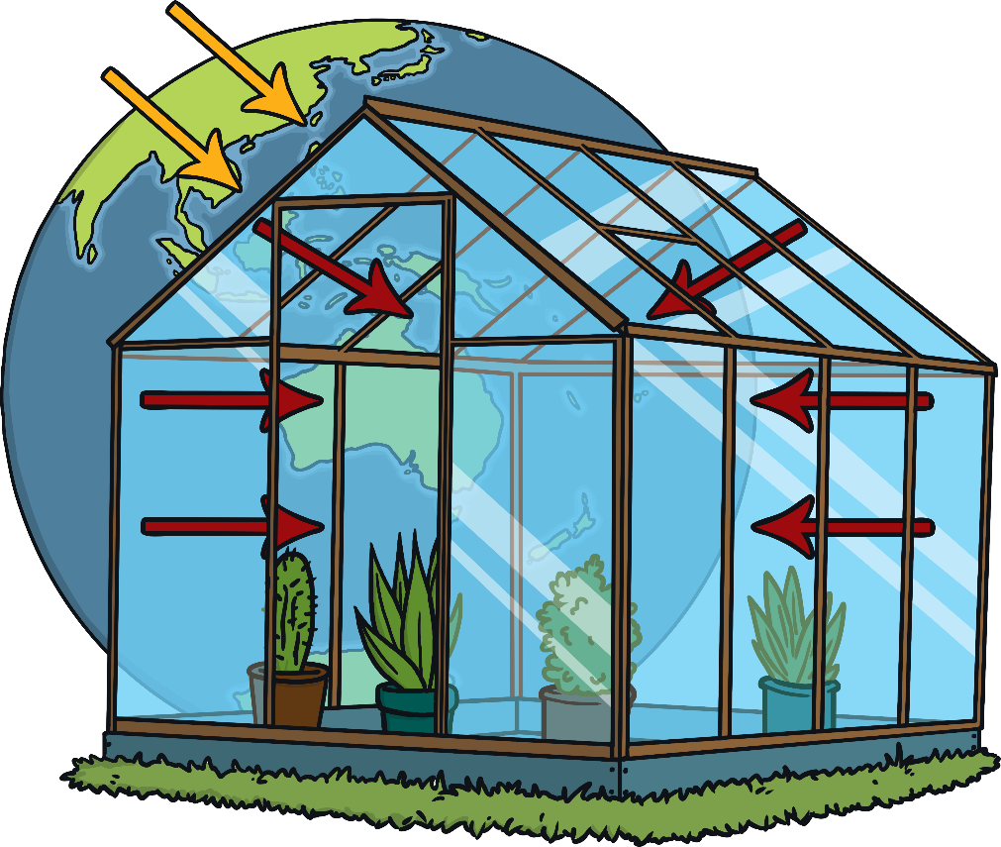
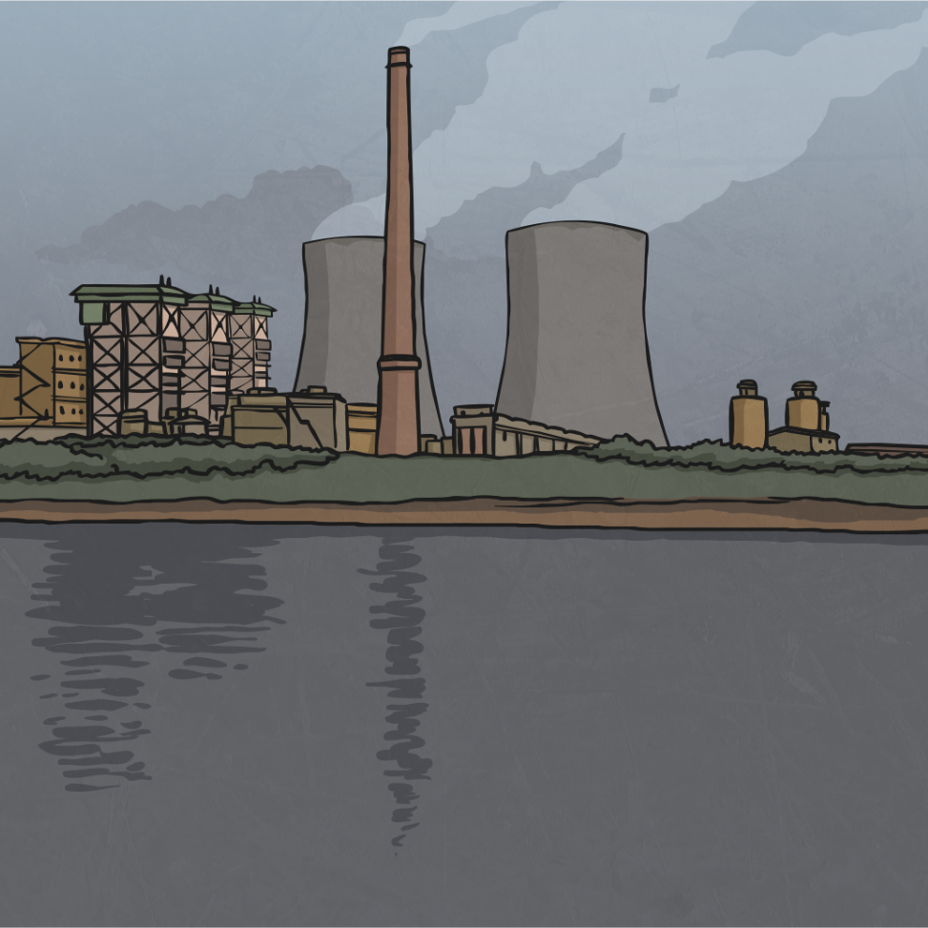
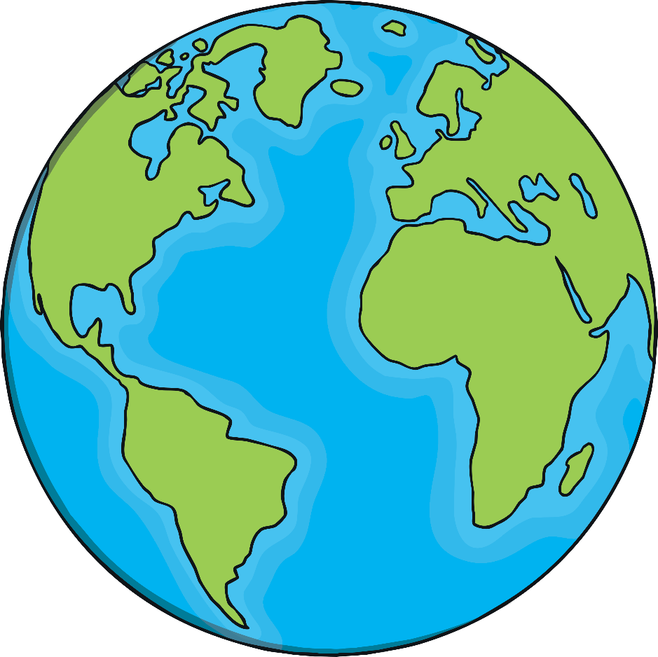
Earth’s Energy
People use fossil fuels like coal, oil and natural gas to make energy.
Fossil fuels take many, many years to form underground. If we keep using lots of them, they will eventually run out.
Burning fossil fuels also puts harmful gases, called greenhouse gases, into the air. These gases also cause an unnatural warming of the planet. This is called climate change.

Slide 7
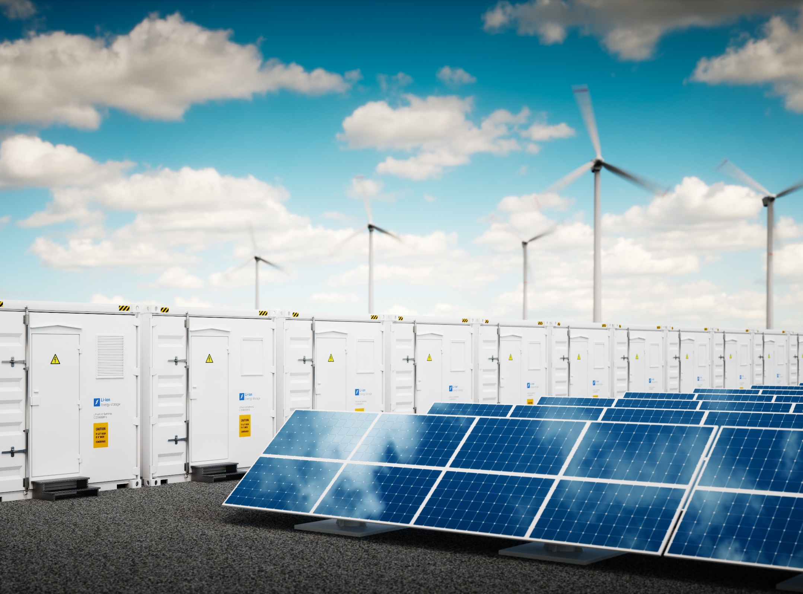
Earth’s Energy
Earth’s Energy
What Can People Do?
Use Renewable Energy: More and more companies are making energy using
Earth’s natural powers, like water,
wind and solar (from the sun). These
types of energy do not run out. This
is known as renewable energy.
Did You Know…?
Renewable energy, like wind and solar energy, does not add greenhouse gases into the air.
© Shutterstock / petrmalinak / WWF

Slide 8
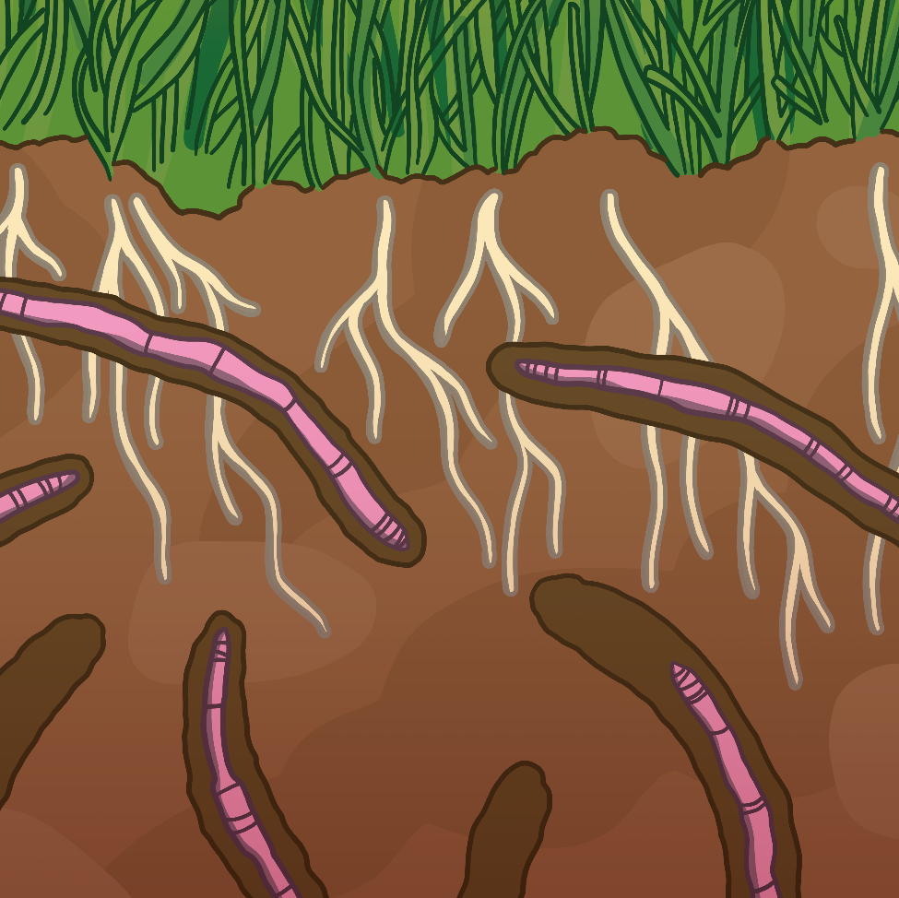
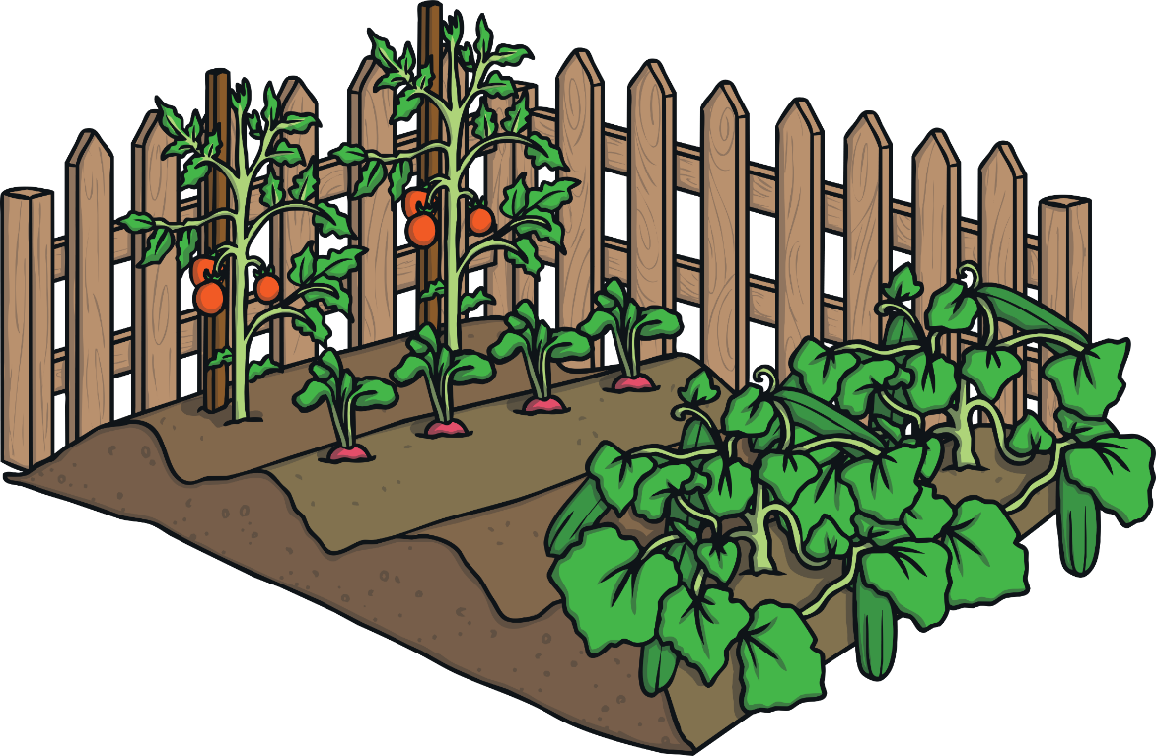
Earth’s Soil
Soil is important because it helps animals and plants to survive. Good quality soil helps plants to grow because it contains lots of things they need to grow called nutrients.
Too much farming, forest fires and not looking after soil properly can cause soil to lose its nutrients. If this happens, the soil cannot be used again to grow plants and support other life, such as insects.

Slide 9
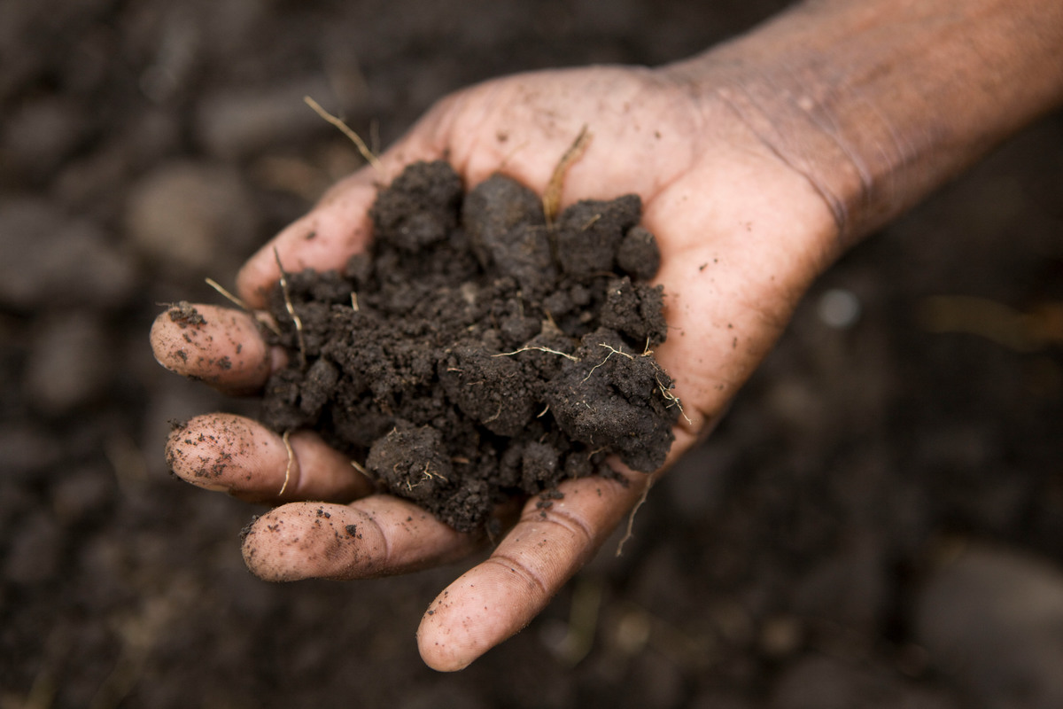
Earth’s Energy
Earth’s Soil
What Can People Do?
Grow Different Types of Plants
Different plants take different nutrients
from the soil so changing the plants that grow each year can keep the soil healthy.
Organic Farming
This is a type of natural farming that
does not use chemicals or sprays
that can damage the quality of the soil.
Did You Know…?
It takes hundreds of years to make
one inch of healthy soil.
© WWF / Simon Rawles

Slide 10
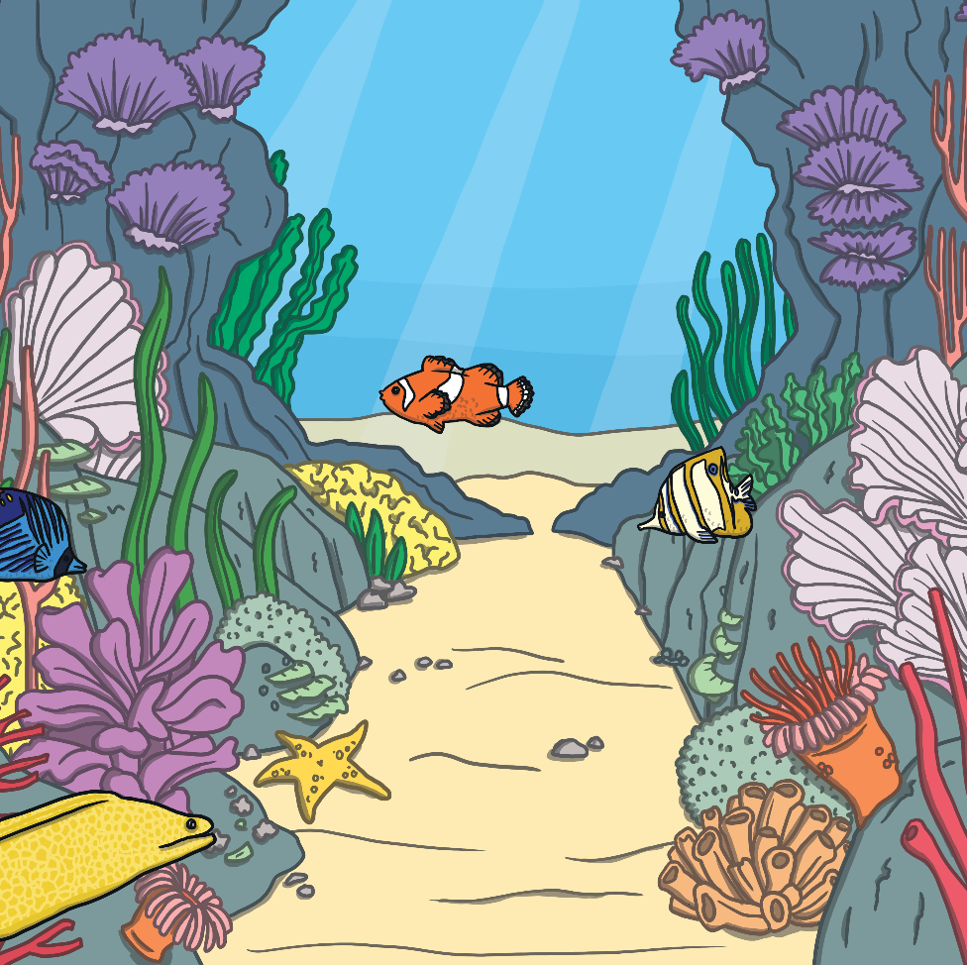
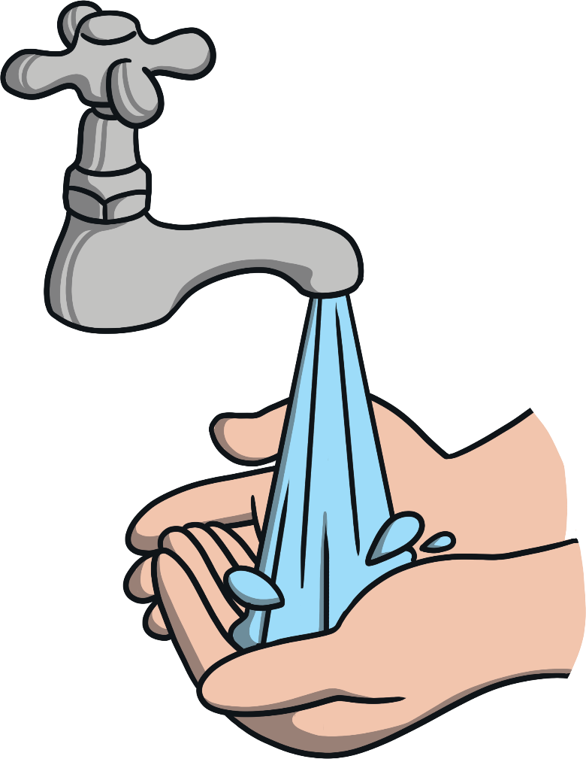
Earth’s Water
Water is important for all life on Earth to survive. A lot of Earth’s fresh water is used to make energy as well as to make food and clothing.
It is important that there is enough water for plants and animals to live and enough clean drinking water for everyone on Earth.

Slide 11
Earth’s Energy
What Can People Do?
Earth’s Water
Protect Rivers
It is important not to let rivers be blocked or
affected by roads, dams, buildings and farms.
If we allow rivers to run freely, plants and
animals can survive and the water can stay
fresh.
Look After Water
Companies and people in power should take responsibility for taking care of the fresh
water that they use. They should not use
too much fresh water and must make sure
that it is replaced or cleaned.
Did You Know…?
Most of Earth’s fresh water is frozen
as snow and ice.
© Gianfranco Mancusi / WWF-Brazil

Slide 12
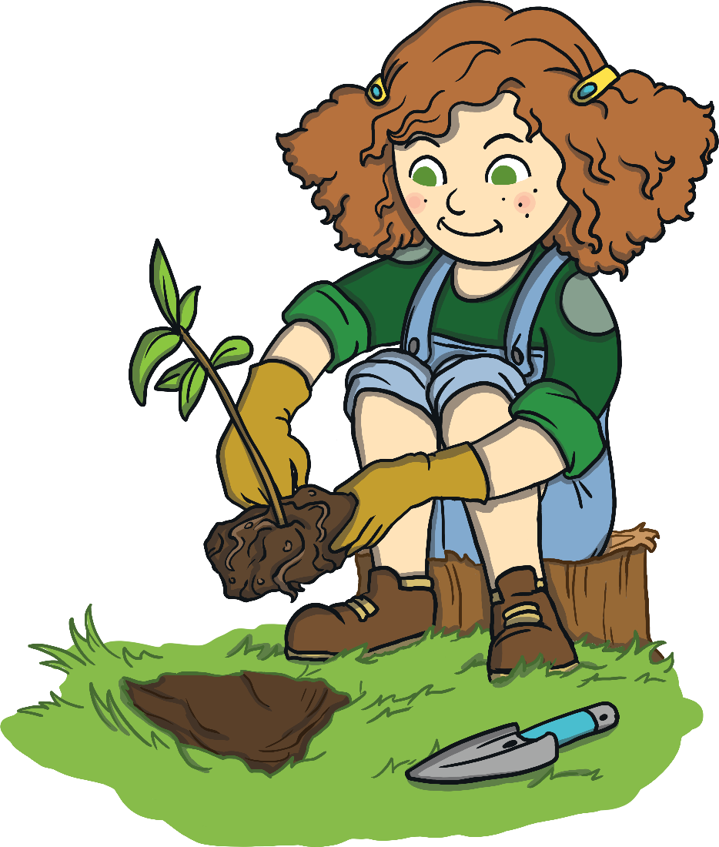
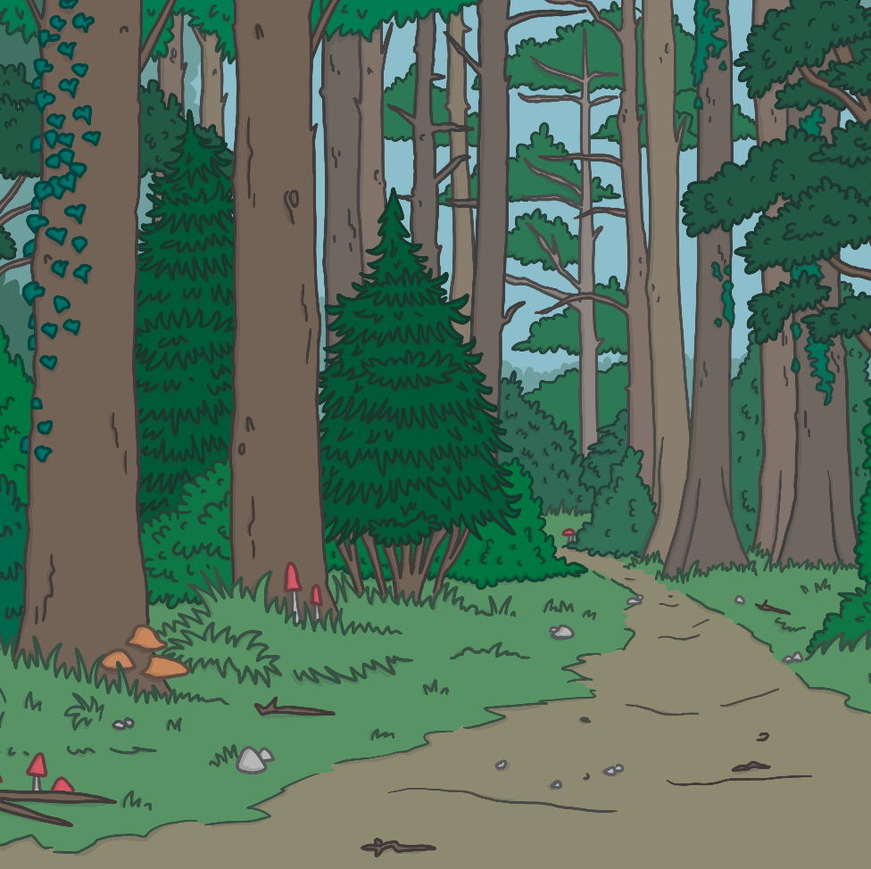
Earth’s Trees
Billions of trees are cut down from forests each year. Most forests are cleared for timber (wood) or to make space for farming land, roads or houses. Some trees are cut down without permission so that people can make money.
Once a tree has been cut down, it takes many years for a new tree to become fully grown.
Forests are important for lots of reasons. They provide a home for many of Earth’s plants and animals and local people need forests for resources, including food. Trees also have an important job in helping to take in a gas called carbon dioxide. This helps to keep the Earth at a stable temperature.

Slide 13
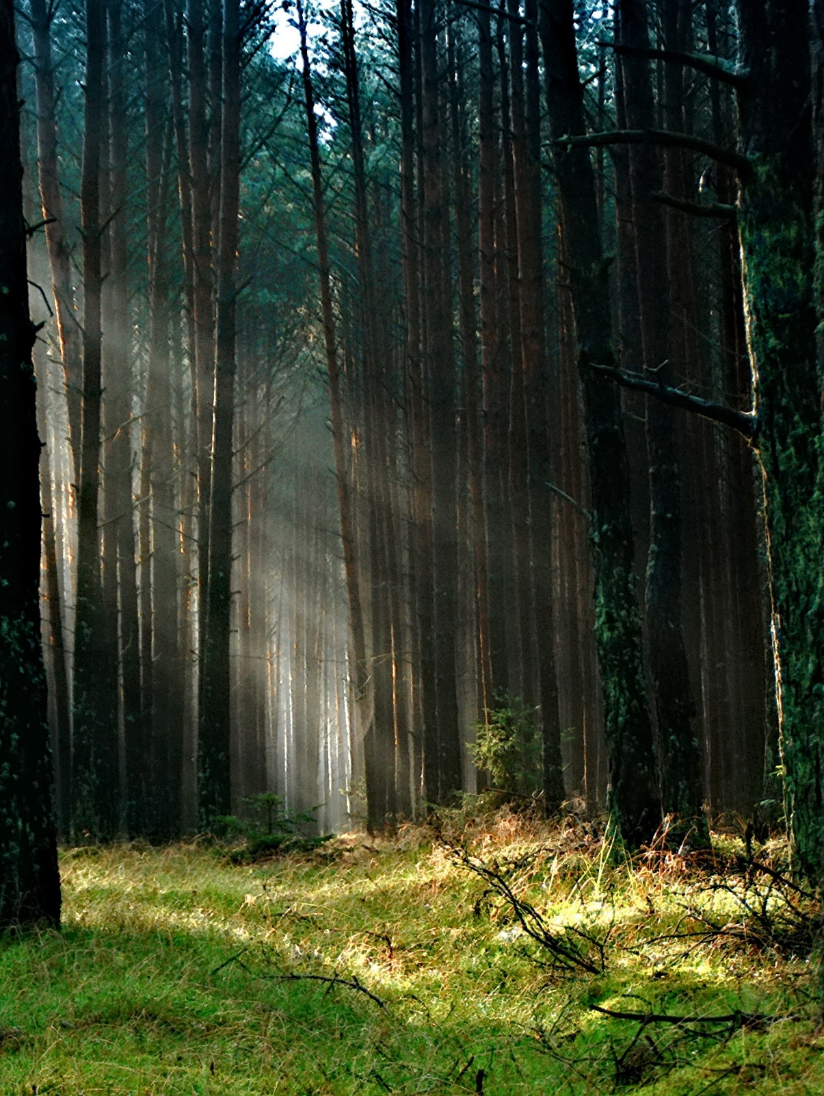
Earth’s Energy
What Can People Do?
Earth’s Trees
Reduce and Recycle
Recycling paper and cardboard and using less paper
means that fewer trees need to be cut down.
Look After Forests
Lots of the Earth’s forest areas are now carefully
managed and protected. This helps to care for the
plants and wildlife that live there as well as help
local people.
Tree Planting
There are groups across the world who are
replanting trees which will grow into new forests.
Did You Know…?
There is a plan called ‘A Trillion Trees’ which aims to grow, save and care for one trillion trees before the year 2050.

Slide 14
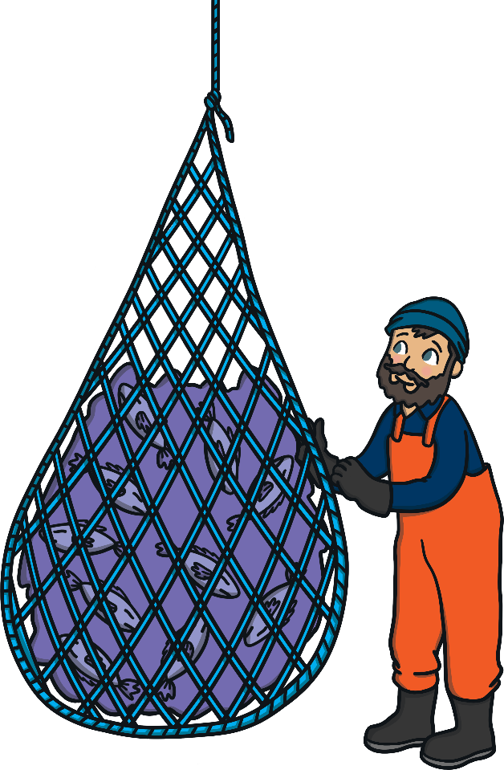
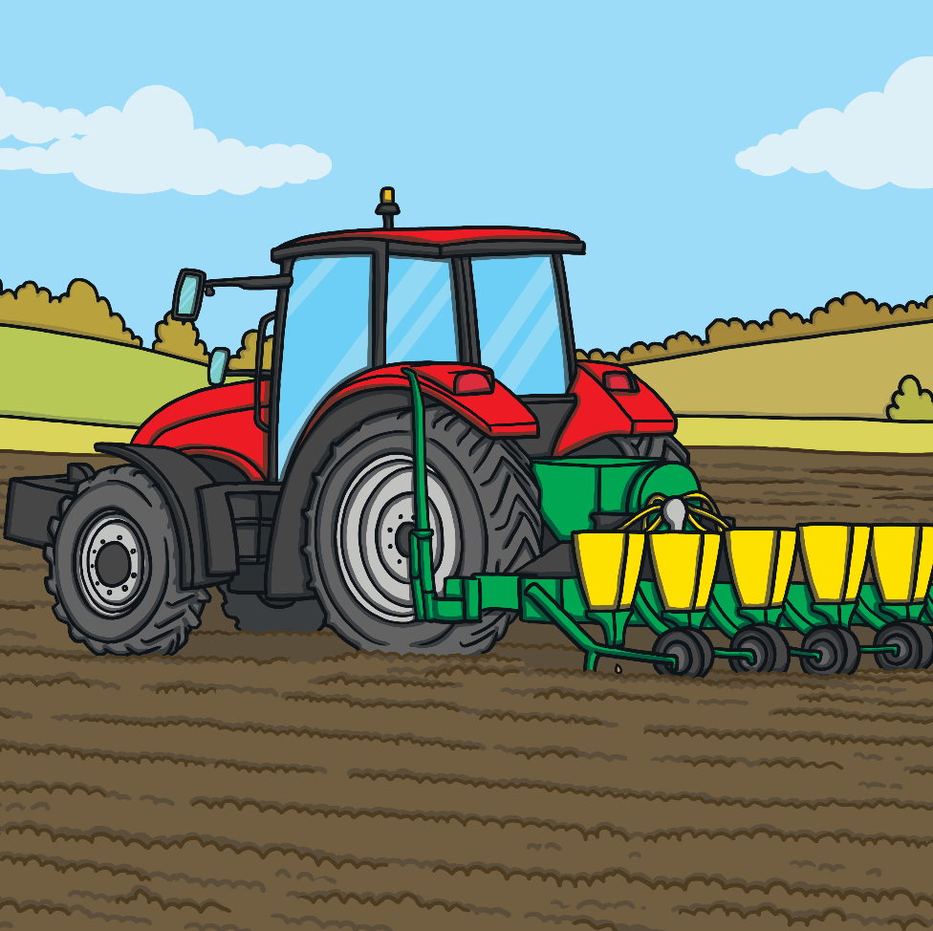
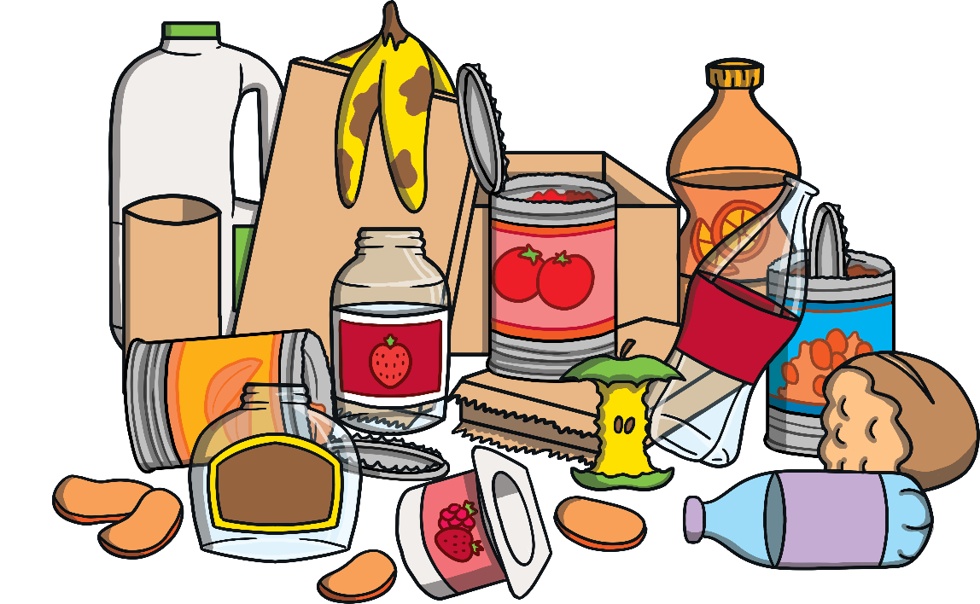
Earth’s Food
Around the world, humans are catching too many fish to eat. This is known as overfishing.
A lot of the Earth’s surface is used to make food for people to eat. A lot of food that is produced is not eaten and is wasted or lost.
We need to change the way that we produce food by wasting less of it and making sure that there is enough space for plants and wildlife.

Slide 15
Earth’s Energy
What Can People Do?
Earth’s Food
Waste Less Food
It is important that people and companies
only buy the food that they need so that
less is wasted.
Choose Food Carefully
It is important to look at the labels on
food as these can show if it has been
produced responsibly. These labels
include organic, Fairtrade and MSC
(which means seafood that has not
been overfished).
Did You Know…?
Around 1.3 billion tonnes of food is
wasted each year.

