Slide 1
Shake Up toolkit

Slide 2
Background for teachers
The benefits of physical activity
Research shows that doing physical activity can have a positive impact on young people’s mental wellbeing and improve their academic attainment.¹
So, to help pupils move more this summer Better Health has teamed up with Disney to create a Shake Up toolkit with simple, bite-sized, fun bursts of activity. Each activity can be used throughout the school day and is inspired by some of the characters from Disney Frozen, Disney and Pixar Toy Story and Marvel’s The Avengers.
How will this Shake Up toolkit help pupils to get active?
Pupils can learn to defend like Black Panther, jump like Bo Peep, and heave ice like Kristoff, helping them reach the recommended level of daily physical activity (at least 60 minutes per day).²
With an emphasis on physical activity and wellbeing, this toolkit will also support you to deliver the RE and HE curriculum.
What works in schools and colleges to increase physical activity, Public Health England (2020)
UK Chief Medical Officers' Physical Activity Guidelines (2019)

Slide 3
Ideas for using this resource
These activities are designed to be fun and flexible, so they can be used at different times throughout the school day, without PE kit.
As being outdoors is good for children’s wellbeing, these activities are designed for outdoor play. We suggest showing the slides to pupils inside before delivering the activities outside.
Lots of people in school can deliver these activities, including:
teachers and teaching assistants
breakfast, midday and after-school supervisors
older pupils (acting as buddies or leaders for other children).
The activities are designed to be inclusive of all pupils, whatever their abilities, disabilities or fitness. See the slide notes for additional inclusive adaptations where relevant.
This PowerPoint contains animation and is best viewed in presentation mode. Instructions for each activity are also in the notes section below slides 10-17.
Remember: for maximum benefit, the children should be feeling warm and/or out of breath to show they are working at the required intensity.
COVID-19
Each activity has been written with current (May 2021) Covid-19 guidelines in mind, with some suggested variations. However, please refer to the latest Government guidelines and your own school’s policies.

Slide 4
Help pupils continue their journey at home
Pupils can continue to have fun and get active with some of their favourite characters over the summer holidays by:
Making up their own Shake Up activities and teaching them to family and friends (see slide 18). You could share this activity – or the whole toolkit – via Google Classroom / Teams (or similar platform) to keep pupils moving over the summer.
Using the downloadable Shake Up games pack at home.
Asking their families to search 10 Minute Shake Up to find more fun activities to do at home. New games coming soon.
Help families join in the fun
To help families get involved, download our Sharing with families toolkit which contains web copy and imagery for your school newsletter or website. There is even a social post to encourage parents and carers to join the fun.
Celebrate with a Shake Up certificate
Reward pupils for taking part by using the Shake Up certificate.
©Disney

Slide 5
We’re going to be moving with some of our favourite characters
©Disney/Pixar
It’s time to shake things up and have some fun as we get moving with exciting activities from Disney Frozen, Disney and Pixar Toy Story and Marvel’s The Avengers!
Notes:
Teachers’ notes
Use this slide to briefly introduce the Shake Ups and inspire pupils.

Slide 6
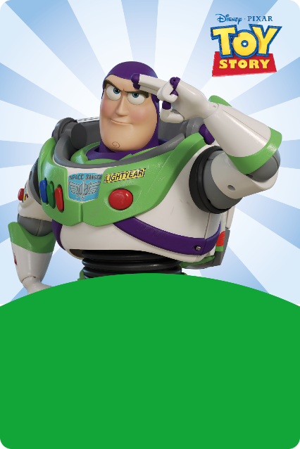
If you could invite them home for the summer…
Which character would you choose to play with?
Why would you choose them?
What activities would you do together?
©Disney ©Disney/Pixar © 2021 MARVEL
Notes:
Teachers’ notes
Spend a few minutes discussing these questions with pupils. You could also ask them to think about how the character could help them to get active.

Slide 7
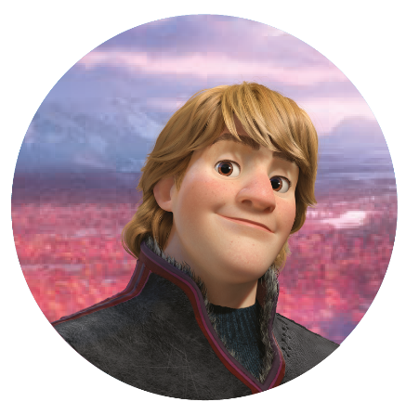
There are lots of ways to move
You could try…
Defending
like Black Panther
Jumping
like Bo Peep
Heaving ice
like Kristoff
©Disney ©Disney/Pixar © 2021 MARVEL
Notes:
Teachers’ notes
Explain that there are lots of different – and fun – ways to move.

Slide 8
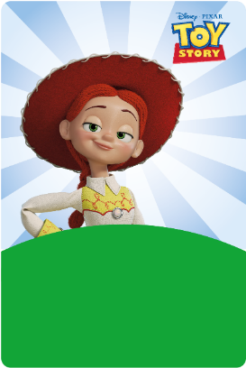
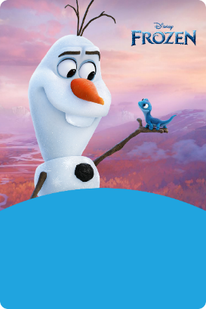
How does moving make you feel?
After each activity, ask yourself…
How does your body feel?
How does your mind feel?
How does your mood feel?
©Disney ©Disney/Pixar © 2021 MARVEL
Notes:
Teachers’ notes
Tell pupils that immediately after each activity, they will have a few moments to focus on the different effects:
Physical effect – on their bodies, for example panting and warm but energised (‘buzzing’).
Cognitive effect – on their brains or minds, for example more alert (‘wide awake’, ‘ready to go’).
Emotional effect – on their moods, for example more pleasure, less worry (‘happy’).
‘Be active’ is one of the five ways to wellbeing (promoted by the NHS and many other organisations).
Physical activity can support mental wellbeing (as well as physical health) by:
releasing ‘feel good’ chemicals in the brain, called endorphins, that can boost the mood
giving more energy (which can also help to boost the mood)
improving concentration, memory and attention.
Quote from the Relationships and Health Education curriculum (DfE, 2020)
“Physical health and mental wellbeing are interlinked, and it is important that pupils understand that good physical health contributes to good mental wellbeing, and vice versa.”

Slide 9
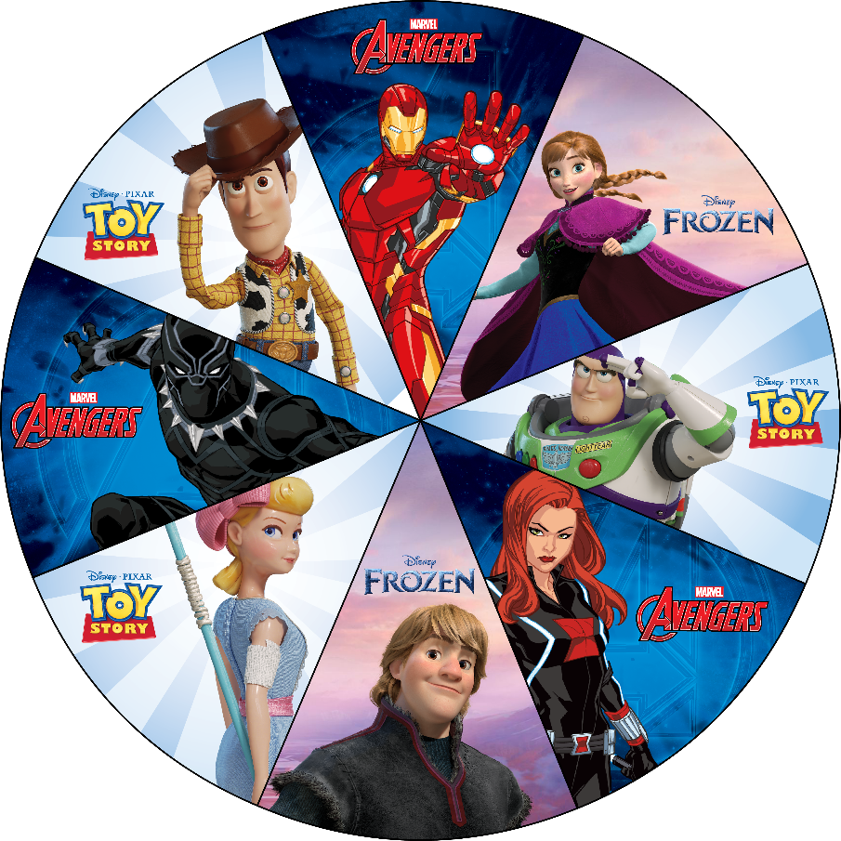
Spin the wheel to get moving!
Click the Spin button to spin
Spin!
Click it again to stop
©Disney ©Disney/Pixar © 2021 MARVEL
Notes:
Teachers’ notes
Please note – the spinner only works when the PowerPoint is in presentation mode.
Click the spin button (or have a pupil click it) in presentation mode to get the spinner moving. Click it again to stop it.
The character it lands on corresponds to the activity you can do with pupils. Click through the slides to find the corresponding activity.

Slide 10
Protect the treasure
Black Panther is the protector of his kingdom. Can you help him to protect its treasures when enemies try to steal them? Like Black Panther, you will need to have speed and stamina!
Who will finish the game with the most treasure?
You will need to set up two large bases at either end of the playground. One is Black Panther’s kingdom. The other belongs to his enemy – Thanos.
Team Thanos – you try to steal the treasures and take them to your base. Team Black Panther – you try to protect the treasures. You can also retrieve stolen treasures from the Team Thanos base and bring them home.
You can only steal or retrieve one treasure at a time. To stop someone, you tag them. If you are tagged, you must stop and return the treasure from where you took it.
Spread out lots of cones in Black Panther’s kingdom. These are the treasures. Sort players into two teams: Team Black Panther and Team Thanos.
Play for 5 minutes. How many treasures can you steal or protect? If time, swap teams and play again.
2
1
3
4
© 2021 MARVEL
Notes:
Teachers’ notes
Additional inclusion ideas:
Create multiple bases for each team, spread around the space.
Create uneven teams, e.g. fewer faster/fitter children on one team v more children on the other.
Allocate roles within teams, e.g. some players are protectors, some are stealers/retrievers.
Start with a set of treasures in both bases. Play stops when one team possesses all of the treasures.
Place some treasures on a higher surface if players cannot stoop or bend.
Play for shorter spells and swap teams more often.
Instructions (these are shown on the slide in presentation mode)
Spread out lots of cones in Black Panther’s kingdom. These are the treasures. Sort players into two teams: Team Black Panther and Team Thanos.
Team Thanos – you try to steal the treasures and take them to your base. Team Black Panther – you try to protect the treasures. You can also retrieve stolen treasures from the Team Thanos base and bring them home.
You can only steal or retrieve one treasure at a time. To stop someone, you tag them. If you are tagged, you must stop and return the treasure from where you took it.
Play for 5 minutes. How many treasures can you steal or protect? If time, swap teams and play again.

Slide 11
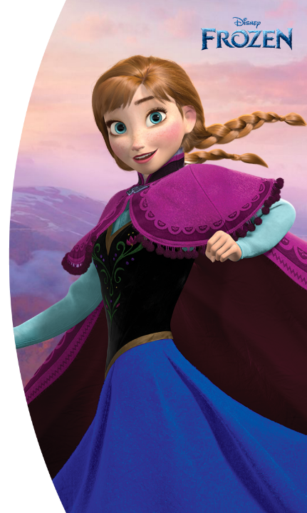
Freeze like Anna!
Anna is fearless and strong. Even though Elsa’s magic makes her start turning to ice, Anna still dives in front of Hans to stop his sword striking Elsa. At that moment she turns to ice!
Can you freeze like Anna?
Get ready for a game of freeze tag. When you are tagged, can you freeze like Anna?
When you are tagged, stop, make a shape and freeze. What shapes can you make? Think tall, small, wide, strong or spiky!
Stay frozen until another player taps your shoulder. Move again. If you are tagged again, make a different shape.
3
Play for 2 minutes then change the tagger.
2
1
©Disney
Notes:
Teachers’ notes
Additional inclusion ideas:
Have more than one tagger at a time.
Have a hot spot (a short ‘rest zone’): players can rest in this zone for 10 seconds without being frozen. Set a limit on how many times and for how long they can rest, e.g. only 10 seconds for each minute of play.
Change what players touch to unfreeze each other, e.g. waist, knee, foot.
Adjust the length of each round, e.g. 1 minute, 3 minutes.
Walk quickly instead of running.
Instructions (these are shown on the slide in presentation mode)
When you are tagged, stop, make a shape and freeze. What shapes can you make? Think tall, small, wide, strong or spiky!
Stay frozen until another player taps your shoulder. Move again. If you are tagged again, make a different shape.
Play for 2 minutes then change the tagger.

Slide 12
Intercept for Iron Man
Iron Man needs to use his intelligence and speed to intercept messages from the mischievous Loki. Practise intercepting like Iron Man!
Can you stop the message getting past?
This group activity needs 5-8 players. Stand in a wide circle with Iron Man in the middle. The other players are Loki.
One player passes a ball to another player across the circle. They cannot pass to a neighbour. Iron Man should try to intercept it – stop it from reaching the other player. How many interceptions (stopped passes) can Iron Man make in the time?
Can you change how the ball is passed each round? For example, you could throw overarm, underarm or with a chest pass; you could bounce, kick or roll the ball instead.
Play for 2 minutes then change places so everyone has the chance to be Iron Man.
2
Can Iron Man make more interceptions next time?
3
4
1
© 2021 MARVEL
Notes:
Teachers’ notes
Additional inclusion ideas:
Change how the ball is passed, e.g. tap, throw, roll, kick, bounce, push with a hockey stick.
Change the size and weight of the ball, e.g. netball, beach ball, tennis ball, balloon.
Sit or kneel instead of standing.
Make the circle larger or smaller.
Change the number of players, e.g. 2 L v 1 IM, 6 L v 2 IM
Loki players must stand on a spot to send and receive so only Iron Man can move.
Loki players must pass the ball in a given order to help Iron Man to anticipate it.
Change Iron Man each time the ball is intercepted.
Loki players aim at a goal rather than passing to another player.
Challenge: When a Loki drops the ball, a member of their team has to run around the circle. This should be taken in turns.
Instructions (these are shown on the slide in presentation mode)
One player passes a ball to another player across the circle. They cannot pass to a neighbour. Iron Man should try to intercept it – stop it from reaching the other player. How many interceptions (stopped passes) can Iron Man make in the time?
Play for 2 minutes then change places so everyone has the chance to be Iron Man.
Can you change how the ball is passed each round? For example, you could throw overarm, underarm or with a chest pass; you could bounce, kick or roll the ball instead.
Can Iron Man make more interceptions next time?

Slide 13
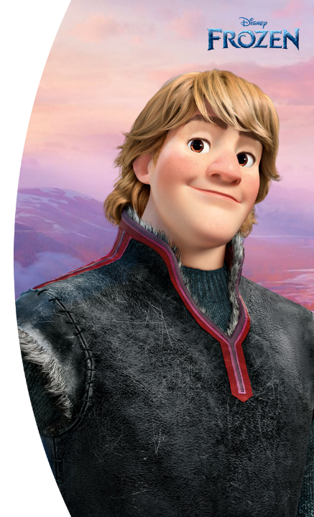
Harvest ice like Kristoff
In winter, ice harvesters, like Kristoff, work together to take ice from the frozen lake, cutting the blocks with their sharp saws. Can you work together to collect ice blocks?
Collect the ice blocks before they melt!
Stand in a line with your team mates (4-6 per team) and spread out so you’re arm’s length away from each other. How quickly can you get an ice block down the line?
Player 1 runs to the frozen lake and returns with a pretend ice block. How big is it? How heavy is it? How will you bring it back? Carrying, pulling, pushing, kicking – it’s up to you!
Pass it down your team line to your sledge. Each player copies the same passing action as player 1. Player 2 runs to collect another ice block. Bring it back to the team using a different method/action.
Keep playing until everyone has collected an ice block – or until time is up. Can you beat your team score/time next round?
2
3
1
You could use a ball, bean bag or balloon as a pretend ice block.
©Disney
Notes:
Teachers’ notes
Additional inclusion ideas:
Players stand closer or further apart.
The space between players varies, e.g. some closer, some further, to increase/decrease the challenge.
Players sit in a line between the ‘lake’ and the ‘sledge’ and swivel to pass the blocks between them.
Leader tells players which action to use, e.g. “Carry the ice block above your head”.
If using equipment, vary the equipment and method, e.g. hockey stick to push small ball, dribble football, bounce basketball, tap balloon with body part or bat.
Instructions (these are shown on the slide in presentation mode)
Player 1 runs to the frozen lake and returns with a pretend ice block. How big is it? How heavy is it? How will you bring it back? Carrying, pulling, pushing, kicking – it’s up to you!
Pass it down your team line to your sledge. Each player copies the same passing action as player 1. Player 2 runs to collect another ice block. Bring it back to the team using a different method/action.
Keep playing until everyone has collected an ice block – or until time is up. Can you beat your team score/time next round?

Slide 14
Move like Woody
Woody is a tall, lanky cowboy, but he can fit into spaces that only a toy can. What different ways can you move?
Can you move like Woody?
Follow the instructions to move like Woody, but be ready to run back to base when Andy is coming!
Crawl under Andy’s bed to find a missing toy. Zig-zag down the garden to escape a scary dog. Creep down the stairs without being seen. Climb up to the windowsill to spy through the window. Jump on to Andy’s bed to make a speech.
Make up your own actions and play again. How else might Woody move? How might the other toys move?
Andy’s coming! Quickly get back to your base! Did you get there in time or did Andy see you move?
1
2
3
©Disney/Pixar
Notes:
Teachers’ notes
Additional inclusion ideas:
Keep the action verbs as open as possible so children can interpret them in different ways, e.g. move as quietly as possible, move as quickly as possible, imagine you are in a small space etc.
Children may move only part of their bodies, e.g. upper limbs if they have a lower limb impairment.
Ask children to imagine they are other characters from Toy Story (such as Bo Peep or Buzz Lightyear) or a character of their own choice: how will they move like that character?
Instructions (these are shown on the slide in presentation mode)
Crawl under Andy’s bed to find a missing toy. Zig-zag down the garden to escape a scary dog. Creep down the stairs without being seen. Climb up to the windowsill to spy through the window. Jump on to Andy’s bed to make a speech.
Andy’s coming! Quickly get back to your base! Did you get there in time or did Andy see you move?
Make up your own actions and play again. How else might Woody move? How might the other toys move?

Slide 15
Travel ‘to infinity and beyond!’
Buzz Lightyear believes he can fly. He pops out his wings and shouts ‘To infinity and beyond!’ when he tries to take off. Can you try and go ‘To infinity and beyond!’ and see how far you can travel?
How far can you travel each time?
Try out your new wings and go for a test flight.
Set a timer or get a friend to time for 2 minutes. How far can you travel in that time?
You can count laps around the playground, distance along a track or the number of shuttle runs you do. Choose a way to travel, such as running, skipping, fast walking.
Set the timer again. Can you go further this time? Set the timer again. Can you go further or travel differently this time? Try to make 4 runs in total. On which one did you travel furthest?
1
How will you encourage each other to fly as well as Buzz Lightyear?
2
3
©Disney/Pixar
Notes:
Teachers’ notes
Additional inclusion ideas:
Adjust timings to suit the children. Use different time periods for different children.
Allow children to choose their own way to travel.
Encourage children to focus on their own improvement rather than comparing with others.
Include a resting phase between each go if needed.
Ask children to work in teams to cover a distance and improve their team score. For example:
Work in teams of 4-6.
Half of the team stands on one side of the ‘canyon’; the rest of the team stand on the other side.
Player 1 from one side ‘flies’ across the canyon, taps a player from the other side who flies back.
Keep alternating the relay from side to side until time is up (4 minutes).
How many canyon crossings did the team make?
Play again to see if they can beat their score a second time.
Instructions (these are shown on the slide in presentation mode)
You can count laps around the playground, distance along a track or the number of shuttle runs you do. Choose a way to travel, such as running, skipping, fast walking.
Set the timer again. Can you go further this time? Set the timer again. Can you go further or travel differently this time? Try to make 4 runs in total. On which one did you travel furthest?
How will you encourage each other to fly as well as Buzz Lightyear?

Slide 16
Training station
Black Widow had to train for more than a decade to become a super spy! Can you train like Black Widow?
Follow the instructions to become a super spy!
One person will be the chief spy (trainer). They stand at the front and call instructions.
Instructions:
Jump high
Crouch low
Kick left and right
Pivot (turn around)
Shuttle (run 5 steps forwards then back)
Cover blown – on this signal, run to the spy base.
Trainee spies spread around the space in front of the chief spy and obey the instructions (make sure you have enough space!). Follow each instruction exactly and speedily if you want to become a spy!
Call out the instructions in a different order to keep the spies on their toes. How quickly can you call and respond? Can you just call out numbers so the spies must remember the action? Can you add your own actions?
2
4
Change the chief spy after 2 minutes.
1
3
© 2021 MARVEL
Notes:
Teachers’ notes
Additional inclusion ideas:
Simplify the verbs so individual children can interpret them in their own way, e.g. “Go high” could be jump high or reach high; “Go low” could be a crouch or just a bend at the waist etc.
Change the instructions to suit the children’s abilities – easier or harder.
Reduce or increase the number of instructions.
Include more running-type instructions, e.g. “Go East” or “Run left”, between stationary actions.
Instead of calling instructions, throw a dice: 1 = jump high, 6 = cover blown.
Ask chief spies to work in pairs, e.g. alternating instructions.
Instructions (these are shown on the slide in presentation mode)
Trainee spies spread around the space in front of the chief spy and obey the instructions (make sure you have enough space!). Follow each instruction exactly and speedily if you want to become a spy!
2. Instructions:
Jump high
Crouch low
Kick left and right
Pivot (turn around)
Shuttle (run 5 steps forwards then back)
Cover blown – on this signal, run to the spy base.
3. Call out the instructions in a different order to keep the spies on their toes. How quickly can you call and respond? Can you just call out numbers so the spies must remember the action? Can you add your own actions?
4. Change the chief spy after 2 minutes.

Slide 17
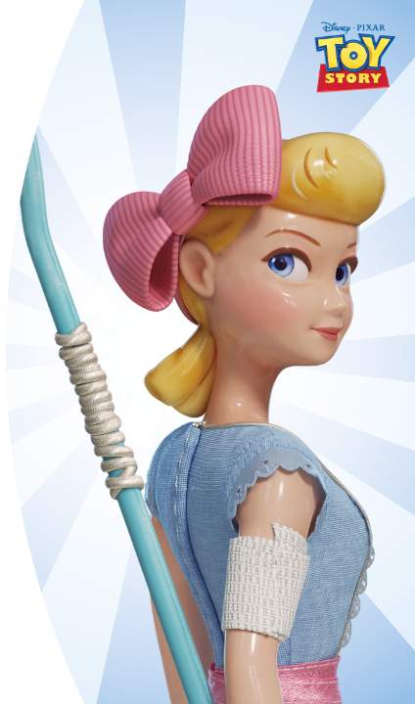
Add to the action!
Brave and tough, Bo Peep has lightning-quick reflexes and never goes anywhere without her staff (the long blue pole).
Are you as agile as Bo Peep?
Stand in a wide circle in your team (4-6 players).
Imagine you each have a staff. Include this in your moves.
Player 1 makes a move like Bo Peep. For example, spin on the spot, star jump, squat, side bend, stand on one leg.
Player 2 copies that move and adds their own.
Can you put all of your moves together to make a routine? Can you keep in time with each other?
Player 3 copies both moves and adds their own. Keep going until player 1 has to remember and make all of the moves!
1
2
3
©Disney/Pixar
Notes:
Teachers’ notes
Additional inclusion ideas:
Leaders demonstrate some basic exercise moves for children to copy.
Suggest children use actions from their favourite sport (and ignore the staff if needs be).
For older children, introduce them to some basic martial arts movements.
Players just make their own move rather than replicating the previous team members’ moves.
Player 1 only makes their own move (and does not have to do the full round at the end).
Group children according to their agility.
Instructions (these are shown on the slide in presentation mode)
Player 1 makes a move like Bo Peep. For example, spin on the spot, star jump, squat, side bend, stand on one leg. Player 2 copies that move and adds their own.
Player 3 copies both moves and adds their own. Keep going until player 1 has to remember and make all of the moves!
Can you put all of your moves together to make a routine? Can you keep in time with each other?

Slide 18
Make up your own Shake Up for your favourite character!
Write the name of, or draw, your favourite Disney or Marvel character.
Design a Shake Up for your character by writing or drawing different moves or actions. How many can you think of?
Take your Shake Up home and teach it to your family and friends.
Challenge: can you make your Shake Up moves:
quicker?
smoother?
more flexible?
with control?
Top tip: think about how your favourite character would move.
©Disney ©Disney/Pixar © 2021 MARVEL
Notes:
Teachers’ notes
Encourage pupils to create their own Shake Up. This is a great activity for them to do over the summer – can they teach family or friends at home? You may wish to share this activity – or the whole toolkit – on Google Classroom / Teams or a similar platform to keep pupils moving at home.

Slide 19
And there are more activities to try with your family at home!
For more activities with your favourite characters, search 10 Minute Shake Up.
Notes:
Teachers’ notes
Explain to pupils that the journey doesn’t stop here – there are going to be lots more opportunities to get active and to have more fun with their favourite characters at home.
Pupils can search ’10 Minute Shake Up’ to find more fun activities to do at home, with new games coming soon.

