Slide 1
Disclaimer
We hope you find the information on our website and resources useful.
Animations
This resource has been designed with animations to make it as fun and engaging as possible. To view the content in the correct formatting, please view the PowerPoint in ‘slide show mode’. This takes you from desktop to presentation mode. If you view the slides out of ‘slide show mode’, you may find that some of the text and images overlap each other and/or are difficult to read.
To enter slide show mode, go to the slide show menu tab and select either from beginning or from current slide.
You may wish to delete this slide before beginning the presentation.

Slide 3
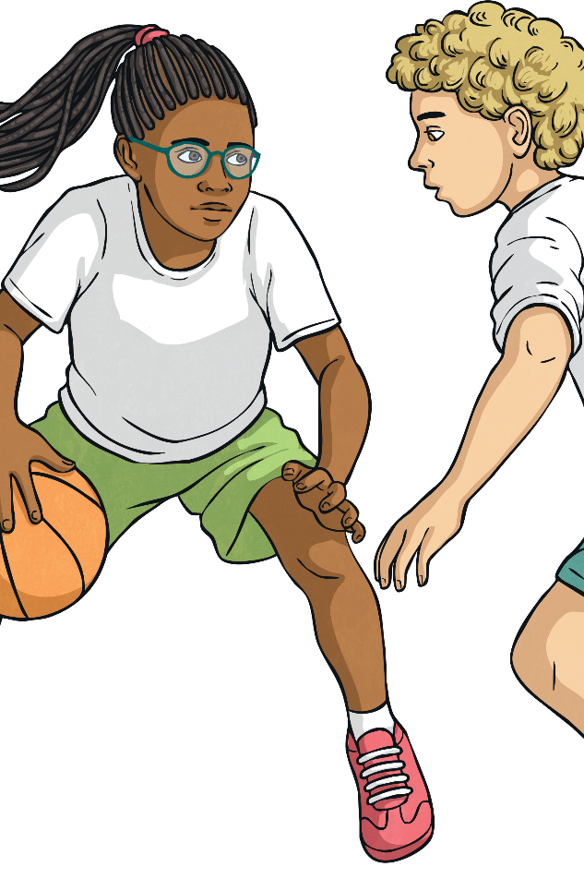
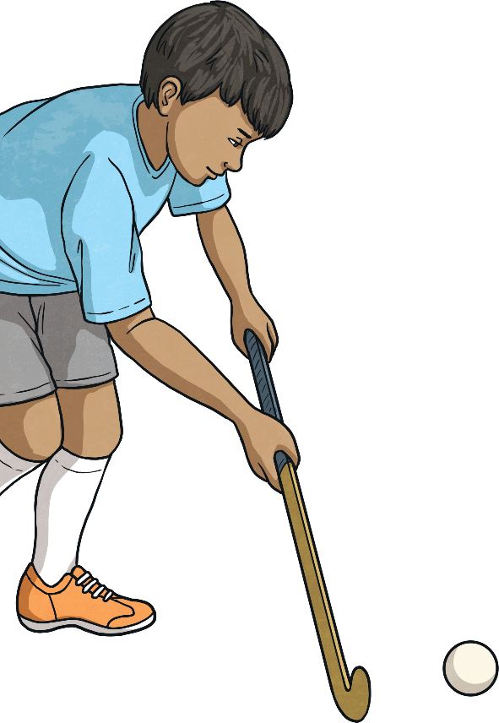
What Am I?
Use the clues to guess the sport being described.

Slide 4
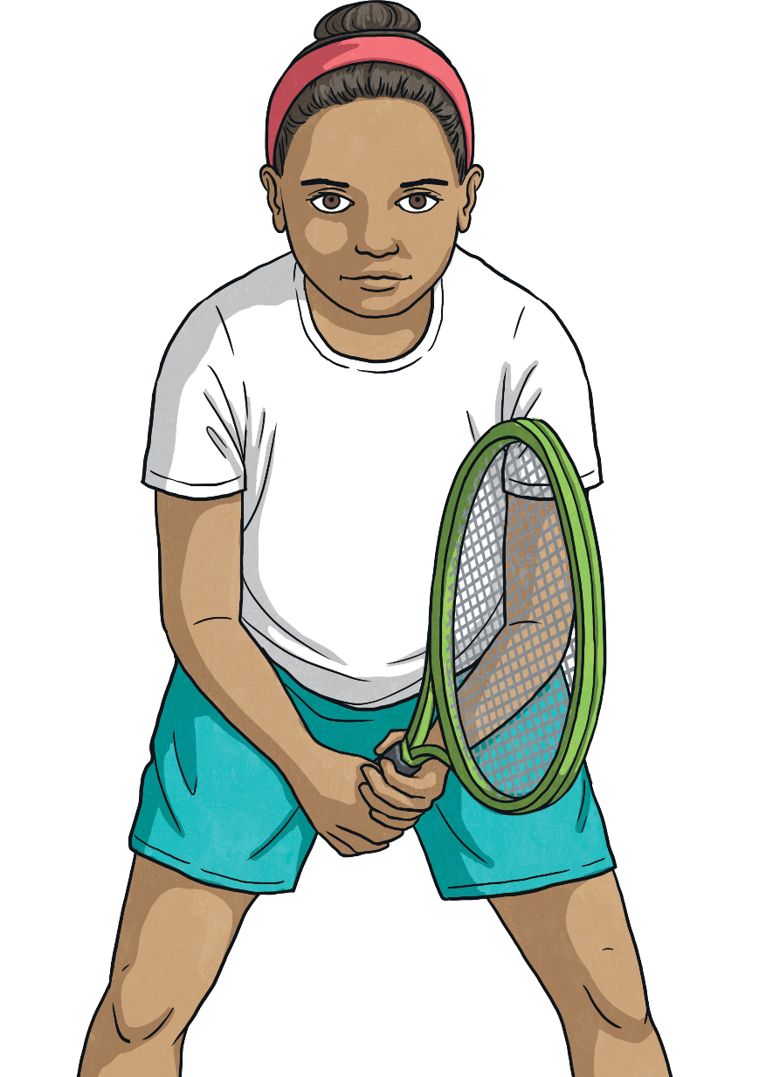
Click to reveal the clues.
?
Players use rackets and a ball.
?
I am played on a court with a low net across the middle.
What Am I?
?
One of my most famous tournaments is played at Wimbledon each year.
tennis

Slide 5
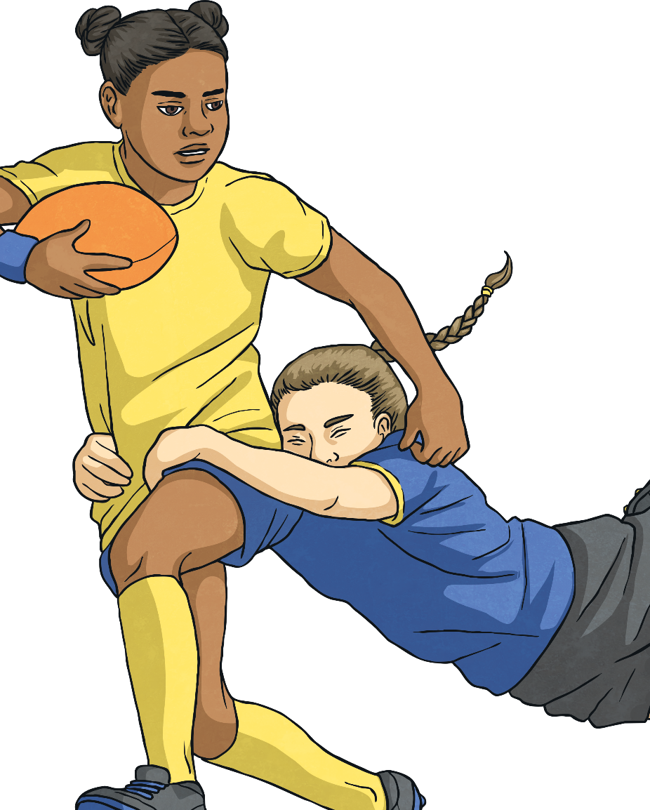
Click to reveal the clues.
?
Players can score tries or make conversions.
?
I am played with an oval shaped ball.
What Am I?
?
Players must pass the ball backwards.
rugby

Slide 6
Click to reveal the clues.
?
I am played by two teams with 6 players each.
?
More than one ball is used at a time.
What Am I?
?
Players aim to eliminate members of the opposite team with a ball.
dodgeball

Slide 7
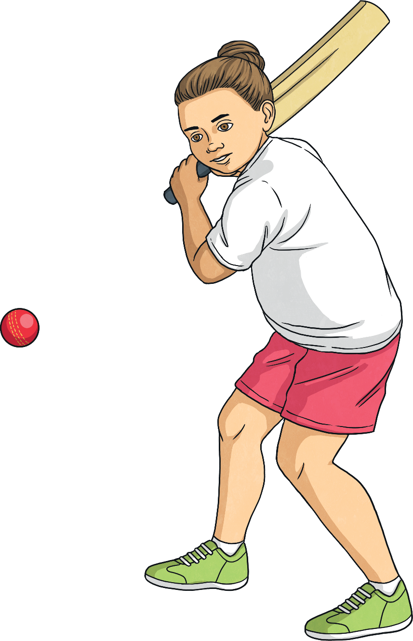
Click to reveal the clues.
?
I am played with a bat and a hard ball.
?
Players can score points by making runs.
What Am I?
?
One player is a wicket keeper.
rugby

Slide 8
Click to reveal the clues.
?
There are two nets, one at either end of the pitch.
?
Players move the ball with their feet.
What Am I?
?
I am sometimes called the ‘beautiful game’.
football

Slide 9
Click to reveal the clues.
?
I am played on a court by two teams of 5 players.
Players score points by shooting the ball through a hoop.
?
What Am I?
Players can make a slam dunk by pushing the ball through a hoop.
?
basketball

Slide 10
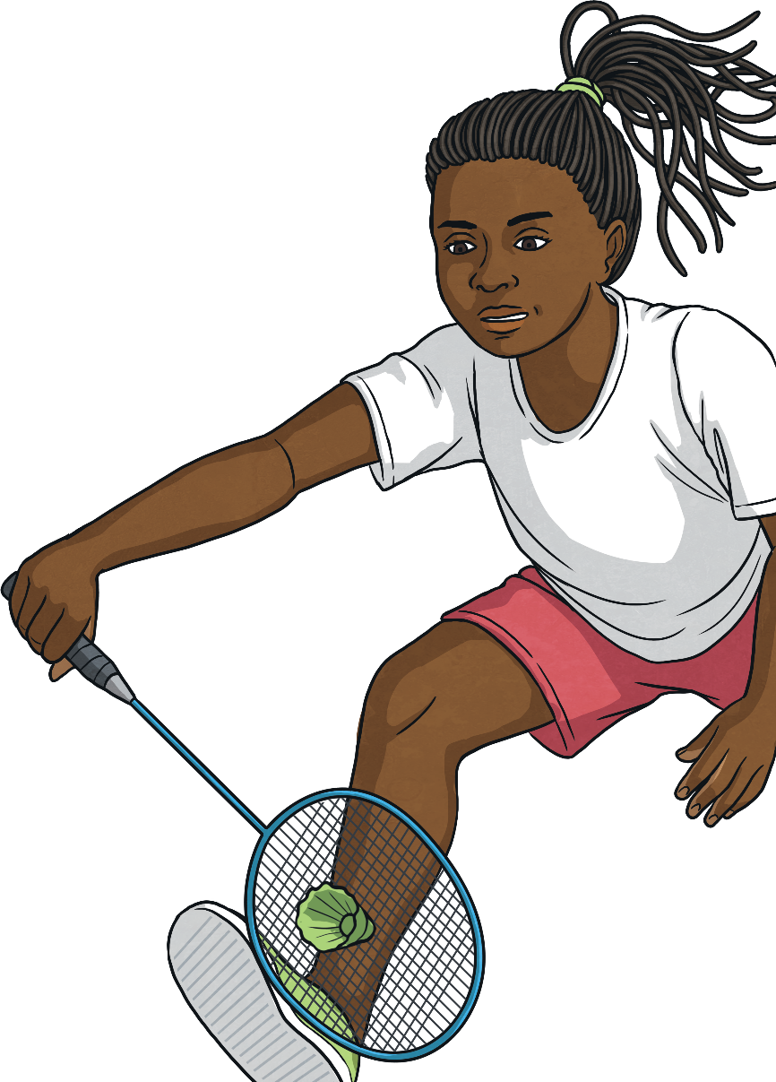
Click to reveal the clues.
?
I am played on an indoor court with a net across the middle.
?
Players use rackets with long thin handles.
What Am I?
?
Players hit a shuttlecock.
badminton

Slide 11
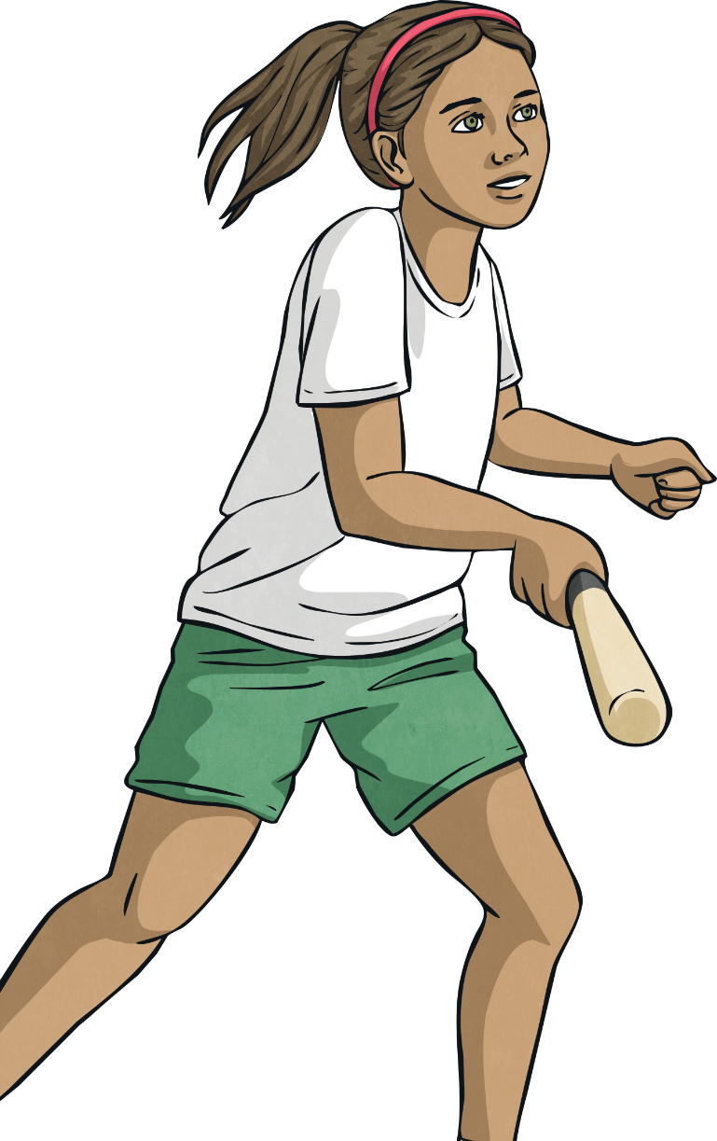
Click to reveal the clues.
?
A team is made up of nine players.
?
Teams take it in turns to field or bat.
What Am I?
Players must run around four bases. A player is safe when they have stopped at a base.
?
rounders

Slide 12
Click to reveal the clues.
?
Participants stay in lines known as lanes.
?
Participants travel using different strokes.
What Am I?
?
Be prepared to get wet.
swimming

Slide 13
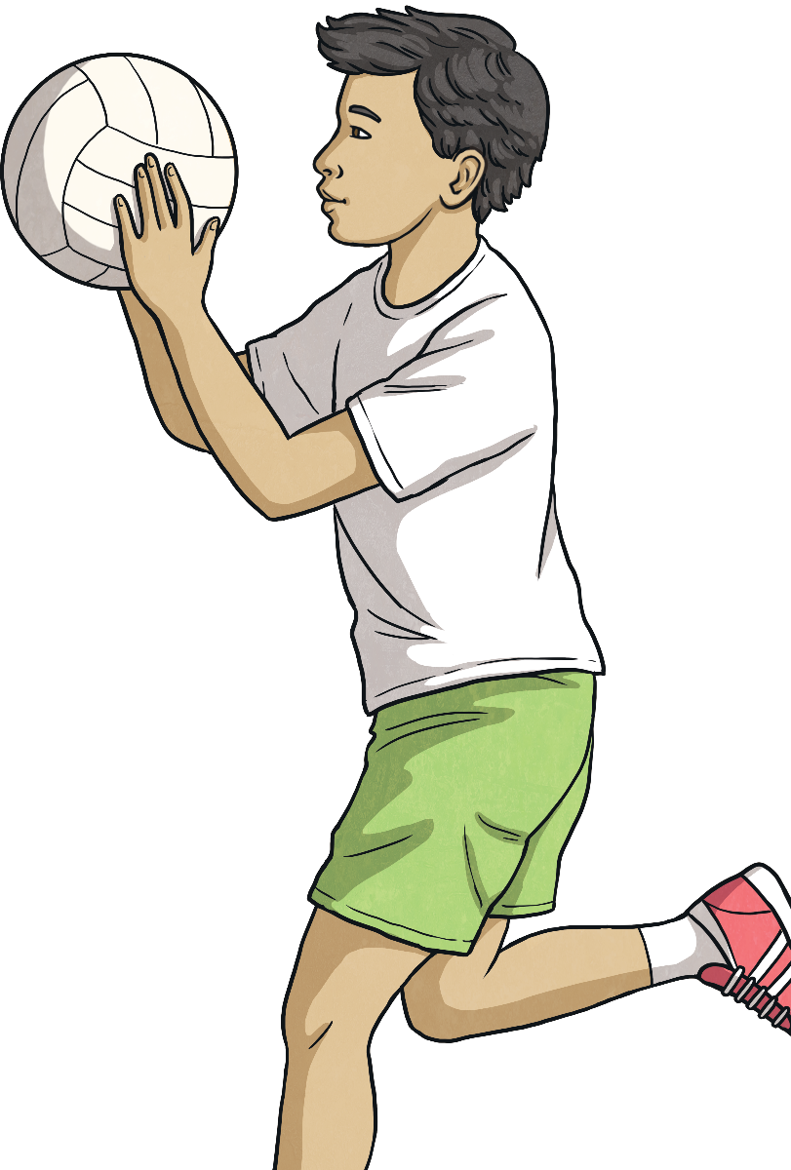
Click to reveal the clues.
?
I am played by two teams with seven players each.
?
I am played by both men and women
What Am I?
?
There is no running with the ball or dribbling the ball.
netball

Slide 14
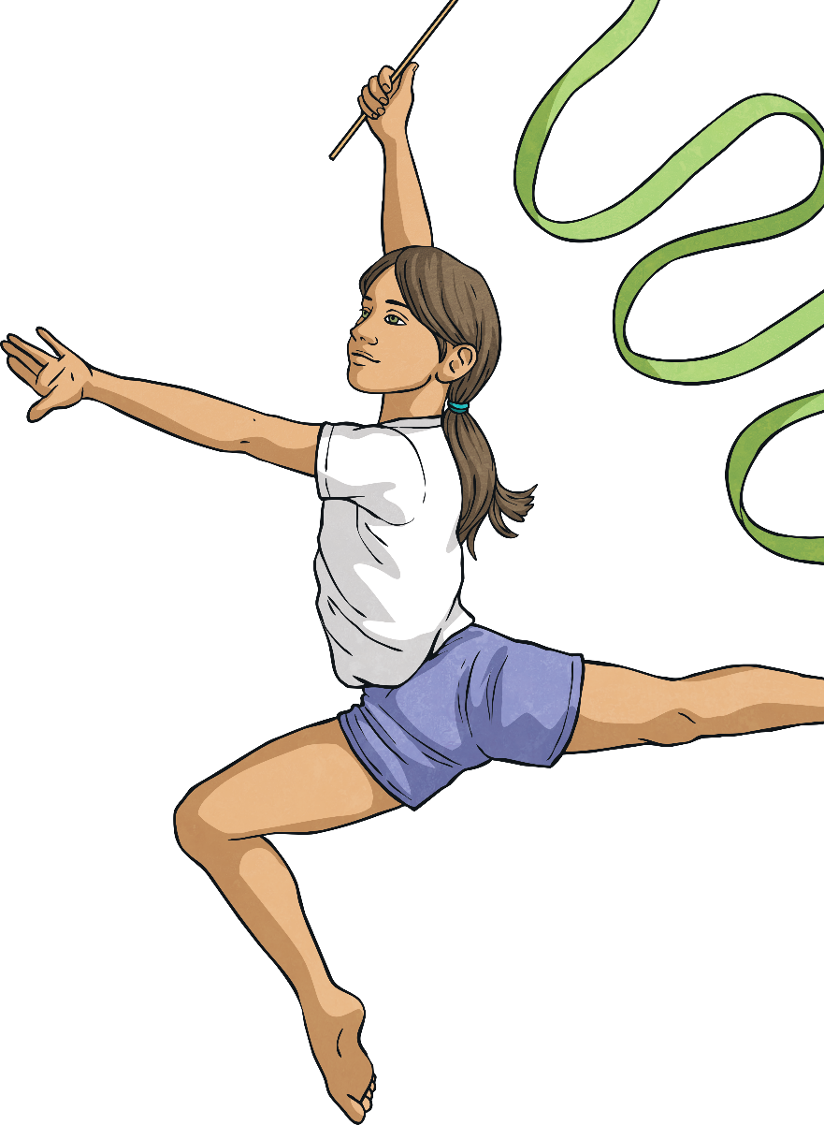
Click to reveal the clues.
?
I require flexibility and coordination.
?
Equipment could include a horse, bars or rings.
What Am I?
Some of the movements needed include rolls, springs and cartwheels.
?
gymnastics

