Slide 1
Easter Traditions

Slide 2
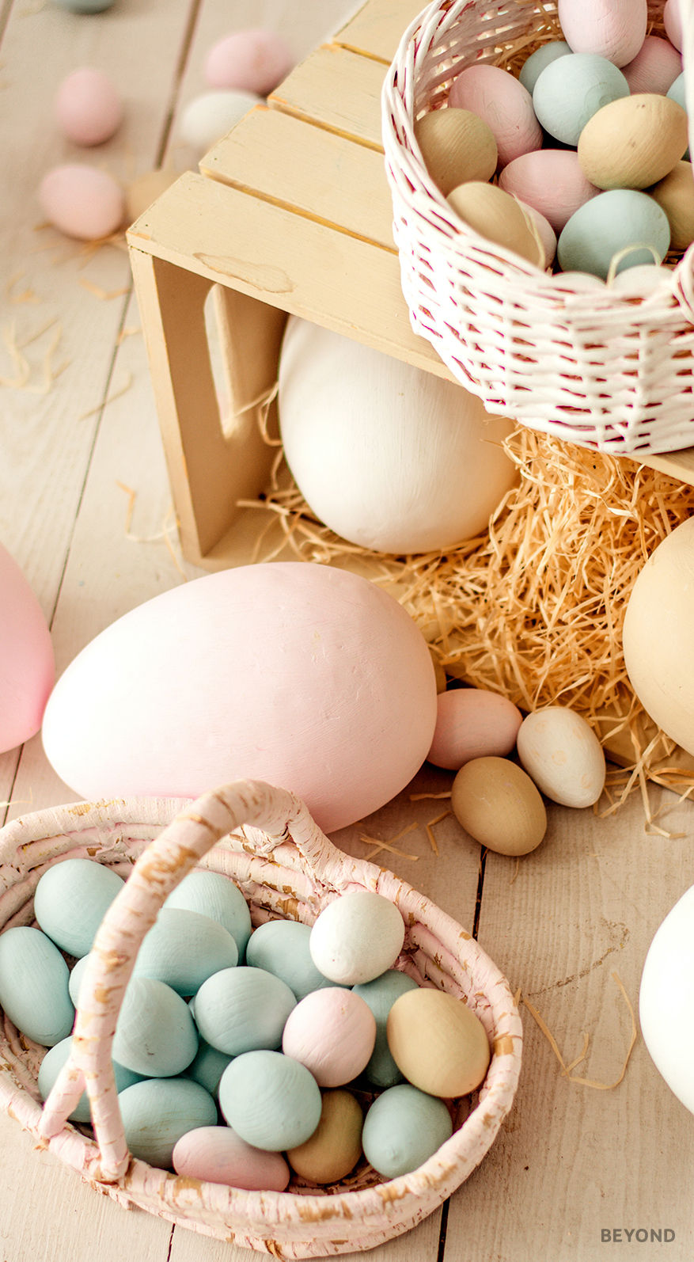
Easter
Easter is a Christian festival celebrating Jesus Christ’s resurrection following crucifixion. It marks the end of Holy Week, the end of Lent, and the last day of the Easter Triduum (starting from the evening of Maundy Thursday, through Good Friday, Holy Saturday, and Easter Sunday).
Easter is celebrated on the first Sunday following the full Moon that occurs on or just after the spring equinox. Easter is a “movable feast” and does not have a fixed date. However, it is always held on a Sunday between 22nd March and 8th May.
There are lots of ways people celebrate Easter around the world that are different from how it is marked in the UK.

Slide 3
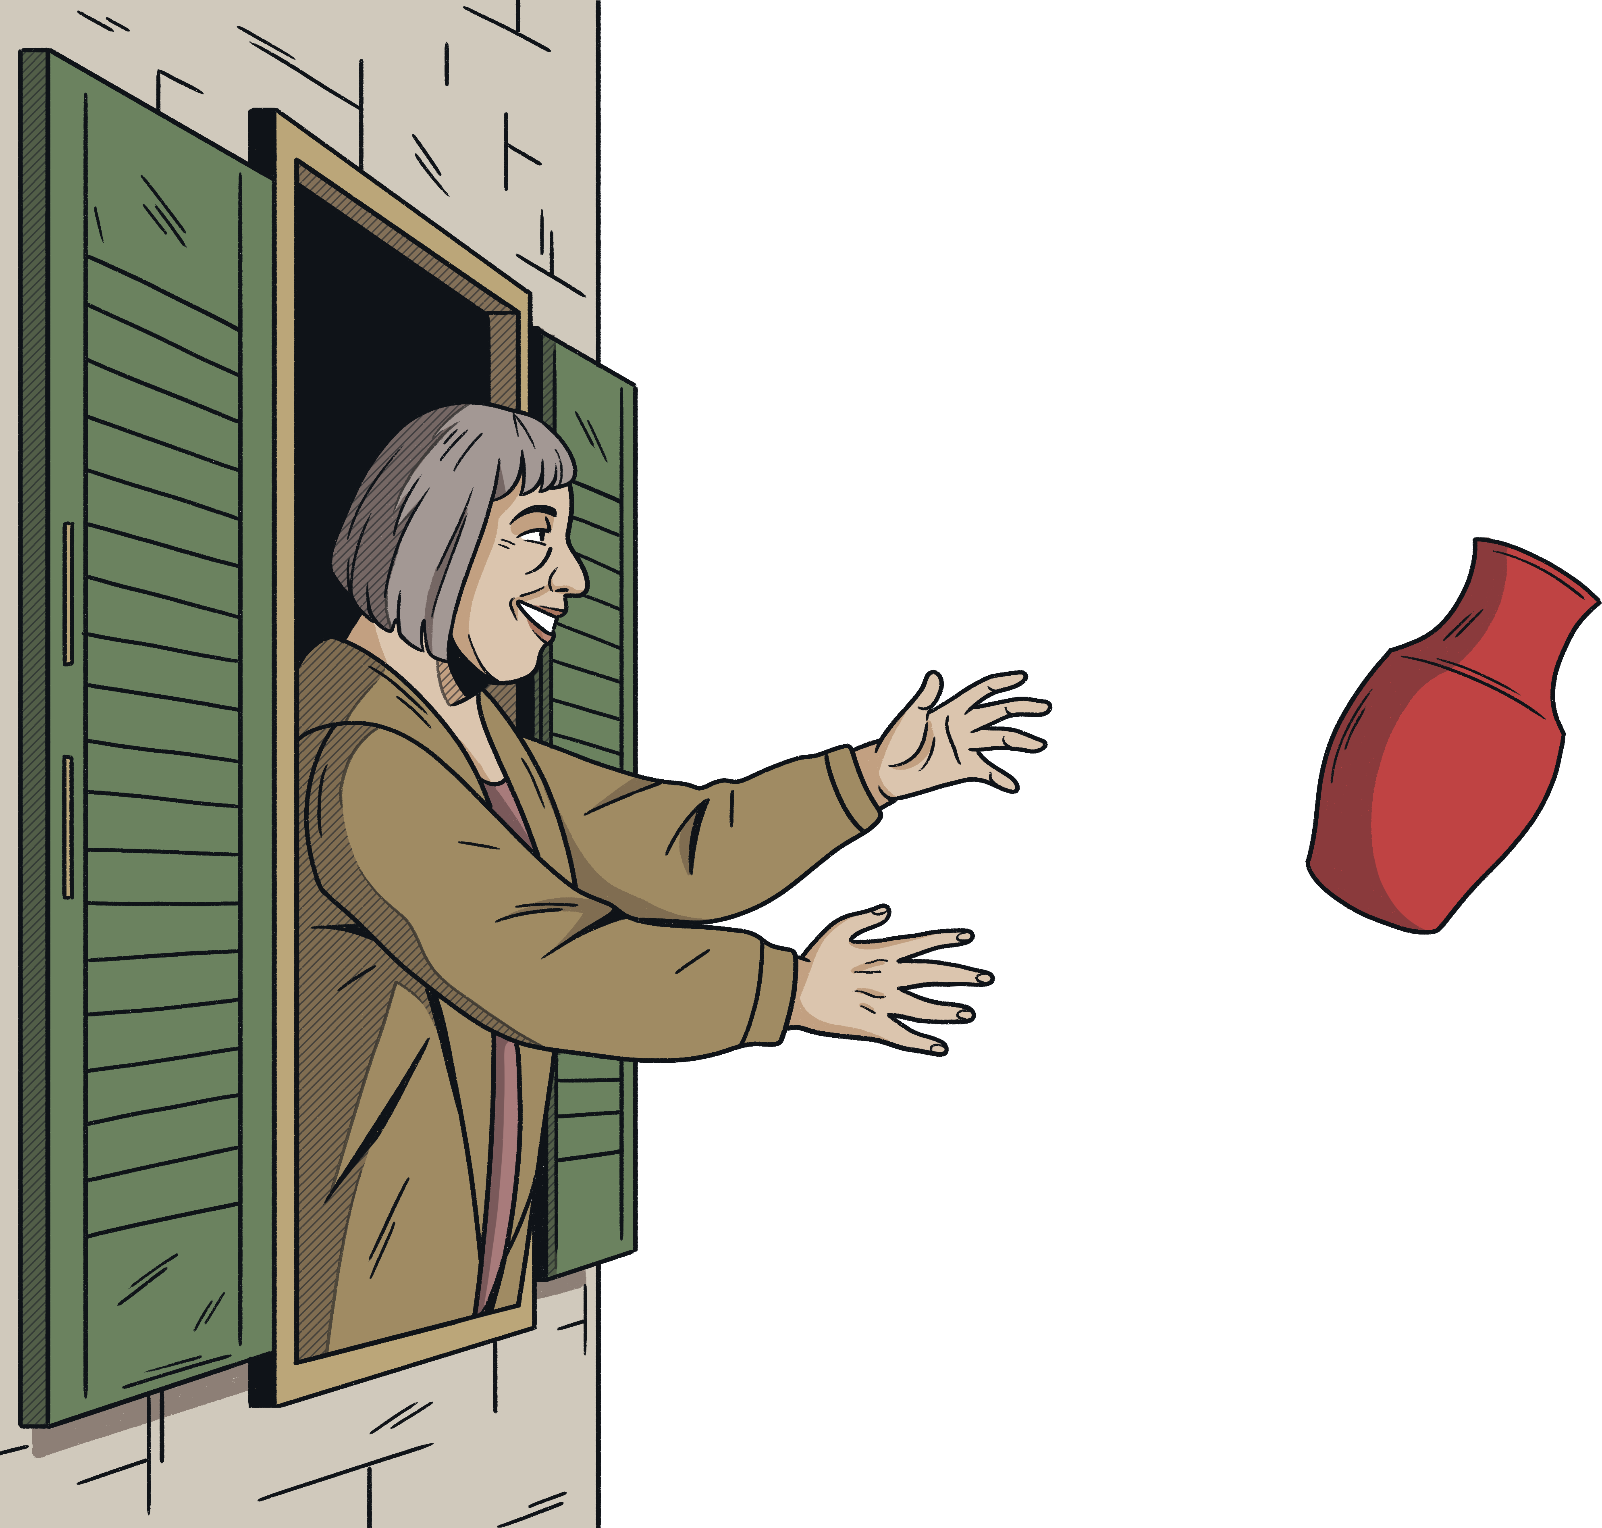
Greece
On the Greek island of Corfu, on Easter Saturday, it is traditional to throw old pots out of the windows onto the streets.
It is thought that the tradition comes from the Venetians who used to throw out all of their old items on New Year’s Day.
Others believe the throwing of the
pots welcomes spring.

Slide 4
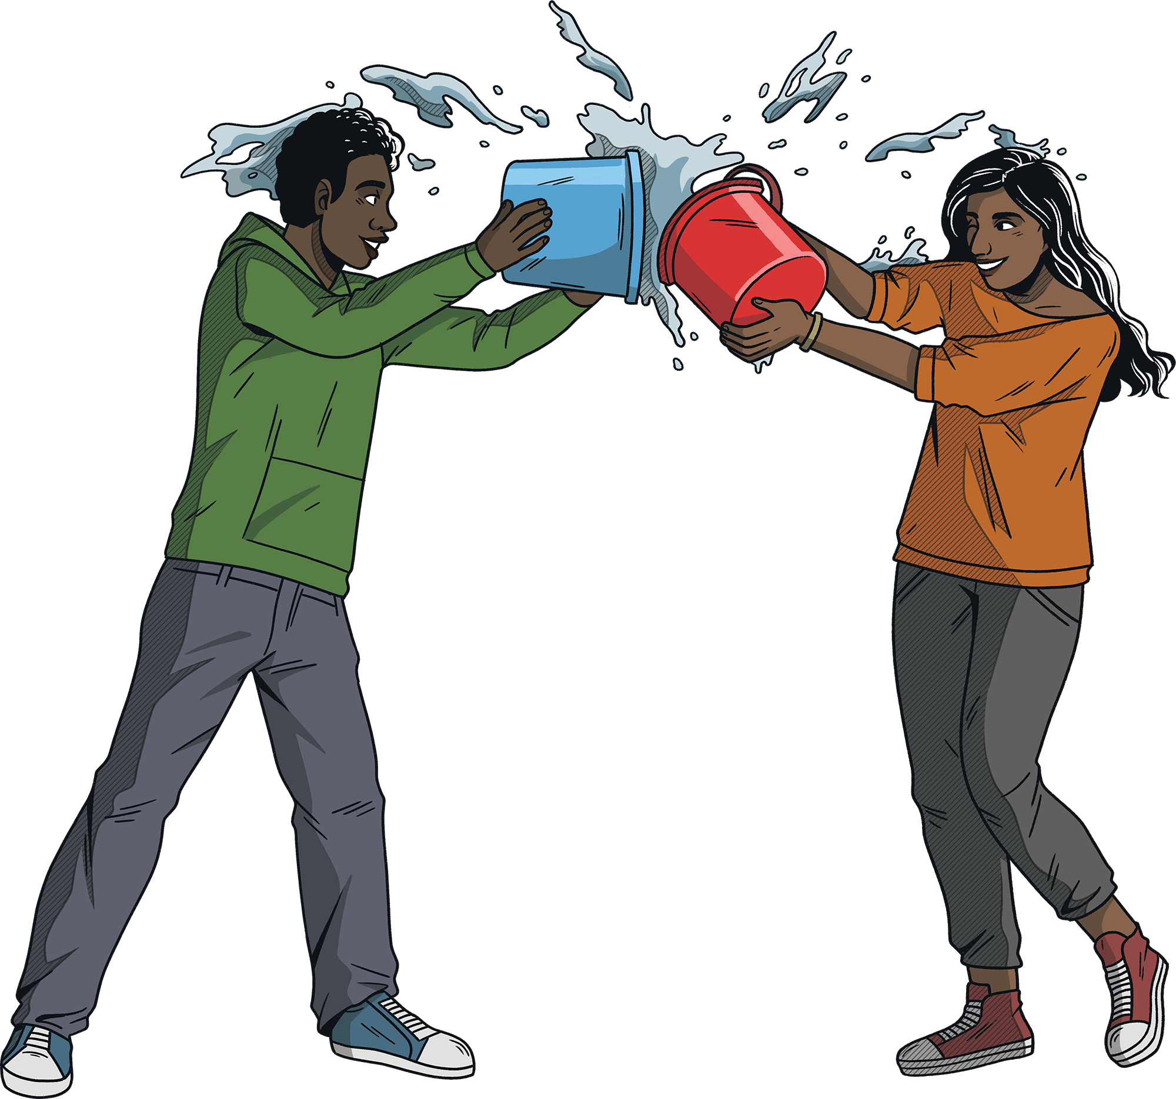
Central and Eastern Europe
Across central and eastern Europe, an ancient tradition is to drench each other with buckets of water on Easter Monday.
This tradition is known as “Smigus-dyngus” (Wet Monday) in Poland, “Watering Monday” in Ukraine, “Watering” in the Czech Republic and Slovakia, and “Sprinkling” in Hungary.
Traditionally, it was men who threw the water over the women. The ritual was supposedly based around women’s fertility as the water would have a “cleansing” effect to make them healthy for the upcoming spring.
For example, in Hungary, people will often dress up in folk costumes and the men will douse the women with buckets of water. In Poland, the tradition has evolved into a country-wide water fight.

Slide 5
Norway
Apparently, in Norway, Easter is a popular time to read crime novels.
The tradition is said to have started in 1923 when a book publisher promoted its new crime novel on the front pages of newspapers.

Slide 6
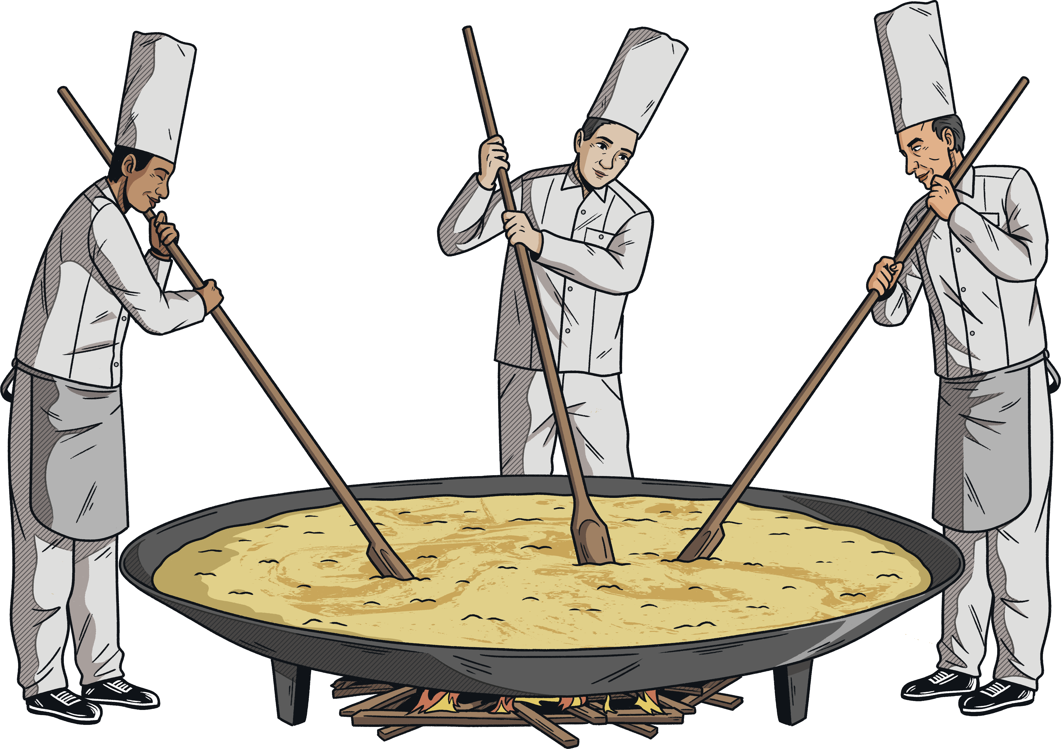
France
Around Easter, it is a tradition in France for the church bells to stop ringing, as a mark of respect for Jesus' death. To explain their silence, children are told the bells have flown to Rome to be blessed by the Pope.
On the morning of Easter Sunday (Jesus' resurrection), the bells then fly back to France, loaded with sweet treats, which they drop into gardens for the children. Afterwards, they then start ringing joyfully again.
In Bessières, a small town in the south of France, people gather every Easter Monday to share a gigantic omelette!
Around 15 000 eggs are used and it’s big enough to feed thousands of people.

Slide 7
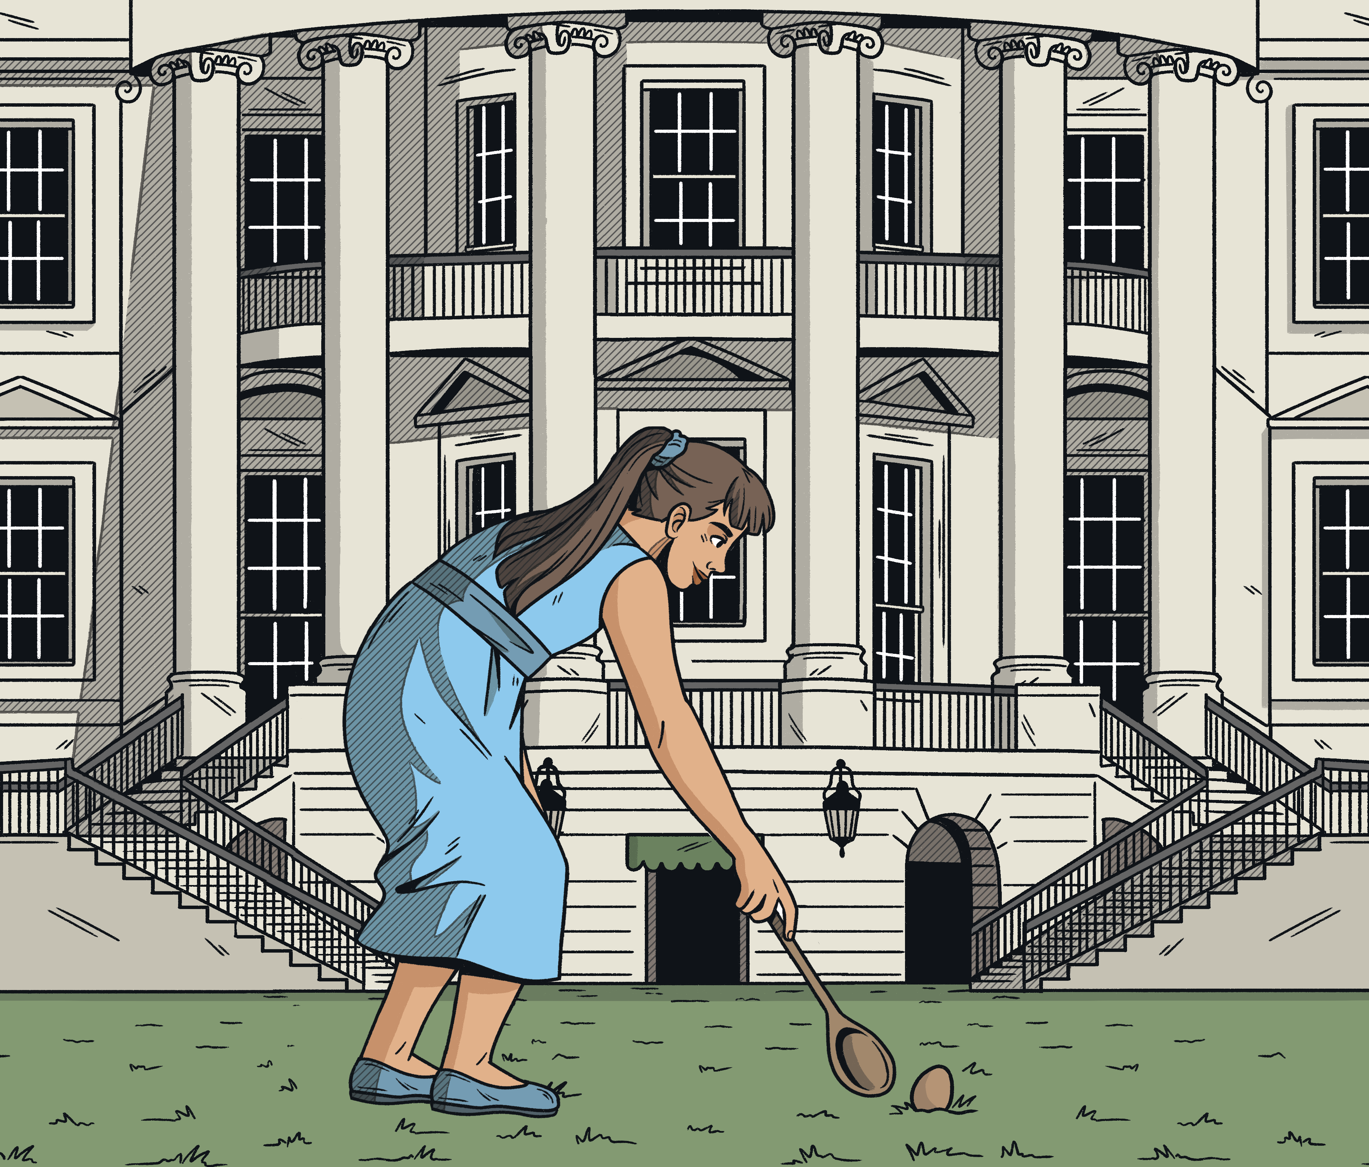
USA
At the White House in America, an annual Easter Egg Roll is held on its South Lawn.
The tradition dates back to 1878. The Egg Roll is held on Easter Monday and it’s usually the president’s wife, the First Lady, who is in charge of the event.
The main activity involves rolling a coloured hard-boiled egg with a large serving spoon.

Slide 8
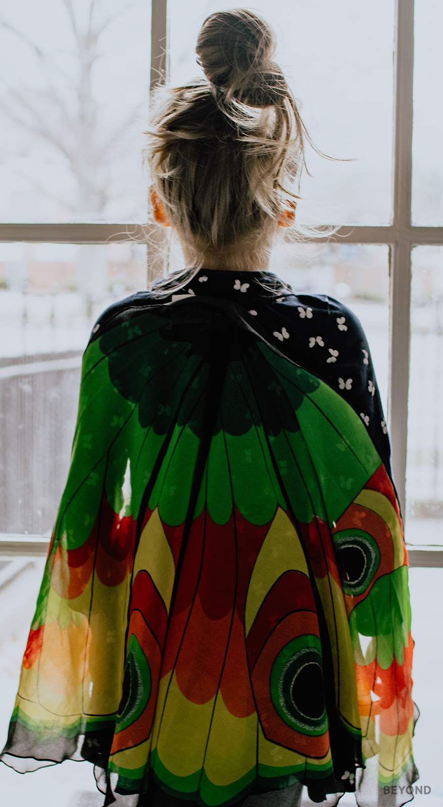
Scandinavia
In parts of Scandinavia, children dress up, similar to Halloween, and ask for chocolates and treats.
They might wear head scarves, make-up and carry twigs with feathers.

Slide 9
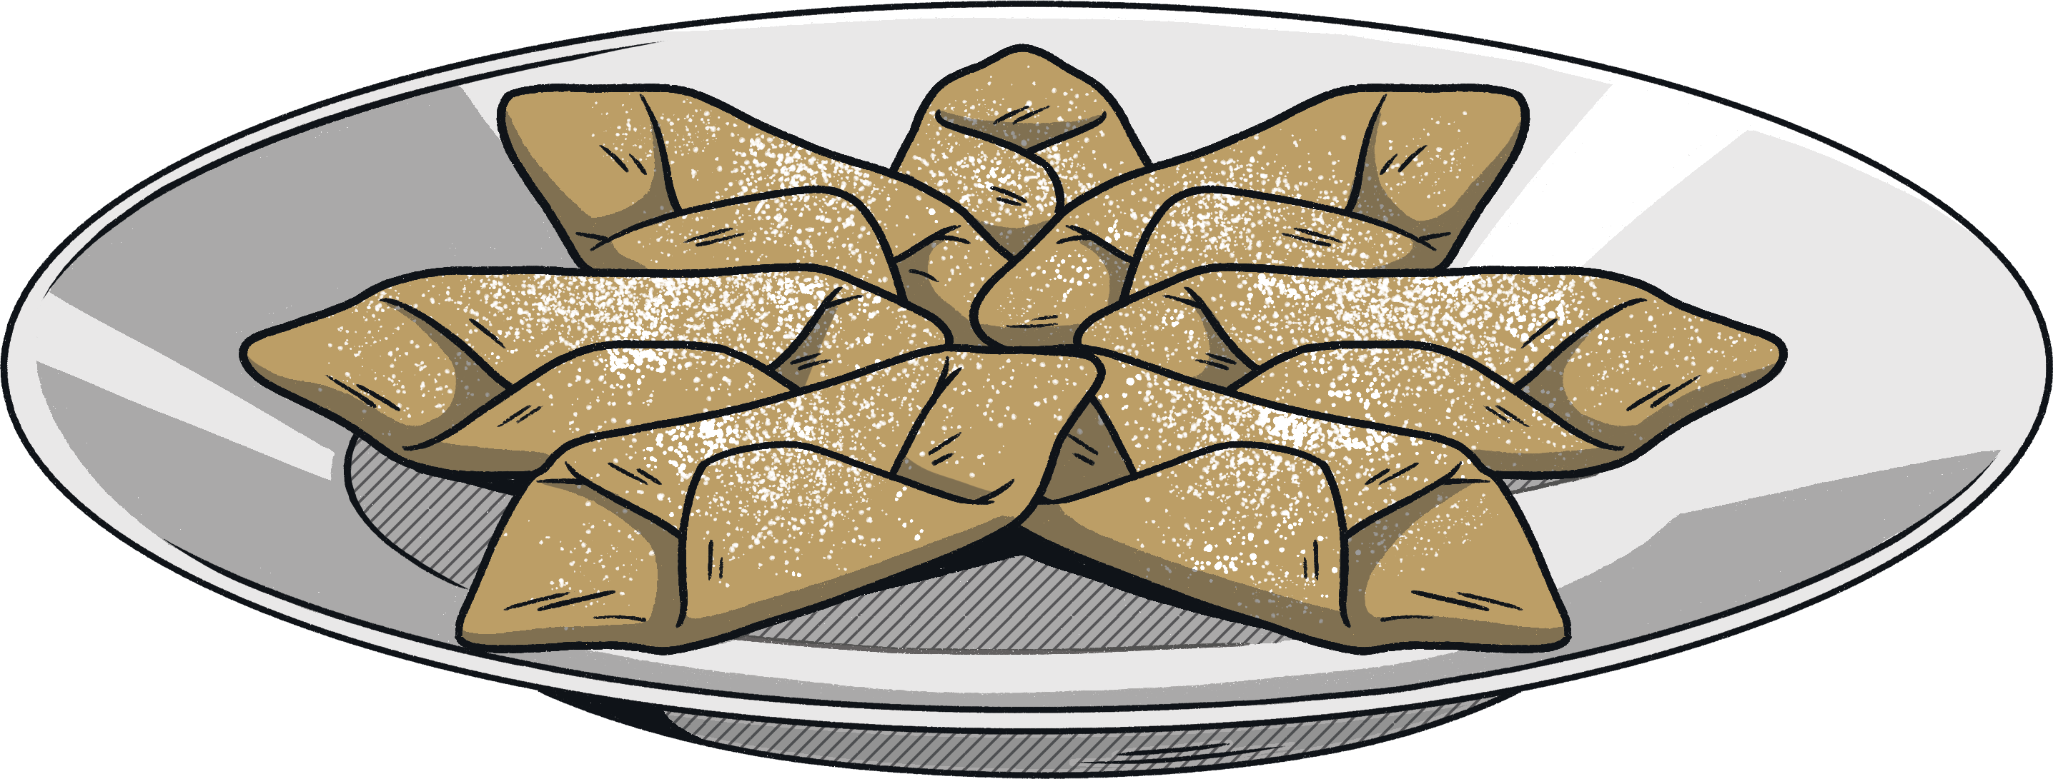
Spain
Known as “Semana Santa”, or “Holy Week”, Easter is observed for an entire seven days.
Celebrations begin during the last week of Lent and involve huge religious processions across the country, where people parade through the streets in costumes or hooded robes.
Treats such as torrija (similar to French toast), pestiños and cakes are very popular.

Slide 10
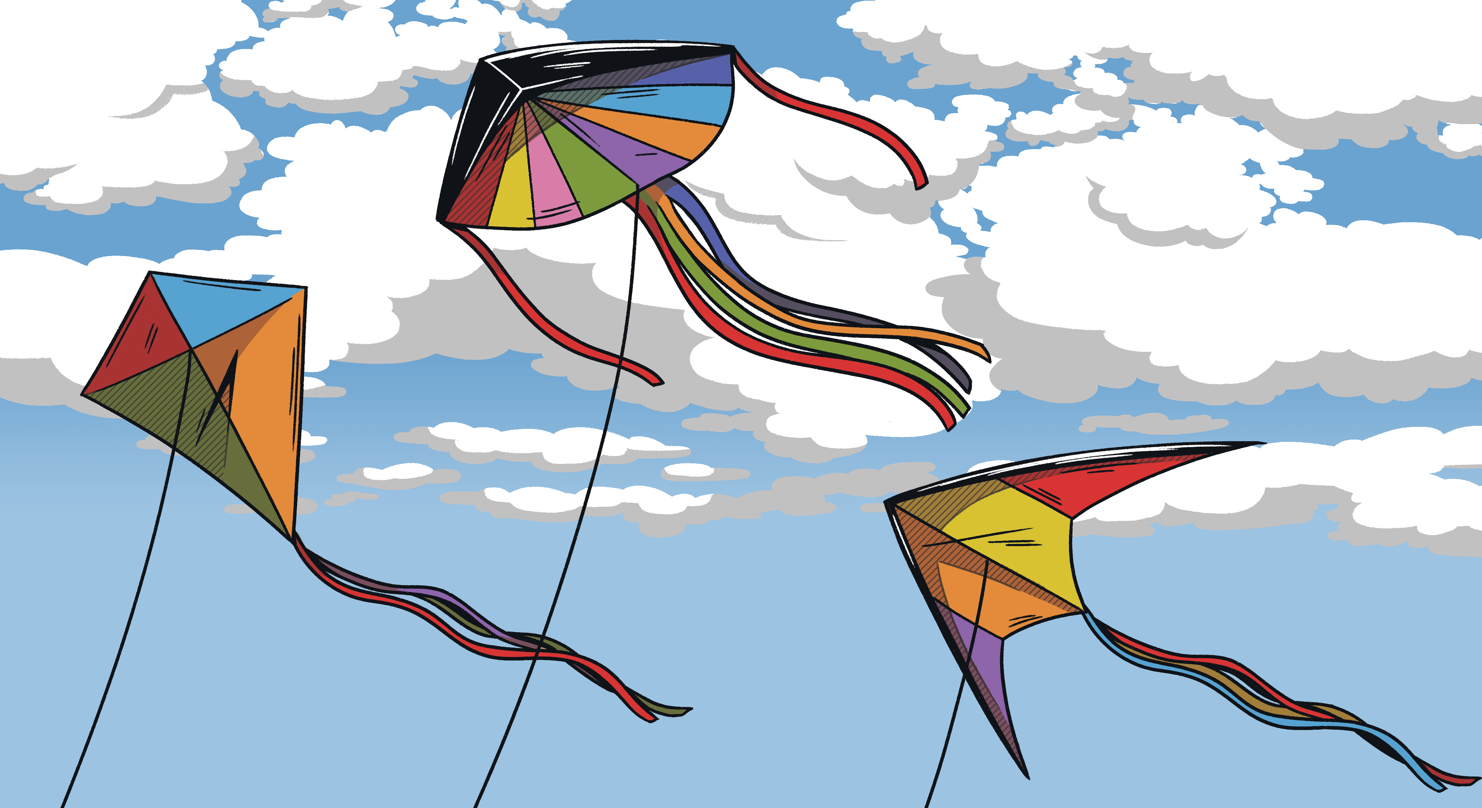
Bermuda
Festivities begin on Good Friday with the Bermuda Kite Festival.
Traditional food includes codfish and hot cross buns.

Slide 11
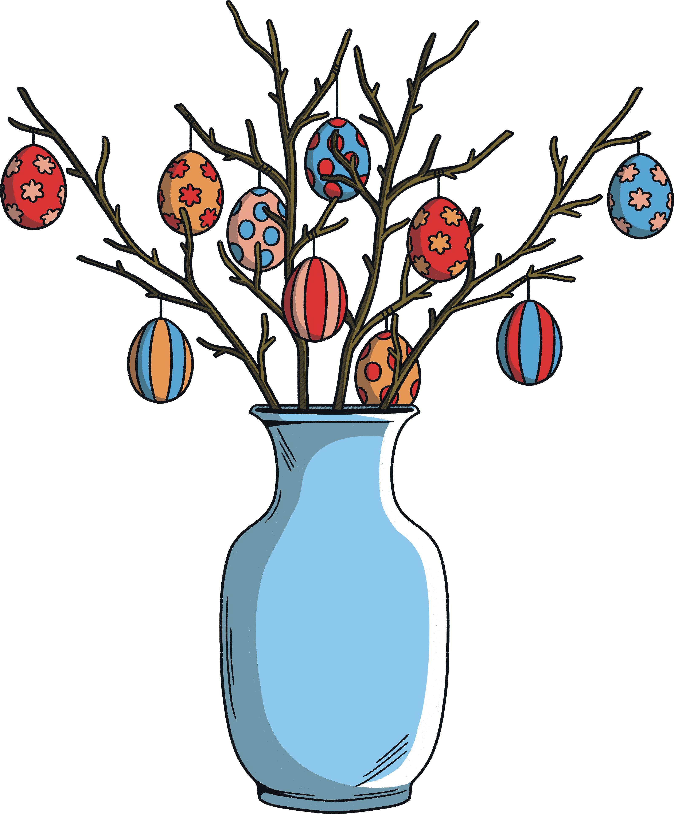
Germany
In Germany, Easter is celebrated by lighting bonfires around sunset on Holy Saturday.
Other traditions include decorating an "Easter tree" with hand-painted eggs, known as the Ostereierbaum. Usually, families hang the ornaments from a small household tree.
It is also traditional in Germany to eat something green on Maundy Thursday, which is called Gründonnerstag (“Green Thursday”).
Spiced sweet bread, enriched with eggs and dairy then topped with almonds, candied peel and raisins are also popular during Easter for breakfast and afternoon tea.

Slide 12
Italy
The Pope leads the Easter celebrations by holding a huge mass on Good Friday at St. Peter's Basilica in Vatican City, where the Via Crucis, or Station of the Cross, is celebrated. During the mass, a huge crucifix made out of burning torches is raised in the night sky.
In Florence, Easter Sunday is marked by the Scoppio del Carro. This event sees a huge and extravagantly designed antique wagon, full of fireworks, set alight by a dove-shaped rocket after being hauled into a small square by oxen and hundreds of people in 15th century dress.
Religious processions are also held over the course of the three days. People will dress in ancient costumes and parade through main squares carrying artefacts, statues and olive branches.
One of the most popular foods during this period is the Colomba di Pasqua, a traditional cake which is similar to a panettone.

