Slide 2
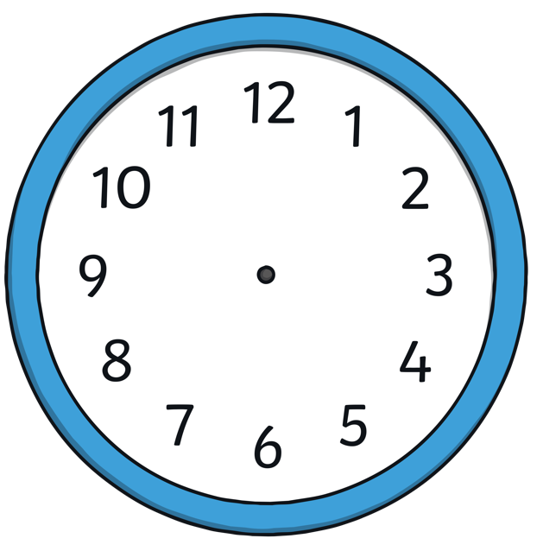
Hands on a Clock
Let’s remind ourselves of the hands on a clock.
minute hand (long hand)
hour hand (small hand)
?
4 o’clock
What is the time?

Slide 3
What Is the Time?
The minute hand is pointing to the 6.
The hour hand is pointing between 3 and 4.
?
What is the time?
half past 3

Slide 4
What Is the Time?
The minute hand is pointing to the 6.
The hour hand is pointing between 8 and 9.
?
What is the time?
half past 8

Slide 5
What Is the Time?
The minute hand is pointing to the 12.
The hour hand is pointing to the 5.
?
What is the time?
5 o’clock

Slide 6
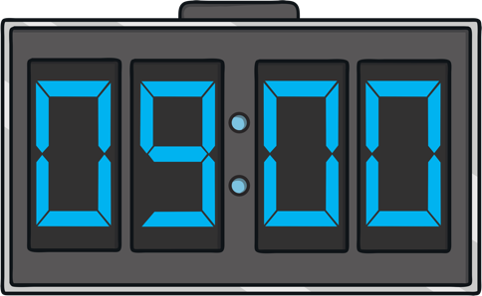
Digital Clocks
Let’s remind ourselves of the digits on a digital clock.
hour digits
?
half past 9
minute digits
What is the time?

Slide 7
What Is the Time?
The minute hand is pointing to the 12.
The hour hand is pointing to the 6.
?
What is the time?
6 o’clock

Slide 8
What Is the Time?
The minute hand is pointing to the 6.
The hour hand is pointing between 1 and 2.
?
What is the time?
half past 1

Slide 9
What Is the Time?
The minute hand is pointing to the 12.
The hour hand is pointing to the 7.
?
What is the time?
7 o’clock

Slide 10
What Is the Time?
The minute hand is pointing to the 6.
The hour hand is pointing between 2 and 3.
?
What is the time?
half past 2

Slide 11
What Is the Time?
The minute hand is pointing to the 6.
The hour hand is pointing between 6 and 7.
?
What is the time?
half past 6

