Slide 1
Disclaimer/s
We hope you find the information on our website and resources useful.
Animations
This resource has been designed with animations to make it as fun and engaging as possible. To view the content in the correct formatting, please view the PowerPoint in ‘slide show mode’. This takes you from desktop to presentation mode. If you view the slides out of ‘slide show mode’, you may find that some of the text and images overlap each other and/or are difficult to read.
To enter slide show mode, go to the slide show menu tab and select either from beginning or from current slide.
You may wish to delete this slide before beginning the presentation.

Slide 3
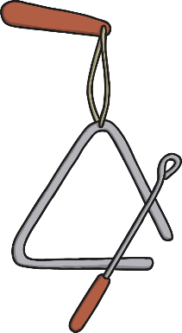
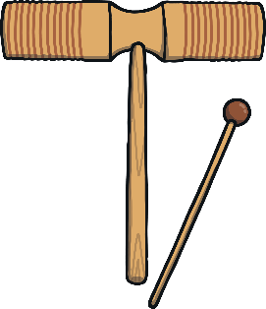
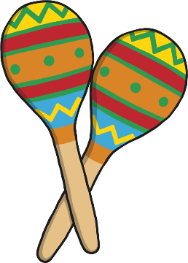
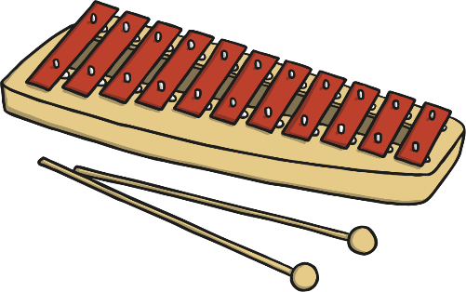
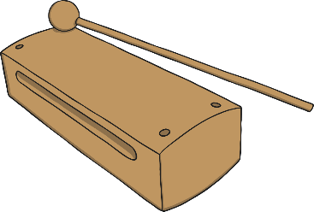
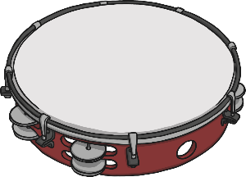
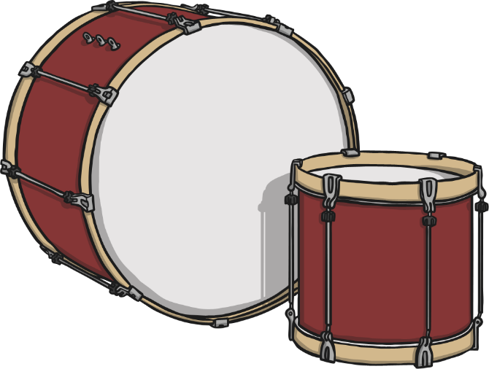
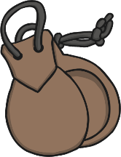
Percussion Instruments
Most percussion instruments make sounds when they are hit; others are shaken, rubbed or scratched.
glockenspiel
triangle
Chinese woodblock
maracas
woodblock
tambourine
drums
cowbell
castanets

Slide 4
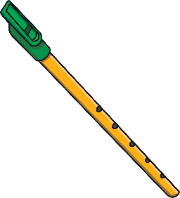
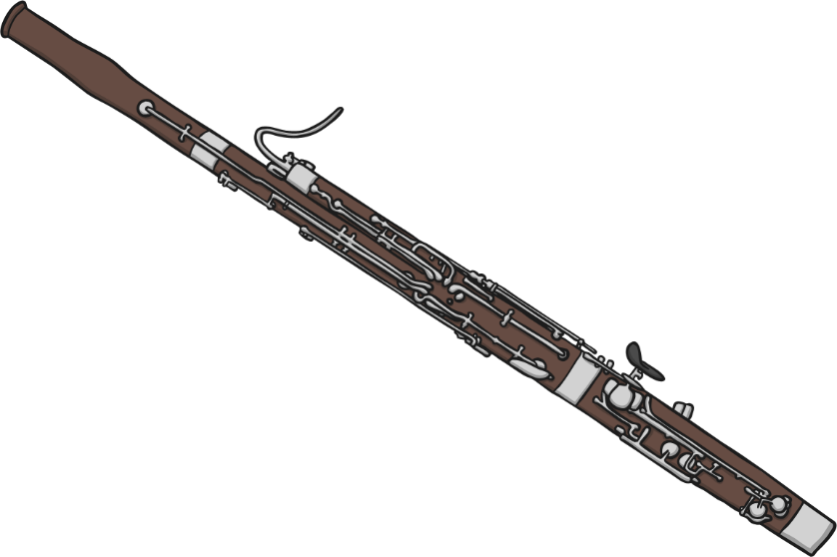
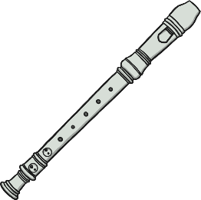
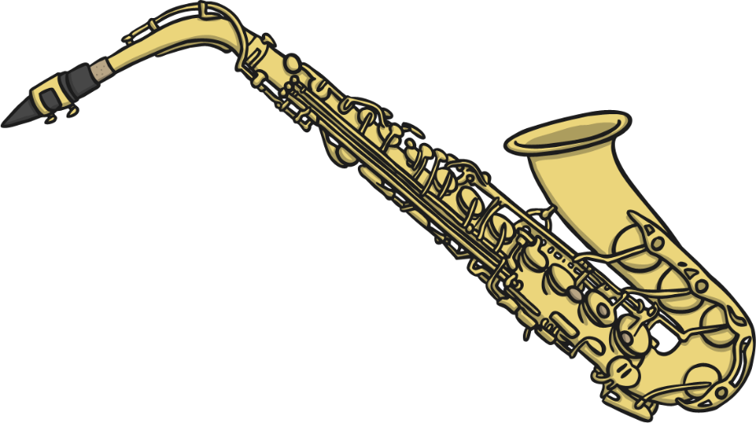
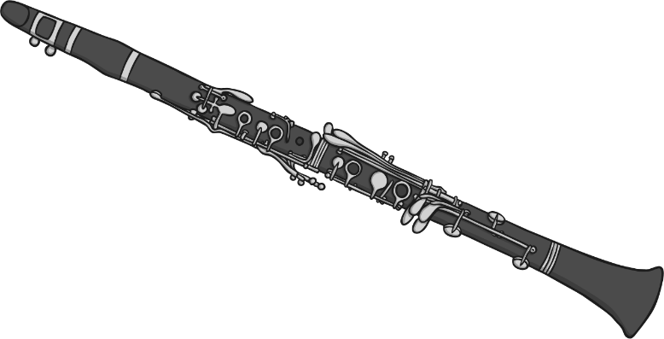
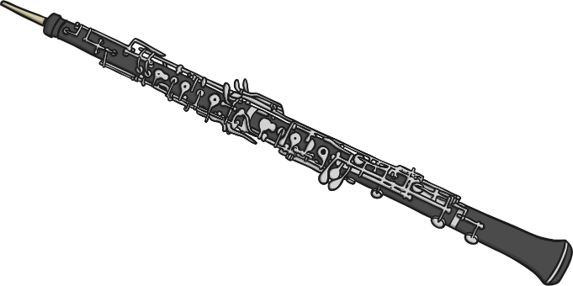
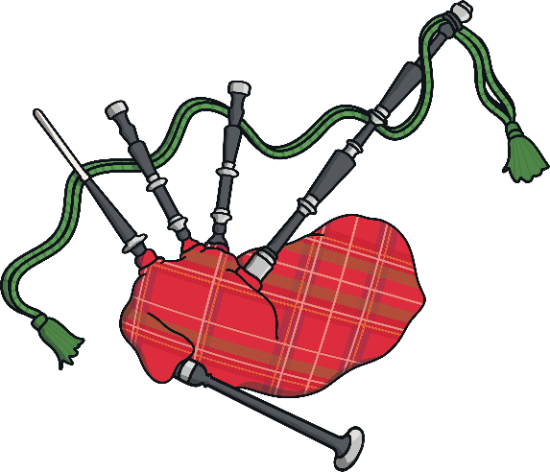
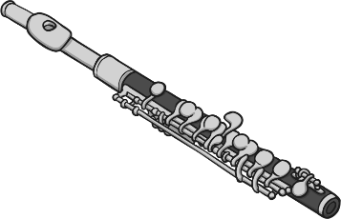
Woodwind Instruments
Woodwind instruments create sound by being blown into. Some woodwind instruments have a reed which vibrates to create the sound. Different pitches are made by covering different holes on the instrument.
bassoon
tin whistle
saxophone
clarinet
recorder
oboe
flute
bagpipes
piccolo

Slide 5
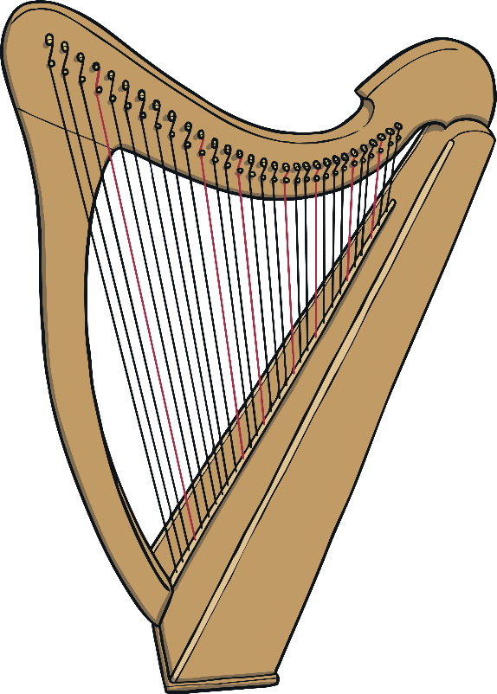
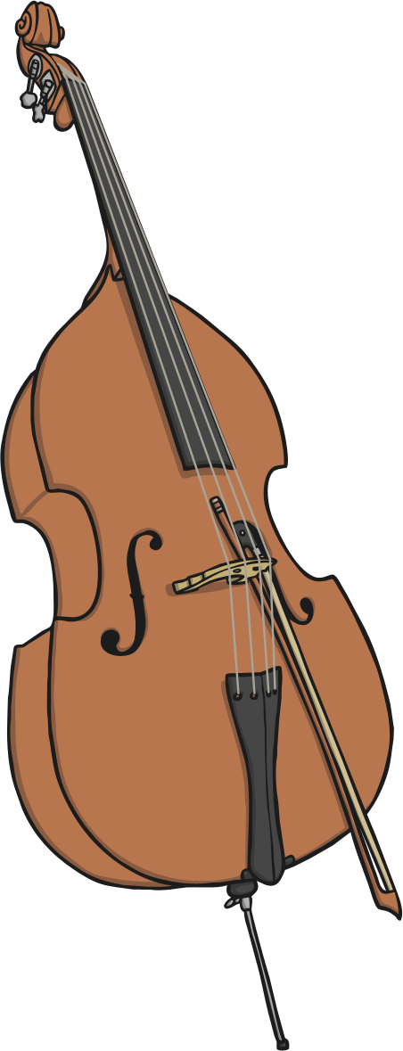
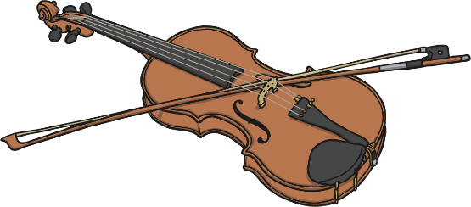
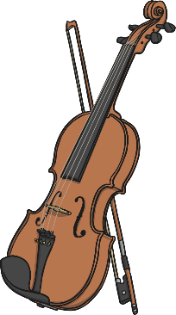
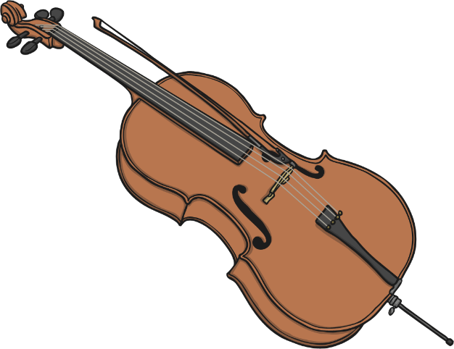
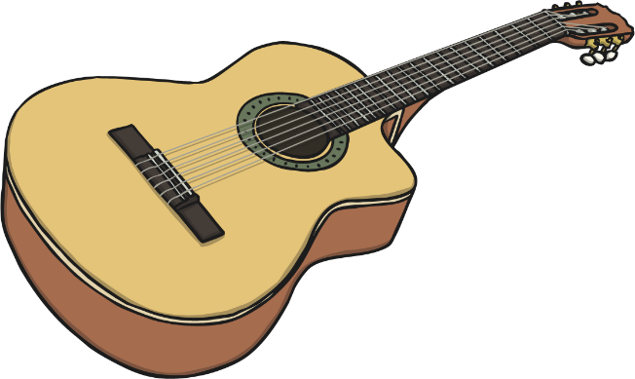
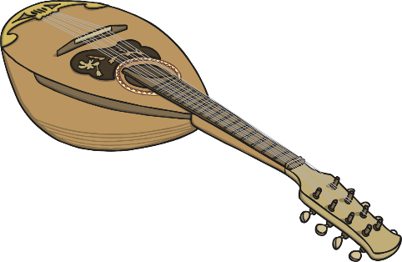
String Instruments
String instruments create their sound by being strummed or plucked by hand or being bowed. This is when a bow is pulled across the strings. Vibrations in the strings cause the sound.
double bass
viola
cello
violin
guitar
harp
mandolin

Slide 6
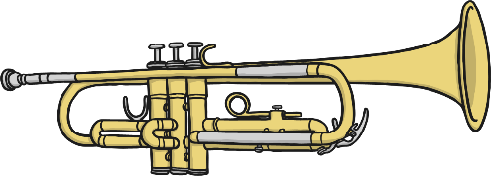
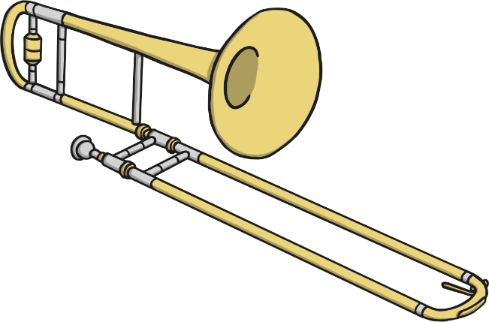
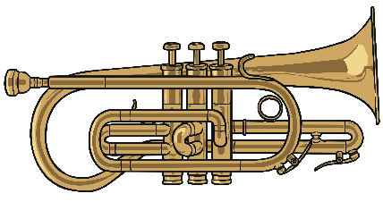
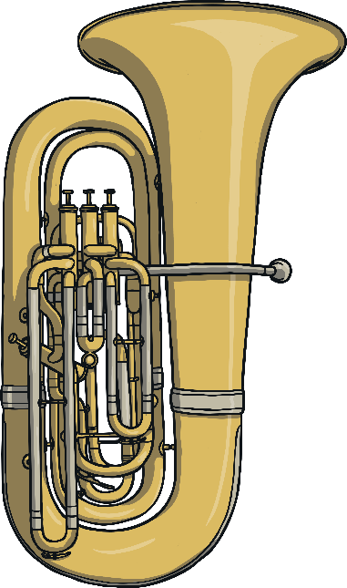
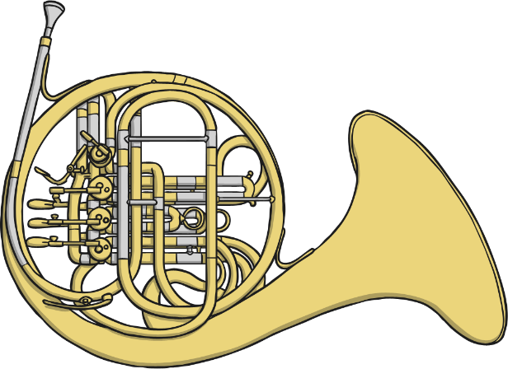
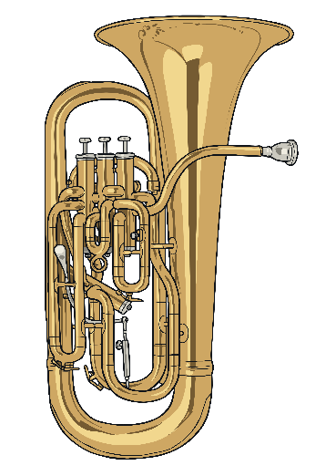
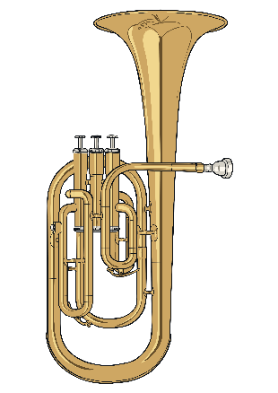
Brass Instruments
Vibrations from the player’s lips into the instrument cause the sound. Different notes are made by the player adjusting their lips, as well as valves, slides and keys on the instruments.
trumpet
trombone
cornet
tuba
French horn
euphonium
tenor horn

