Slide 2
Teacher Instructions
Welcome to our collection of speaking games! They are specially made for online classes, but also work for socially distanced or in-person classes generally.
Use the menu to navigate, or pick a game with the random game generator. The instructions for each game are on each slide.
The games start easy (A1 level) and get more difficult (B2 level and above).

Slide 3
Game List
Fish Fingers!
What’s the Object?
Shopping List
Count to 21
Categories
Find Something...
Quick-Change Artist
Odd One Out
Two Truths and a Lie
What Can You Guess about Me?
The Two-Minute Weekend
Liar, Liar, Pants on Fire
Tongue Twisters
Map Adventure
One-Word Stories
Fortunately, Unfortunately
The Expert
Yes/No Game
What Can You Do with It?
And Then...
Would You Rather?
Interview a Celebrity
Picture Prompt
Roll of the Dice Story
Desert Island
Riddles
The Perfect Party
I Am an Alien
Mad Libs
Mini Role Play
Random Debate Picker

Slide 4
Surprise Me! The Random Game Generator
?
?
?
?
?
?
?
?
?
?
?
?
?
?
?
?
?
?
?
?
?
?
?
?
?
?
?
?
?
?
?

Slide 5
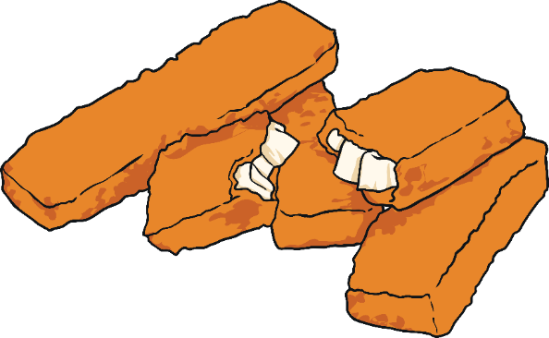
Fish Fingers!
Instructions: All students must close their eyes or move off-screen. One student says ‘fish fingers’ in their silliest voice (try singing, using a robot voice, saying it really high or low). The other students in the group have to guess who said ‘fish fingers’.
Return to menu

Slide 6
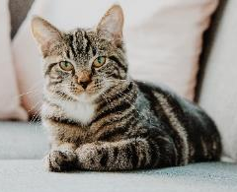
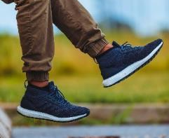
What’s the Object?
Instructions: Look at the parts of different objects. What do you think they are? Make sentences with ‘could’ - ‘It could be a…’ - and your teacher will reveal the object.
Extra challenge: Bring your own object to class and show a corner on the screen. Can your classmates guess what it is?
Return to menu

Slide 7
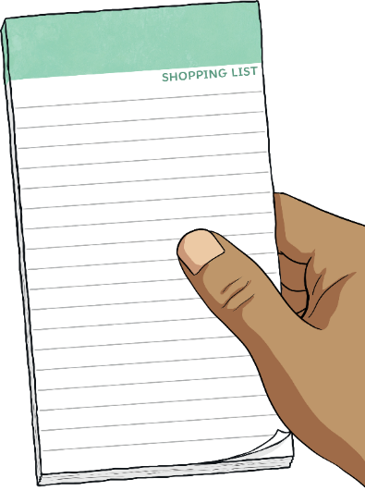
Shopping List
Instructions: One student starts a sentence with ‘I went to town and I bought…’ and says an object, e.g. ‘a picture’. The next student must remember that object and add their own, e.g. ‘I went to town and I bought a picture and a car.’ Continue for as long as you can. For extra points, see if you can do it in alphabetical order.
Example: I went to town and I bought a picture. I went to town and I bought a picture and a car. I went to town and I bought a picture, a car and a banana. I went to town and I bought a picture, a car, a banana and a cactus.
Return to menu

Slide 8
Count to 21
Instructions: The aim of the game is to count from 1 to 21. Any student can say a number at any time, but if two students speak at the same time, they have to start again.
1
3
5
2
4
Return to menu

Slide 9
Categories
Instructions: Take turns in alphabetical order of your names or go round in a circle naming examples of things in that category. The first student who can’t name one is out of the game.
subjects at school
pets
?
?
wild animals
?
colours
?
?
objects in the house
shapes
?
things in your backpack
?
superheroes
?
words beginning with ‘h’
countries
?
?
capital cities
?
things you see at the beach
?
?
jobs
vegetables
?
drinks
?
fruit
?
Return to menu

Slide 10
Find Something...
Instructions: Click on the box to choose a category. As fast as you can (or for your next class), find an object that fits that description. Then, answer the questions. Now, invent your own categories!
Find something yellow.
?
?
Find something wooden.
What does your object look like? What can you do with it? Is it special? Why? Do you know where it’s from?
?
?
Find a spoon.
Find something you wear on your head.
?
?
Find a key.
Find a potato.
Find a soft toy.
?
Find a paintbrush.
?
Find a photo.
?
Return to menu

Slide 11
Quick-Change Artist
Instructions: A student from the group is chosen (the quick-change artist). All the students look closely at that student’s clothes and/or background. Then, all the students shut their eyes, (or, if you're playing online, the quick-change artist could briefly turn off their camera) and the quick-change artist changes something about their appearance or background. Maybe they move an object, or put on a hat. Then the other students have to say what’s changed. The first one to guess is the next quick-change artist.
Return to menu

Slide 12
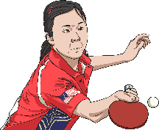
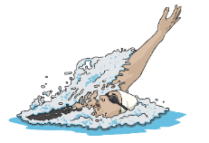
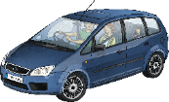
Odd One Out
Instructions: Which one is different? Why? Can you make your own list of four where one thing is different?
Eggs aren’t made from milk.
?
Swimming isn’t a ball sport.
?
A car isn’t an emergency vehicle.
?
?
A grape isn’t a citrus fruit.
Return to menu

Slide 13
Two Truths and a Lie
Instructions: Write down three ‘facts’ about yourself - two things that are true, one thing that is a lie. Tell your classmates what you wrote. Can they guess which one is a lie? They might ask you some extra questions.
Return to menu

Slide 14
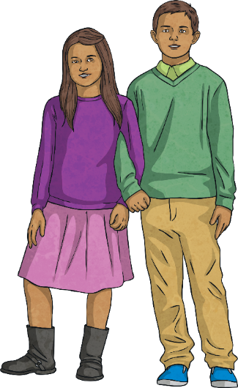
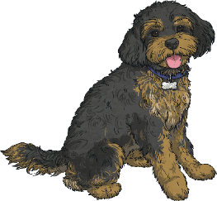
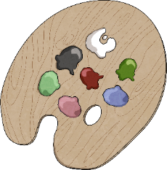
What Can You Guess about Me?
Instructions: Use the topics to make sentences about your classmates (e.g. I think Beth has a pet hamster) and then ask questions to see if you’re correct. The person with the most correct guesses wins!
books and films
pets
hobbies
brothers and sisters
favourite subjects
food and drink
sports
Return to menu

Slide 15
The Two-Minute Weekend
Instructions: Students can work in pairs, or as a group. One student (A) describes everything they did at the weekend as quickly as possible, and the other students (B) interrupt with questions to keep them talking. For example, if student A says ‘I ate breakfast’, student B might ask ‘What did you eat?’ or ‘What time did you have breakfast?’. If student A is still talking at the end of two minutes, student B is the winner.
Return to menu

Slide 16
Liar, Liar, Pants on Fire!
Instructions: Ask and answer the questions. The answer to the question has to be ‘Yes!’ even if this is a lie. The other students will ask follow-up questions to find out more, e.g. ‘When did you go there?’ and say if they think this student is telling the truth or is a ‘liar, liar, pants on fire’.
Have you ever…
dreamt you were at school?
pretended to be ill?
been shopping by yourself?
planted a tree?
caught a fish?
seen a snake?
eaten an insect?
forgotten to wash your gym clothes?
been camping on a mountain?
pretended to be asleep so you could read late at night?
climbed a tree?
Return to menu

Slide 17
Tongue Twisters
Instructions: Say these slowly, then faster. How fast can you say them? How many times?
Not these things here, but those things there
She sells seashells by the seashore.
Red lorry, yellow lorry
Copper-bottomed coffee pot
I saw a kitten eating chicken in the kitchen.
She sees cheese.
Black background, brown background
How much wood would a woodchuck chuck if a woodchuck could chuck wood?
Return to menu

Slide 18
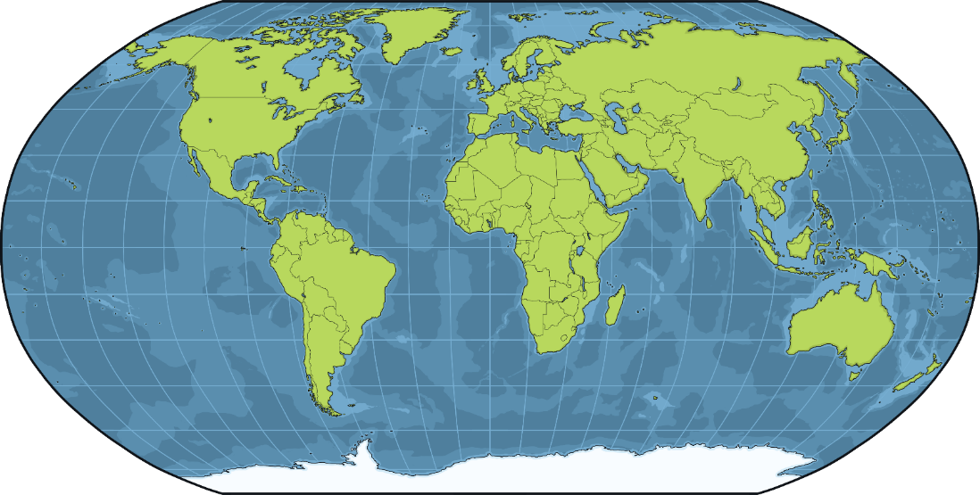
Map Adventure
Instructions: Choose a city to explore on an online map. Move through the city using instructions (e.g. turn left, turn right) and ask questions:
What’s that?
How would you describe this?
How many (people) can you see?
What are people doing here?
What’s the word for that in English?
Return to menu

Slide 19
One-Word Stories
Instructions: Make a story together! Students can only say one word each to add to the story.
Example: One day a big dinosaur went to school
...
Return to menu

Slide 20
Fortunately, Unfortunately
Instructions: One student starts a story with just one sentence. The next student has to continue the story, starting their sentence with ‘fortunately’. The next student continues the story with a new sentence starting with ‘unfortunately’. Then, back to ‘fortunately’ and so on.
Example: One day, Bob woke up. Fortunately, it was a Sunday and he could stay in bed. Unfortunately, there was a storm outside and water was pouring in through his window. Fortunately, all he had to do was get up and close the window. Unfortunately, when he got up, he saw that there was a tiger next to the window! Fortunately…
Return to menu

Slide 21
The Expert
Instructions: Nominate a student. The student has to choose a topic and talk about it for 30 seconds (or longer) as if they were the expert. If they can, they gain a point!
Australian animals
pizza
?
?
the sea
?
social media
?
superheroes
sleep
?
?
famous singers
?
Olympic sports
?
books
?
shopping
?
languages
?
Return to menu

Slide 22
Yes/No Game
Instructions: Students ask questions to a nominated classmate. The nominated student is not allowed to answer the questions with ‘yes’ or ‘no’ - they have to use other words instead. When they do use ‘yes’ or ‘no’, another student is chosen.
Examples: “Are you from Spain?” “I have never been to Spain, and in fact I was born in Italy.” “Is your name Gabriel?” “People have never called me Gabriel, because my name is Thomas.”
YES
NO
Return to menu

Slide 23
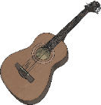
What Can You Do with It?
Instructions: Choose an object and try and think of as many things as possible that you could use it for. The winner is the student or group who can think of the most, so be as creative as possible!
brick
paperclip
slime
pillowcase
big cardboard box
Example: What can you do with a plate? You can eat off it. You can use it as a frisbee. You can cover food with it in the microwave. You can draw a circle with it. You can keep the rain off your head with it. You can put a plant pot on it.
cactus
tree
guitar
Return to menu

Slide 24
And Then...
Instructions: One student starts a story. The next student continues the story with one sentence, starting with ‘and then’. The next student continues with a sentence starting ‘and then…’ And so on.
Example: There once was a very hungry hamster. And then he saw some food outside of his cage. And then he opened the door of his cage and went outside. And then he saw a cat! And then…
And Then...
Return to menu

Slide 25
Would You Rather?
Instructions: Click on the boxes to reveal the questions. Ask and answer the questions with your partner or class. Give the reasons for your opinion. Then, think of your own questions.
Would you rather be a hamster the size of a T. rex, or a T. rex the size of a hamster?
?
Would you rather eat worms or a snail?
?
Would you rather live on a tropical island or in a city?
?
Would you rather live in a treehouse or underground?
?
?
Would you rather be able to fly or be able to become invisible?
?
Would you rather go to the North Pole or the Sahara?
?
Would you rather sing on stage or do extra maths homework?
?
Would you rather have a pet dragon or a pet unicorn?
Return to menu

Slide 26
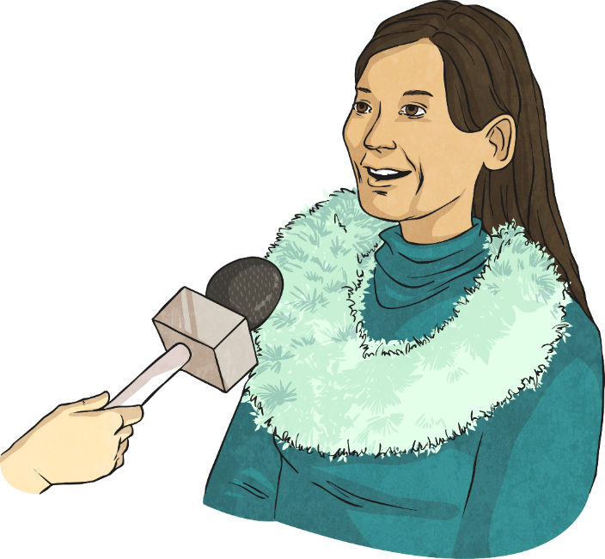
Interview a Celebrity
Instructions: Think of a celebrity you’d like to meet one day. It can be a real or imaginary person, alive or dead. Think of five questions you would ask them. One student will then pretend to be the celebrity and answer the questions ‘in character’.
Return to menu

Slide 27
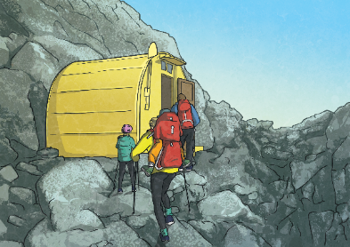
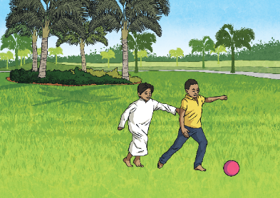
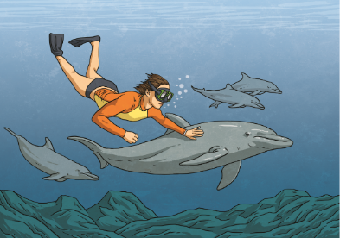
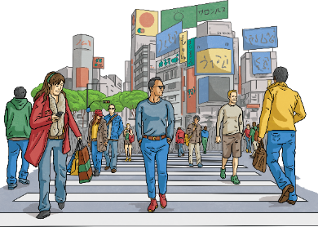
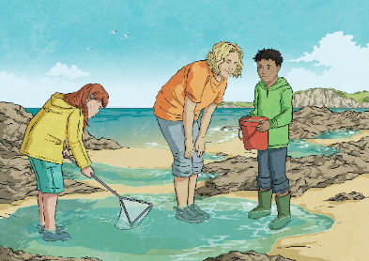
Picture Prompt
Instructions: Choose a picture. What’s happening in the story? What happened before? What’s going to happen next?
Return to menu

Slide 28
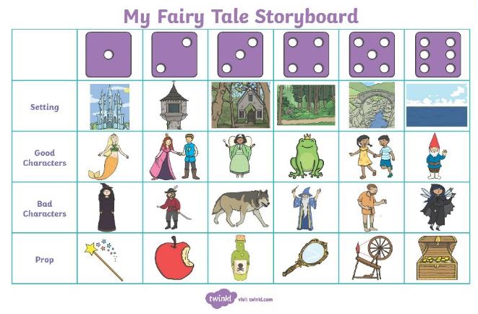
Roll of the Dice Story
Instructions: Choose one of the storyboards. Roll a dice four times - once for each row. Select the element from each row which corresponds to the number rolled. Then, use all the elements to make a story together.
Return to menu

Slide 29
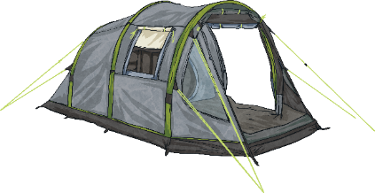
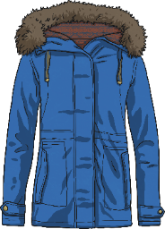
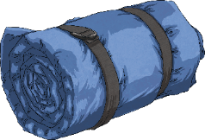
Desert Island
Instructions: Imagine you are going to a desert island for a year. You can only take five objects with you. What do you choose? Here are some ideas...
Return to menu

Slide 30
Riddles
Instructions: Can you guess what these riddles mean? Click on them to reveal the answers underneath.
What flies but has no wings?
What has a face but no arms or legs?
How many letters are there in the alphabet?
What occurs once in a minute, twice in a moment and never in one
What five-letter word becomes shorter when you add two letters to it?
I can speak all the languages in the world. What am I?
I’m sometimes full, but I never overflow. What am I?
The more of them you take, the more you leave behind. What are they?
?
time
?
a clock
?
eleven
thousand years?
?
m
?
short
?
an echo
?
the Moon
?
footsteps
Return to menu

Slide 31
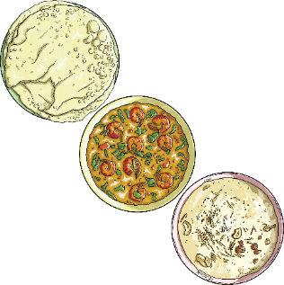
The Perfect Party
Instructions: You are hosting a party. You can invite whomever you like - celebrities or people you know, real or imaginary people, but only eight in total. Who will you invite? What will you have to eat and drink? What else will you do to make it a special party?
Guest List
Menu
1. 2.3.4.5.6.7.8.
Starter:
Main Course: Dessert:
Drinks:
Return to menu

Slide 32
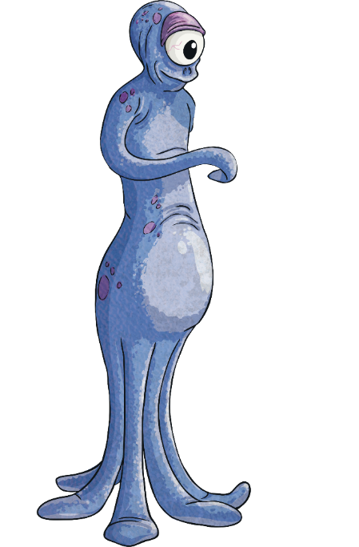
I Am an Alien
Instructions: Imagine your teacher is an alien! They need to complete an everyday task. You’re going to teach them the vocabulary they need and then teach them how to do it. Good luck!
Ideas for everyday tasks to teach your teacher - I mean alien:
going to the supermarket to buy bread making a sandwich washing their clothes brushing their teeth getting the bus to the city centre
Return to menu

Slide 33
Mad Libs
Instructions: Each player completes the grammatical features grid with unusual examples of words. When all players have finished their grids, give them a copy of the story so they can fill the gaps in and read them out. Cue laughter!
Return to menu

Slide 34
Mad Libs
Instructions: Each player completes the grammatical features grid with unusual examples of words. When all players have finished their grids, give them a copy of the story so they can fill the gaps in and read them out. Cue laughter!
Return to menu

Slide 35
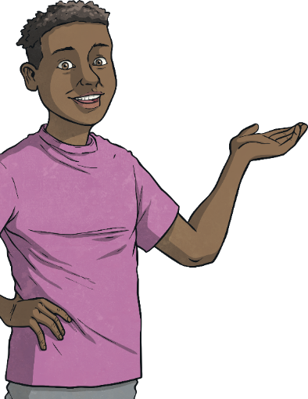
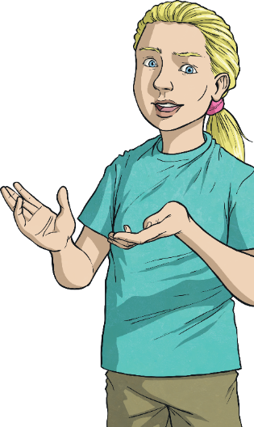
Mini Role Play 1
Instructions: Your teacher will give you a role to play. Imagine you are that person - what will you say?
Role Play 1
Student A:
You are a teenager. You went to a party and told your parents you would be back at 9 p.m. You just arrived home at 11 p.m. Why are you late?
Student B:
You are a parent. Your teenage son/daughter said they would be back at 9 p.m. but they just arrived at 11 p.m. What will you say to them?
Return to menu

Slide 36
Mini Role Play 2
Instructions: Your teacher will give you a role to play. Imagine you are that person - what will you say?
Role Play 2
Student A:
You live in a house with your friend. You get up in the morning to have breakfast but all your milk is missing. You see your housemate having a bowl of cereal… with milk.
Student B:
You live in a house with your friend. You get up in the morning and have cereal for breakfast. You used your milk.
Return to menu

Slide 37
Random Debate Picker
Instructions: Pick a box to reveal the random debate topic. You have five minutes to debate the question with your classmates. Go!
?
?
?
?
Cats are better pets than dogs.
We should all become vegetarian.
We should do all school outside for half the day.
We should all have to learn three languages.
?
?
?
?
We should limit the number of clothes people are allowed to buy.
Social media should be turned off at 11 p.m. so people will sleep.
We should release all animals in zoos into the wild.
Children should be allowed to vote.
Return to menu

