Slide 2
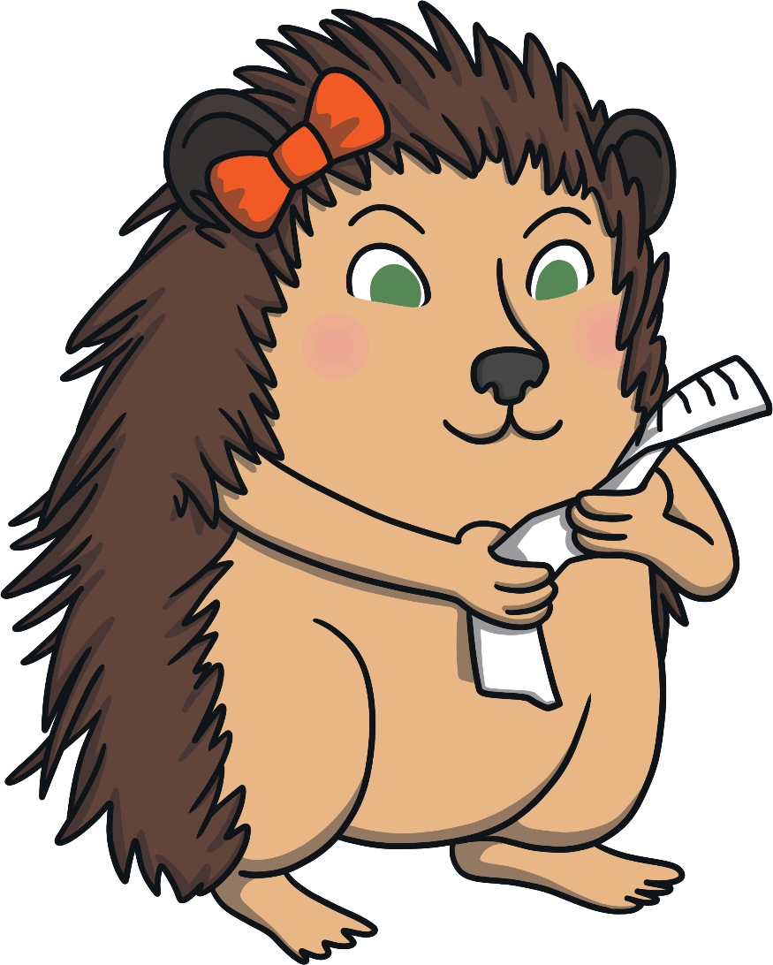
Holly Hedgehog is going on a nature trail. She has written a list of all the things she hopes to find.
Can you help her?
Go!

Slide 3
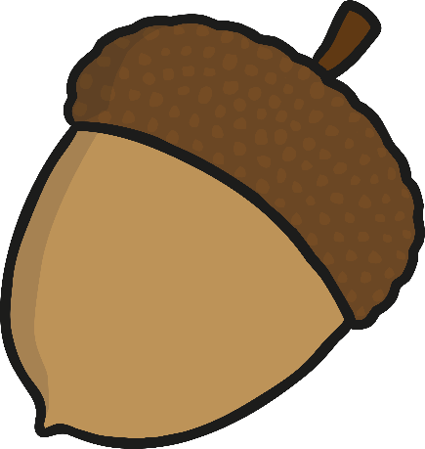
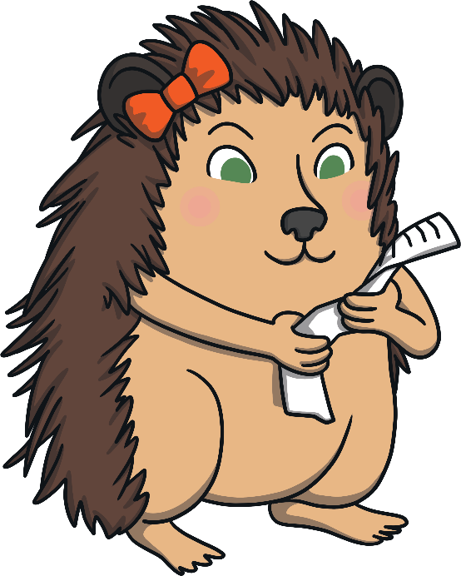
The first thing on Holly’s list is something big.
Which acorn should I pick? Which one is big?
Well done! You picked the big acorn.
Try again
Correct!

Slide 4
The next thing on Holly’s list is something small.
Great job! You picked the small leaf.
Which leaf is small? Which one should I pick?
Try again
Correct!

Slide 5
Now, Holly needs to find something tall.
Which one of these trees is tall? How can you be sure?
Excellent! You picked the tall tree.
Try again
Correct!

Slide 6
Holly is looking for something that is short.
Can you help her to choose?
Super! This is the short flower.
These flowers are both lovely but which one is short?
Try again
Correct!

Slide 7
Holly has found two wiggly worms.
I love wiggly worms. Which one of these worms is long?
Well done! This is the long worm.
Try again
Correct!

Slide 8
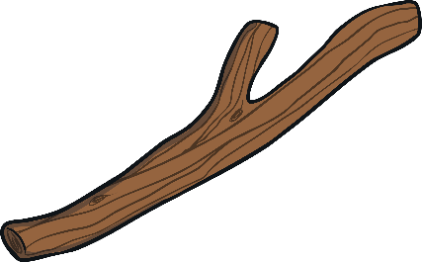
Holly is nearly at the end of her nature trail. Before she goes home, can you help her to find something short?
Which one of these sticks is short?
You are a star! Thank you for finding the short stick.
Try again
Correct!

Slide 9
Holly had such fun on her nature trail. Can you remember all of the things she found? Which size words can you use to describe them?

