Slide 2
Where Is Muffin?
Muffin has been out exploring her new home.
Look at each picture and say where Muffin is.

Slide 3


Where Is Muffin?
on her bed
under her bed
next to her bed

Slide 4

Well done!
Next

Slide 5

Hang in there and try again!
Back

Slide 6

Where Is Muffin?
in front of Harold
next to Harold
behind Harold

Slide 7
Well done!
Next

Slide 8
Hang in there and try again!
Back

Slide 9
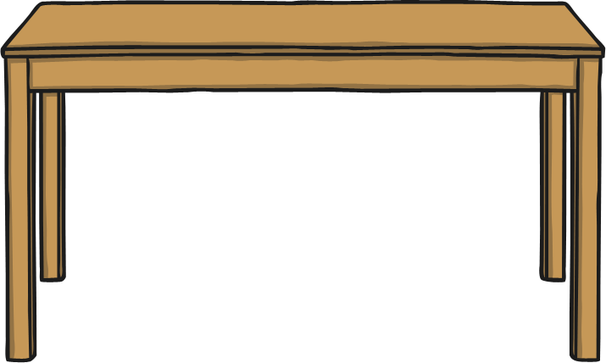
Where Is Muffin?
under the table
next to the table
on the table

Slide 10
Well done!
Next

Slide 11
Hang in there and try again!
Back

Slide 12
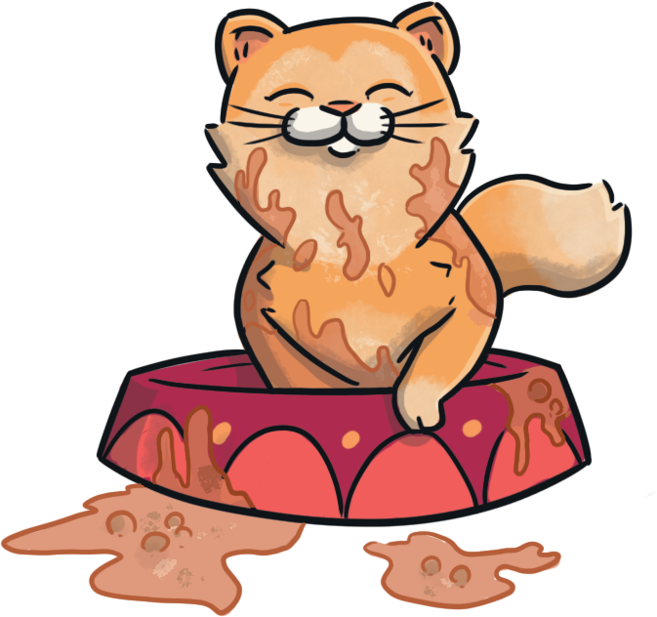
Where Is Muffin?
in front of the bowl
behind the bowl
in the bowl

Slide 13
Well done!
Next

Slide 14
Hang in there and try again!
Back

Slide 15

Where Is Muffin?
behind the box
in the box
on the box

Slide 16
Well done!
Next

Slide 17
Hang in there and try again!
Back

Slide 18
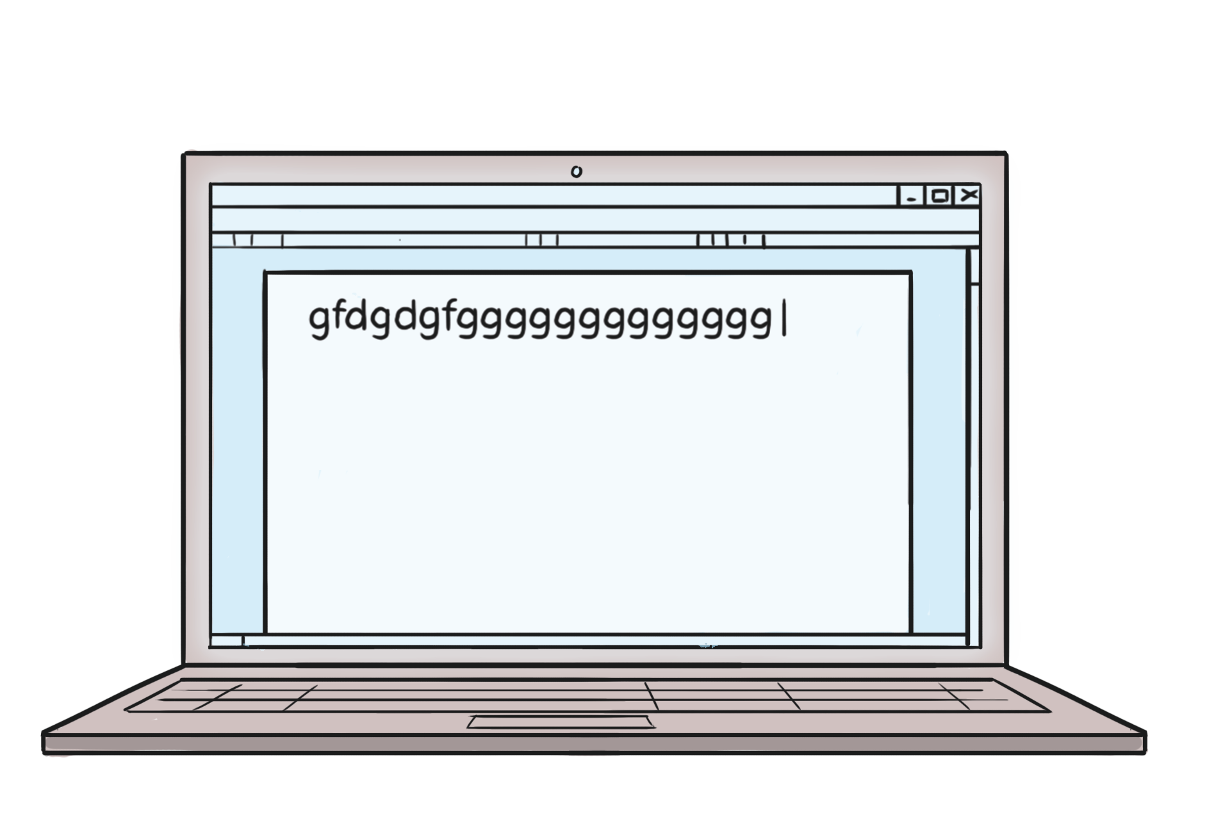
Where Is Muffin?
in the laptop
in front of the laptop
behind the laptop

Slide 19
Well done!
Next

Slide 20
Hang in there and try again!
Back

