Slide 1
Practise counting forwards in 5s up to 100 and back again, using this timed PowerPoint presentation as a prompt.
This PowerPoint activity is an ideal way to help your child practise counting forwards and backwards in 5s – a key national curriculum objective for children in year 1.
Use a hundred square and ask your child to colour in multiples of 5. Can they see a pattern? Can they continue counting in 5s with numbers over 100? Can they spot a rule for multiples of 5?

Slide 3
How to Change Slideshow Timings
Simply go to the ‘Transitions’ tab and adjust the timings here.
Click ‘Apply to All’.

Slide 4
0

Slide 5
5

Slide 6
10

Slide 7
15

Slide 8
20

Slide 9
25

Slide 10
30

Slide 11
35

Slide 12
40

Slide 13
45

Slide 14
50

Slide 15
55

Slide 16
60

Slide 17
65

Slide 18
70

Slide 19
75

Slide 20
80

Slide 21
85

Slide 22
90

Slide 23
95

Slide 24
100

Slide 25
95

Slide 26
90

Slide 27
85

Slide 28
80

Slide 29
75

Slide 30
70

Slide 31
65

Slide 32
60

Slide 33
55

Slide 34
50

Slide 35
45

Slide 36
40

Slide 37
35

Slide 38
30

Slide 39
25

Slide 40
20

Slide 41
15

Slide 42
10

Slide 43
5

Slide 44
0

Slide 45
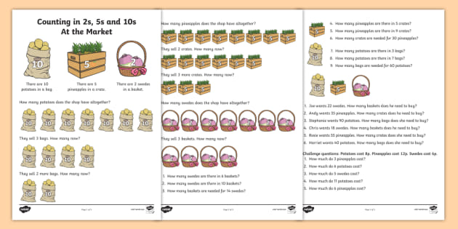
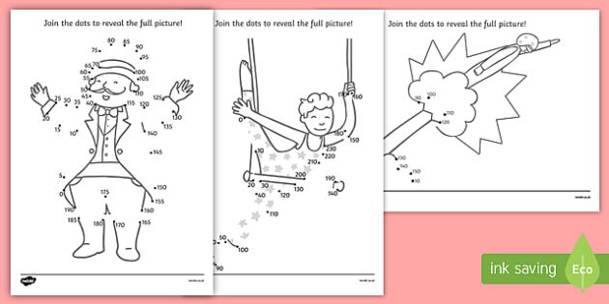
Counting in 2s, 5s and 10s
Circus Dot to Dot Count in 5 and 10

