Slide 2
1
2
3
4
5

Slide 3
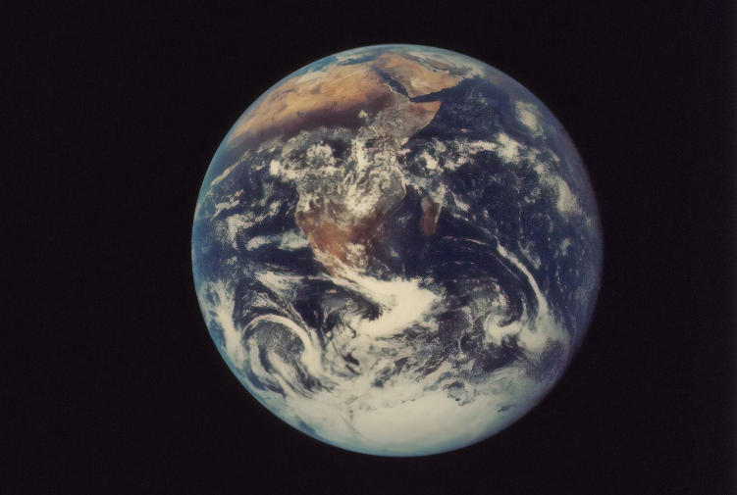
How many objects can you see in these pictures?
1
back
next

Slide 4
Follow the dot to make the number.
1
A downward stroke, my that’s fun.
Now I’ve made the number one.
back
next

Slide 5
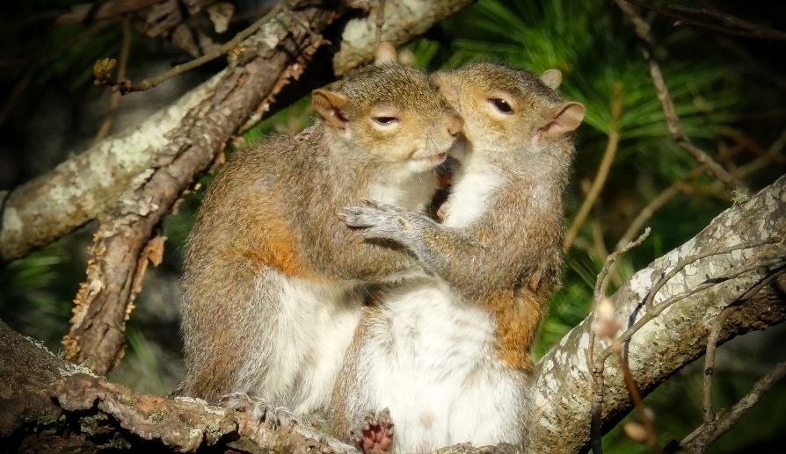
How many objects can you see in these pictures?
2
back
next

Slide 6
Follow the dot to make the number.
2
2
Half a heart says “I love you.”
Add a line. Now I’ve made the number two.
back
next

Slide 7
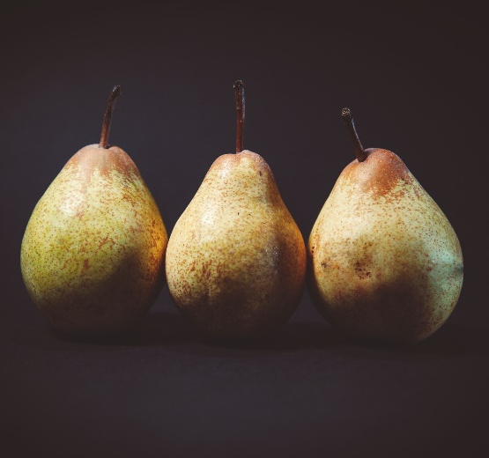
How many objects can you see in these pictures?
3
back
next

Slide 8
Follow the dot to make the number.
3
3
Around the tree, around the tree. Now I’ve made the number three.
back
next

Slide 9
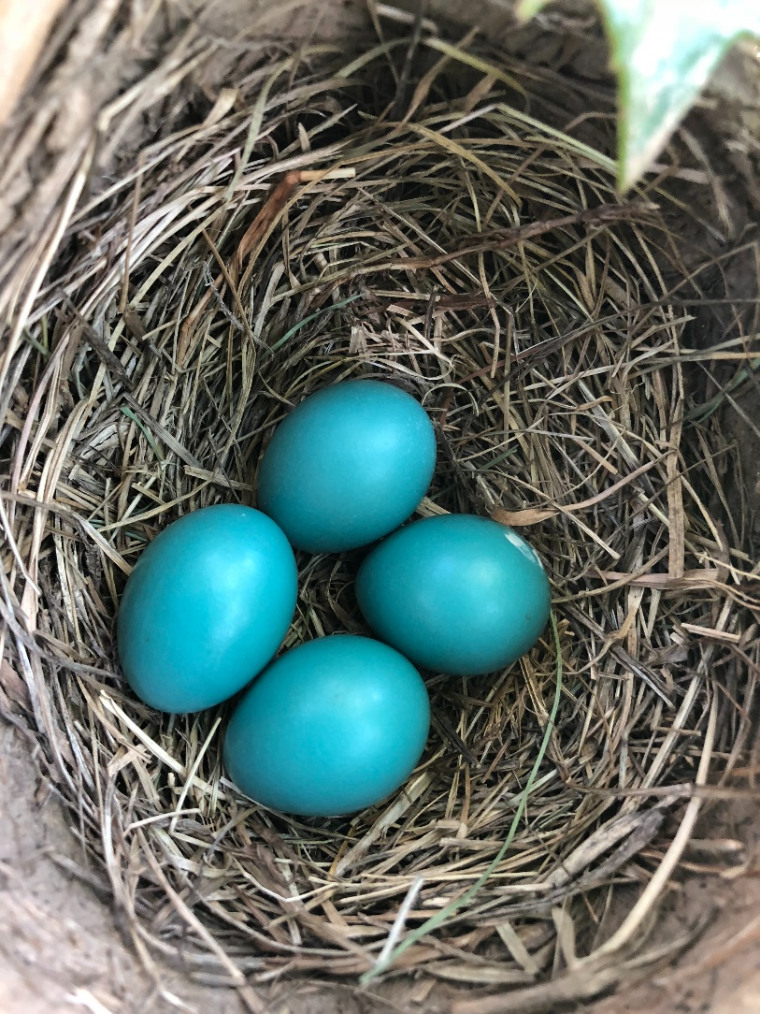
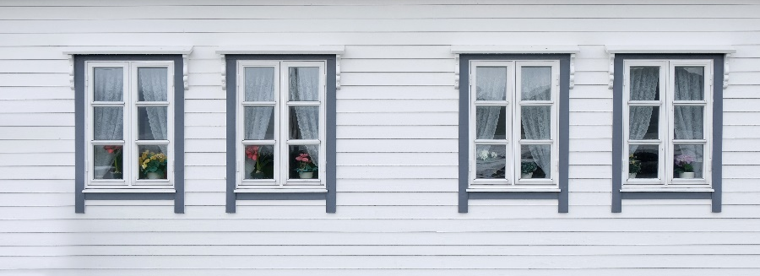
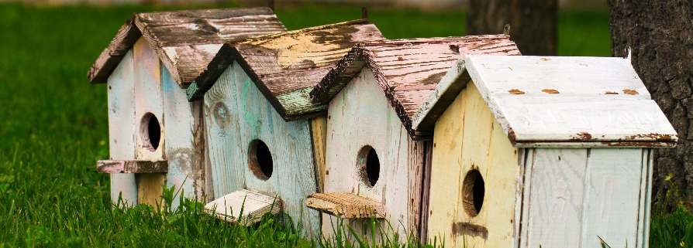
How many objects can you see in these pictures?
4
back
next

Slide 10
Follow the dot to make the number.
4
4
Down and across and down once more.
Now I’ve made the number four.
back
next

Slide 11
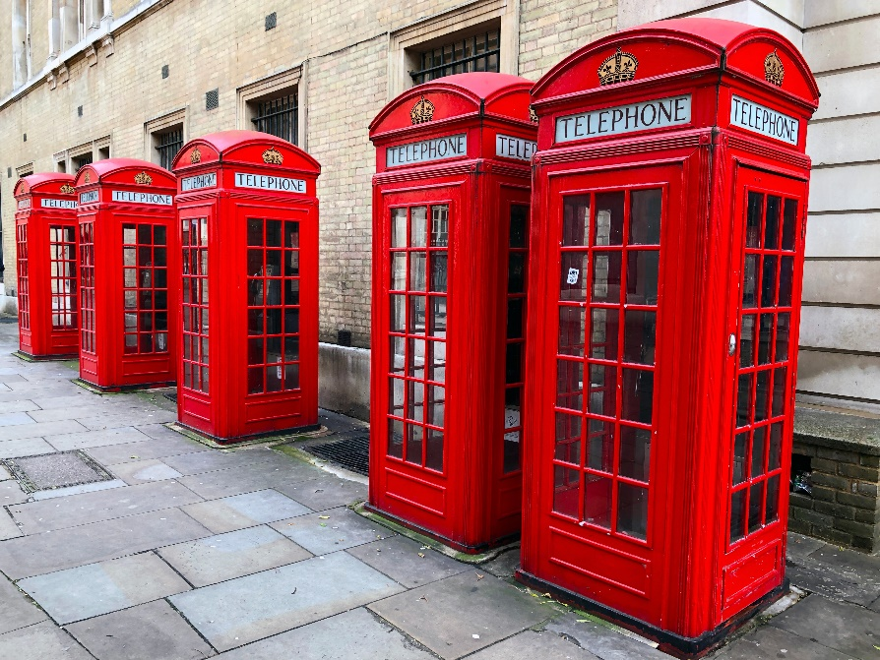
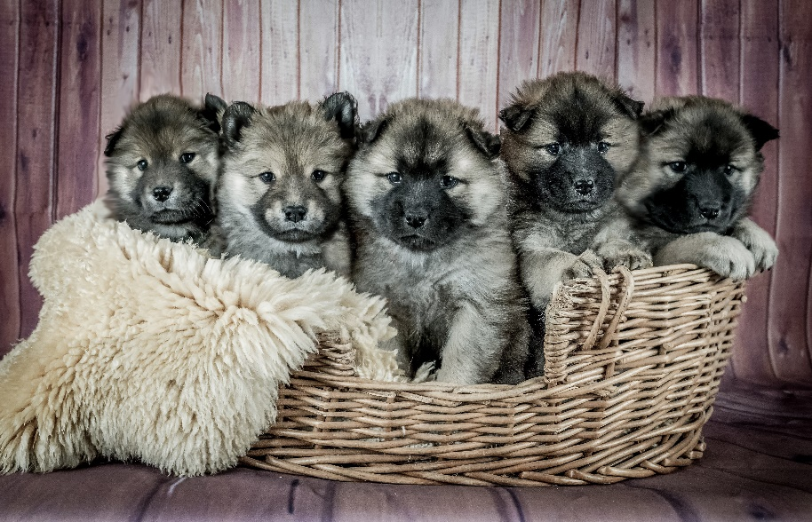
How many objects can you see in these pictures?
5
back
next

Slide 12
Follow the dot to make the number.
5
5
Draw the hat, the back and the belly. It’s a five.
Watch out, it might come alive!
back
end

