Slide 3
Instructions
Each slide shows a different number of frogs at the pond.
Carefully, count how many there are. Then, click on the correct numeral.
Start

Slide 5
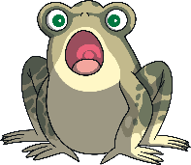
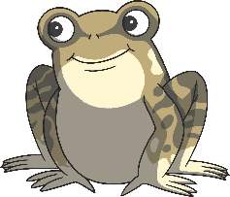
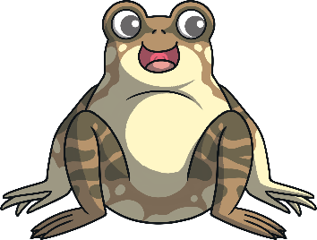
6
12
9

Slide 8
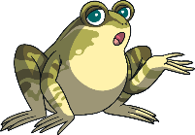
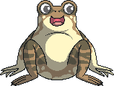
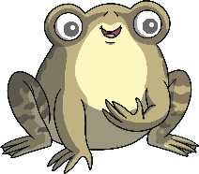
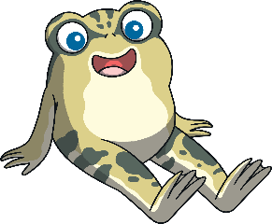
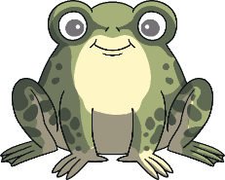
13
7
3

Slide 11
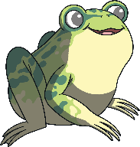
5
15
10

Slide 14
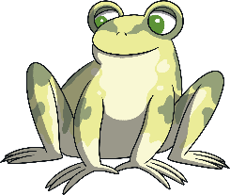
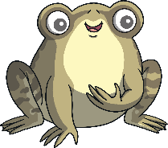
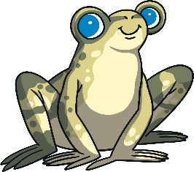
17
11
8

Slide 17
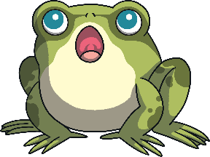
14
19
18

Slide 20
3
4
16

Slide 23
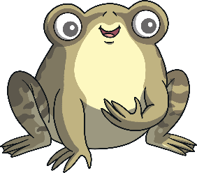
2
7
10

Slide 26
8
12
14

Slide 29
19
20
13

Slide 32
11
1
10

Slide 35
9
6
15

Slide 38
5
1
2

Slide 41
12
16
20

Slide 44
18
17
16

Slide 47
4
8
13

Slide 50
1
5
7

Slide 53
14
4
9

Slide 56
11
6
15

Slide 59
18
20
3

Slide 62
17
2
19

