Slide 2
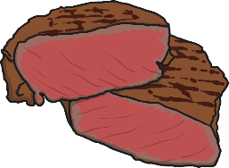
Click the picture cards to match them to the word cards.
next
leaf
seal
bead
meat

Slide 3
Click the picture cards to match them to the word cards.
next
read
sea
teacher
teapot

Slide 4
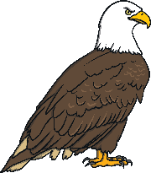
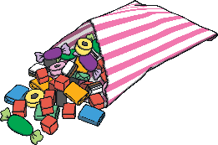
Click the picture cards to match them to the word cards.
next
peas
jeans
eagle
treat

Slide 5
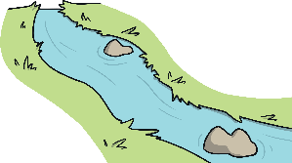
Click the picture cards to match them to the word cards.
next
seat
steam
team
stream

