Slide 1
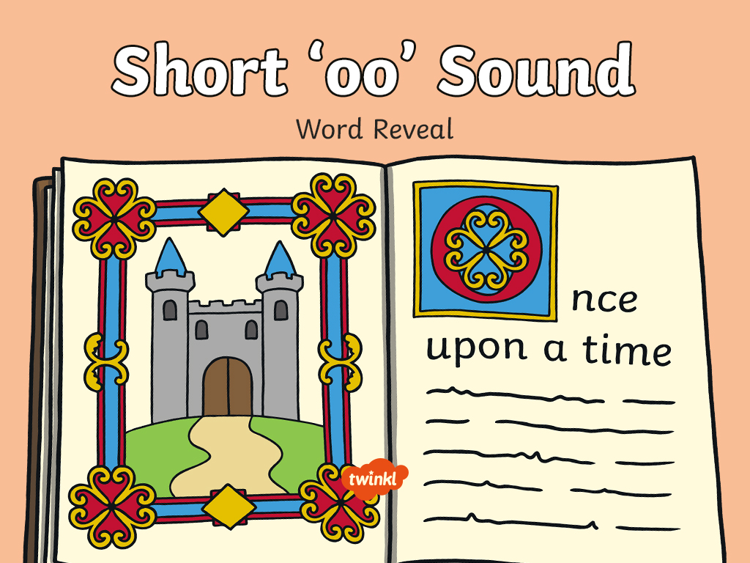

Slide 2

Click the box to reveal the word
?
book

Slide 3
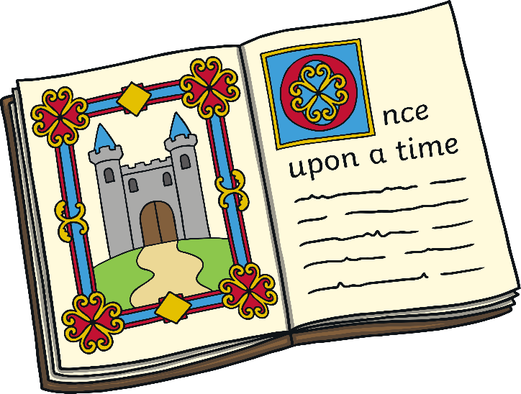
Click the box to reveal the word
?
book
Next

Slide 4
Click the box to reveal the word
?
hook

Slide 5

Click the box to reveal the word
?
hook
Next

Slide 6
Click the box to reveal the word
?
hood

Slide 7
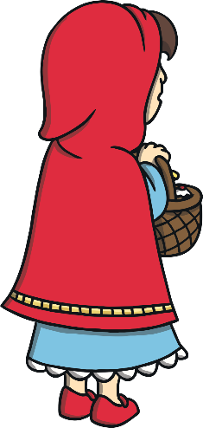
Click the box to reveal the word
?
hood
Next

Slide 8
Click the box to reveal the word
?
foot

Slide 9
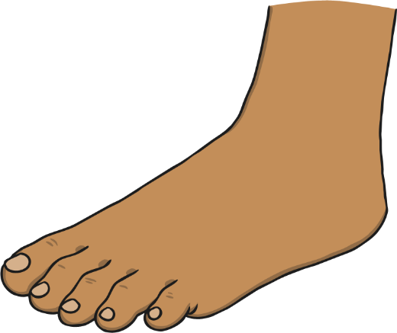
Click the box to reveal the word
?
foot
Next

Slide 10
Click the box to reveal the word
?
wood

Slide 11
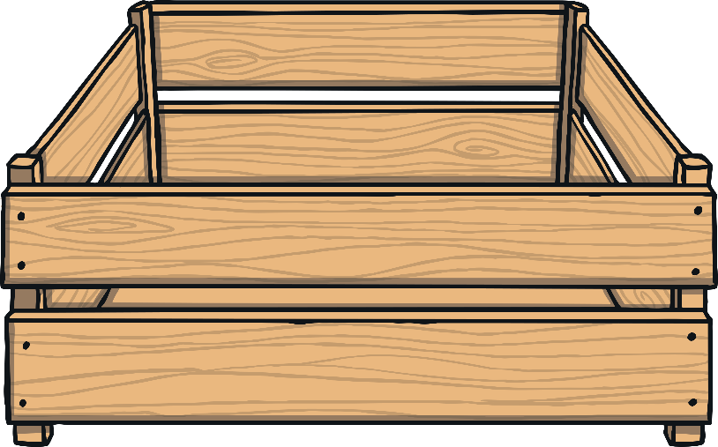
Click the box to reveal the word
?
wood
Next

Slide 12
Click the box to reveal the word
?
cook

Slide 13
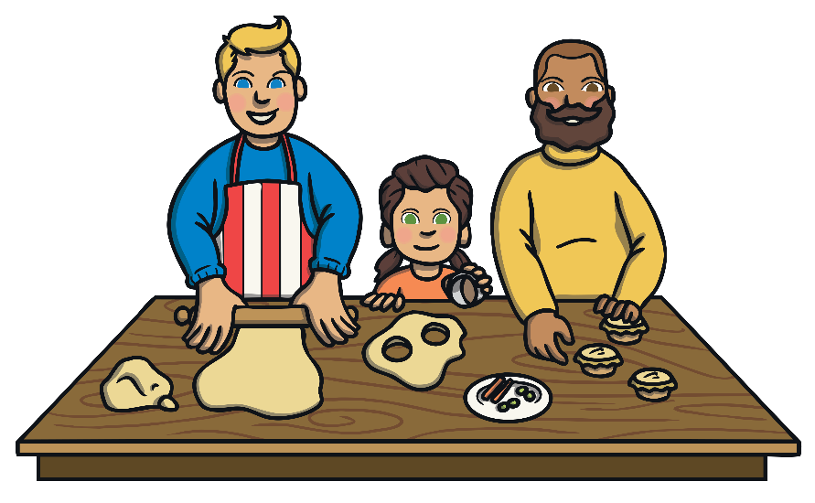
Click the box to reveal the word
?
cook
Next

Slide 14
Challenge!
Can you guess which word has been covered up in the sentence? Click the boxes to reveal the answers!
Play!

Slide 15


Challenge!
I read my book under the tree.
?

Slide 16

Challenge!
?
I put up my hood when it is raining.

Slide 17
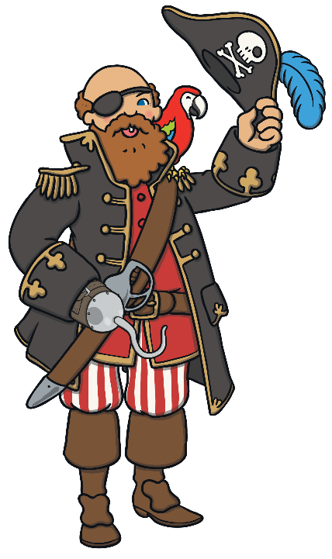
Challenge!
The pirate had a hook for a hand.
?

Slide 18

Challenge!
What will you cook for dinner?
?

Slide 19
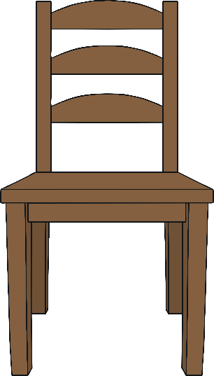
Challenge!
The chair was made out of wood.
?

Slide 20
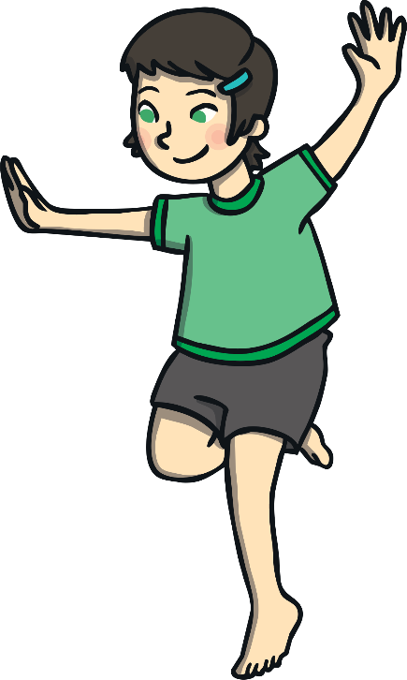
Challenge!
She hopped on
one foot.
?

Slide 21
