Slide 2
To the Teacher:
These activities require no preparation, but children will need writing equipment for some activities.
Slides are editable as for some of the activities you may wish to change the wording. For example, depending upon whether parents are involved or children are working independently, if you wish an activity to be a talk activity or you would prefer children to record their answers.

Slide 3
Select an Activity
Wordsearch
Write a sentence about a picture
Read a sentence and draw a picture
Can you read the words?
Can you help Pirate Pete?
Can you spot the common exception words?
Read the words
Roll the dice and read the words
Can you find the missing letters?
Unscramble the letters
Match the picture to the sentence
Write a sentence about a picture

Slide 4
Can you find the exception words?
Select another activity
Can you hunt the words in this word search? How many can you find?
Write them on your whiteboard. They will only be down and across.
c | r |  |  | l | f | r | a | k | b | k | m
e | l |  |  |  |  |  |  | i | q | k | m
a | b | c | t | e | f | c | o | e | w | r | y
u |  | c | r | r | h | i | q | y | j |  | m
g |  | y | w | e | u | m | r | i | j |  | r
h |  | u |  |  |  |  |  |  | q |  | m
i |  | t | d | e | l | g | h | l | j |  | m
e |  | c | b | k | a | g | a | o | j |  | j
h | l | n | d | w | m | n | h | i | p | k | m
l | r |  |  |  |  |  |  | b | t | y | t
o | b | q | d |  |  |  |  |  | j | j | m
q | u | j | d | e | o | g | p | t | j | k | m
oh
o h
c a l l e d
called
a
s
k
e
d
t
h
e
i
r
people
Oops, Try Again.
p e o p l e
their
asked
l o o k e d
looked
c o u l d
could

Slide 5
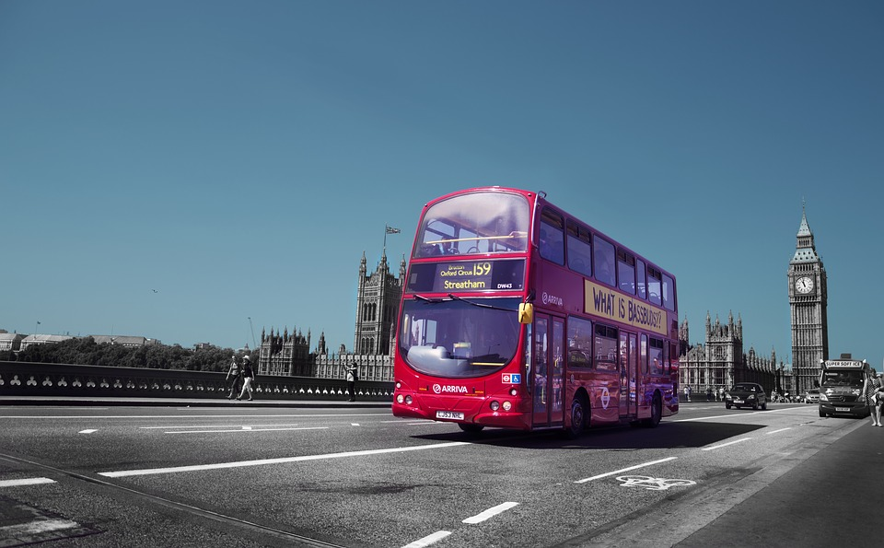
Can you write a sentence about this picture?
Select another activity
Can you write a sentence using the word people?

Slide 6
Can you read the sentence and draw a picture?
Select another activity
I looked out to sea and
could see a huge shark.

Slide 7
Can you read the words?
Select another activity
people
Mr
Mrs
asked
looked
Now write some sentences using the words.
I looked at my sister.
I asked my mum to play a game.
Mrs Blant went to the shop.
The shop is full of people.
Mr Wood lives next door.

Slide 8
Can you help Pirate Pete find the treasure?
Select another activity
The real treasure has real words on it.
The fake treasure has made up words on it.
Can you find the real treasure?
people
Mstr
asked
luked
ow
could
their
Mrs
askt
called
cud
looked
peepl
oh
Mr
answers

Slide 9
Can you help Pirate Pete find the treasure?
Select another activity
The real treasure has real words on it.
The fake treasure has made up words on it.
Can you find the real treasure?
people
asked
could
their
Mrs
called
looked
oh
Mr

Slide 10
Can you spot the common exception words in this story?
Select another activity
On your whiteboard, write down the common exception words you read, in order.
I looked up into the sky and saw lots of stars looking back at me. I called out to the stars. I asked, “Is anybody there? Could I be your friend?” and I was shocked to hear the stars say, “Oh, I would love to be your friend but I am afraid of people!” The next night, I asked Mr and Mrs Plant to come and talk to the stars.
I looked up into the sky and saw lots of stars looking back at me. I called out to the stars. I asked, “Is anybody there? Could I be your friend?” and I was shocked to hear the stars say, “Oh, I would love to be your friend but I am afraid of people!” The next night, I asked Mr and Mrs Plant to come and talk to the stars.

Slide 11
Can you read the words?
Select another activity
called
their
oh
could
Now write some sentences using the words.
I wish I could meet an alien.
Oh no, a monkey is on the roof!
I called my mum on the phone.
I ate their sweets.

Slide 12
Can you roll your dice and read the words?
Select another activity
Roll your dice and read the words.
 | people | looked | asked | could | oh
 | Mrs | asked | their | Mr | called
 | looked | called | could | Mrs | asked
 | Mr | oh | people | looked | called
 | called | their | Mrs | looked | asked
 | could | Mr | oh | their | people

Slide 13
Can you work out the missing letters?
Select another activity
These words are missing a letter. See if you can work out the missing letter and write the word.
peop_e
c_lled
co_ld
the_r
lo_ked
_sked
o_
M_s
answers

Slide 14
Can you work out the missing letters?
Select another activity
These words are missing a letter. See if you can work out the missing letter and write the word.
people
called
could
their
looked
asked
oh
Mrs

Slide 15
Can you unscramble the letters?
Select another activity
The letters have been scrambled. Can you unscramble the words and write the correct word?
rM
skaed
pelope
cllaed
iethr
Msr
ho
answers

Slide 16
Can you unscramble the letters?
Select another activity
The letters have been scrambled. Can you unscramble the words and write the correct word?
Mr
asked
people
called
their
Mrs
oh

Slide 17
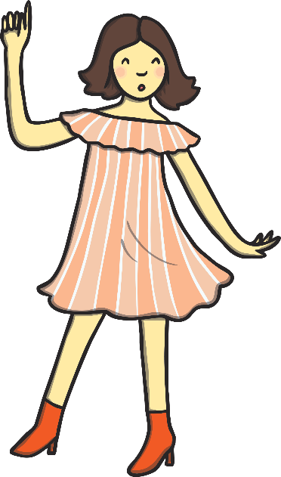
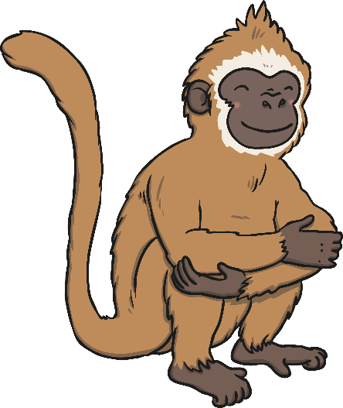
Can you match the picture to the sentence?
Select another activity
Match the pictures to the right sentence. Write the sentences in order.
1. Oh! Don’t these clouds seem like puffs of smoke?
1. Oh! Don’t these clouds seem like puffs of smoke?
B
2. The elephant looked at the people.
2. The elephant looked at the people.
A
3. Mr Saturn is dancing with Mrs Fleming.
3. Mr Saturn is dancing with Mrs Fleming.
4. The monkey took their lunch.
4. The monkey took their lunch.
C
D

Slide 18
Can you match the picture to the sentence?
Select another activity
Match the pictures to the right sentence. Write the sentences in order.
1. Oh! Don’t these clouds seem like puffs of smoke?
B
2. The elephant looked at the people.
A
3. Mr Saturn is dancing with Mrs Fleming.
4. The monkey took their lunch.
C
D

Slide 19
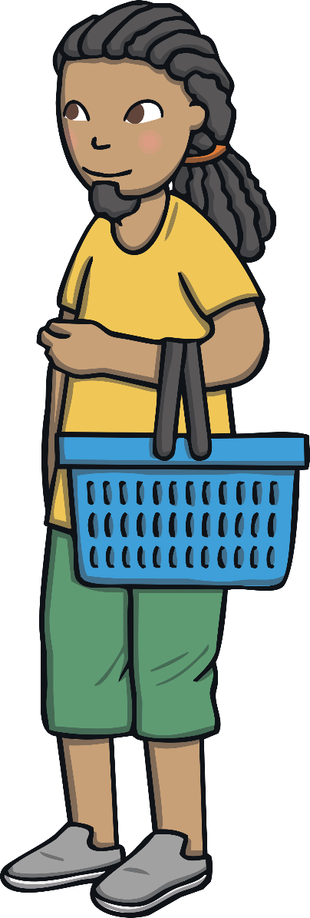
Can you write a sentence about this picture?
Select another activity
Can you write a sentence using people, looked and their?

