Slide 2
Ho, ho, hello children!
Some Christmas presents have fallen on to the phoneme frames. Can you look at the picture and work out which phoneme has been covered up?
Click ‘check’ to see if you are right.
Can you help me collect all the presents?

Slide 3
h
a
t
Click the check button to reveal the answer.
Check

Slide 4
p
e
g
Click the check button to reveal the answer.
Check

Slide 5
l
o
g
Click the check button to reveal the answer.
Check

Slide 6
b
o
x
Click the check button to reveal the answer.
Check

Slide 7
s
a
ck
Click the check button to reveal the answer.
Check

Slide 8
r
e
d
Click the check button to reveal the answer.
Check

Slide 9
t
o
p
Click the check button to reveal the answer.
Check

Slide 10
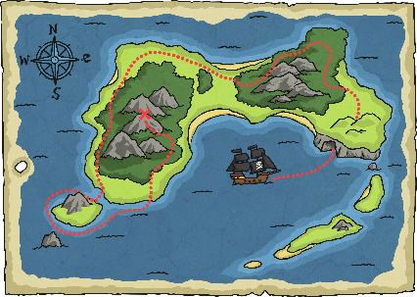
m
a
p
Click the check button to reveal the answer.
Check

Slide 11
c
a
t
Click the check button to reveal the answer.
Check

Slide 12
n
u
t
Click the check button to reveal the answer.
Check

Slide 13
Well Done!
You found all of the missing phonemes and collected all the presents. Thank you for your help!
Click the presents to return to the beginning of the presentation.

